Slide 1
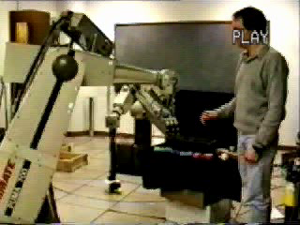
Robot Vision
Control of robot motion from video
M. Jagersand

Slide 2
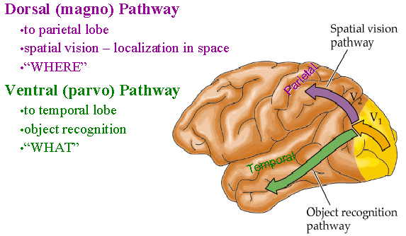
What is vision?
Two main categories
Object recognition: Use cues in 2D image
Spatial vision: Understand and invert the 3D to 2D imaging process: Two subcategories:
  Full 3D scene reconstruction
  Use of partial 3D information, implicitly or explicitly

Slide 3
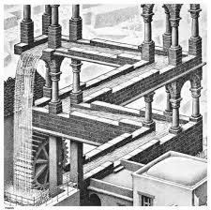
Uses of partial information from
2D-3D camera geometry
Single view measurements
Visual constraints: verify alignments, detect impossible configurations (Esher paintings)
Visual servoing
Visual tracking
… many more

Slide 4
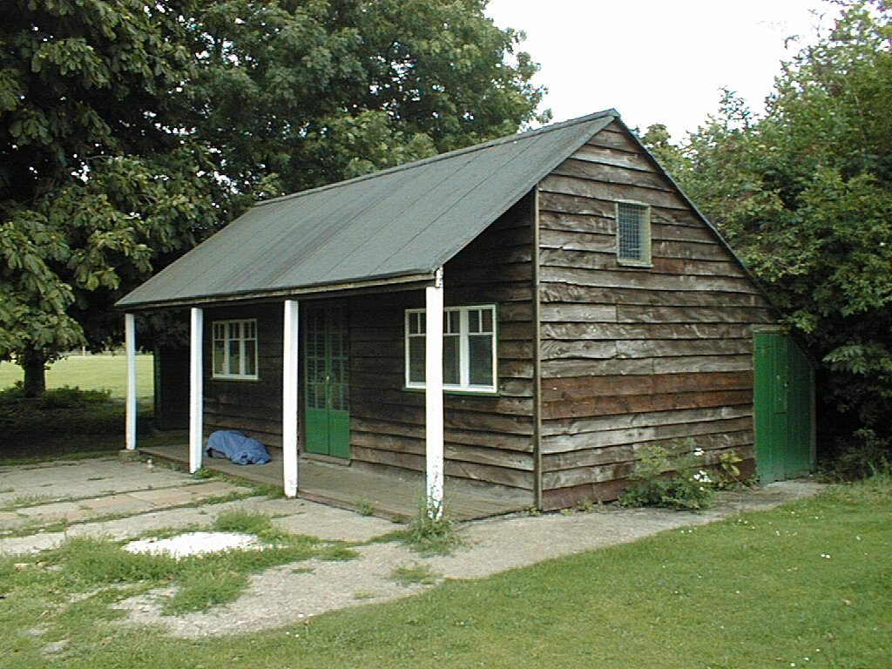
Geometric Cues
Vertical vanishing
point
(at infinity)
Vanishing
line
Vanishing
point
Vanishing
point

Slide 5
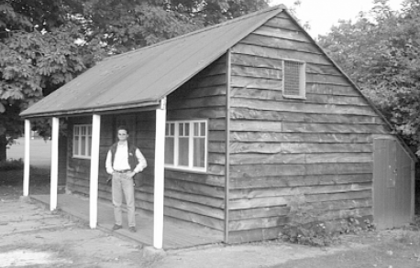
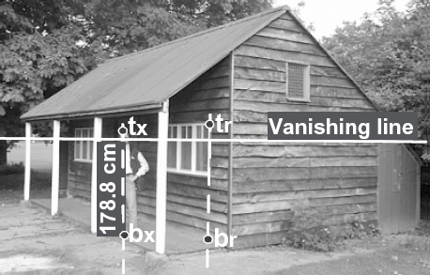
Estimating Height
The distance || t_{r} – b_{r} || is known
Used to estimate the height of the man in the scene

Slide 6
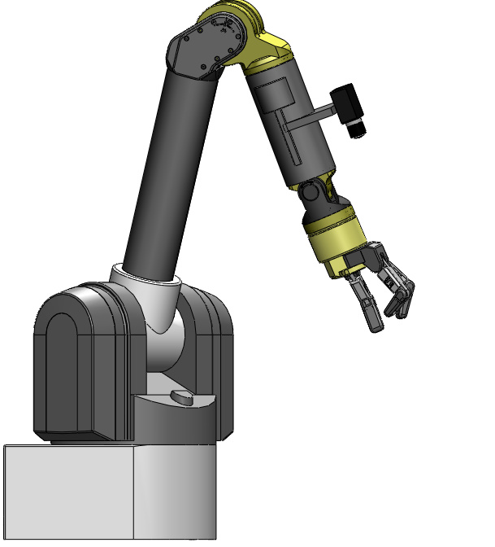
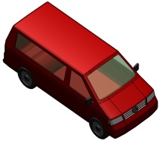
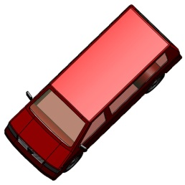
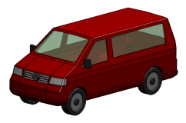
Vision-Based Control (Visual Servoing)
Initial Image
User
Desired Image

Slide 7
Vision-Based Control (Visual Servoing)
: Current Image Features
: Desired Image Features

Slide 8
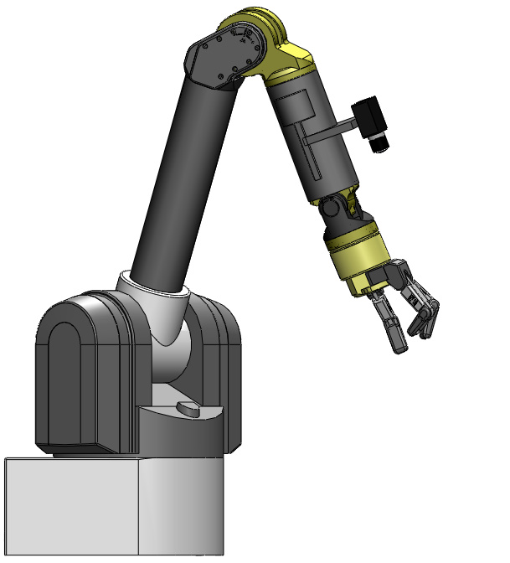
Vision-Based Control (Visual Servoing)
: Current Image Features
: Desired Image Features

Slide 9
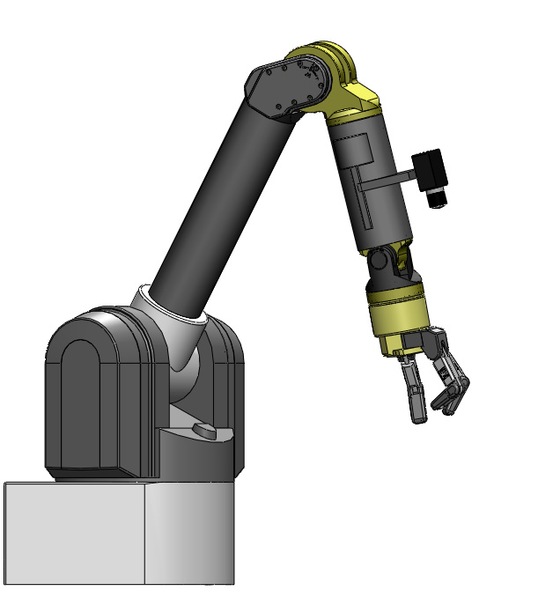
Vision-Based Control (Visual Servoing)
: Current Image Features
: Desired Image Features

Slide 10
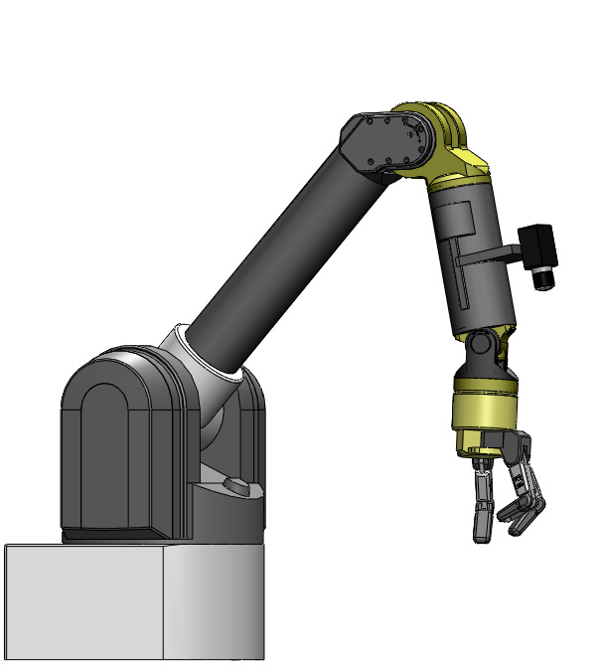
Vision-Based Control (Visual Servoing)
: Current Image Features
: Desired Image Features

Slide 11
Vision-Based Control (Visual Servoing)
: Current Image Features
: Desired Image Features

Slide 12
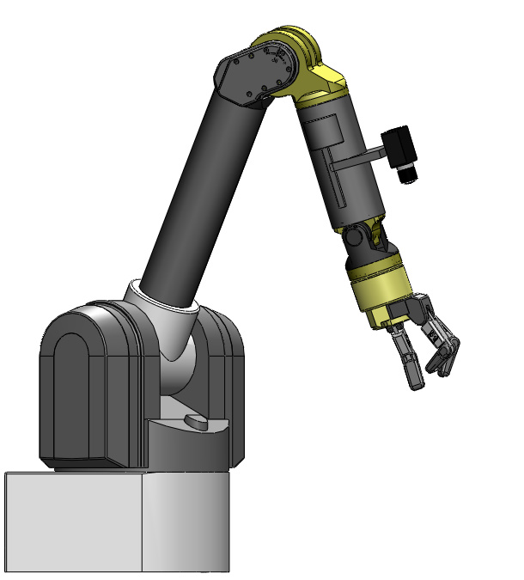
u,v Image-Space Error
v
u
: Current Image Features
: Desired Image Features
One point
Pixel coord
Many points
Notes:
Error vectors in image space -> composed total error vector

Slide 13
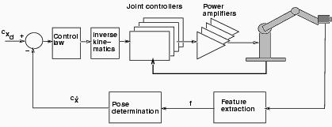
Conventional Robotics: Motion command in base coord
EE
We focus on the geometric transforms

Slide 14
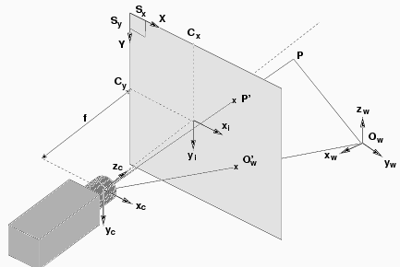
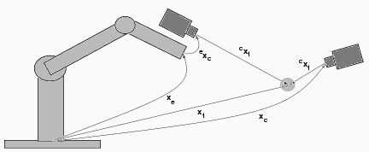
Problem: Lots of coordinate frames to calibrate
Camera
  Center of projection
  Different models
Robot
  Base frame
  End-effector frame
  Object

Slide 15




Image Formation is Nonlinear
Camera
frame

Slide 16


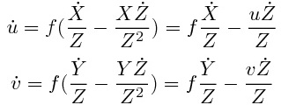
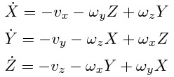

Camera Motion to Feature Motion
Camera
frame

Slide 17
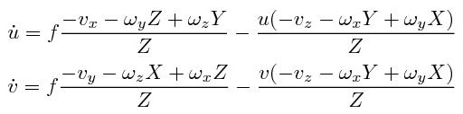
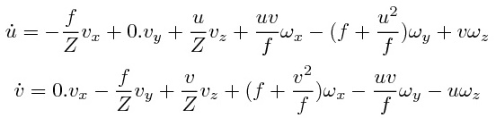
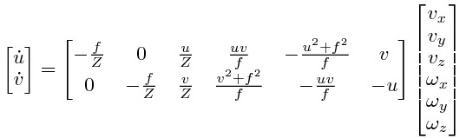

Camera Motion to Feature Motion
This derivation is
for one point.
Q. How to extend
to more points?
Q. How many
points needed?
Interaction matrix is a Jacobian.
Notes:
Needs a-priori f and Z

Slide 18
Problem: Lots of coordinate frames to calibrate
Robot
  Base frame
  End-effector frame
  Object
Camera
  Center of projection
  Different models
Only covered one transform!

Slide 19
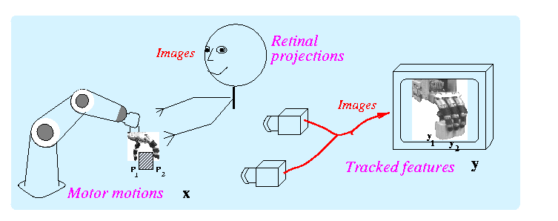
Other (easier) solution:
Image-based motion control
Achieving 3d tasks
via
2d image control
Motor-Visual function: y=f(x)
Notes:
Use notes: Motivation from motion estimation.

Slide 20
Other (easier) solution:
Image-based motion control
Note: What follows will work for one or two (or 3..n) cameras. Either fixed or on the robot.
Here we will use two cam
Achieving 3d tasks
via
2d image control
Motor-Visual function: y=f(x)

Slide 21
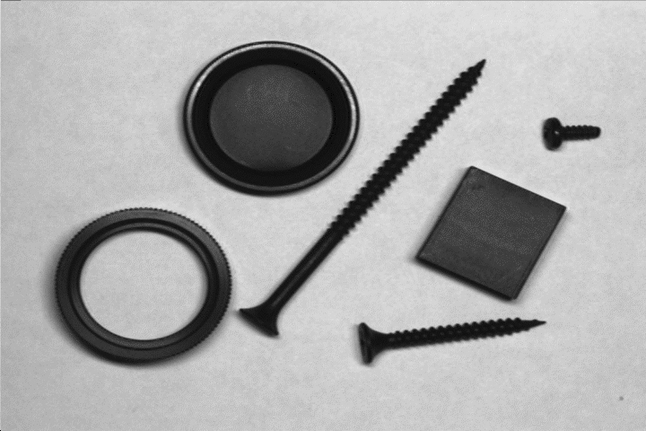

Simplest case: 2D planar world and aligned camera
This method is commonly used in industry machine vision
  Usually overhead camera pointing straight down on a work table
  Adjust cam position so pixel [u,v] = s[X,Y]. s = scalefactor (pix/mm)
  Pixel coordinates are scaled world coord
Y
v
X
u
Camera
Thresholded image
Robot scene

Slide 22
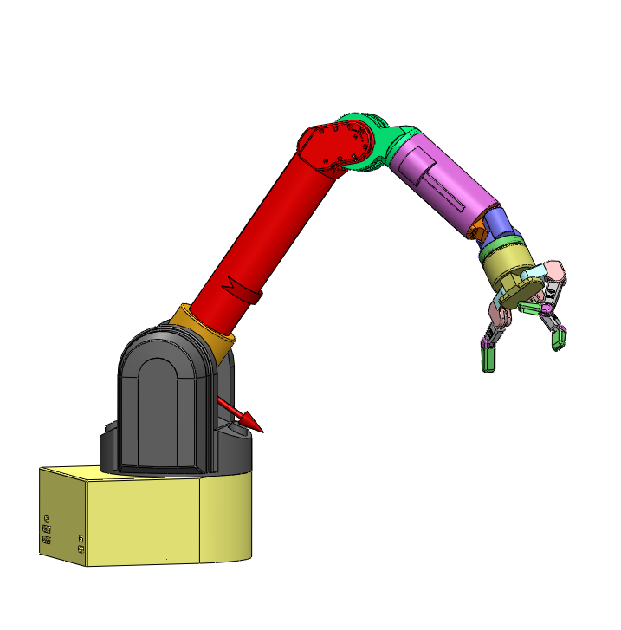
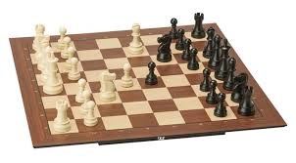
My first robotics problem

Slide 23
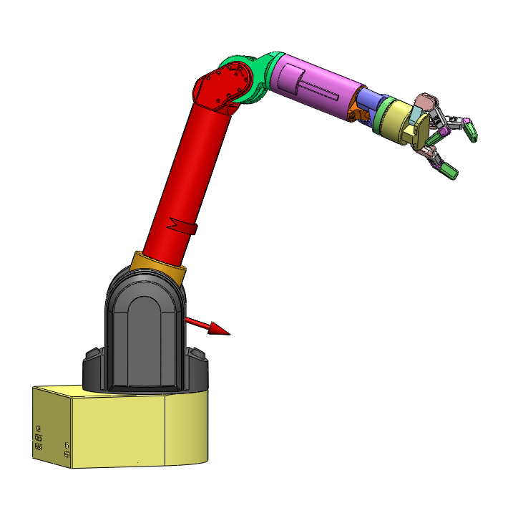
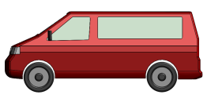
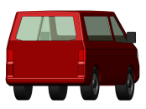
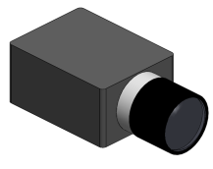
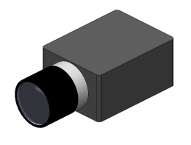
Vision-Based Control
Image 1
Image 2

Slide 24
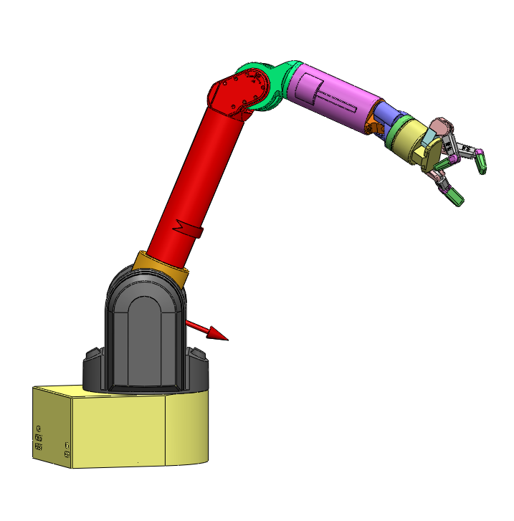
Vision-Based Control
Image 1
Image 2

Slide 25
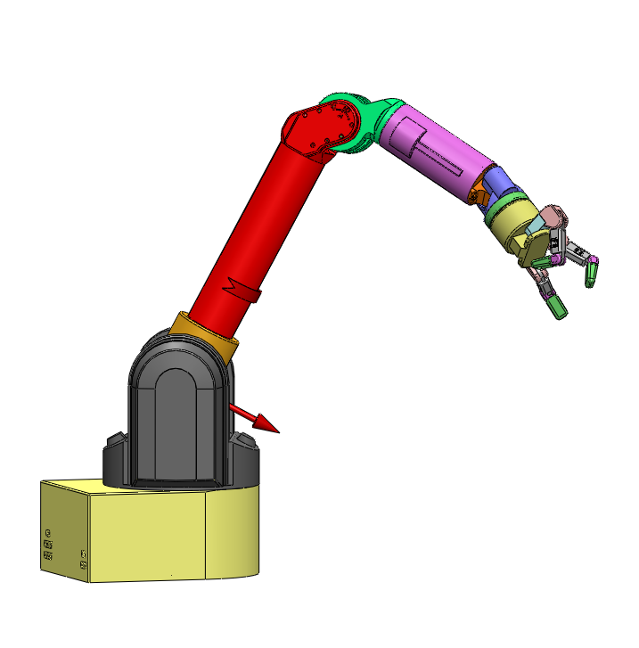
Vision-Based Control
Image 1
Image 2

Slide 26
Vision-Based Control
Image 1
Image 2

Slide 27
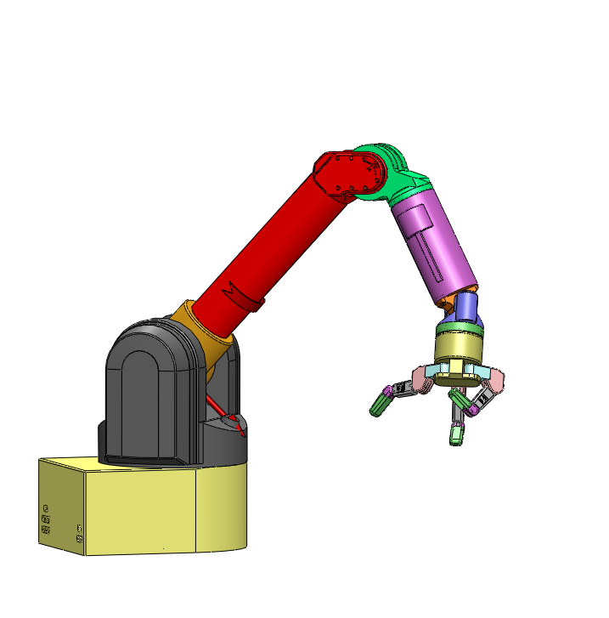
Vision-Based Control
Image 1
Image 2

Slide 28
Image-based Visual Servoing
Observed features:
Motor joint angles:
Local linear model:
Visual servoing steps: 1 Solve:
2 Update:

Slide 29
Find J Method 1:
Test movements along basis
Remember: J is unknown m by n matrix
Motor moves (scale these):
Suitable
Finite difference:

Slide 30
Find J Method 2:
Secant Constraints
Constraint along a line:
Defines m equations
Collect n arbitrary, but different measures y
Solve for J

Slide 31
Find J Method 3:
Recursive Secant Constraints
Based on initial J and one measure pair
Adjust J s.t.
Rank 1 update:
Consider rotated coordinates:
  Update same as finite difference for n orthogonal moves

Slide 32
Achieving visual goals:
Uncalibrated Visual Servoing
Solve for motion:
Move robot joints:
Read actual visual move
Update Jacobian:
repeat
Can we always guarantee when a task is achieved/achievable?

Slide 33
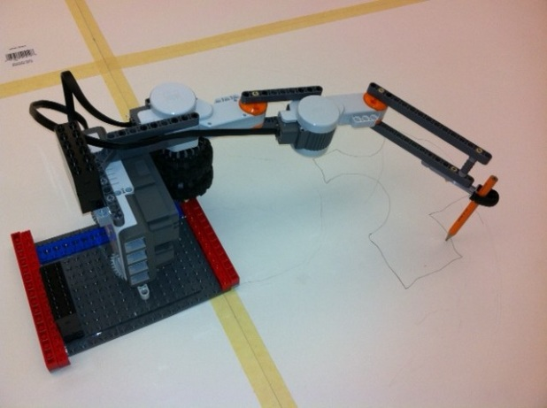

What we need for VS
v
u
Camera(s) Place for visibility and
Tracking
  Markerless algorithms - MTF
  Put LED on robot end-effector
    Lower brightness so LED brighterest
Robot: Anywhere within reach
Control command access
  Joint posiiton move
  Joint velocity
  Cartesian
    Issues with angle representation: Euler, quatern, exp
Camera
Y
LED
X

Slide 34
Visually guided motion control
Issues:
What tasks can be performed?
  Camera models, geometry, visual encodings
How to do vision guided movement?
  H-E transform estimation, feedback, feedforward motion control
How to plan, decompose and perform whole tasks?

Slide 35
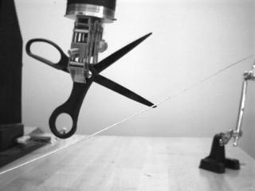
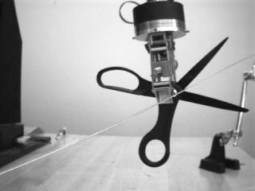
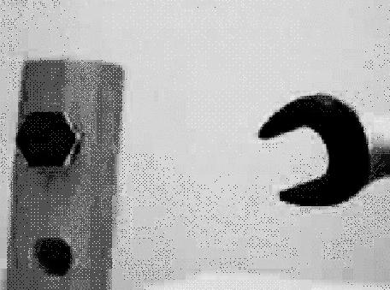
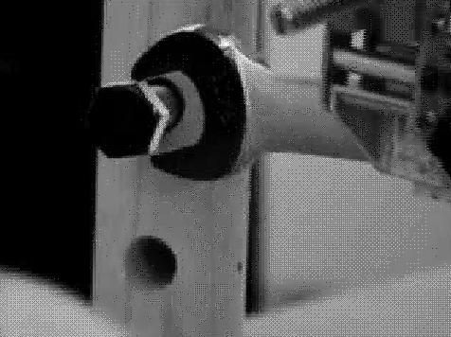
How to specify a visual task?

Slide 36
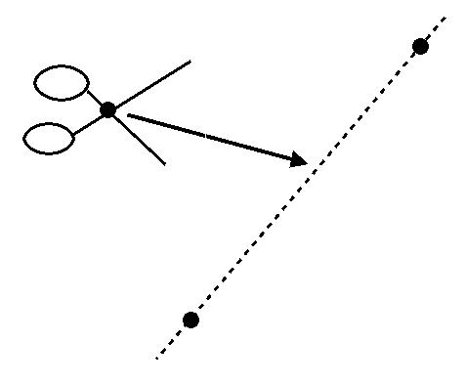
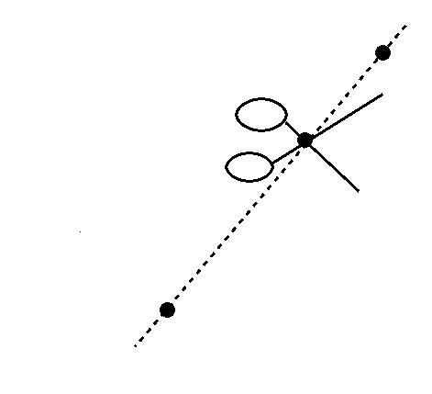
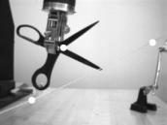

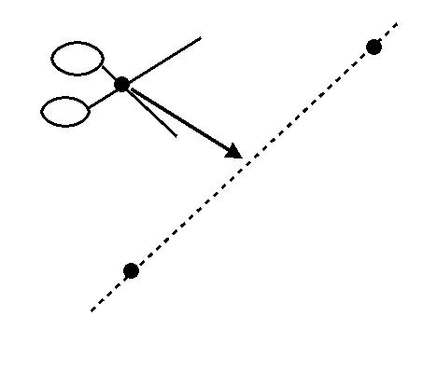
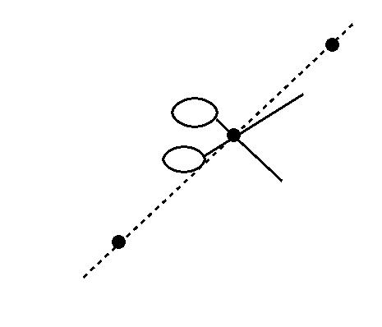
Task and Image
Specifications
Task function T(x) = 0 Image encoding E(y) =0
task space error
task space satisfied
image space error
image space satisfied

Slide 37
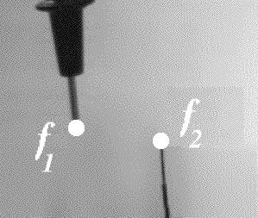
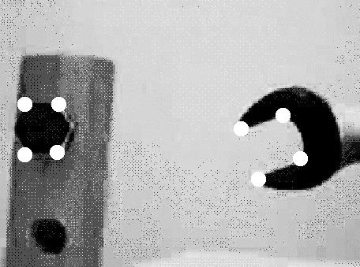
Visual specifications
Point to Point task “error”:
Why 16 elements?

Slide 38
Visual specifications 2
Point to Line
Line:
Note: y homogeneous coord.

Slide 39
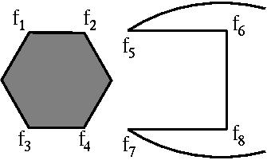
Parallel
Composition example
y - y
2
5
y - y
4
7
E (y ) =
wrench
y • (y × y )
6
1
2
y • (y × y )
8
3
4
(plus e.p. checks)

Slide 40
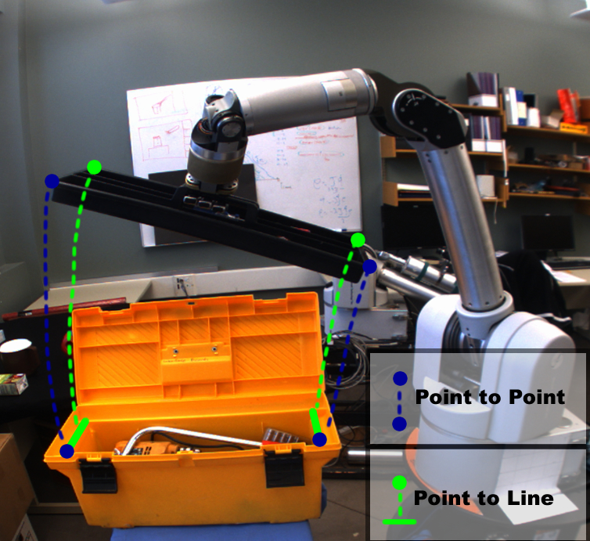
5.4. Visual specifications
Image commands = Geometric constraints in image space
HRI: User points/clicks on features in an image
Robot controller drives visual error to zero

Slide 41
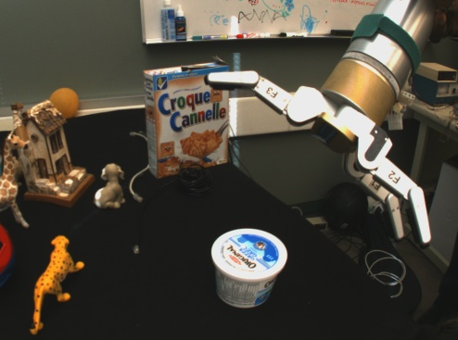
Visual Specifications
Additional examples:
Point to conic
  Identify conic C from 5 pts on rim
  Error function yCy’
Point(s) to plane
Plane to plane
Etc.

Slide 42
Achieving visual goals:
Uncalibrated Visual Servoing
Solve for motion:
Move robot joints:
Read actual visual move
Update Jacobian:
repeat
Can we always guarantee when a task is achieved/achievable?

Slide 43
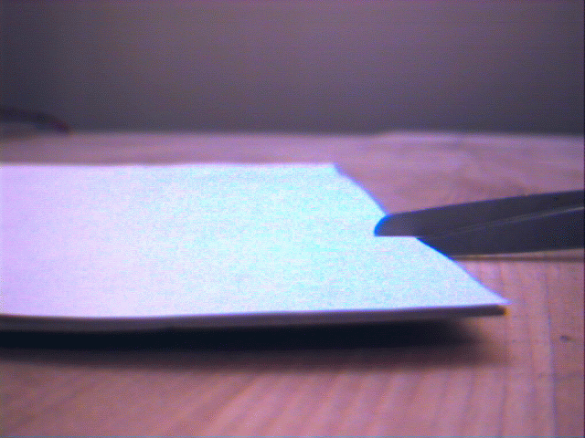

Task ambiguity
Will the scissors cut the paper in the middle?

Slide 44

Task ambiguity
Will the scissors cut the paper in the middle? NO!

Slide 45


Task Ambiguity
Is the probe contacting the wire?

Slide 46

Task Ambiguity
Is the probe contacting the wire? NO!

Slide 47


Task Ambiguity
Is the probe contacting the wire?

Slide 48

Task Ambiguity
Is the probe contacting the wire? NO!

Slide 49
Task decidability and invariance
A task T(f)=0 is invariant under a group G of transformations, iff
x
n
n
∀ f ∈ V , g ∈ G with g(f ) ∈ V T(f )=0 ⇔ T(g(f ))=0
x
T(f ) must be 0 here, if T is G invariant
If T(f ) = 0 here,
sim
T(f ) must be 0 here, if T is G invariant
aff
T(f ) must be 0 here, if T is G invariant
proj
T(f ) must be 0 here, if T is G invariant
inj

Slide 50
All achievable tasks...
1
1
1
1
0
0
0
1
0
1
1
0
0
0
0
0
0
0
4pt. coincidence
0
0
0
0
0
0
0
1
1
0
0
0
0
0
1
1
0
3pt. coincidence
0
0
0
0
0
1
1
0
0
0
0
0
1
0
1
0
0
0
0
Coincidence
0
2 2pt. coincidence
0
0
1
0
0
0
0
0
1
0
1
0
1
0
α
2pt. coincidence
0
1
1
0
1
0
0
0
0
0
0
0
0
Cross Ratio
0
1
0
One point
1
0
1
1
1
0
0
0
0
1
0
0
0
1
1
0
0
0
0
1
0
0
1
0
Collinearity
0
0
1
0
1
0
0
0
0
0
Noncoincidence
1
Coplanarity
0
0
0
1
0
1
0
0
0
0
0
1
are ALL projectively distinguishable coordinate systems
0
1
0
0
0
0
0
0
0
1
0
0
0
0
General Position
1
General Position

Slide 51
Composing possible tasks
T_{pp}
point-coincidence
Injective
C_{inj}
Task primitives
T_{col}
collinearity
T_{pp}
T_{copl}
coplanarity
Projective
C_{wk}
T_{crα}
cross ratios (α)
AND
OR
NOT
T₁
0 if T = 0
T₁ ∧ T₂ =
T₁ ∨ T₂ = T₁•T₂
¬T =
T₂
1 otherwise
Task operators

Slide 52



Result: Task toolkit
wrench: view 1
wrench: view 2
T_{pp}(x₁,x₅) ∧
₆
₅
₂
T_{pp}(x₃,x₇) ∧
₁
T_{wrench}(x_{1..8}) =
₈
₇
₄
T_{col}(x₄,x₇,x₈) ∧
₃
T_{col}(x₂,x₅,x₆)

Slide 53
Serial Composition
Solving whole real tasks
Task primitive/”link”
Acceptable initial (visual) conditions
Visual or Motor constraints to be maintained
Final desired condition
Task =

Slide 54
“Natural” primitive links
Transportation
  Coarse primitive for large movements
  <= 3DOF control of object centroid
  Robust to disturbances
Fine Manipulation
  For high precision control of both position and orientation
  6DOF control based on several object features

Slide 55


Example:
Pick and place type of movement
3. Alignment???
  To match transport final to fine manipulation initial conditions

Slide 56
More primitives
4. Guarded move
  Move along some direction until an external contraint (e.g. contact) is satisfied.
5. Open loop movements:
  When object is obscured
  Or ballistic fast movements
  Note can be done based on previously estimated Jacobians

Slide 57

Solving the puzzle…

Slide 58
Conclusions
Visual servoing: The process of minimizing a visually-specified task by using visual feedback for motion control of a robot.
Is it difficult? Yes.
  Controlling 6D pose of the end-effector from 2D image features.
  Nonlinear projection, degenerate features, etc.
Is it important? Of course.
  Vision is a versatile sensor.
  Many applications: industrial, health, service, space, humanoids, etc.

Slide 59


What environments and tasks are of interest?
Not the previous examples.
  Could be solved “structured”
Want to work in everyday unstructured environments

Slide 60



Use in space applications
Space station
On-orbit service
Planetary Exploration

Slide 61





Power line inspection
A electric UAV carrying camera flown over the model
Simulation: Robot arm holds camera
Model landscape: Edmonton railroad society

Slide 62
Use in Power Line Inspection
Notes:
spanish (project colobri U madrid), wales: Jones,
Photosynth some power poles.
Q: How close must illustrating examples be?
Only power lines? Or other CV capture?

Slide 63
Some References
M. Spong, S. Hutchinson, M. Vidyasagar. Robot Modeling and Control. Chapter 12: Vision-Based Control. John Wiley & Sons: USA, 2006. (Text)
S. Hutchinson, G. Hager, P. Corke, "A tutorial on visual servo control," IEEE Trans. on Robotics and Automation, October 1996, vol. 12, no 5, p. 651-670. (Tutorial)
F. Chaumette, S. Hutchinson, "Visual Servo Control, Part I: Basic Approaches," and "Part II: Advanced Approaches," IEEE Robotics and Automation Magazine 13(4):82-90, December 2006 and 14(1):109-118, March 2007. (Tutorial)
B. Espiau, F. Chaumette, P. Rives, "A new approach to visual servoing in robotics," IEEE Trans. on Robotics and Automation, June 1992, vol. 8, no. 6, p. 313-326. (Image-based)
W. J. Wilson, C. C. Williams Hulls, G. S. Bell, "Relative End-Effector Control Using Cartesian Position Based Visual Servoing", IEEE Transactions on Robotics and Automation, Vol. 12, No. 5, October 1996, pp.684-696. (Position-based)
E. Malis, F. Chaumette, S. Boudet, "2 1/2 D visual servoing," IEEE Trans. on Robotics and Automation, April 1999, vol. 15, no. 2, p. 238-250. (Hybrid)
M. Jägersand, O. Fuentes, R. Nelson, "Experimental Evaluation of Uncalibrated Visual Servoing for Precision Manipulation," Proc. IEEE Intl. Conference on Robotics and Automation (ICRA), pp. 2874-2880, 20-25 Apr. 1997. (Uncalibrated, model-free)
F. Chaumette, "Potential problems of stability and convergence in image-based and position-based visual servoing," The Confluence of Vision and Control, LNCS Series, No 237, Springer-Verlag, 1998, p. 66-78.

