Slide 1
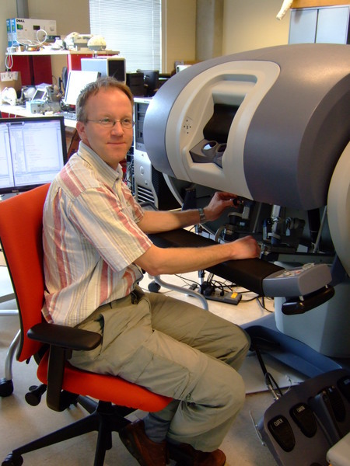
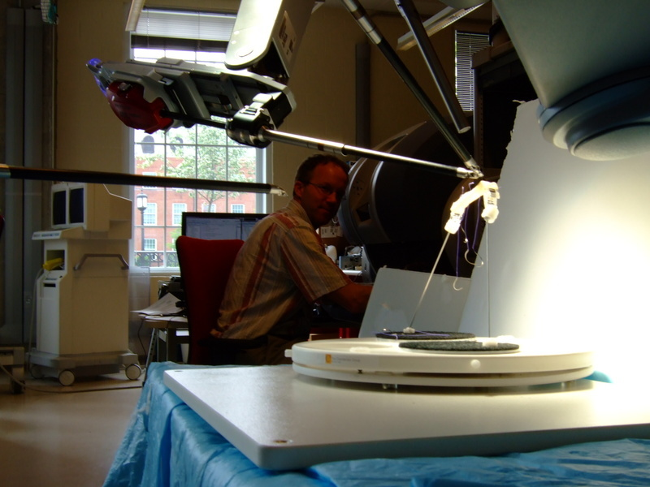
Surgical robotics

Slide 2
Robot-Assisted Laparoscopic Surgery
New form of minimally invasive surgery
Allows surgeon to perform complex surgeries with greater accuracy and freedom than previous methods
Compared to standard laparoscopic surgery, new technology offers reduced operating time, is safer, and is a less strenuous process for surgeon

Slide 3
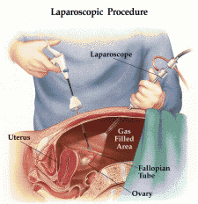
What is laparoscopic surgery?
Operation performed in pelvis or abdomen through small incisions
Done for diagnostic purpose or to perform a surgery
Small camera called laparoscope is used
Benefits- patients experience less pain, smaller chance of hemorrhaging, and shorter recovery time

Slide 4
Tools for Standard Laparoscopic Surgery
2 types of laparoscopes:
1) Telescopic rod lens system
-attached to a video camera
2) Digital laparoscope
-fiber optic cable system is
connected to a light source
so operative area can be
illuminated
-then inserted through tiny tube (cannula) to see the operation
-abdomen is then insufflated with carbon dioxide (not harmful to body) to raise abdominal wall above organs

Slide 5
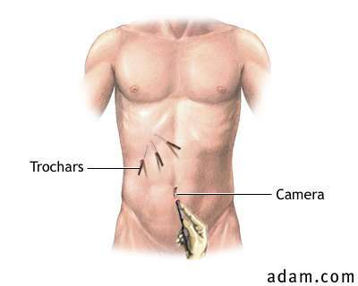
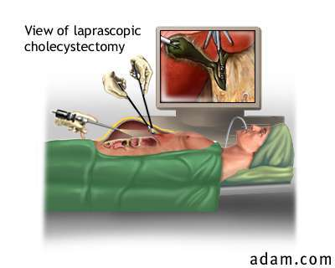
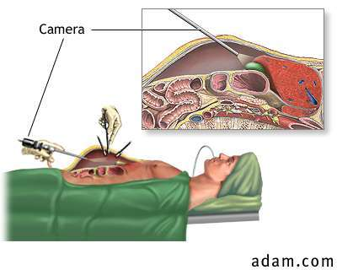
Can get complex with many instruments / people holding

Slide 6
da Vinci System
Makes laparoscopic surgery even easier for surgeons and less staff is required for the procedure
Surgery is performed without any direct contact between surgeon and patient
Doctor sits a few feet away from operating table at a computer console viewing 3D visual of operative region

Slide 7
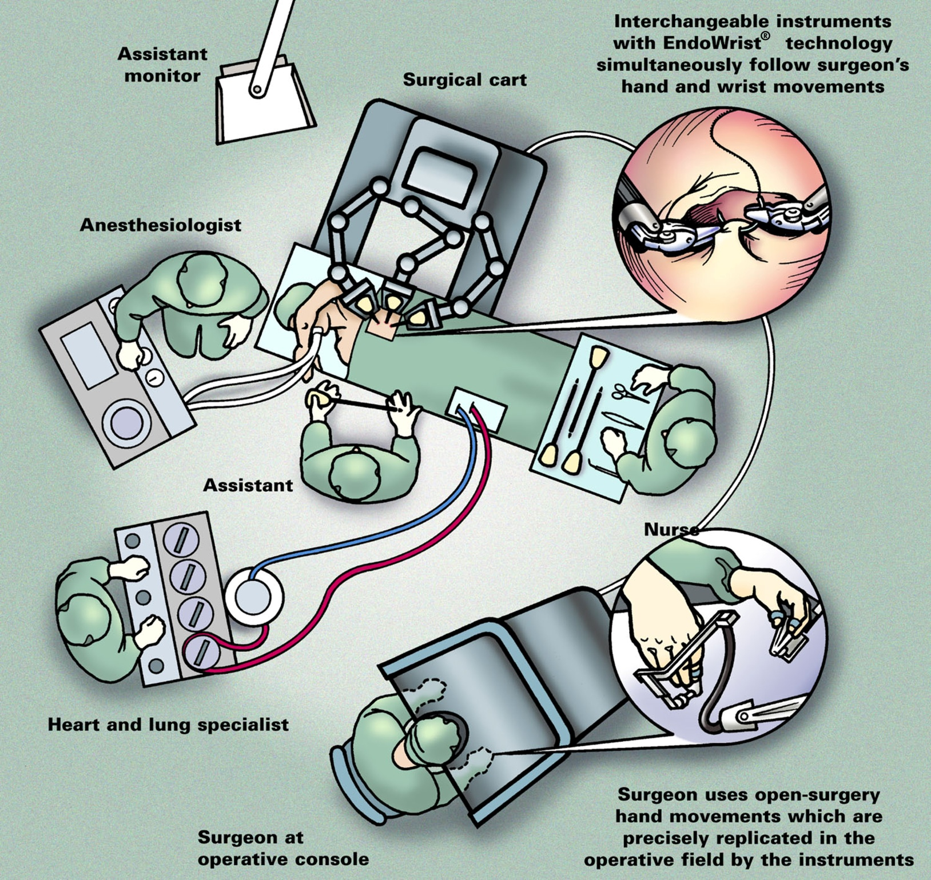

Slide 8
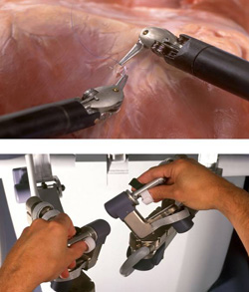
Components of da Vinci System
Doctor uses 2 masters that each control
a mechanical arm of the robot
One of the three arms is an endoscope
arm
Provides over a thousand frames per
second of the instrument position to get rid of possible background noise
Endoscope is also programmed to regulate the temperature of the tip to prevent any fogging during the procedure
Surgeon can switch to different views easily by the touch of a foot pedal

Slide 9
Components (cont…)
Other two arms are equipped with specialized tools called EndoWrist detachable instruments
Robot arms also have wider range of motion than the human hand- rotating in 7 different planes and can rotate around completely

Slide 10
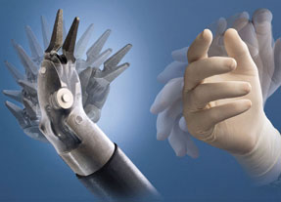
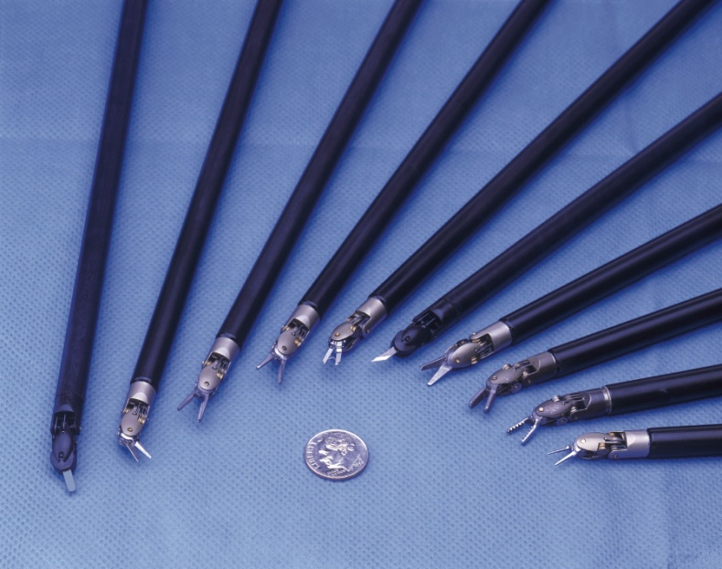
EndoWrist Instruments
Each instrument has its own function and can easily be switched using the quick-release lever on each arm
The device memorizes the position of the arm before being replaced so the next instrument can be set to the same position
Surgeon can also choose how much force to be applied- can go from an ounce to several pounds

Slide 11
Pros and Cons of da Vinci System
Pros
Hospital stay is cut in half- cutting cost by around 33%
Does not leave a large surgical scar
More high risk patients can undergo surgery because it’s less invasive
Less staff required for surgery
FDA approved for use in U.S.
Cons
Cost of equipment-
$1 million
Steep learning curve for surgeons
Doctors training on device felt hindered by lack of ability to feel the tissue they’re working on
Surgery with this system takes 40-50 minutes longer than standard procedure

Slide 12
Survey of Malfunction Experience
An international survey was performed and published in the Journal of Endourology
Doctors were asked how they dealt with malfunctions of the da Vinci System
Of the 176 that responded, 100 said they have experienced irrecoverable intraoperative malfunctions
80 experienced mechanical malfunction prior to surgery, which of those surgeries, 46 had to be rescheduled
There are dangers with any type of surgery, whether done by human or machine, but the new technology of the da Vinci System is providing a much safer and quicker alternative to the standard laparoscopy

Slide 13
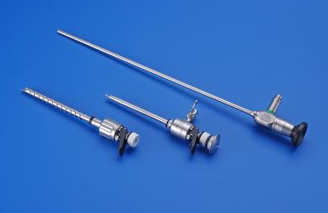
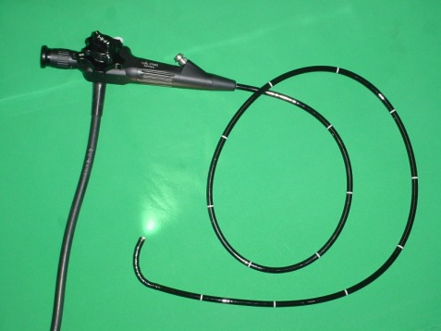
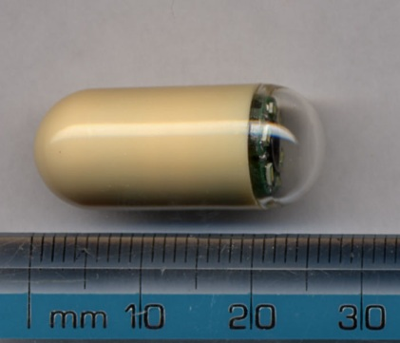
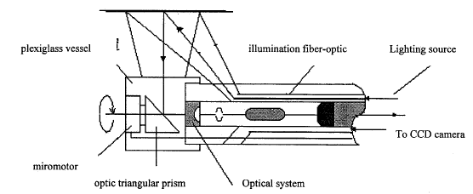
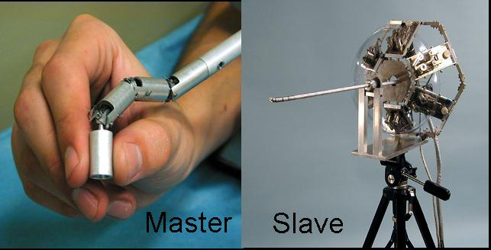
In-Vivo Imaging Devices
Rod-lens by Hopkins and cold light source of fiber optics by Karl Storz.
Flexible endoscope using fiber optics to delivery light and transmit image.
Pill camera without locomotion.
Endoscope with rotating mirror.
Endoscope positioned by multilink arm with piezoelectric actuators.
Karl Storz Endoscope
Flexible Endoscope
Pill camera
Gao et al., 1998
Ikuta et. al., 2002

Slide 14
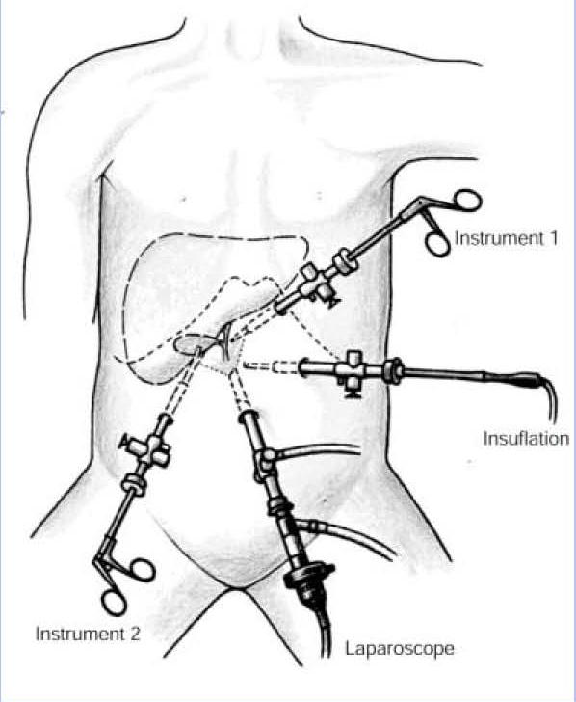
Limitations of Standard Endoscope
Paradigm of pushing long sticks into small openings.
  Narrow angle imaging.
  Limited workspace.
  Counter intuitive motion.
  Assistants needed to control the camera.
  Additional incisions for other laparoscopic instruments.

Slide 15
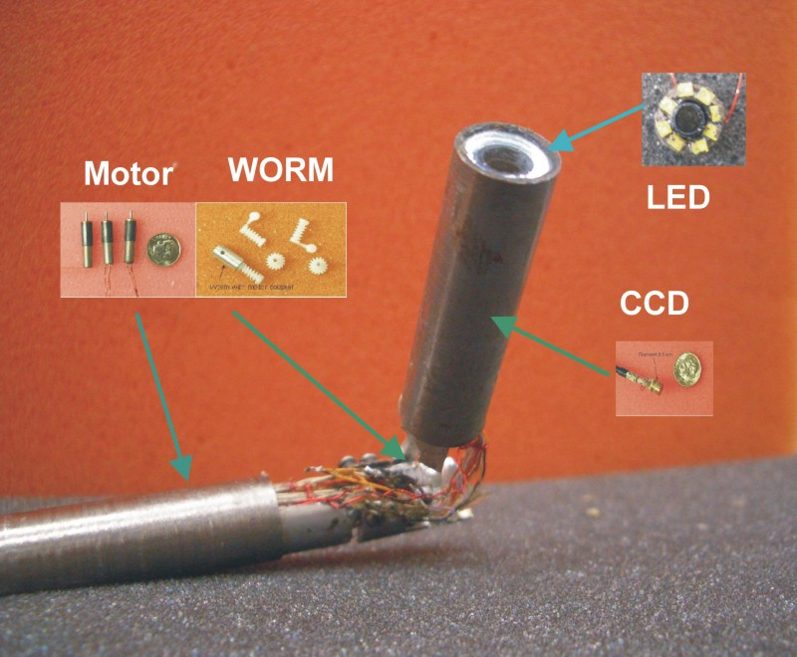
Articulated endoscope camera
110 mm in length and 11 mm in diameter.
120 degrees Pan/ 90 degrees Tilt.
Integrated 8 LED light source and miniature camera module.
Package to protect the delicate electronics and fragile wires from body fluid and moisture.
  Fully sealed camera module.
  Joint sealed by rubber boot.
Joystick control.

Slide 16
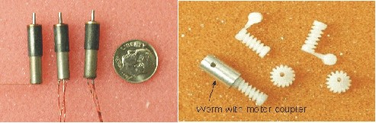
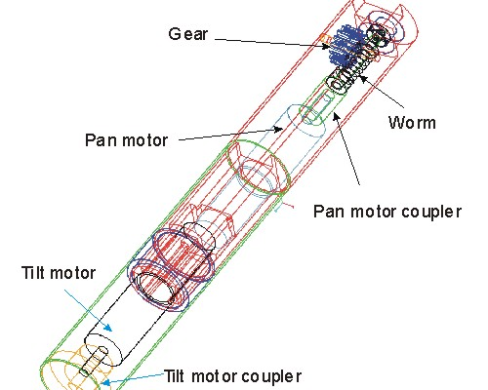
Pan/Tilt Mechanism
Miniature Brushless DC motor (0513G, Faulhaber Group).
  25mNm output torque.
  5.8 mm in diameter.
Miniature worm gear (Kleiss Gear Inc.)
  Gear ratio 16:1.
  Compact size.
  Increased torque.
Sleeve bearing to reduce the friction of tilt motion.

Slide 17
Timing of Each Procedures for Laparoscope and articulated robot camera
Procedure | Laparoscope (minutes) | Robot (minutes)
Running Bowel | 4:20 | 3:30
Appendectomy | 2:20 | 2:20
Suturing | 5:00 | 4:00

Slide 18
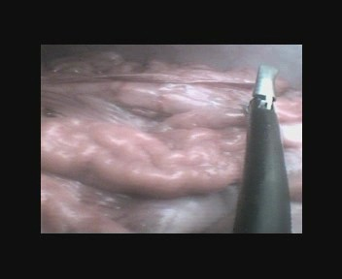
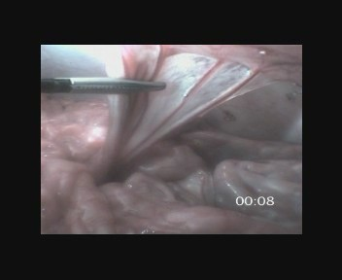
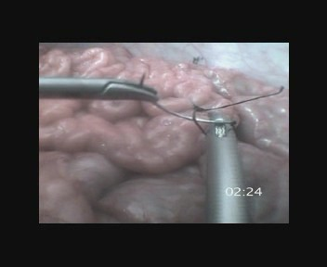
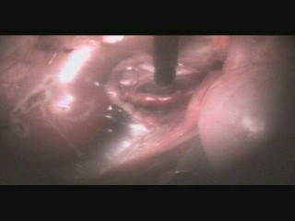
Laparoscopic Procedures
Appendectomy
Video
Running (measuring) the bowel
Suturing
Nephrectomy

Slide 19
References
Stoeckle, Michael, Siemer. (2008, April). Robot-assisted (da Vinci) laparoscopy: the beginning of a new era in operative urology. Der Urologe A.
Kaushik, Dharam, High, Clarke. (2010, March 1). Malfunction of the da Vinci Robotic System During Robot-Assisted Laparoscopic Prostatectomy: An International Survey. Journal of Endourology.
Robot-Assisted Laparoscopic Surgery The Using da Vinci System. Center for Pancreatic and Biliary Diseases, University of Southern California.<http://www.surgery.usc.edu/divisions/tumor/pancreasdiseases/web%20pages/laparoscopic%20surgery/da%20vinci.html>.
Robotic Surgery: da Vinci Surgical System. Brown University. < http://biomed.brown.edu/Courses/BI108/BI108_2005_Groups/04/davinci.html>.
Laparoscopic Surgery. <http://en.wikipedia.org/wiki/Laparoscopic_surgery>.

Slide 20
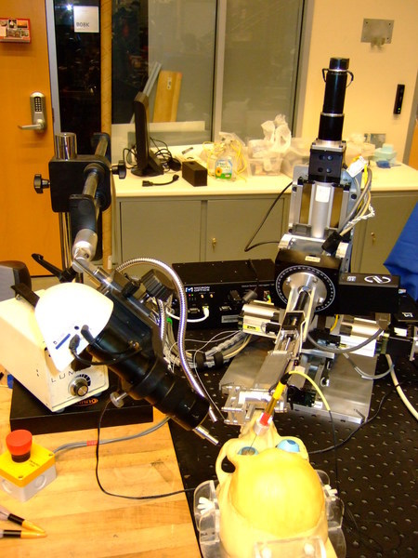
JHU Steady hand

Slide 21
Where virtual fixtures can be useful?
Central retinal vein occlusion, solution= retinal vein cannulation
Free hand vein cannulation
http://www.youtube.com/watch?v=MiKVFwuFybc&feature=player_embedded
Robot assisted vein cannulation
http://www.youtube.com/watch?v=s5c9XuKtJaY&feature=player_embedded
What to prove? “robot can increase success rate of cannulation and increase the time the micropipette is maintained in the retinal vein during infusion”
Notes:
Bring it to the top, occlusion=blocked. vein cannulation: MJ inject fluid to unblock?

