Slide 1
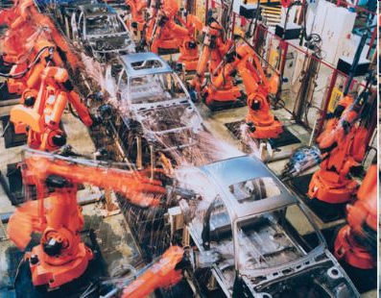
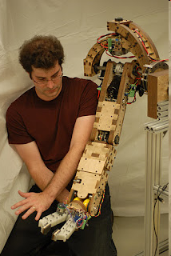
Robot Arms, Hands:
With slides from

Slide 2
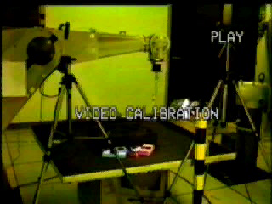
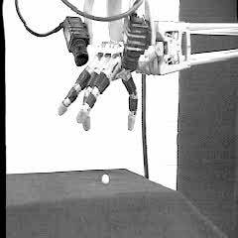
What a robot arm and hand can do
Martin 1992-’97 PhD work

Slide 3

What a robot arm and hand can do
Camilo 2011-15 PhD work

Slide 4
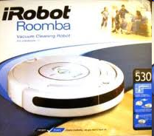
Robotics field . .
6 Million mobile robots
From $100 roomba to $millions Mars rovers
3 million robot arms
Usually $20,000-100,000, some $millions (Canadaarm)
Value of industrial robotics sector: $100 billion
Roomba: $300M in sales
Industrial arms $75billion in sales
Arms crucial for these industries:
Automotive (Welding, painting, some assembly)
Electronics (Placing tiny components on PCB)
General: Pack boxes, move parts from conveyor to machines
http://www.youtube.com/watch?v=DG6A1Bsi-lg

Slide 5
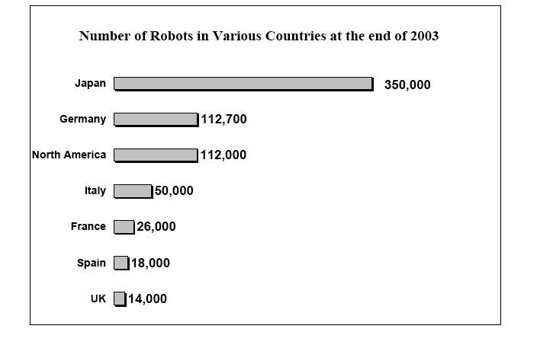
01_02
Robots in everyday use and popular culture
Chances are, something you eat, wear, or use was made by a robot
http://www.robotuprising.com/
Notes:
01_02.jpg

Slide 6
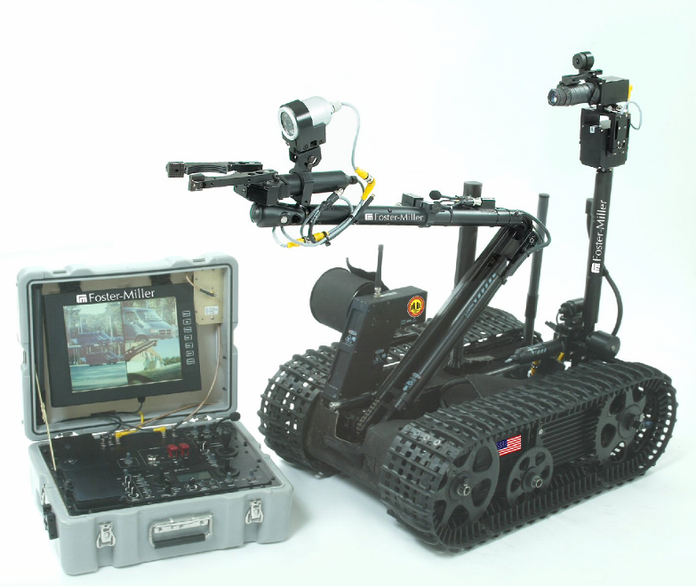
Common applications
Industrial
Robotic assembly
Commercial
Household chores
Military
Medical
Robot-assisted surgery
Picture of Roomba
Notes:
Congressional act: more autonomous military vehicles/agents

Slide 7
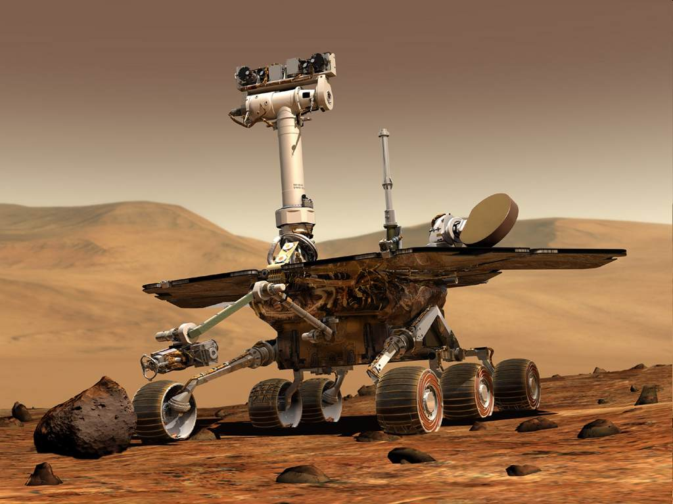
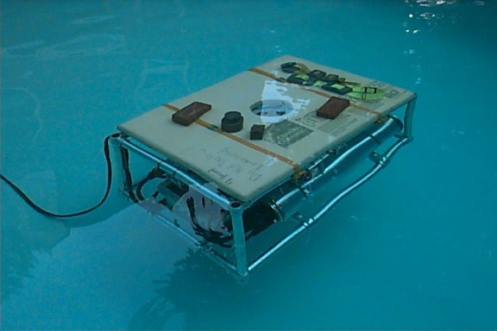
Common applications
Planetary Exploration
Fast, Cheap, and Out of Control
Mars rover
Undersea exploration
JHUROV; Johns Hopkins
Notes:
Finding the titanic using the first underwater robot

Slide 8
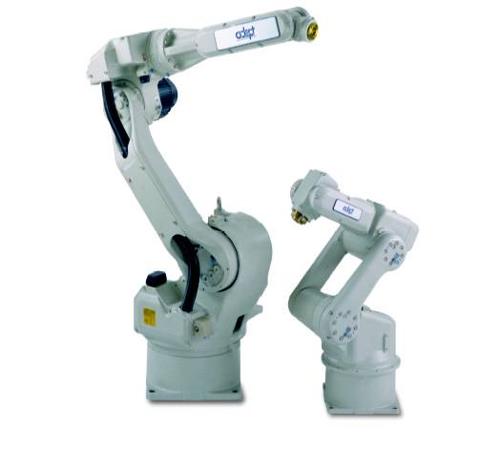
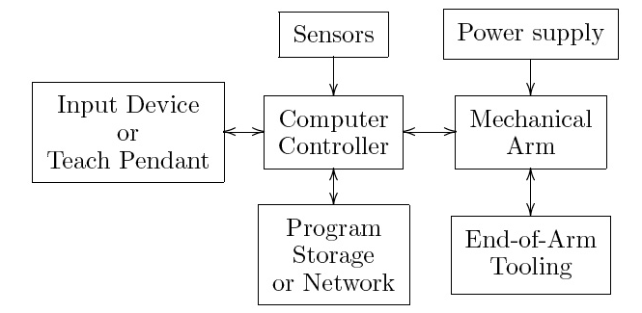
01_01
Industrial robots
High precision and repetitive tasks
Pick and place, painting, etc
Hazardous environments
Notes:
Industrial robot movie. Use industrial robots as a basis for analysis.
01_01.jpg

Slide 9
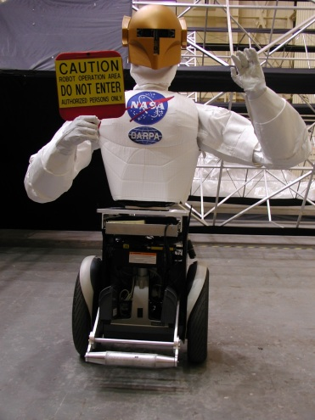
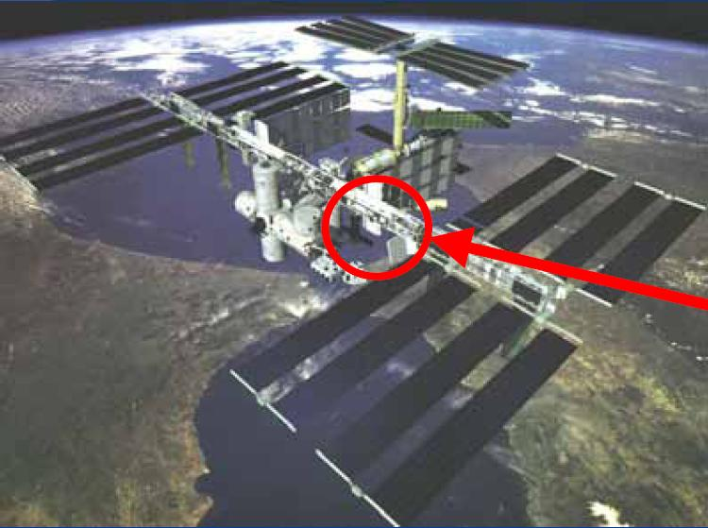
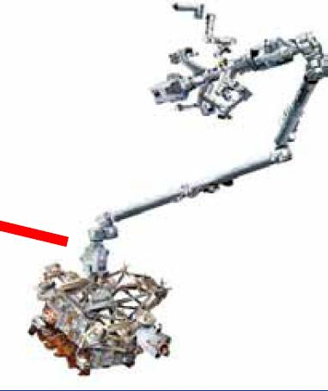
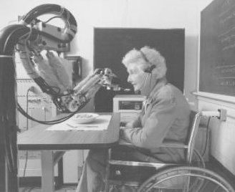
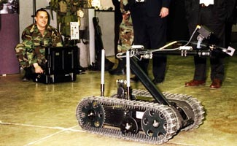
Emerging Robotics Applications
Space - in-orbit, repair and maintenance, planetary exploration anthropomorphic design facilitates collaboration with humans
Basic Science - computational models of cognitive systems, task learning, human interfaces
Health - clinical applications, "aging-in-place,” physical and cognitive prosthetics in assisted-living facilities
Military or Hazardous - supply chain and logistics support, re-fueling, bomb disposal, toxic/radioactive cleanup
No or few robots currently operate reliably in these areas!

Slide 10
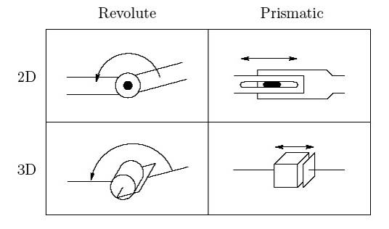
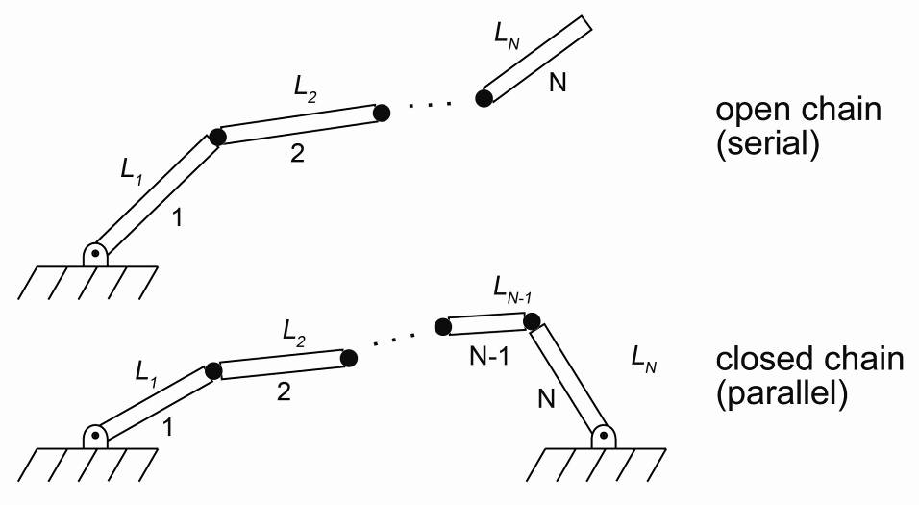
01_03
Representations
For the majority of this class, we will consider robotic manipulators as open or closed chains of links and joints
Two types of joints: revolute (θ) and prismatic (d)
Notes:
01_03.jpg

Slide 11
Definitions
End-effector/Tool
Device that is in direct contact with the environment. Usually very task-specific
Configuration
Complete specification of every point on a manipulator
set of all possible configurations is the configuration space
For rigid links, it is sufficient to specify the configuration space by the joint angles
State space
Current configuration (joint positions q) and velocities
Work space
The reachable space the tool can achieve
Reachable workspace
Dextrous workspace
Notes:
Talk about the number of DOFs in terms of workspace reachability and redundancy. Rigid body has 6DOF

Slide 12
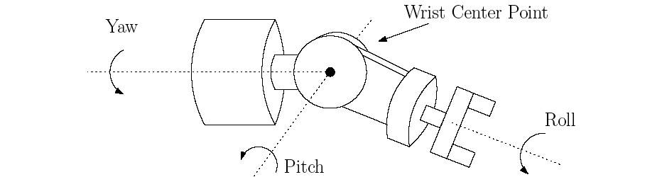
01_06
Common configurations: wrists
Many manipulators will be a sequential chain of links and joints forming the ‘arm’ with multiple DOFs concentrated at the ‘wrist’
Notes:
01_06.jpg

Slide 13
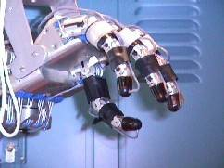
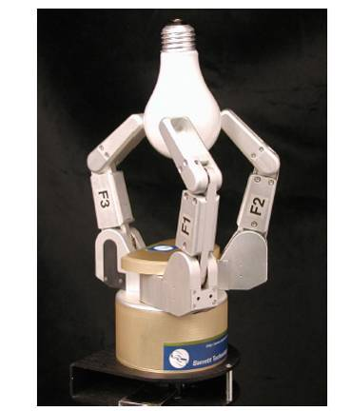
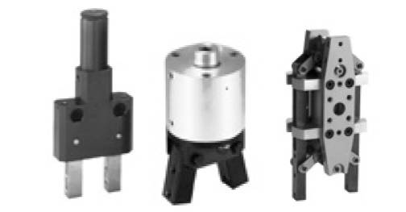
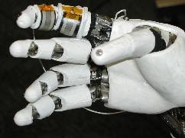
01_07
Example end-effector: Grippers
Anthropomorphic or task-specific
Force control v. position control
Utah MIT hand
Notes:
01_07.jpg

Slide 14
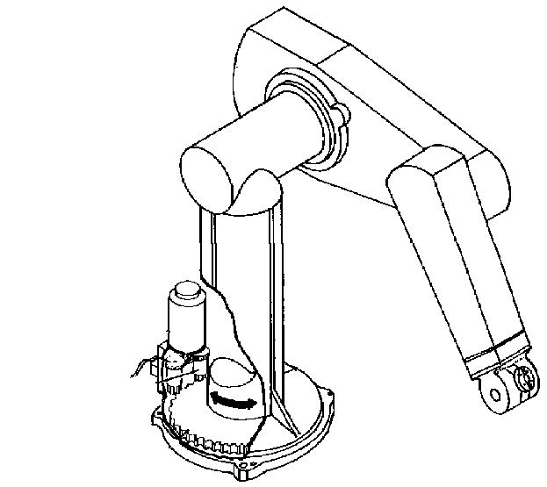
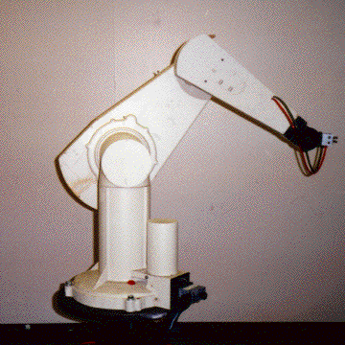
An classic arm - The PUMA 560
2
3
4
1
There are two more joints on the end effector (the gripper)
The PUMA 560 has SIX revolute joints
A revolute joint has ONE degree of freedom ( 1 DOF) that is defined by its angle

Slide 15
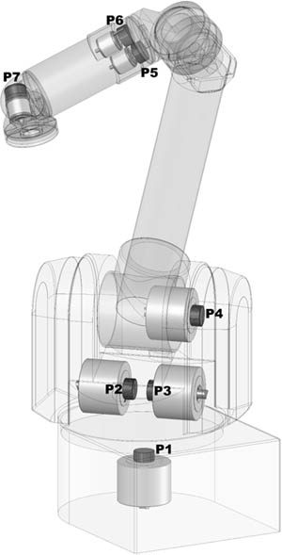
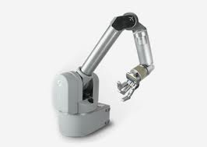
An modern arm - The Barrett WAM
The WAM has SEVEN revolute joints.
Similar motion (Kinematics) to human

Slide 16
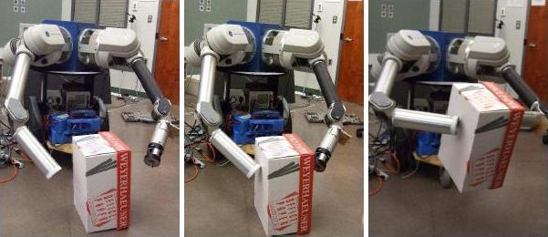
UA Robotics Lab platform 2 arm mobile manipulator
2 WAM arms, steel cable transmission and drive
Segway mobile platform
2x Quad core computer platform.
Battery powered, 4h run time.

Slide 17
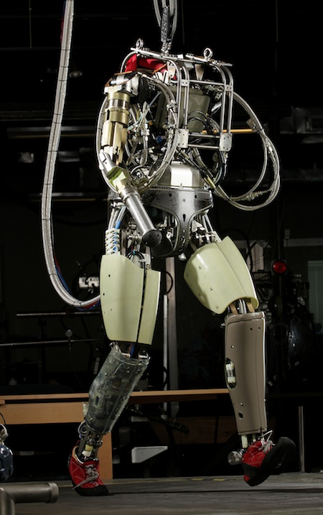
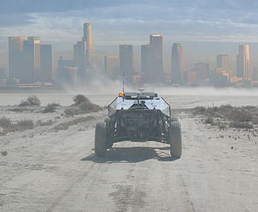
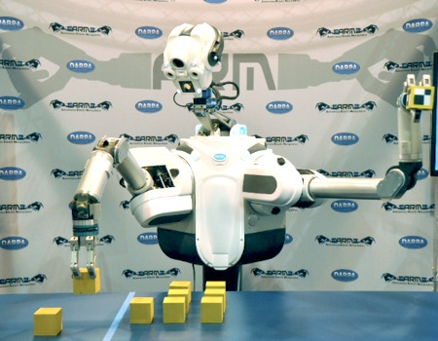
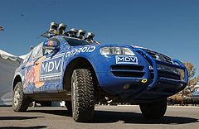
Robotics challenges
Manipulation ‘11-14
Navigation ‘05
Humanoids ’12-

Slide 18
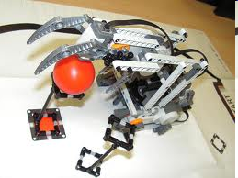
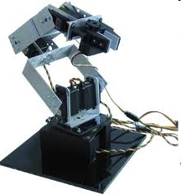
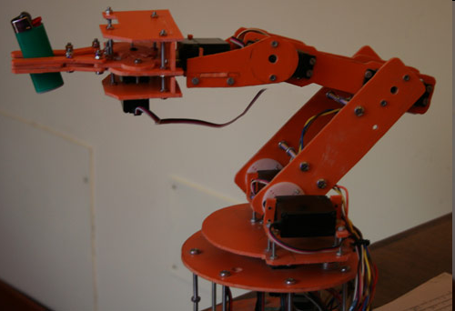
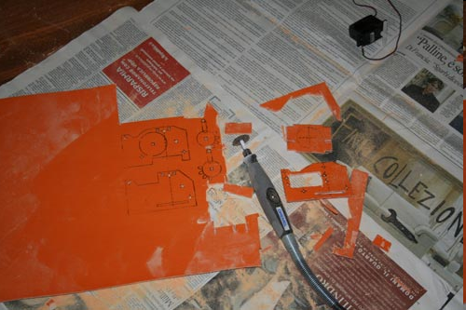
Build or buy?
Lego
Lynxmotion
Off the shelf kits:
Build your own:

Slide 19
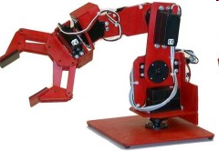
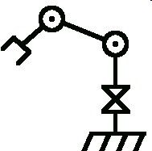
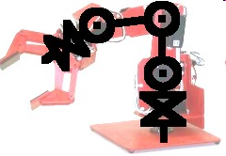
Mathematical modeling
Robot
Abstract model
Strategy:
Model each joint separately
Combine joints and linkage lengths
http://www.societyofrobots.com/robot_arm_tutorial.shtml

Slide 20
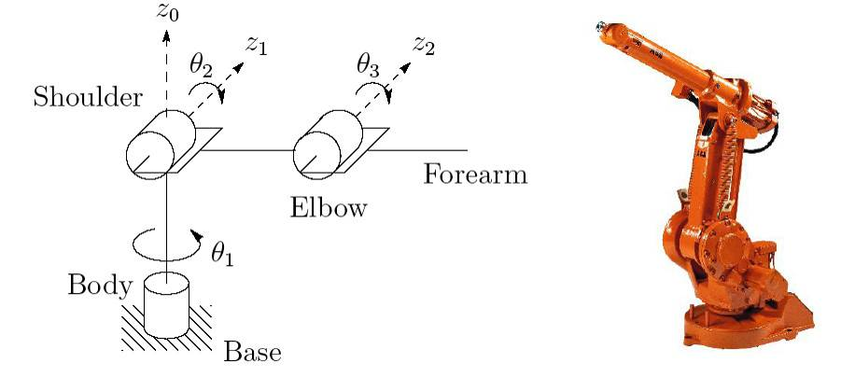
01_09
Common configurations: elbow manipulator
Anthropomorphic arm: ABB IRB1400
Very similar to the lab arm (RRR)
Notes:
01_09.jpg

Slide 21
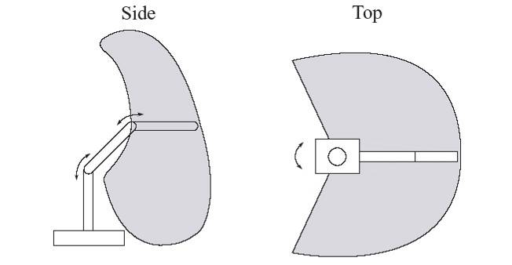
01_10
Workspace: elbow manipulator
Notes:
01_10.jpg

Slide 22
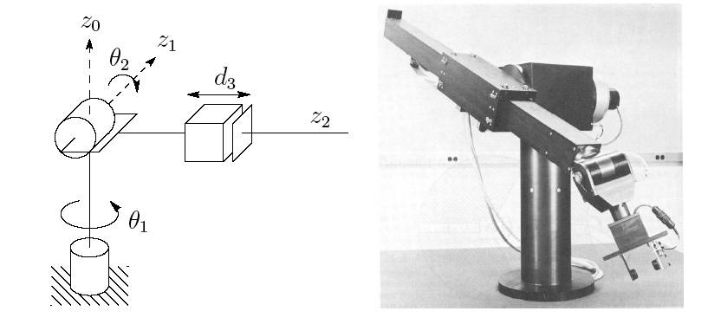
01_12
Common configurations: Stanford arm (RRP)
Spherical manipulator (workspace forms a set of concentric spheres)
Notes:
01_12.jpg

Slide 23
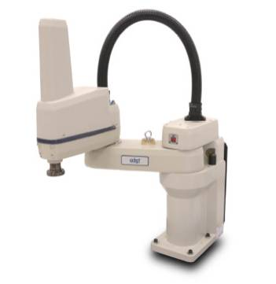
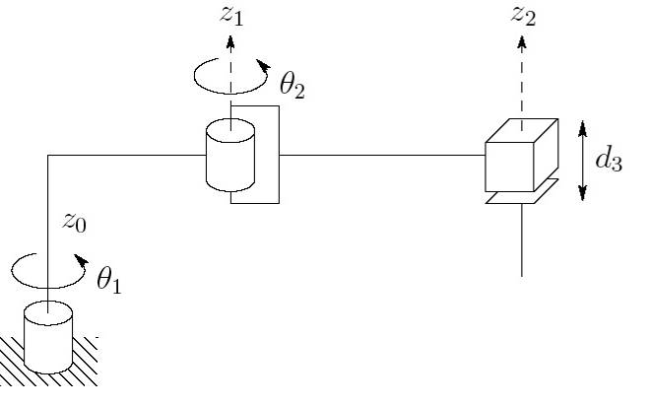
01_14
Common configurations: SCARA (RRP)
Adept Cobra Smart600 SCARA robot
Notes:
01_14.jpg

Slide 24
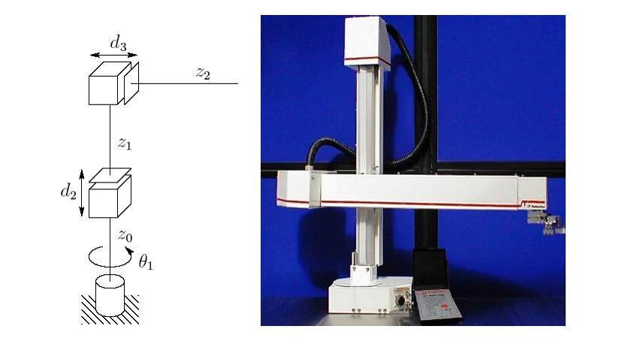
01_15
Common configurations: cylindrical robot (RPP)
workspace forms a cylinder
Seiko RT3300 Robot
Notes:
01_15.jpg

Slide 25
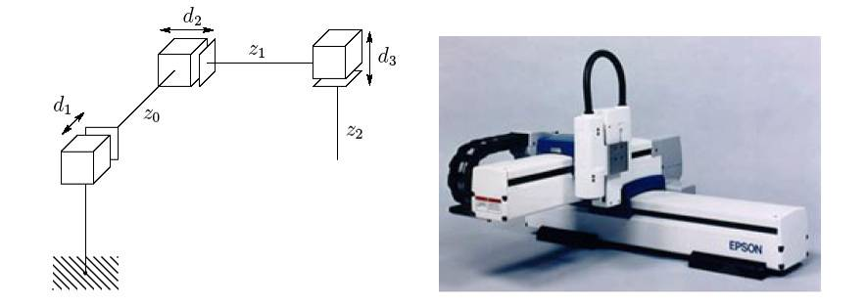
01_16
Common configurations: Cartesian robot (PPP)
Increased structural rigidity, higher precision
Pick and place operations
Notes:
01_16.jpg

Slide 26
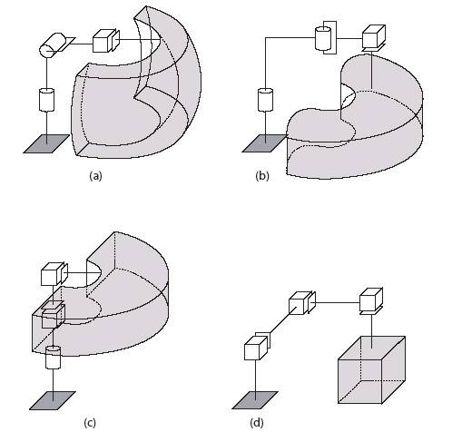
01_17
Workspace comparison
(a) spherical
(b) SCARA
(c) cylindrical
(d) Cartesian
Notes:
01_17.jpg

Slide 27
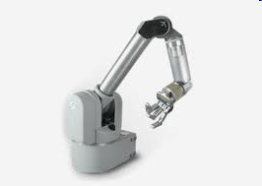
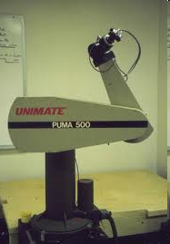
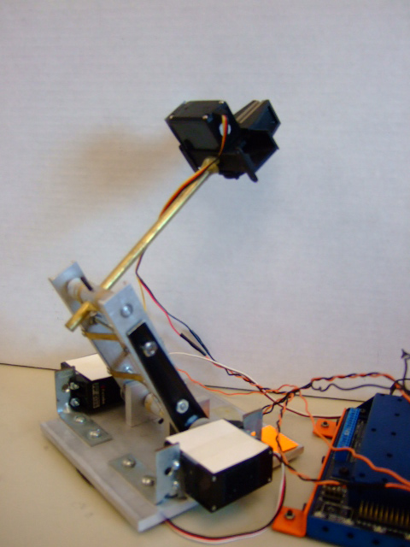
Linkage configuration
Motors serially in arm
Each motor carries the weight of previous
Heavy
Motors at base
Lightweight and faster
More complex transmission
Pic of our small arm

Slide 28



01_18
Parallel manipulators
some of the links will form a closed chain with ground
Advantages:
Motors can be proximal: less powerful, higher bandwidth, easier to control
Disadvantages:
Generally less motion, kinematics can be challenging
6DOF Stewart platform
ABB IRB6400
ABB IRB940 Tricept
Notes:
01_18.jpg

Slide 29

Hands, two arms: also parallel

Slide 30

How to build your Lego robot
Minimize loading of motors from weight of other motors.
Solutions:
SCARA
Parallelogram linkage
(Similar to a Phantom 1)

Slide 31
Mathematical modeling
Robot
Abstract model
Strategy:
Model each joint separately
Combine joints and linkage lengths
A simple example follows here.
More general treatment of next lecture
http://www.societyofrobots.com/robot_arm_tutorial.shtml

Slide 32

01_19
Simple example: Modeling of a 2DOF planar manipulator
Move from ‘home’ position and follow the path AB with a constant contact force F all using visual feedback
Notes:
01_19.jpg

Slide 33

01_20
Coordinate frames & forward kinematics
Three coordinate frames:
Positions:
Orientation of the tool frame:
0
1
2
2
0
1
Notes:
‘0’ is the base frame, ‘2’ is the tool frame. The orientation of the tool frame is the projection of the tool frame onto the base frame (i.e. dot product)
01_20.jpg

Slide 34


01_21
Inverse kinematics
Find the joint angles for a desired tool position
Two solutions!: elbow up and elbow down
Notes:
These are simple examples… this becomes more complex for higher DOFs
01_21.jpg

Slide 35

01_23
Velocity kinematics: the Jacobian
State space includes velocity
Inverse of Jacobian gives the joint velocities:
This inverse does not exist when θ₂ = 0 or π, called singular configuration or singularity
Notes:
Give an example of a human arm fully extended
01_23.jpg

Slide 36

01_24
Path planning
In general, move tool from position A to position B while avoiding singularities and collisions
This generates a path in the work space which can be used to solve for joint angles as a function of time (usually polynomials)
Many methods: e.g. potential fields
Can apply to mobile agents or a manipulator configuration
Notes:
Potential fields: create a topological map of the environment to account for obstacles (i.e. obstacles would be surrounded by ‘high’ potential fields) and take the path of lowest energy
01_24.jpg

Slide 37
01_24
Joint control
Once a path is generated, we can create a desired tool path/velocity
Use inverse kinematics and Jacobian to create desired joint trajectories
desired trajectory
error
controller
system dynamics
measured trajectory (w/ sensor noise)
actual trajectory
Notes:
01_24.jpg

Slide 38
Other control methods
Force control or impedance control (or a hybrid of both)
Requires force/torque sensor on the end-effector
Visual servoing
Using visual cues to attain local or global pose information
Common controller architectures:
PID
Adaptive
Repetitive
Challenges:
Underactuation
Nonholonomy (mobile agents)
nonlinearity
Notes:
We will form a matrix for both sensors and actuators to describe some common configurations as well as discuss active research in both these areas

Slide 39
General multivariable control overview
joint controllers
manipulator dynamics
motor dynamics
desired joint torques
state estimation sensors
inverse kinematics,
Jacobian
estimated configuration
desired trajectory

Slide 40
Sensors and actuators
sensors
Motor encoders (internal)
Inertial Measurement Units
Vision (external)
Contact and force sensors
motors/actuators
Electromagnetic
Pneumatic/hydraulic
electroactive
Electrostatic
Piezoelectric
Basic quantities for both:
Bandwidth
Dynamic range
sensitivity
Notes:
We will form a matrix for both sensors and actuators to describe some common configurations as well as discuss active research in both these areas

Slide 41




Computer Vision
Simplest form: estimating the position and orientation of yourself or object in your environment using visual cues
Usually a statistical process
Ex: finding lines using the Hough space
More complex: guessing what the object in your environment are
Biomimetic computer vision: how do animals accomplish these tasks:
Obstacle avoidance
Optical flow?
Object recognition
Template matching?
Notes:
Mention real-world problems such as cameras/calibration, lighting, etc

Slide 42




MEMS and Microrobotics
Difficult definition(s):
Robotic systems with feature sizes < 1mm
Robotic systems dominated by micro-scale physics
MEMS: Micro ElectroMechanical Systems
Modified IC processes to use ‘silicon as a mechanical material’
Fearing; Berkeley
Donald; Dartmouth
Pister; Berkeley

Slide 43


Surgical robotics
Minimally invasive surgery
Minimize trauma to the patient
Potentially increase surgeon’s capabilities
Force feedback necessary, tactile feedback desirable

Slide 44

Humanoid robots
For robots to efficiently interact with humans, should they be anthropomorphic?
QRIO Sony
Asimo; Honda (video from Siegwart?)

Slide 45

Winning IROS 2000-2012 work

Slide 46
Next class…
Homogeneous transforms as the basis for forward and inverse kinematics
Consider reading:
Craig, J.J., Introduction to Robotics, Mechanics, and Control
Chapter 3 (and 2 if math/geometry review needed)
Book available in library, bookstore or on-line
Other texts:
M. Spong, S. Hutchinson, and M. Vidyasagar, “Robot Modeling and Control”, Wiley
(In UA library)
Grad level:
Li, Murray, Sastry, “A Mathematical Introduction to Robotic Manipulation”, CRC Press
(Downloadable PDF on-line@Caltech)

