Slide 1
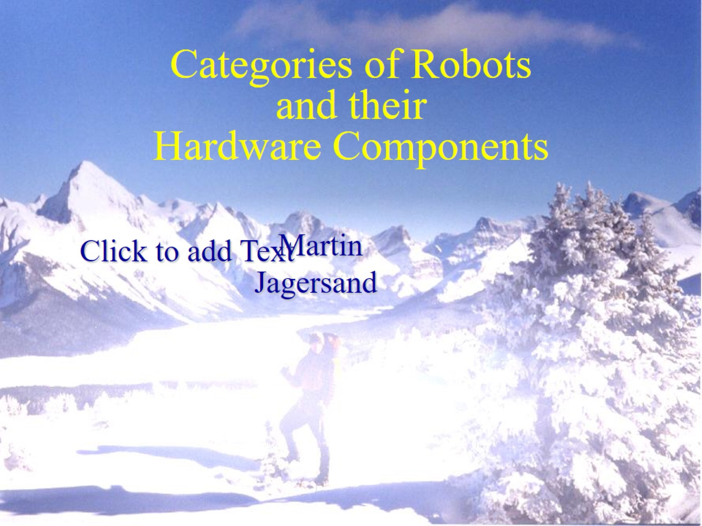
Categories of Robots and their Hardware Components

Slide 2
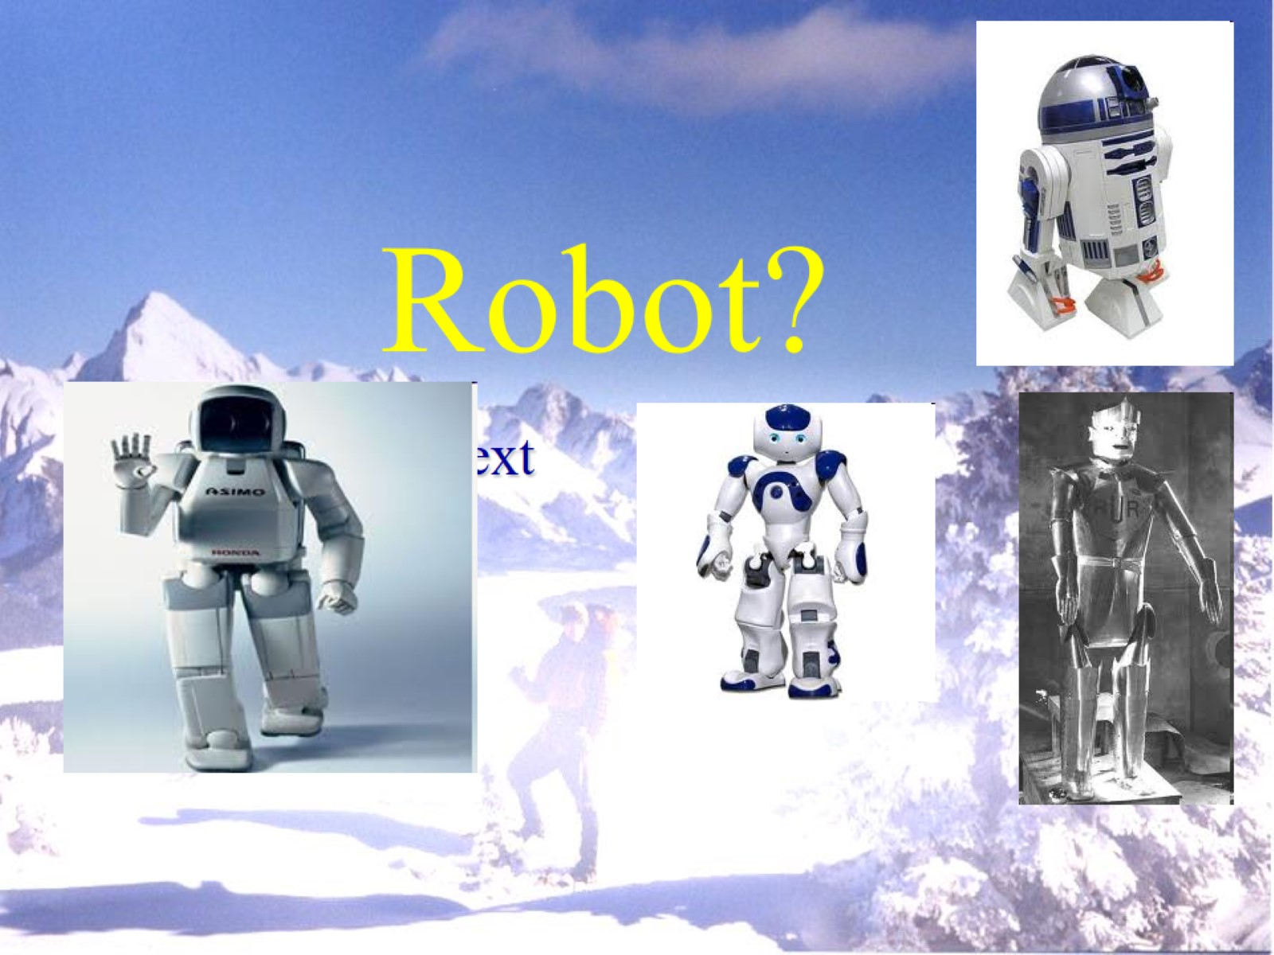
Robot?

Slide 3
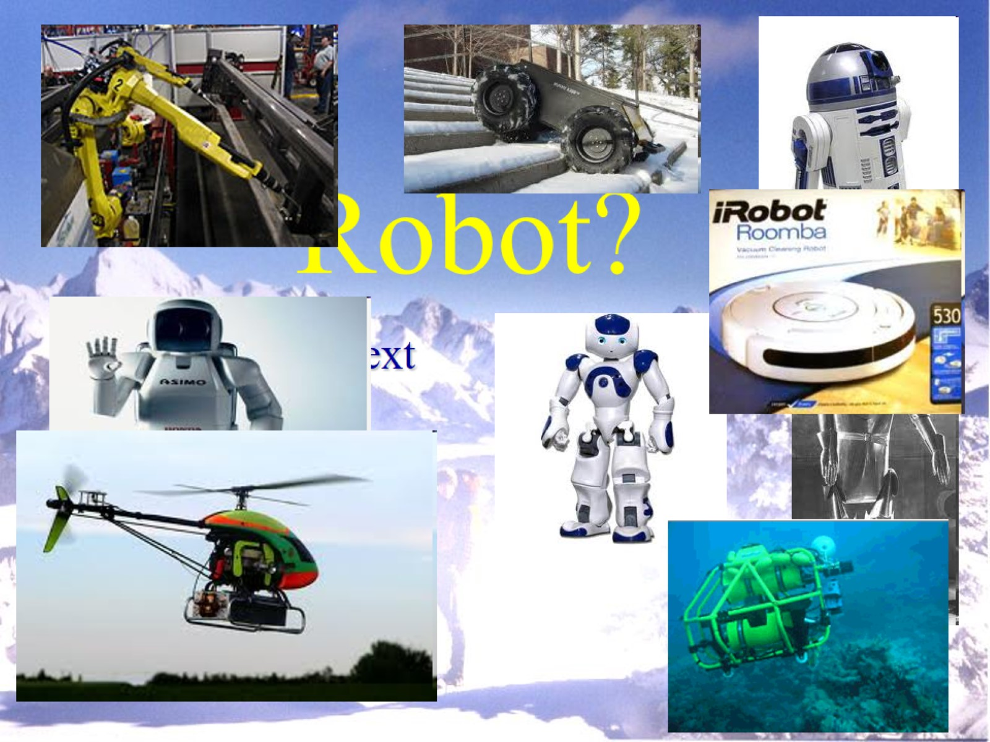
Robot?

Slide 4
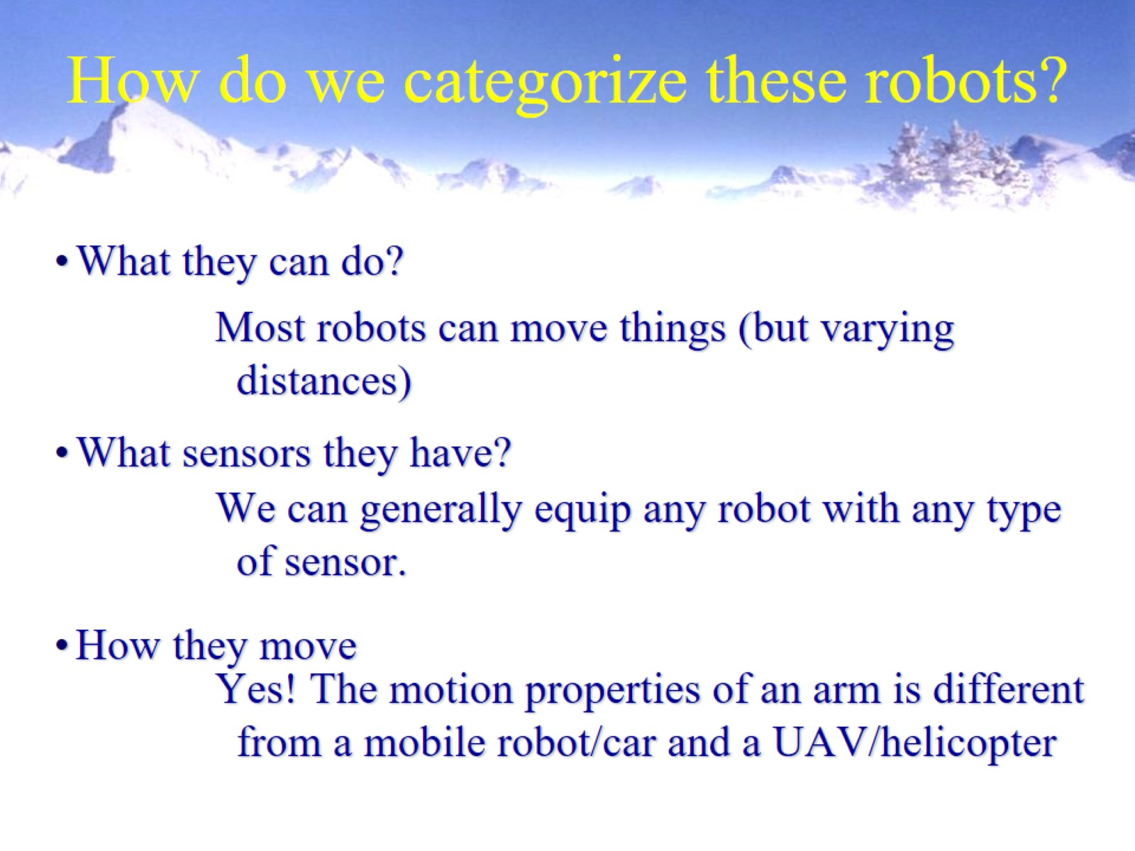
How do we categorize these robots?

Slide 5
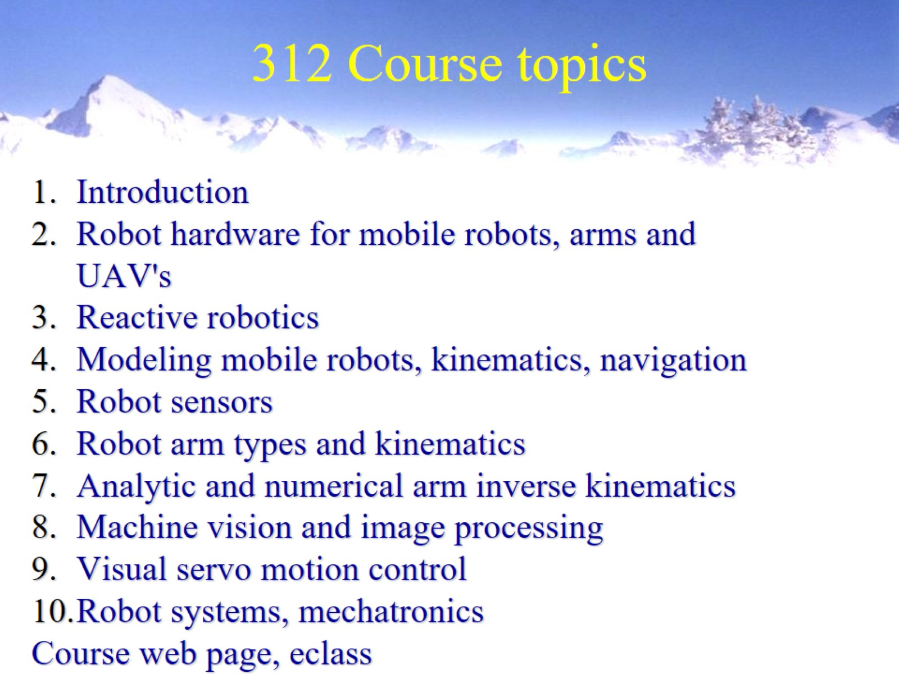
312 Course topics

Slide 6
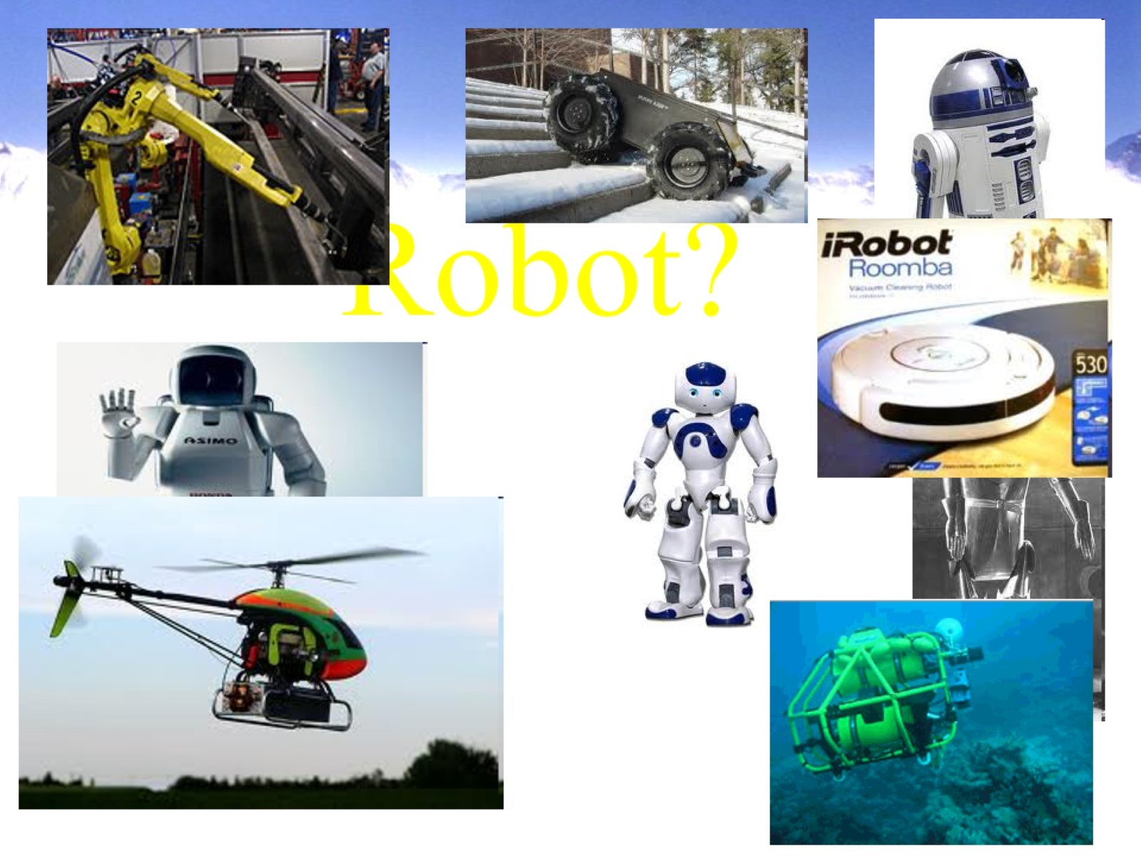
Robot?

Slide 7
How do we categorize these robots?

Slide 8
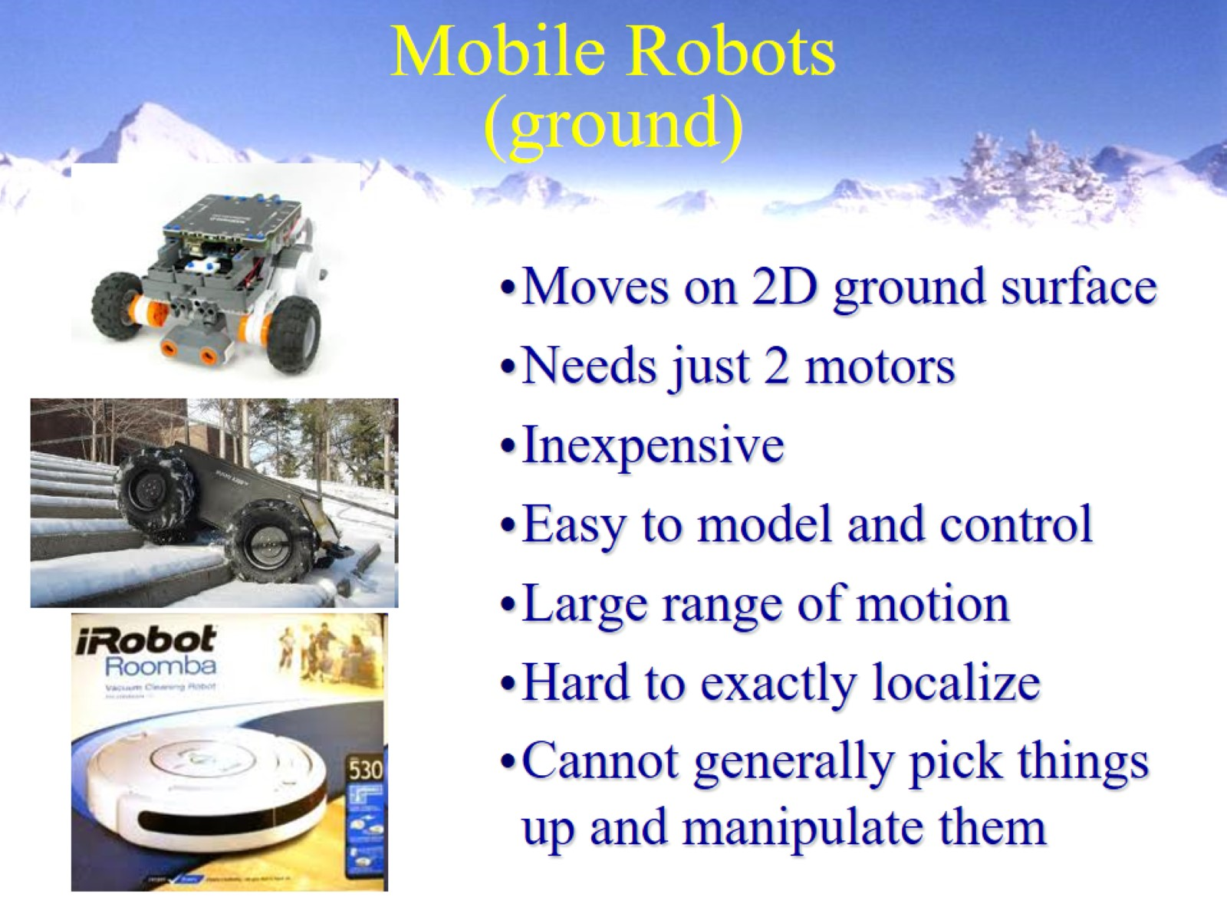
Mobile Robots (ground)

Slide 9
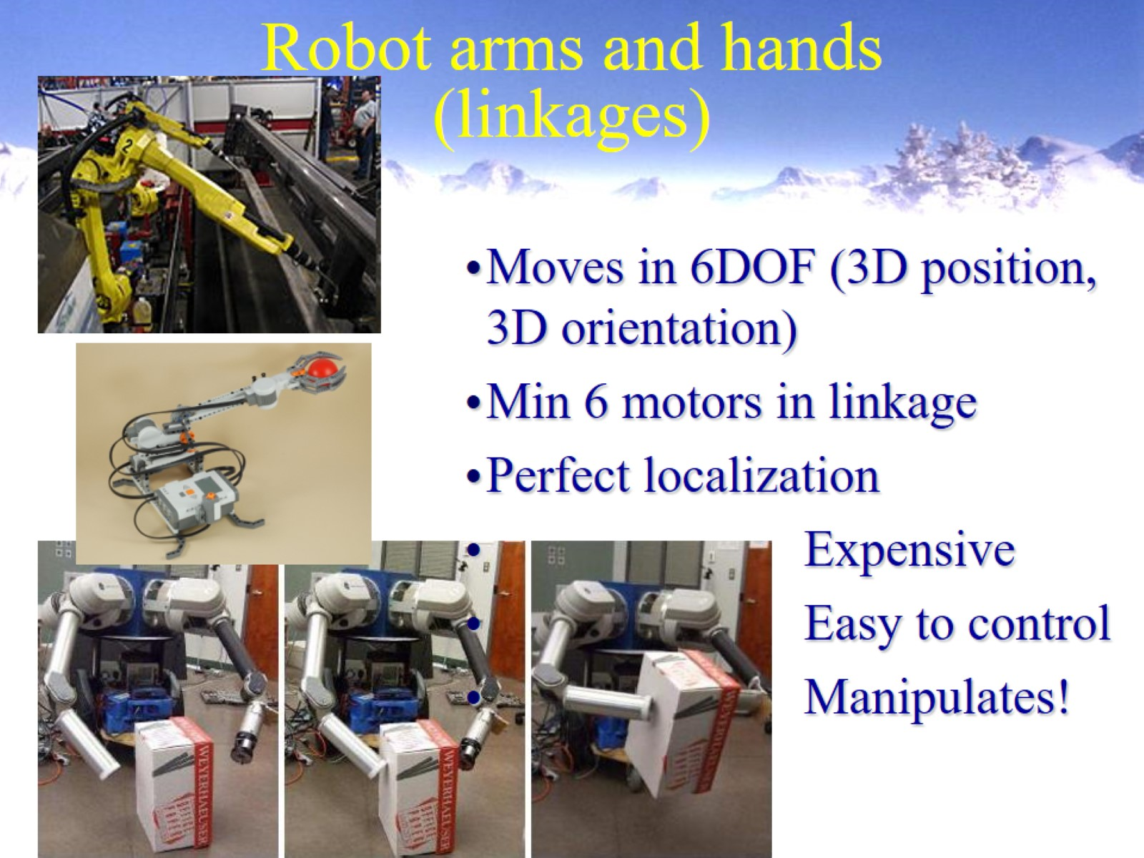
Robot arms and hands (linkages)

Slide 10
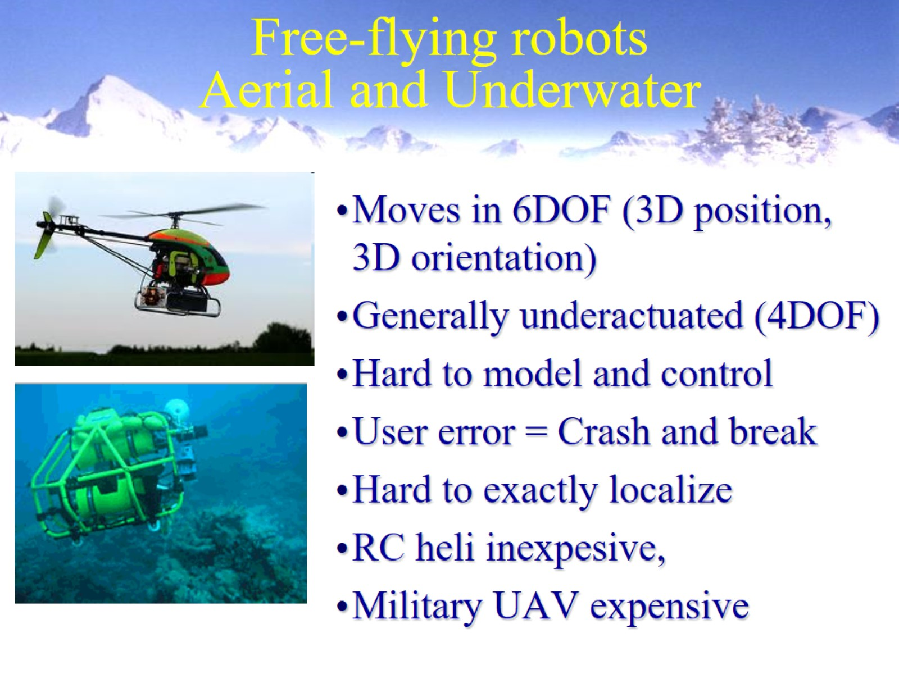
Free-flying robots Aerial and Underwater

Slide 11
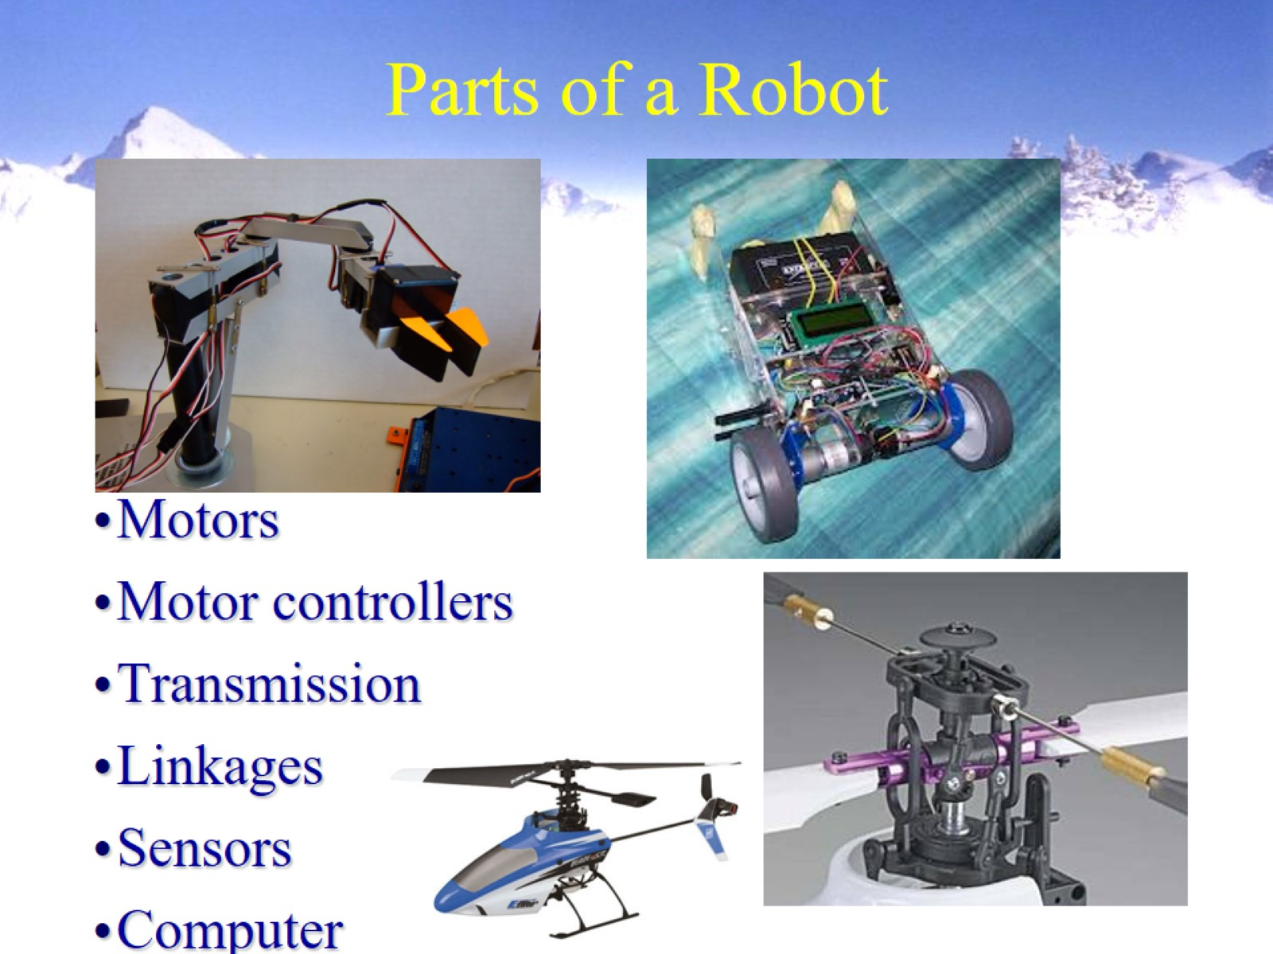
Parts of a Robot

Slide 12
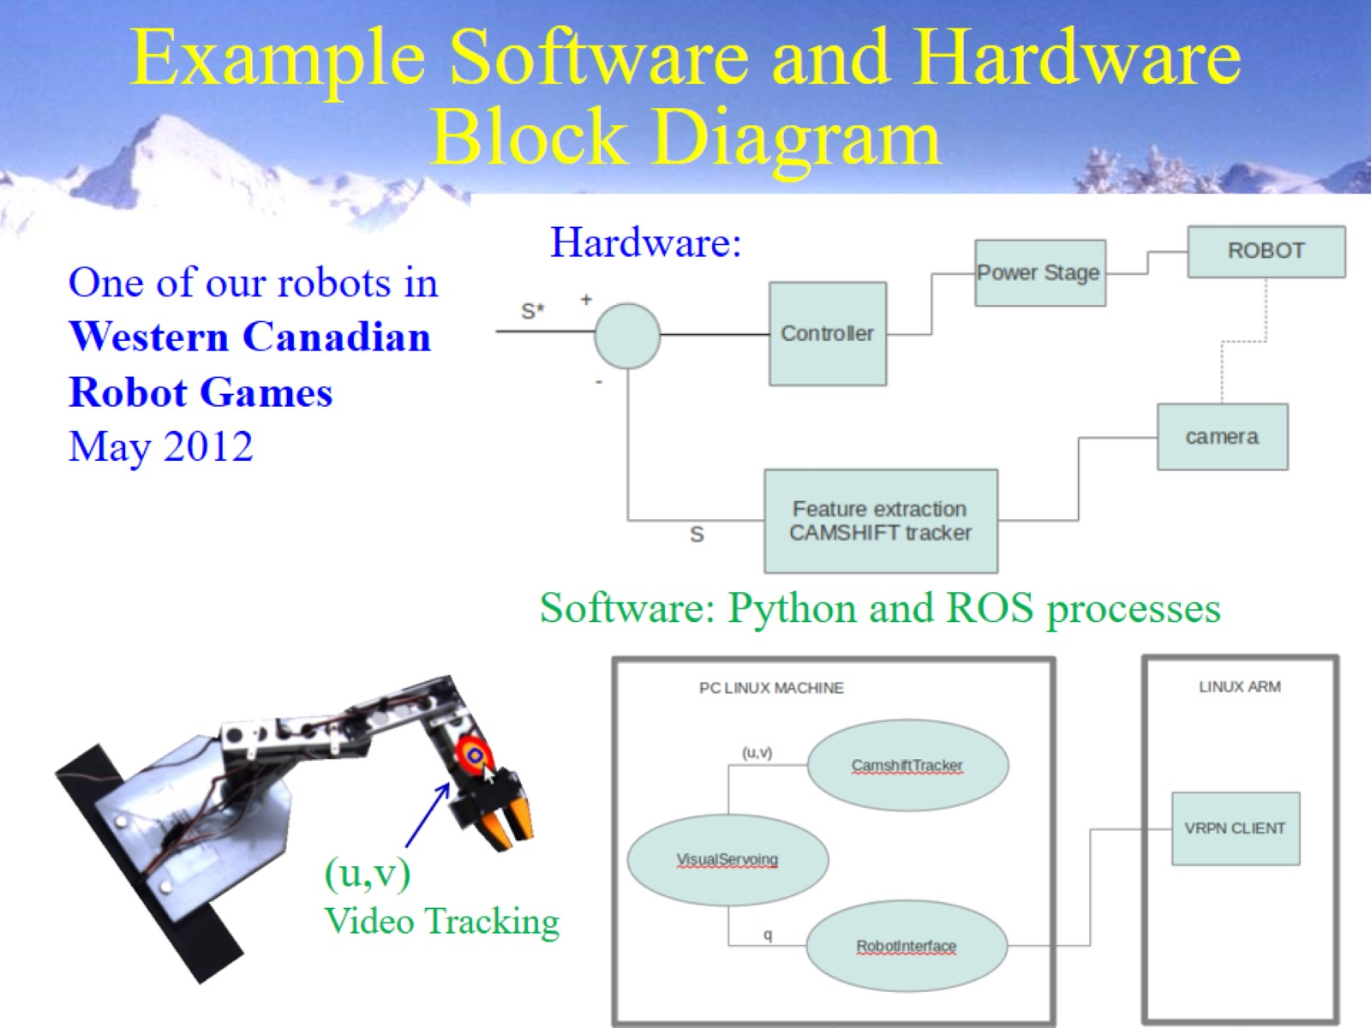

Slide 13
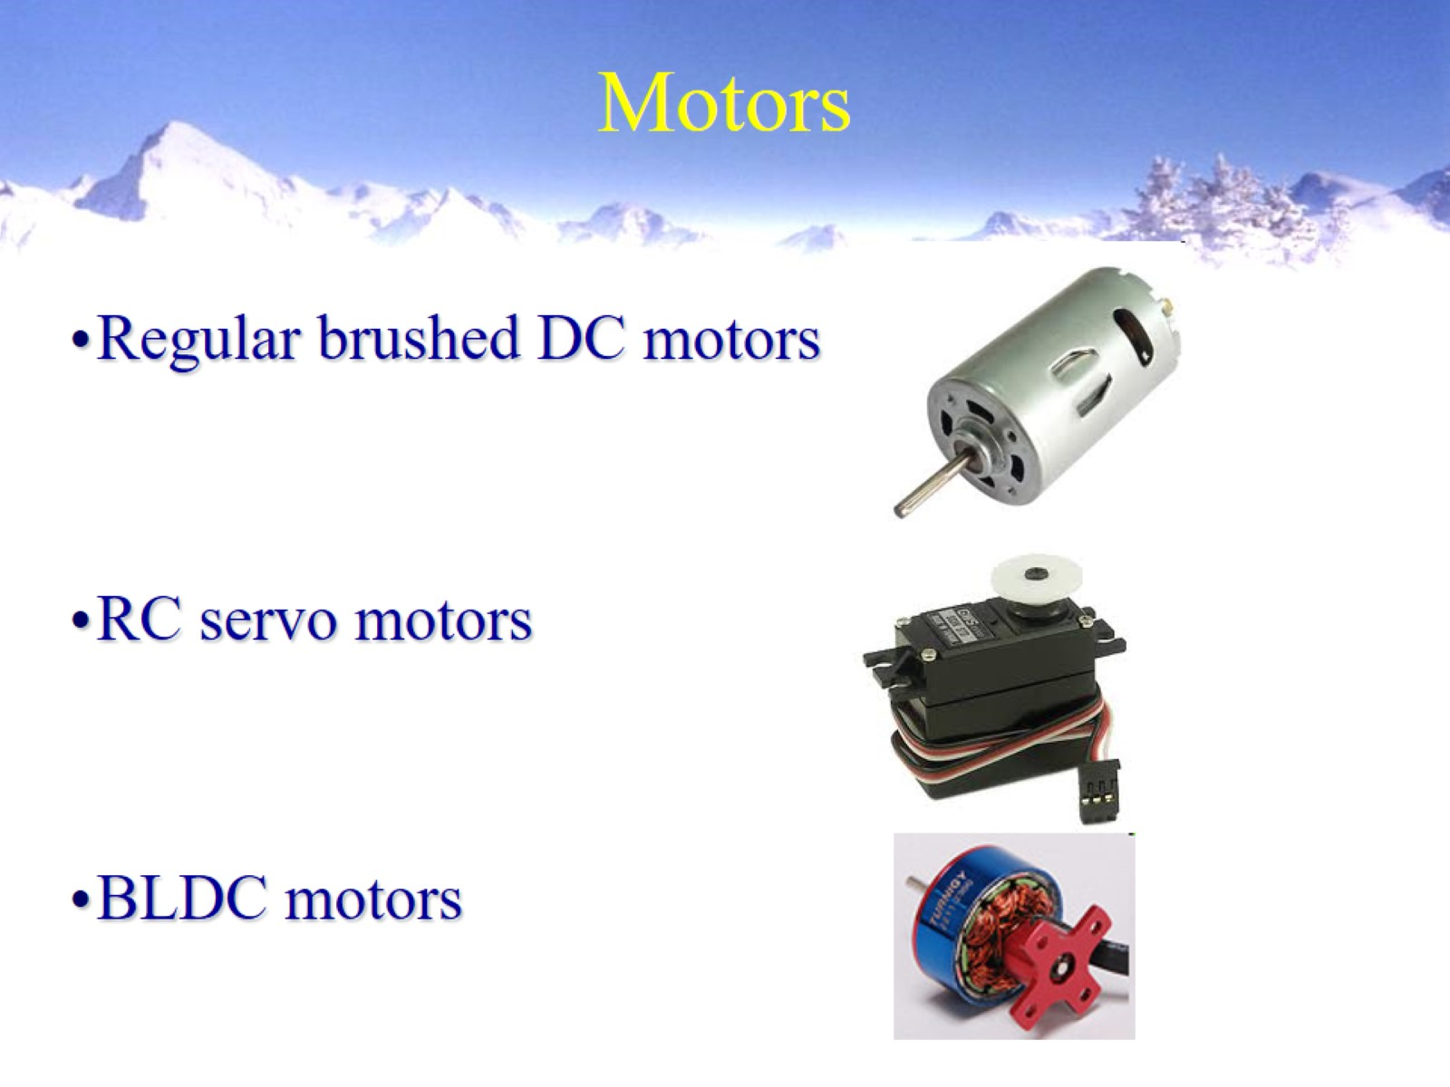
Motors

Slide 14
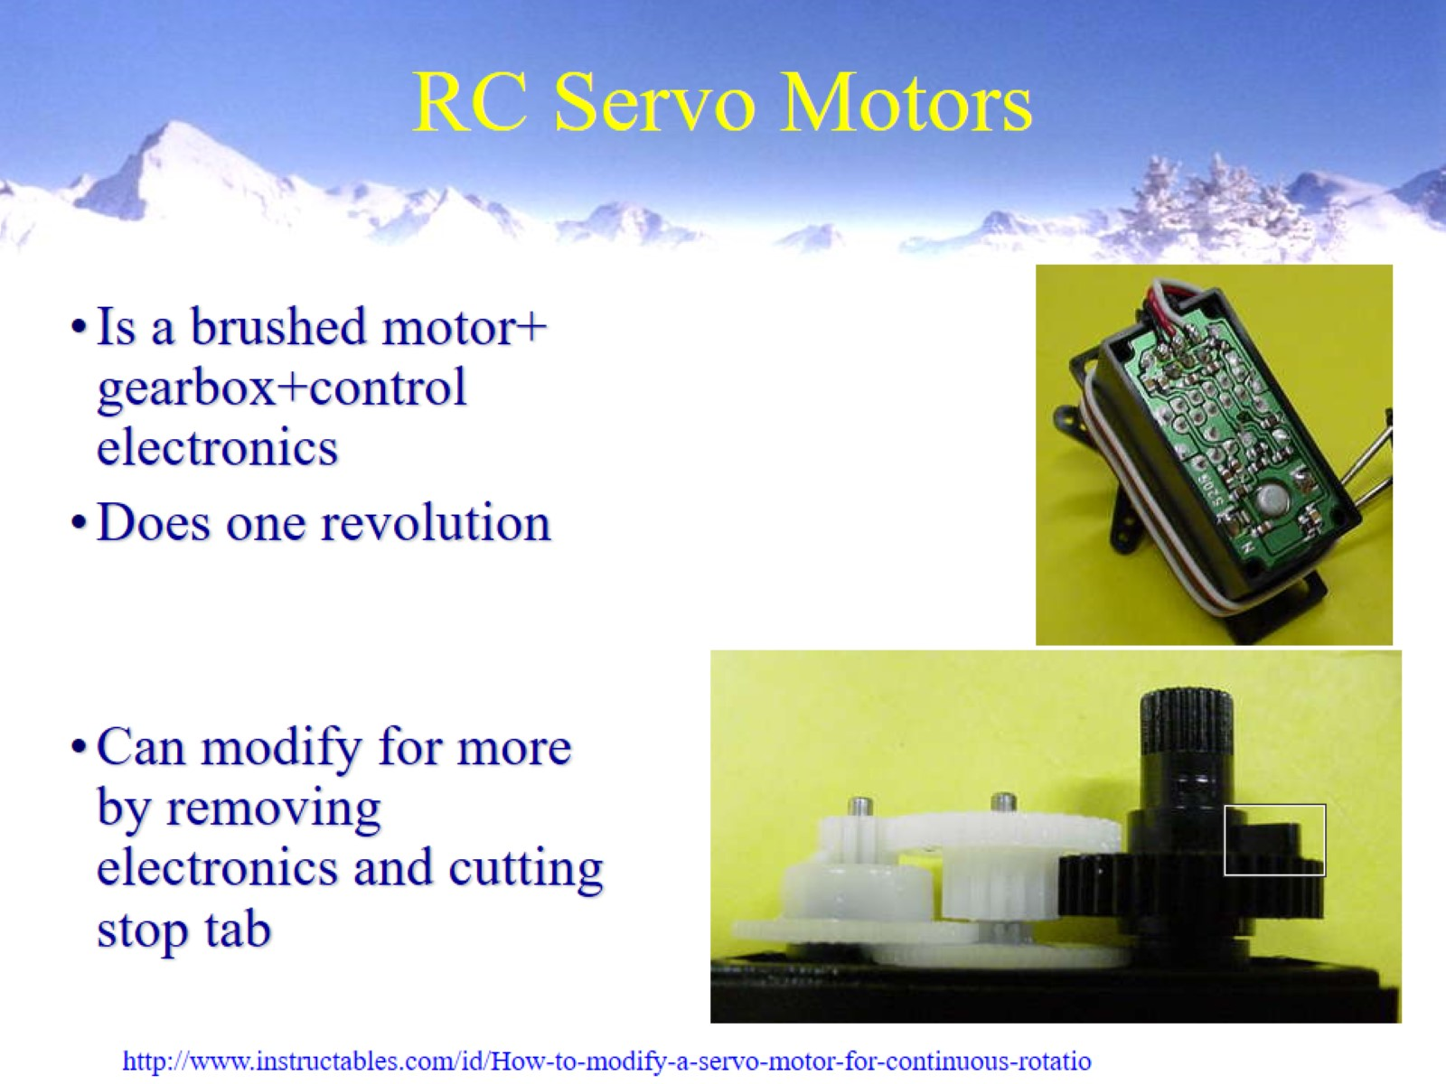
RC Servo Motors

Slide 15
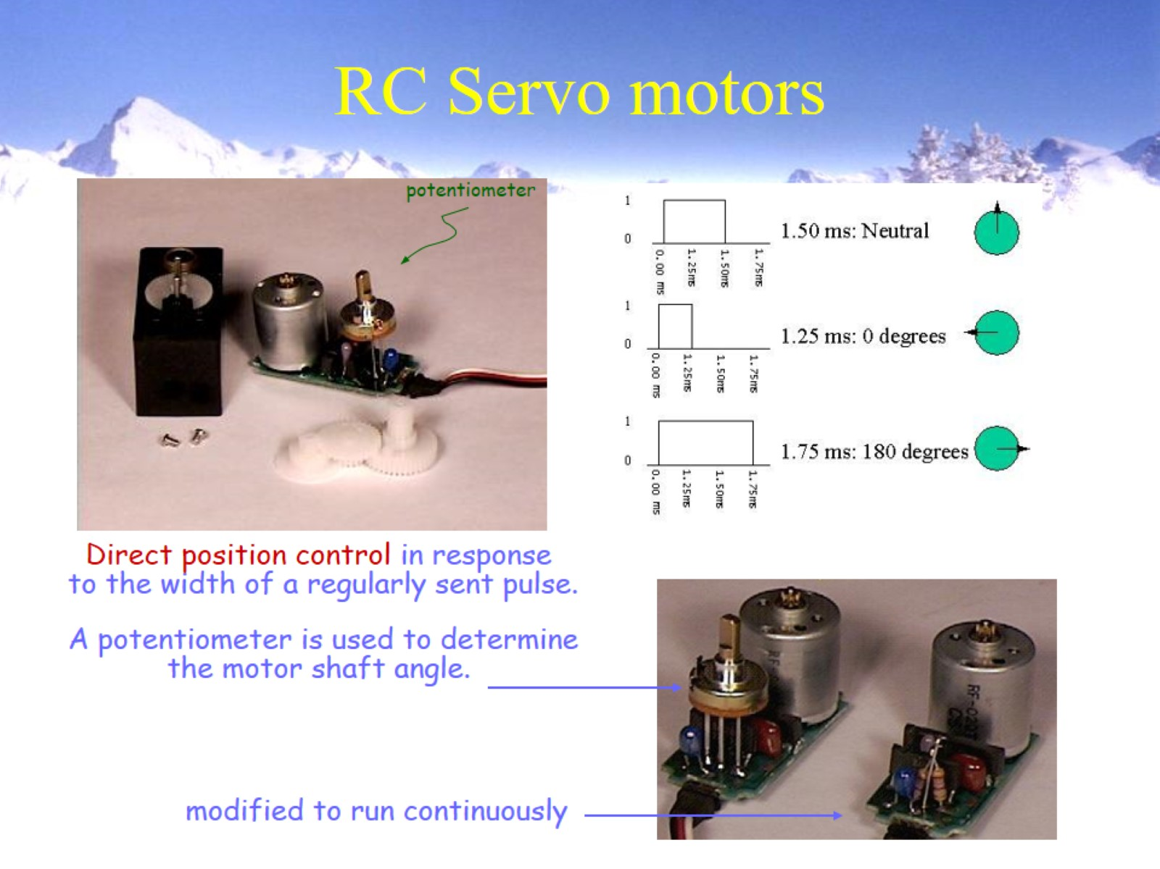
RC Servo motors

Slide 16
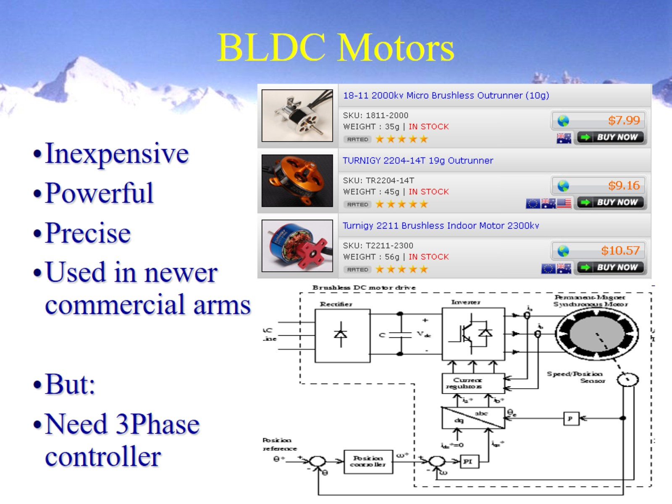
BLDC Motors

Slide 17
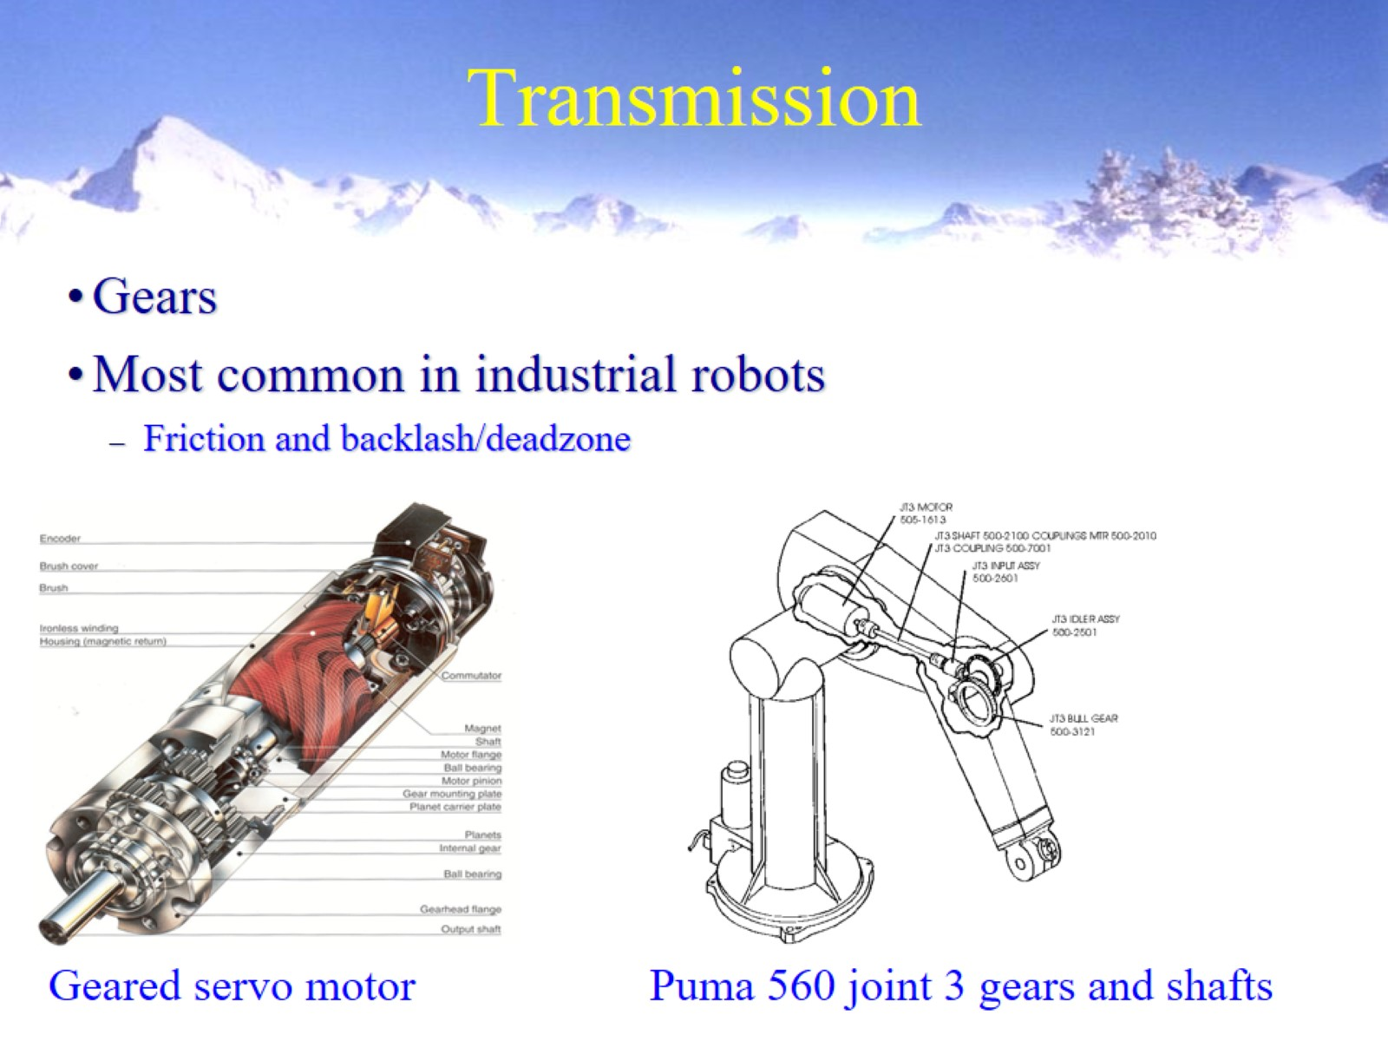
Transmission

Slide 18
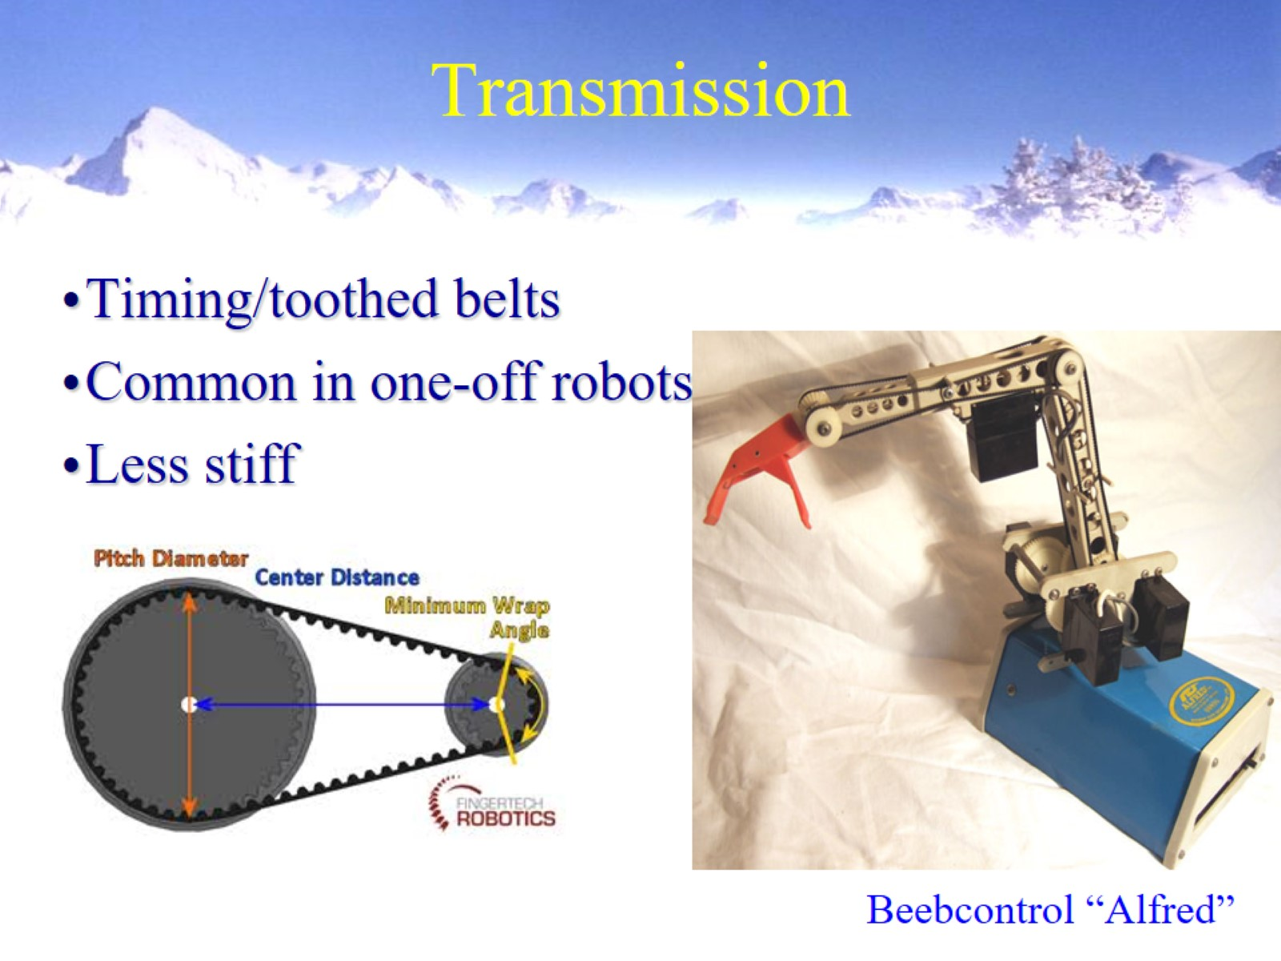
Transmission

Slide 19
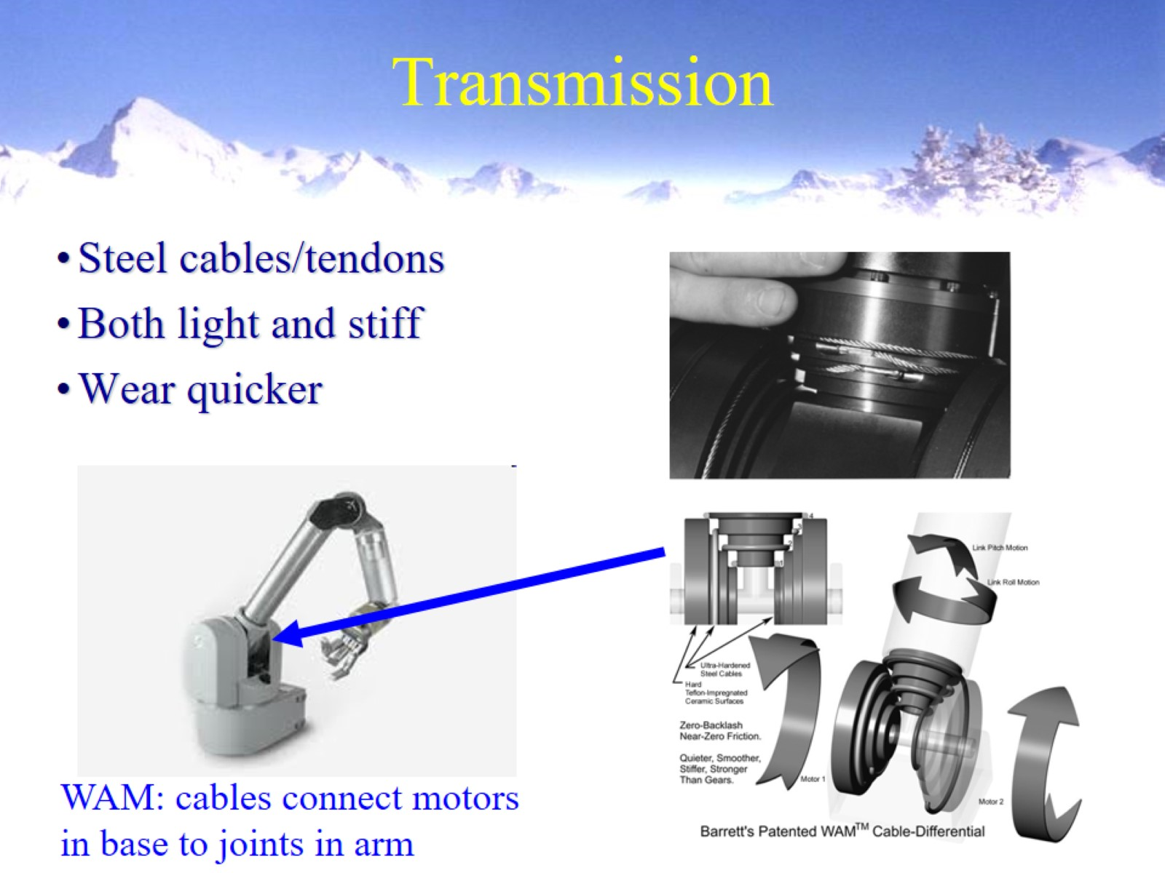
Transmission

Slide 20
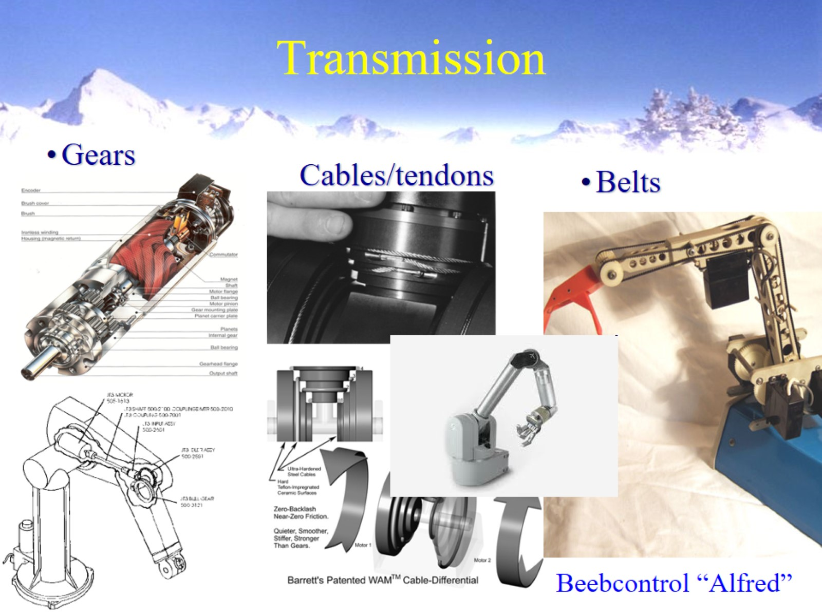
Transmission

Slide 21
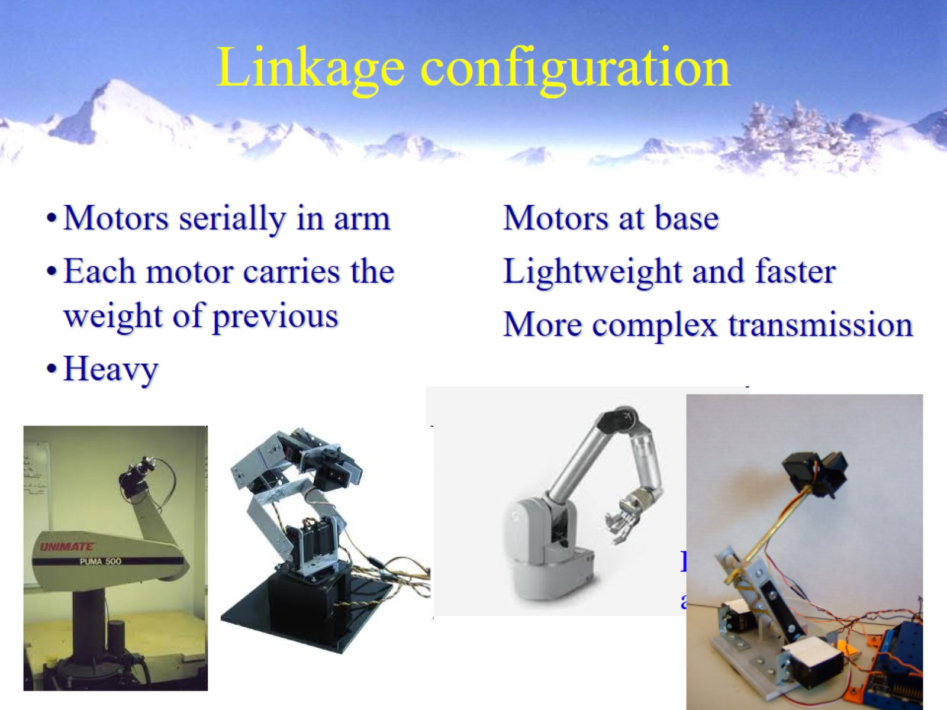
Linkage configuration

Slide 22
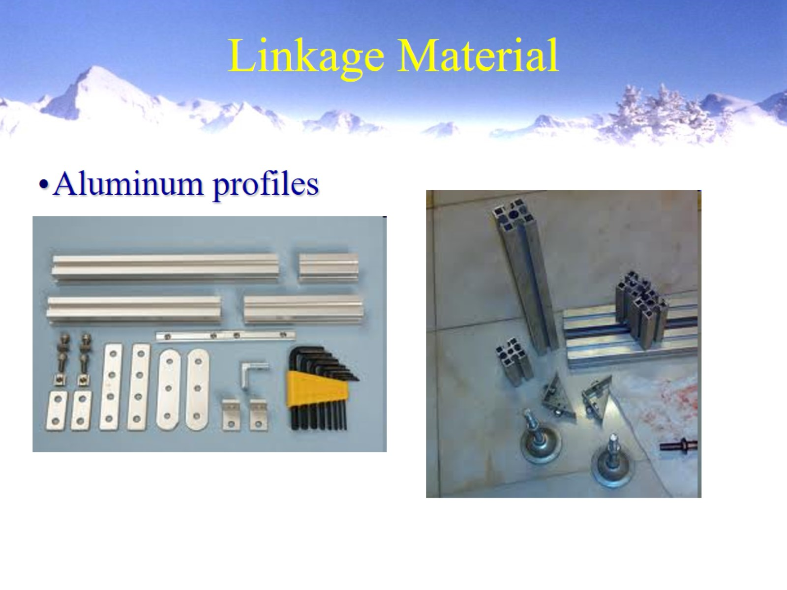
Linkage Material

Slide 23
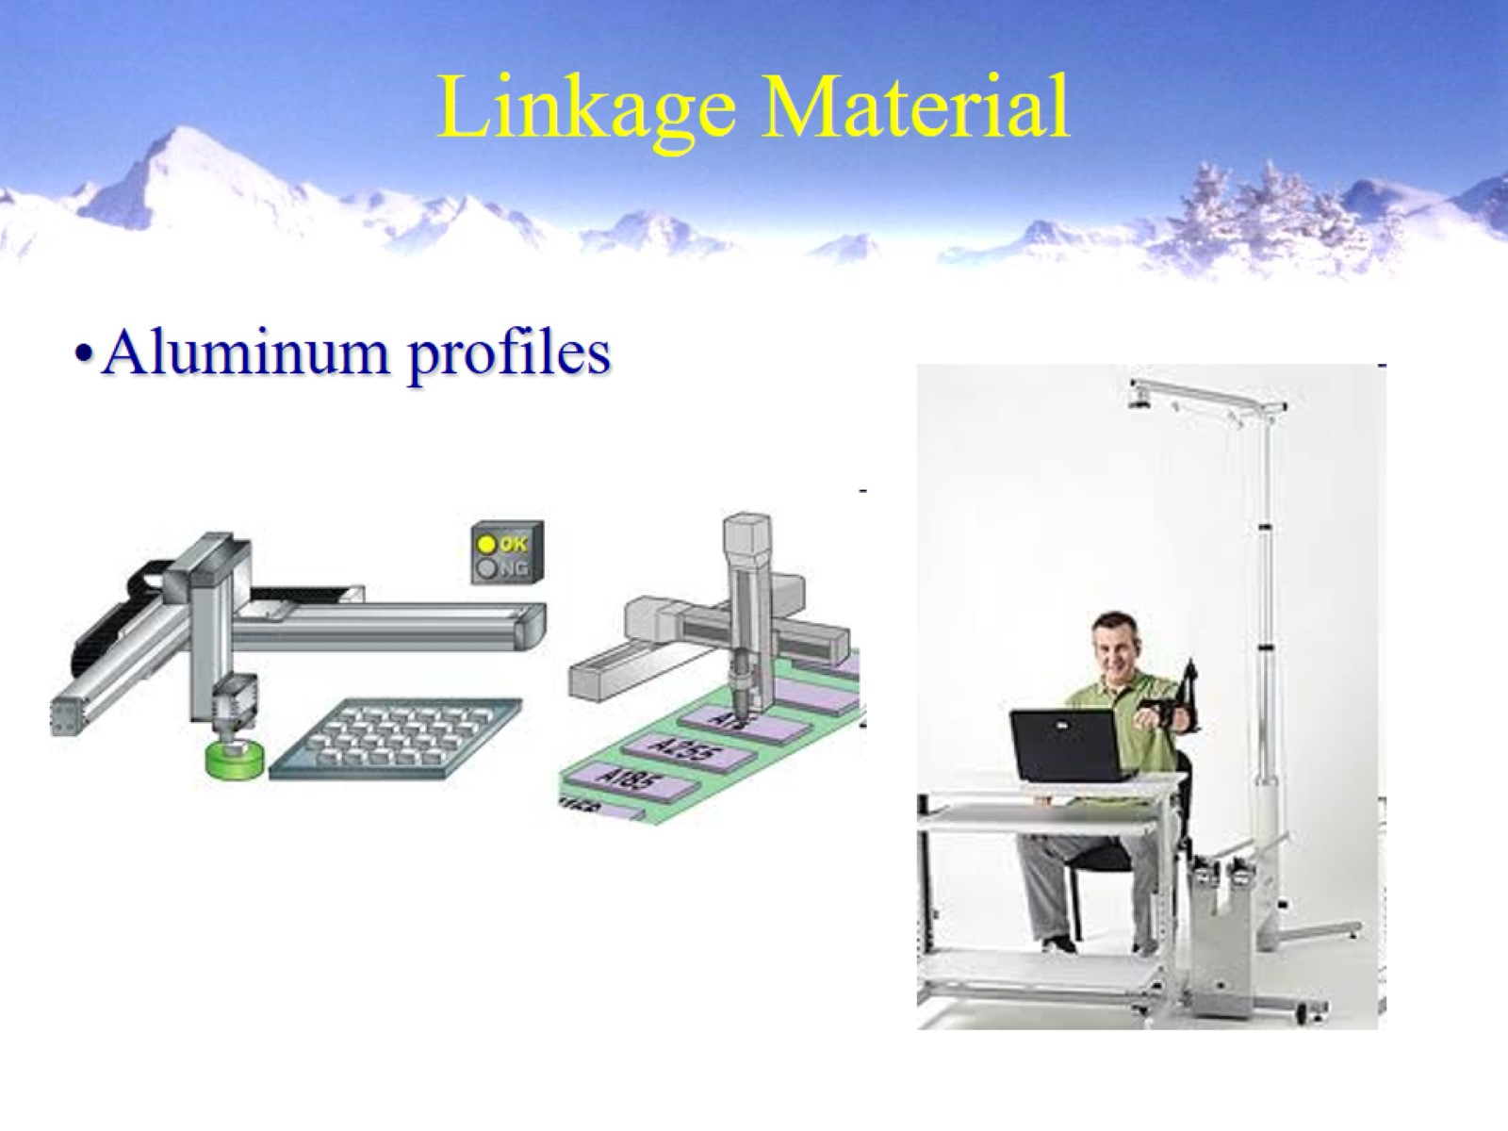
Linkage Material

Slide 24
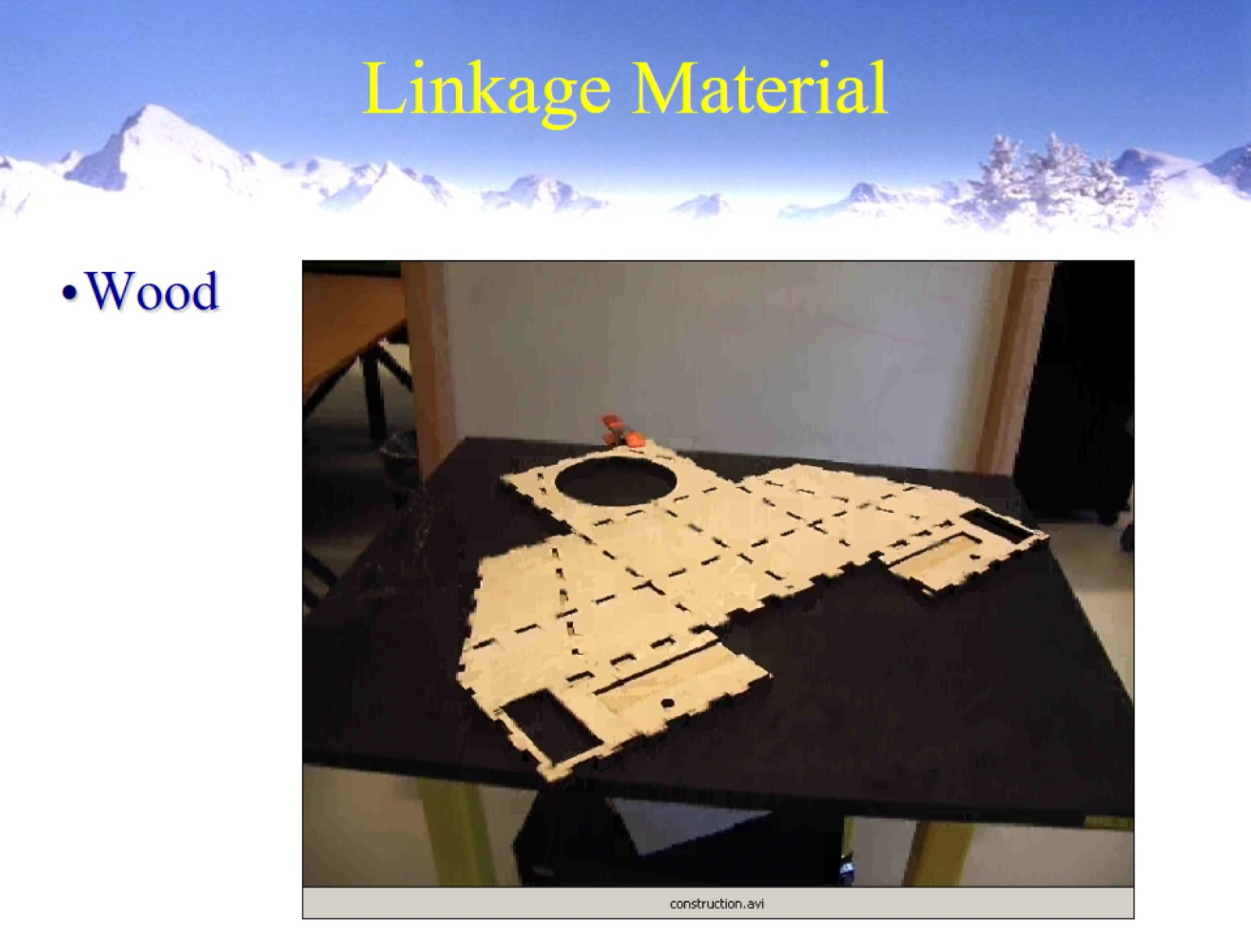
Linkage Material

Slide 25
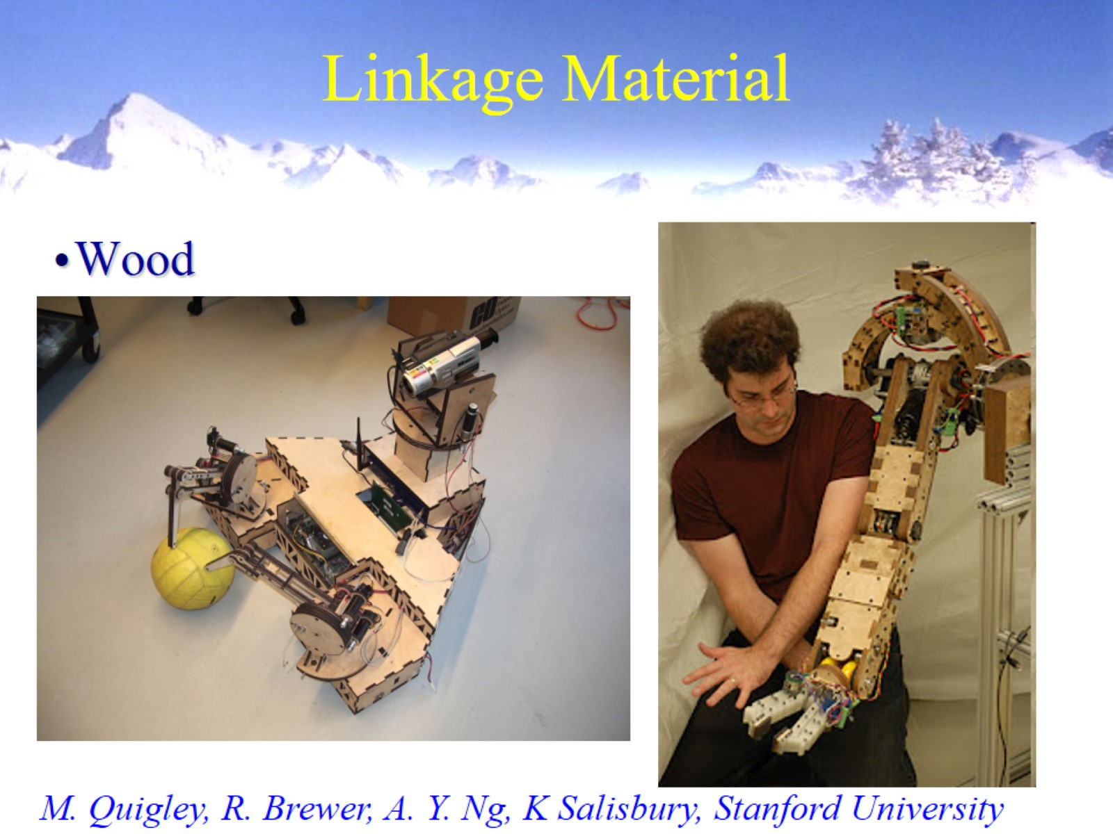
Linkage Material

Slide 26
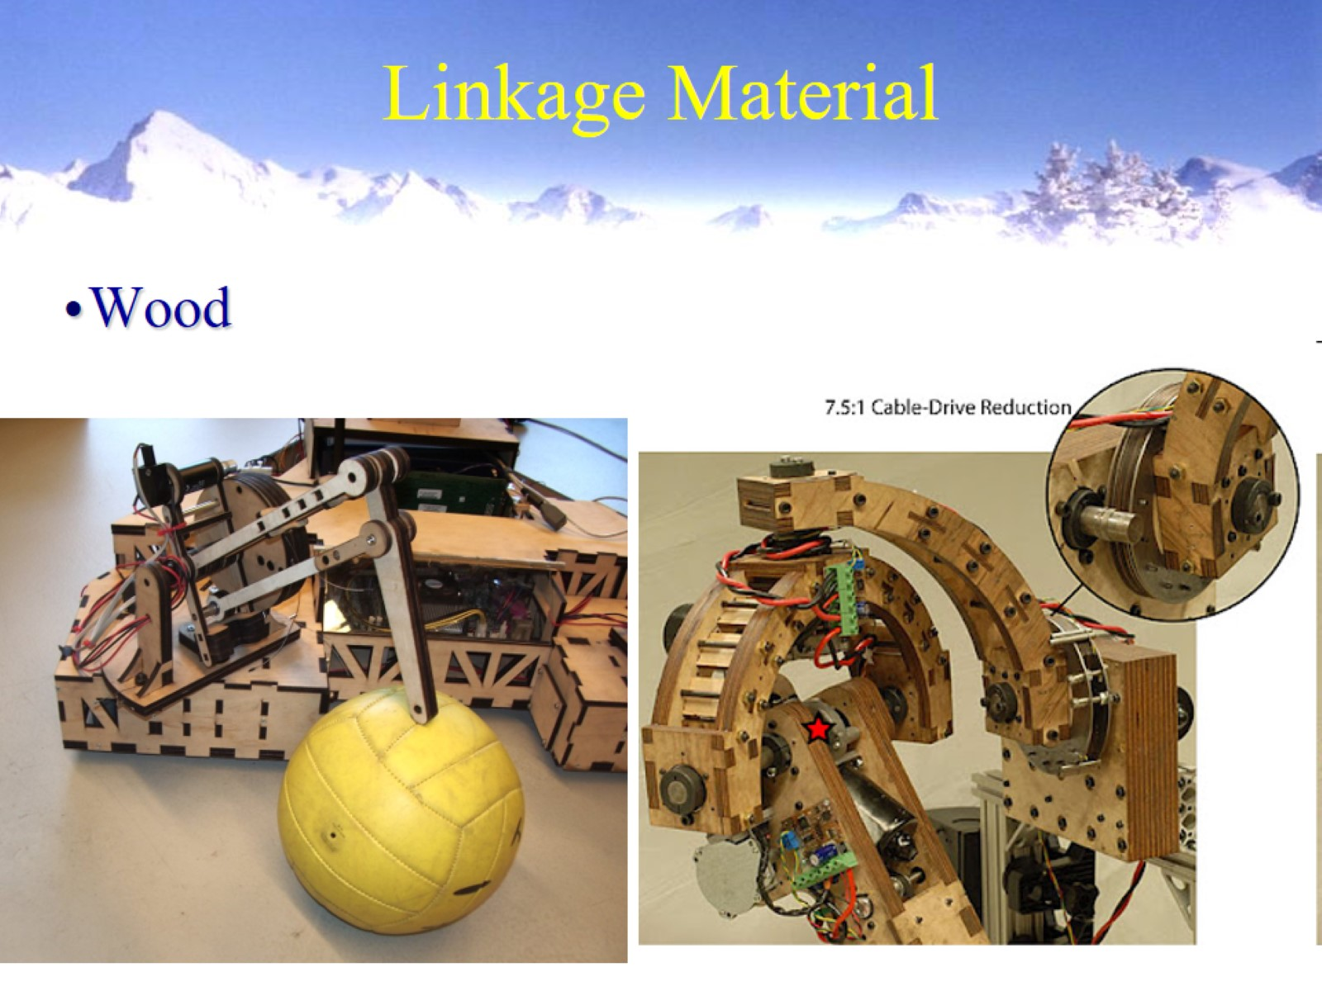
Linkage Material

Slide 27
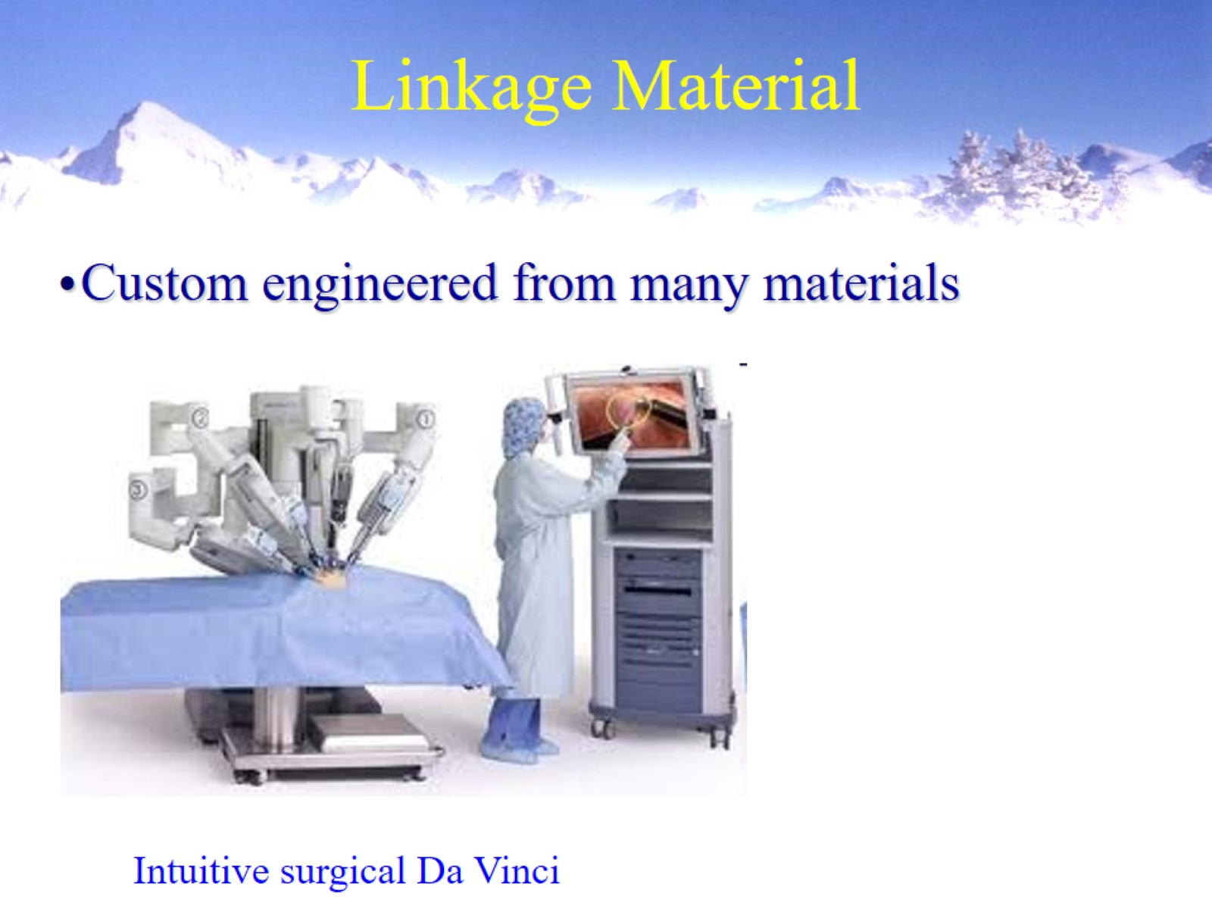
Linkage Material

Slide 28
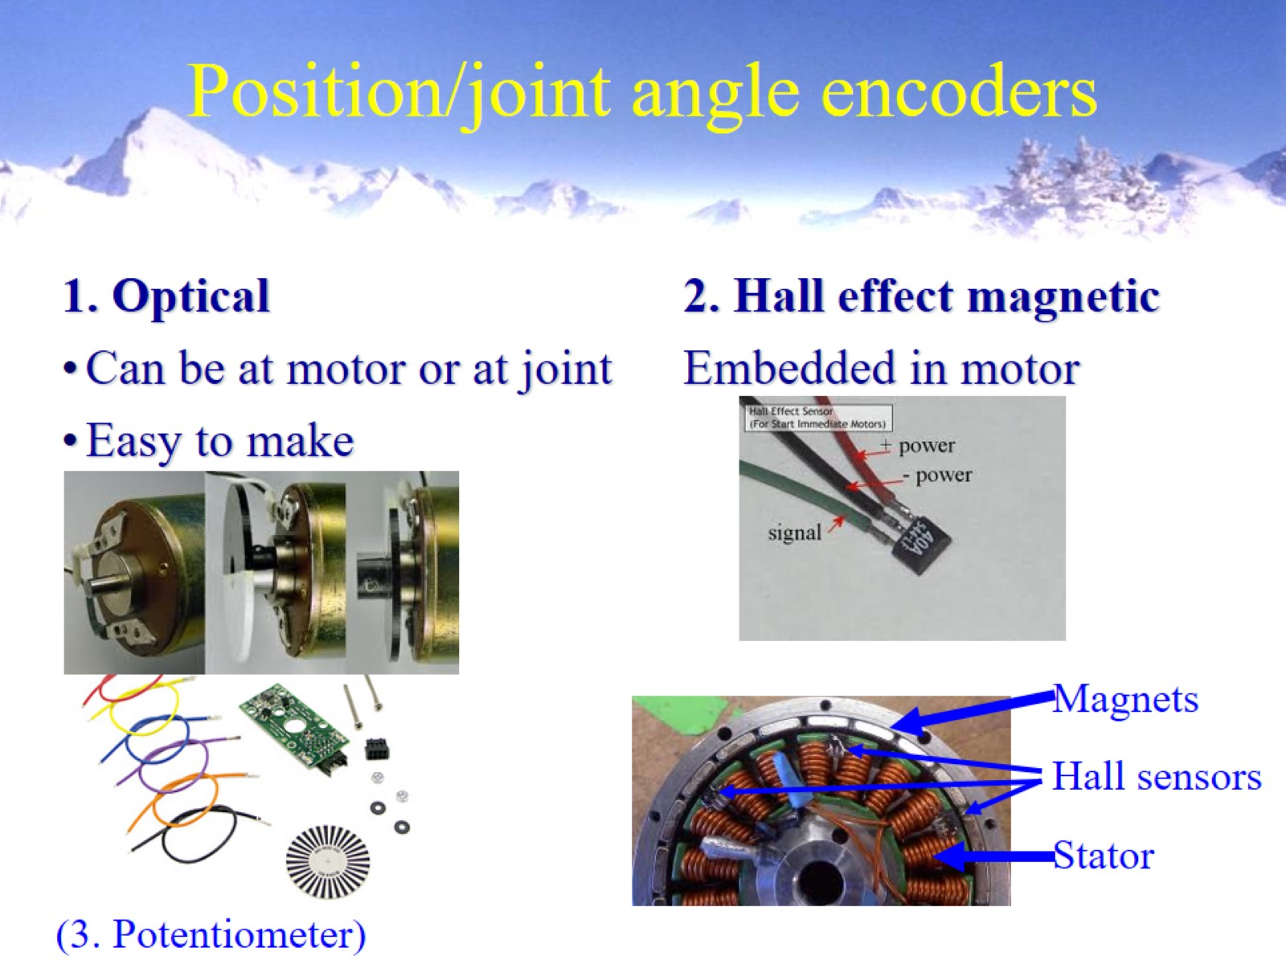
Position/joint angle encoders

Slide 29
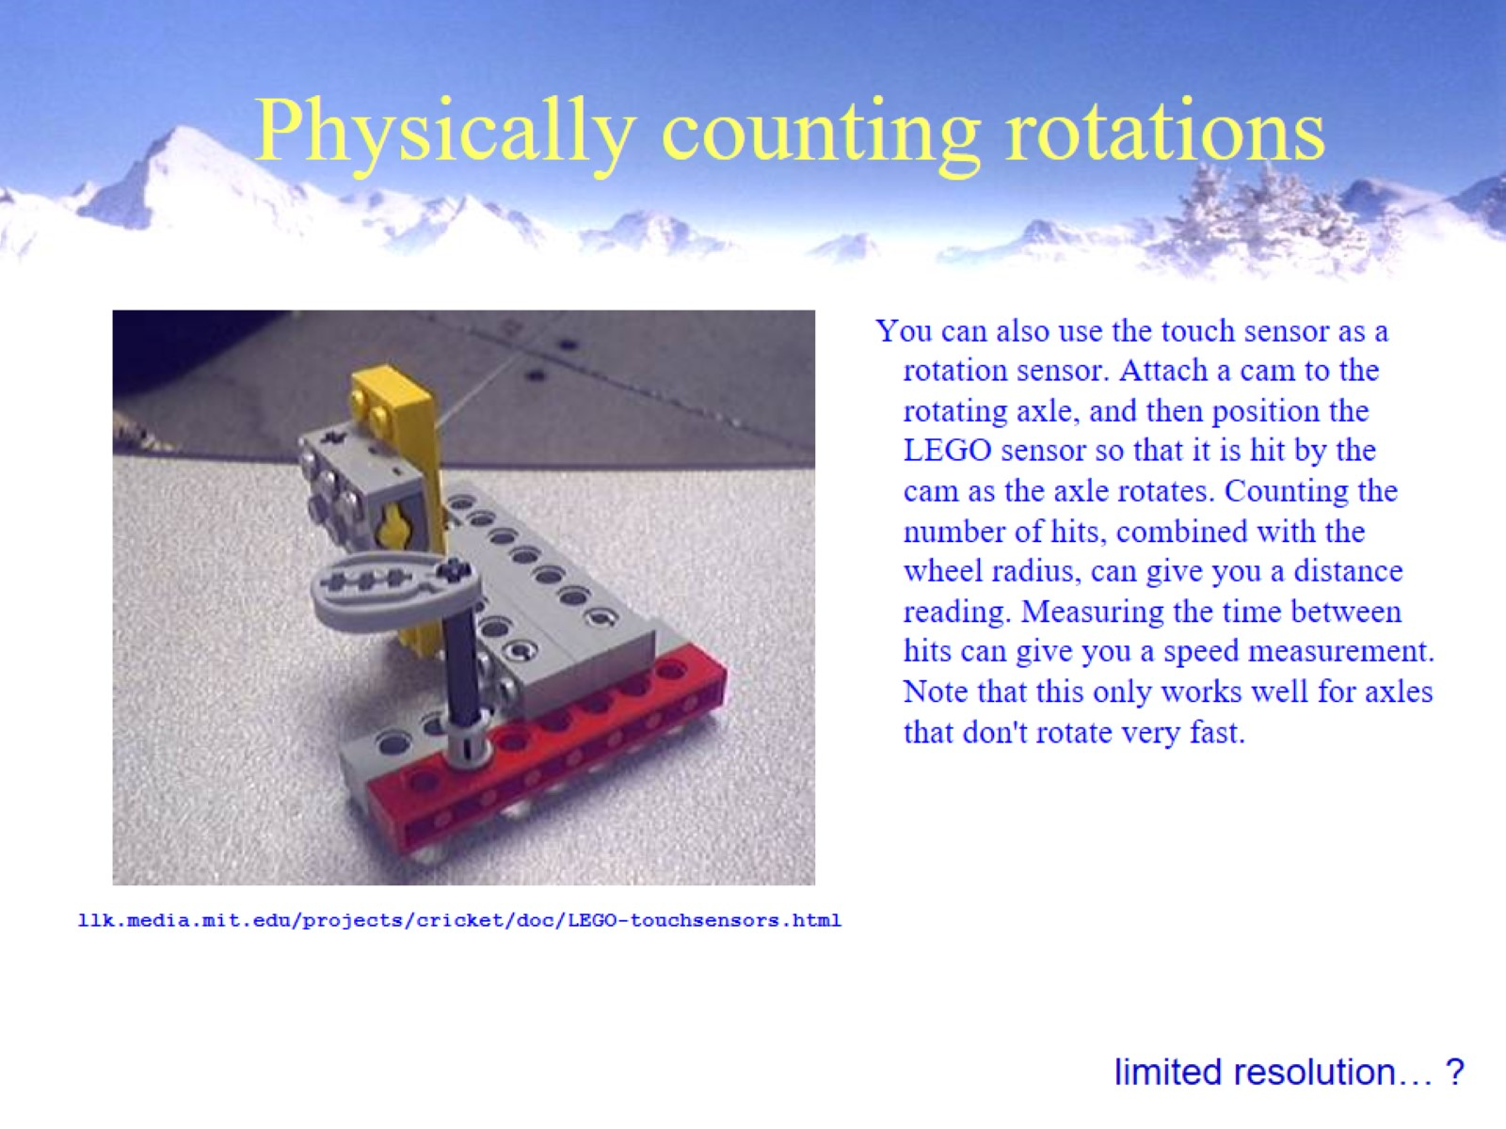
Physically counting rotations

Slide 30
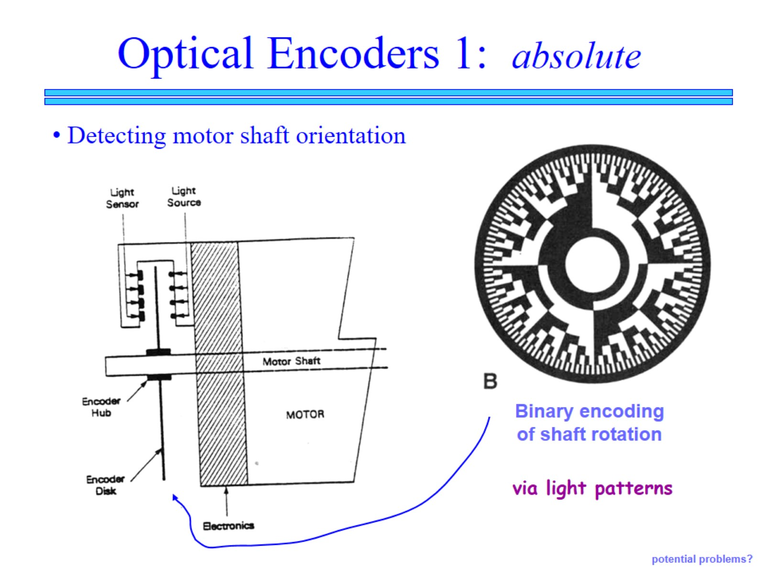

Slide 31
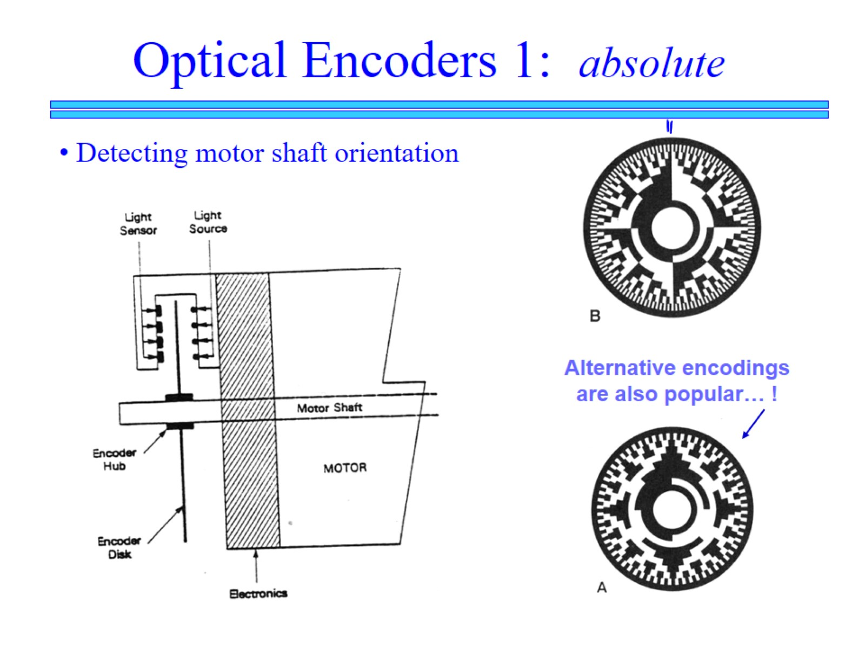

Slide 32
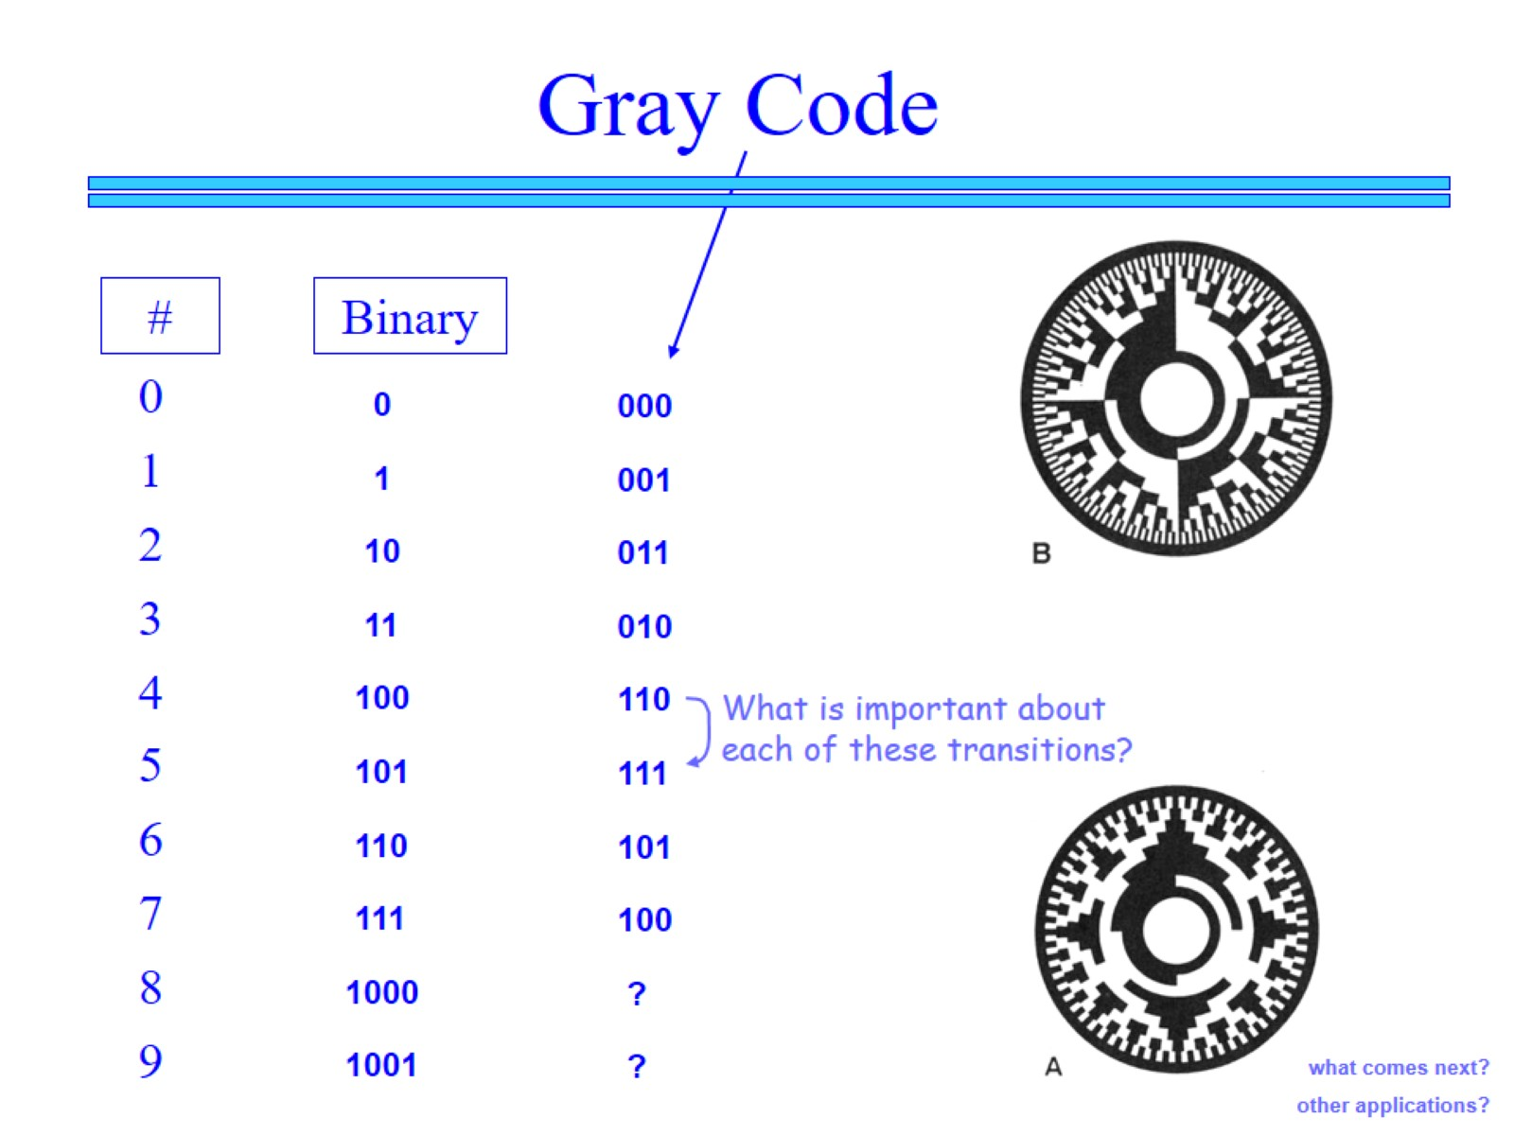

Slide 33
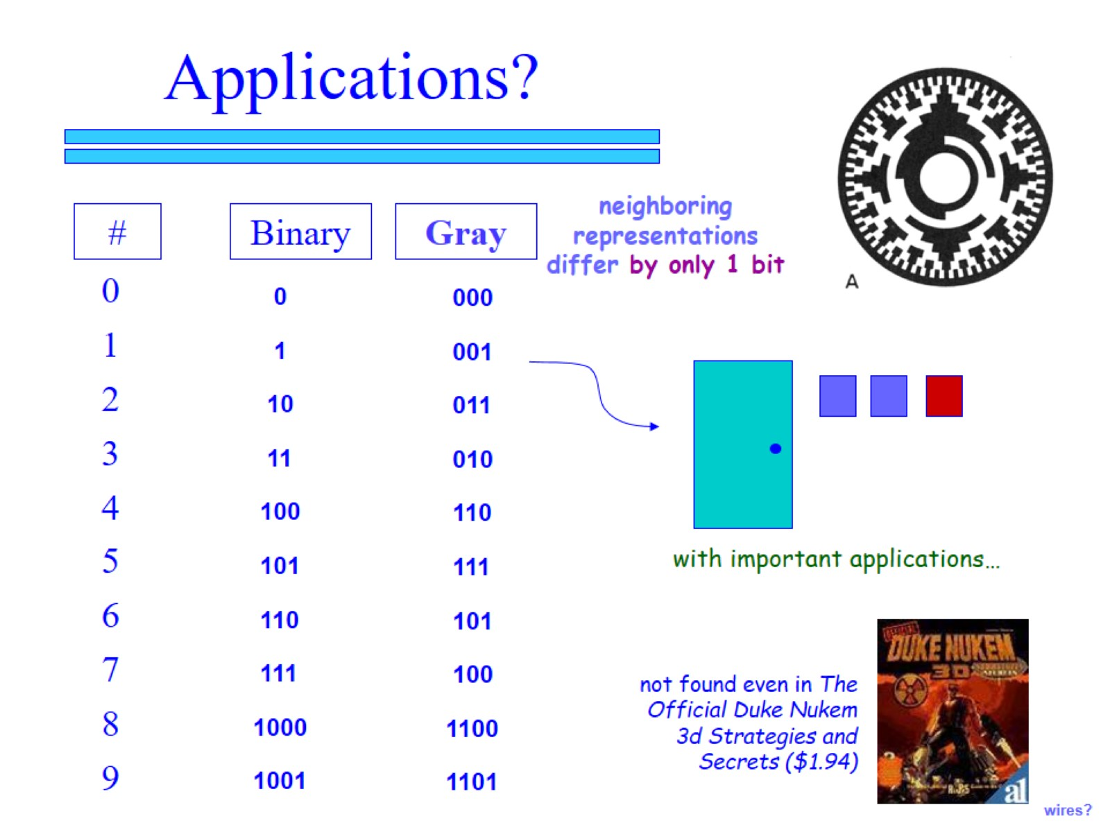

Slide 34
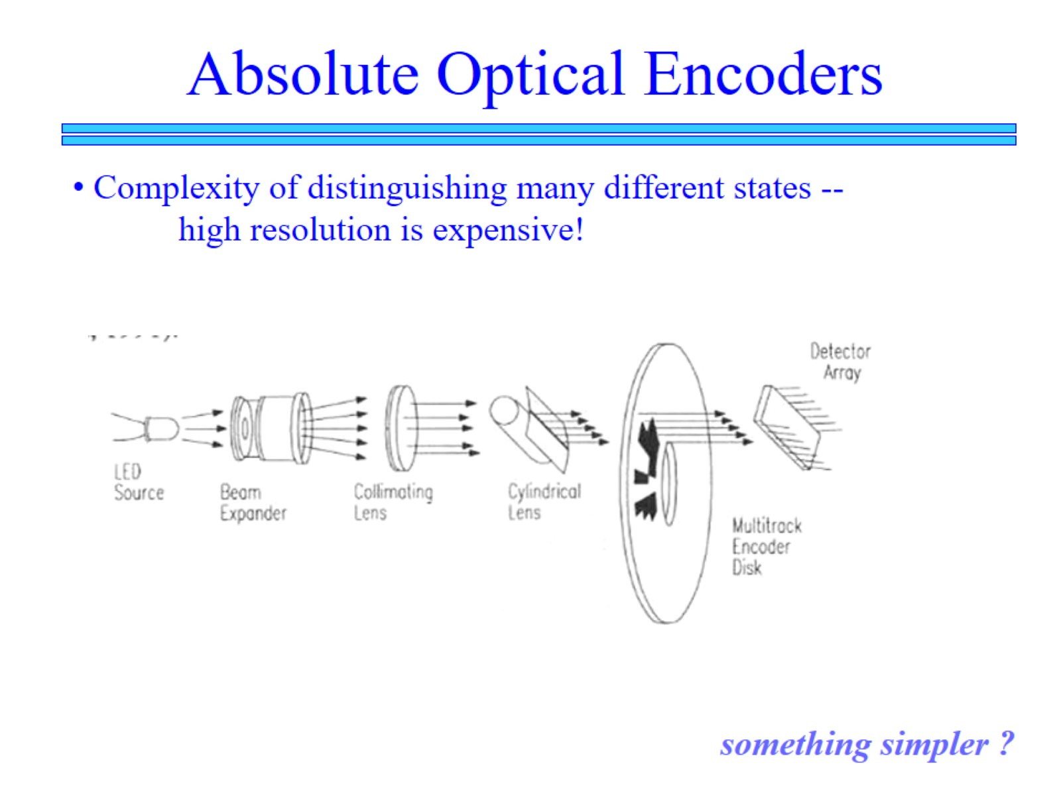

Slide 35
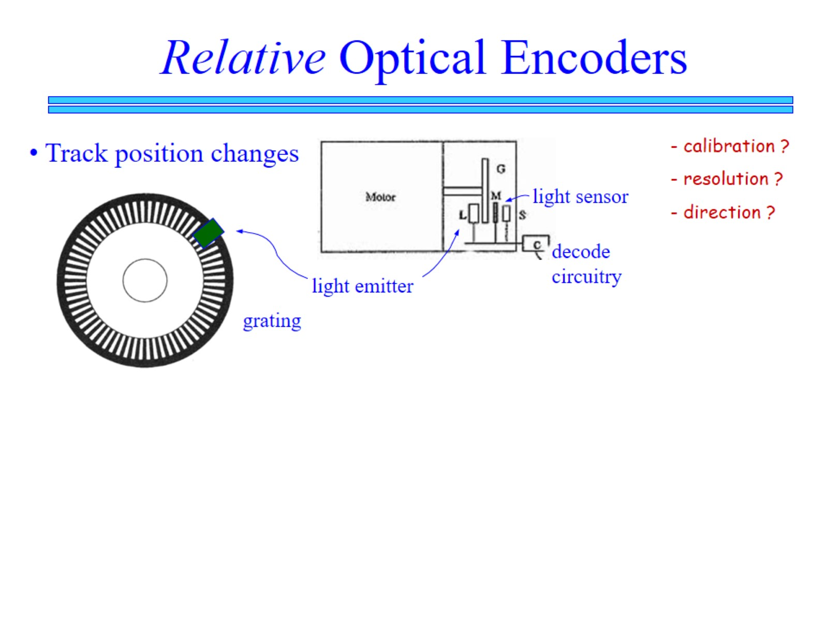

Slide 36
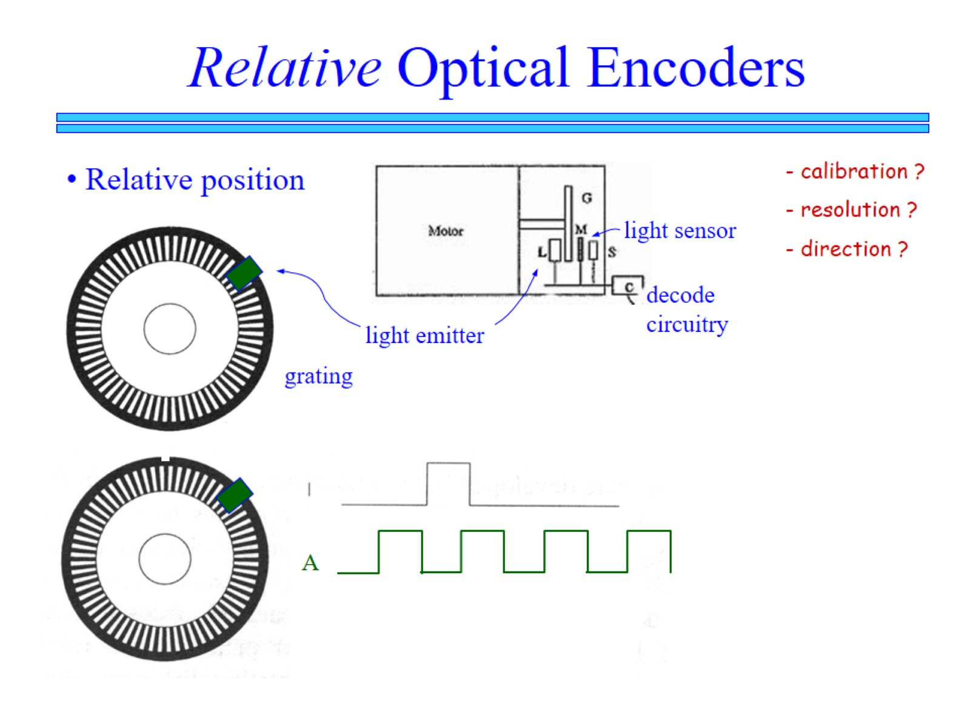

Slide 37
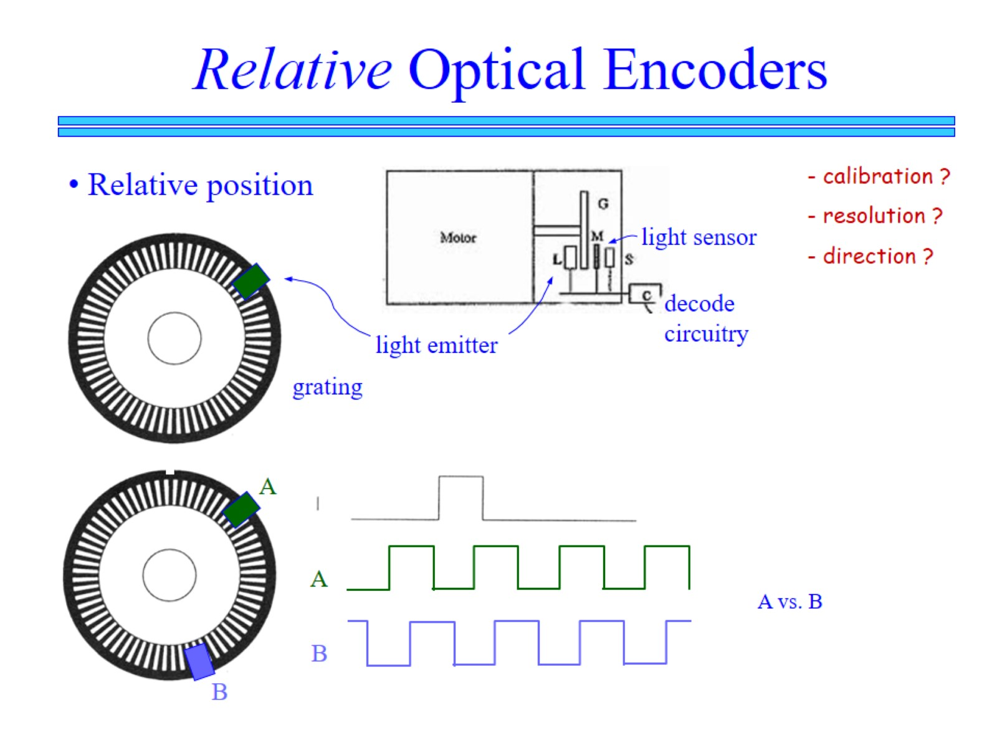

Slide 38
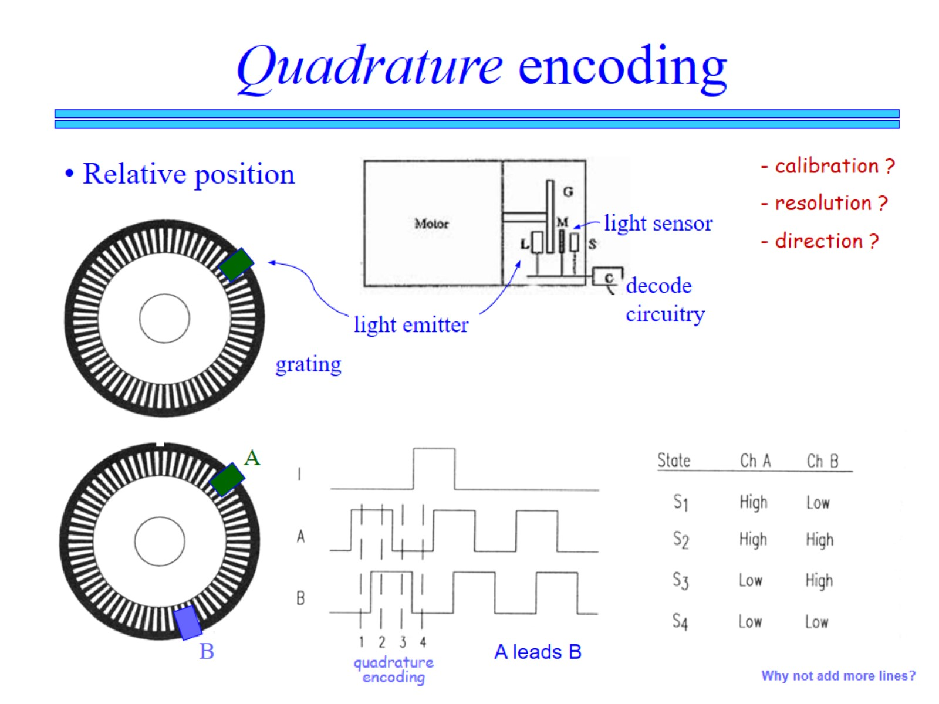

Slide 39
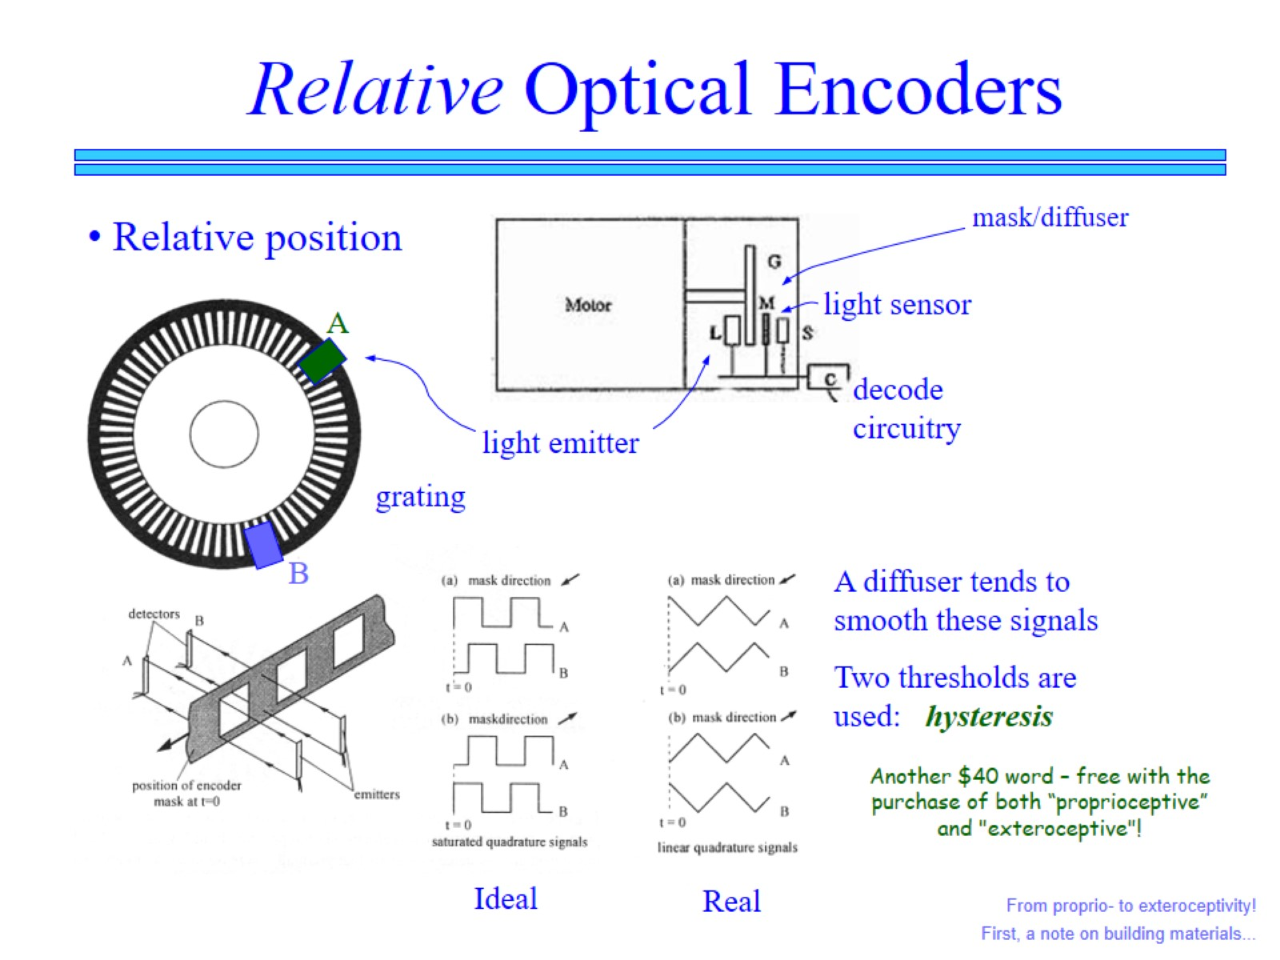

Slide 40
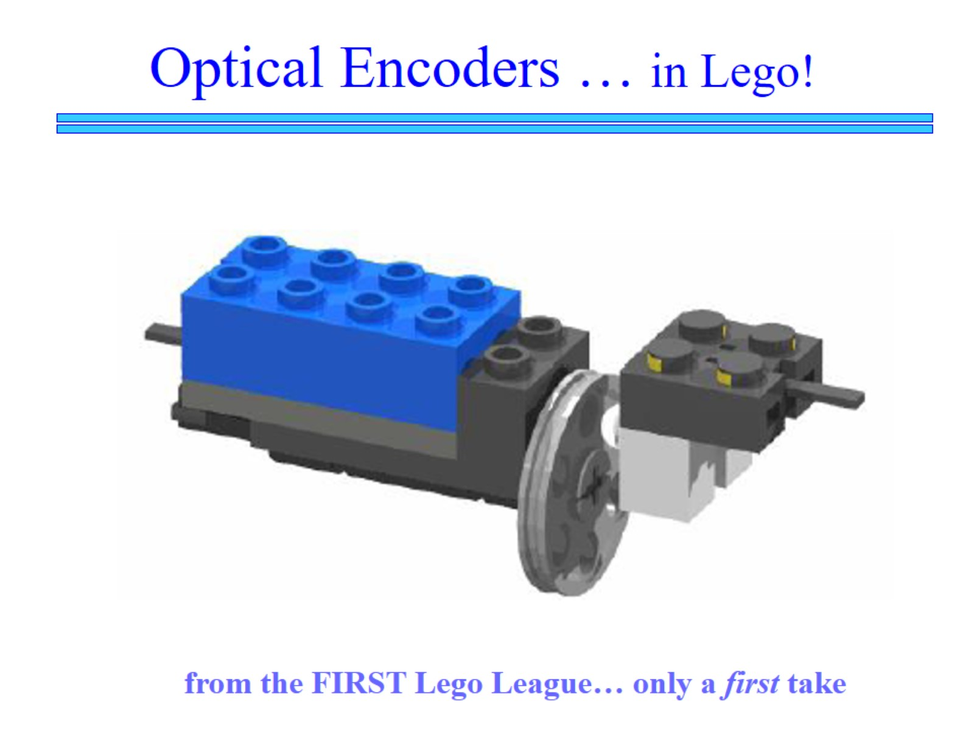

Slide 41
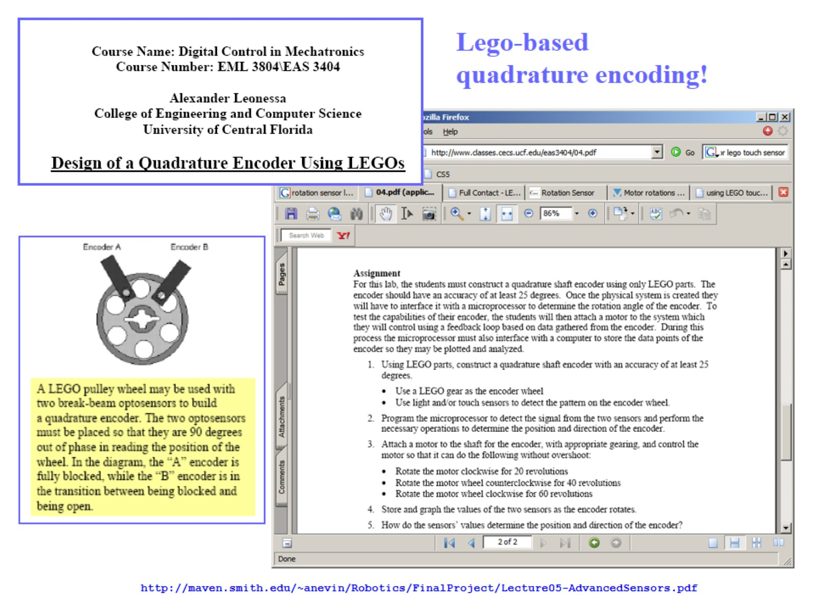

Slide 42
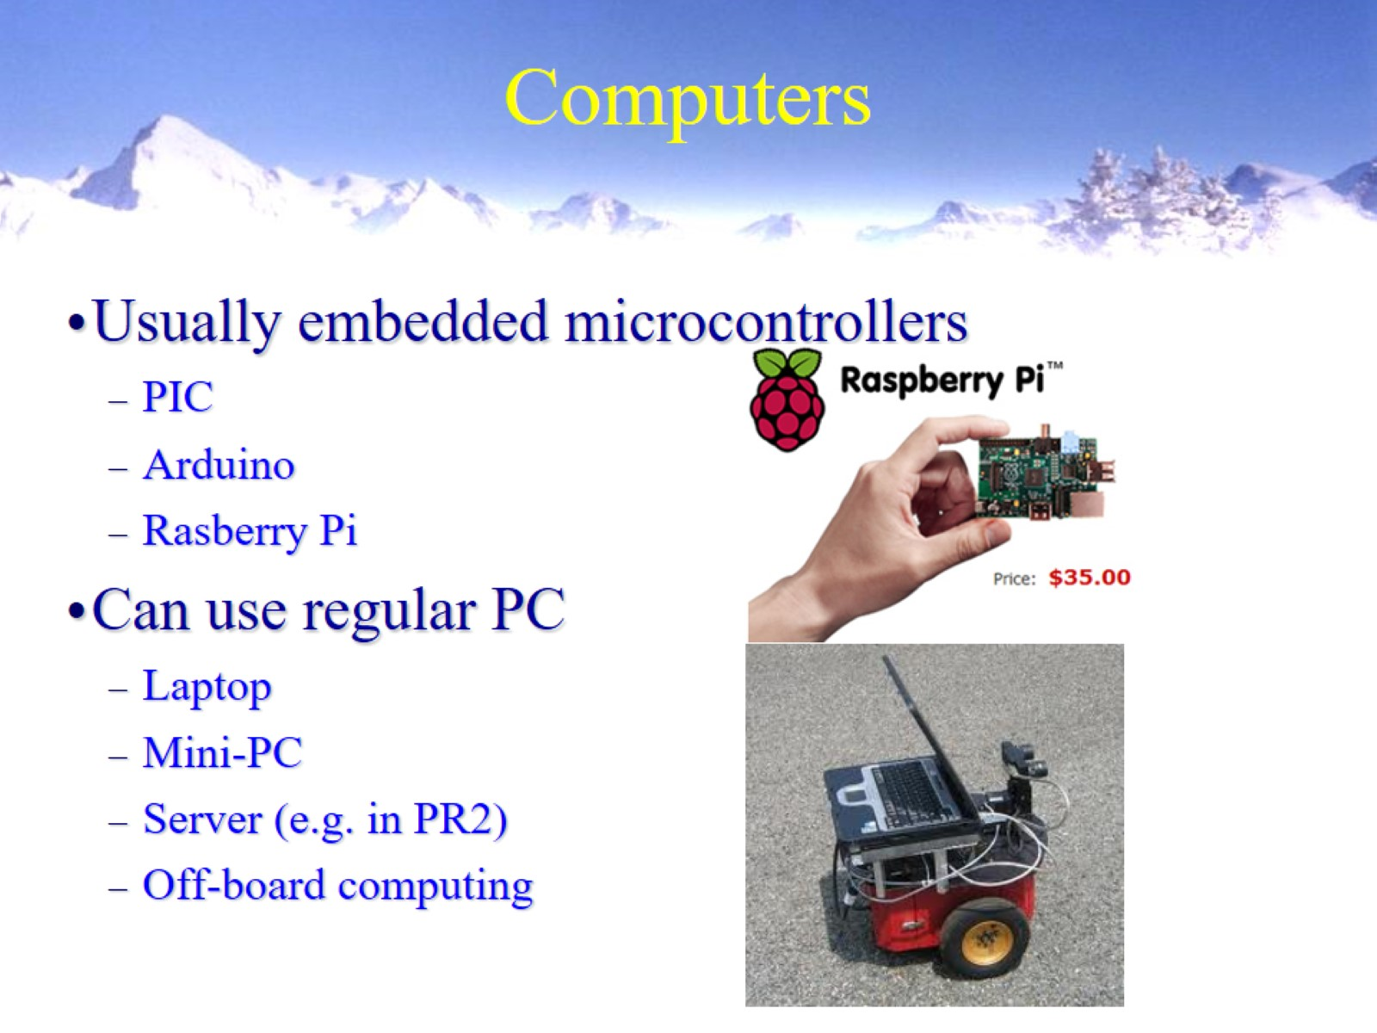
Computers

Slide 43
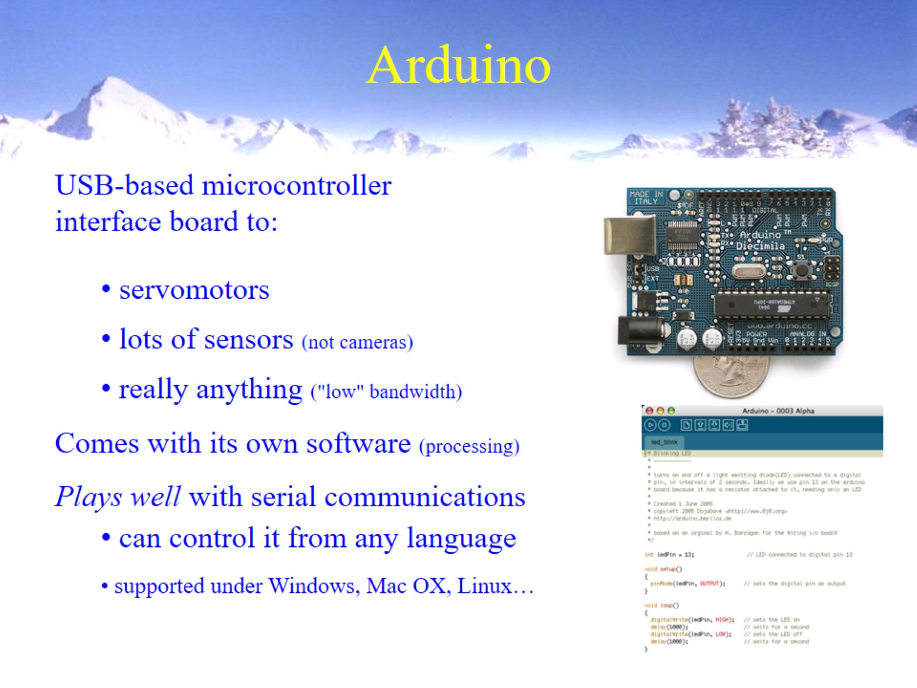
Arduino

Slide 44
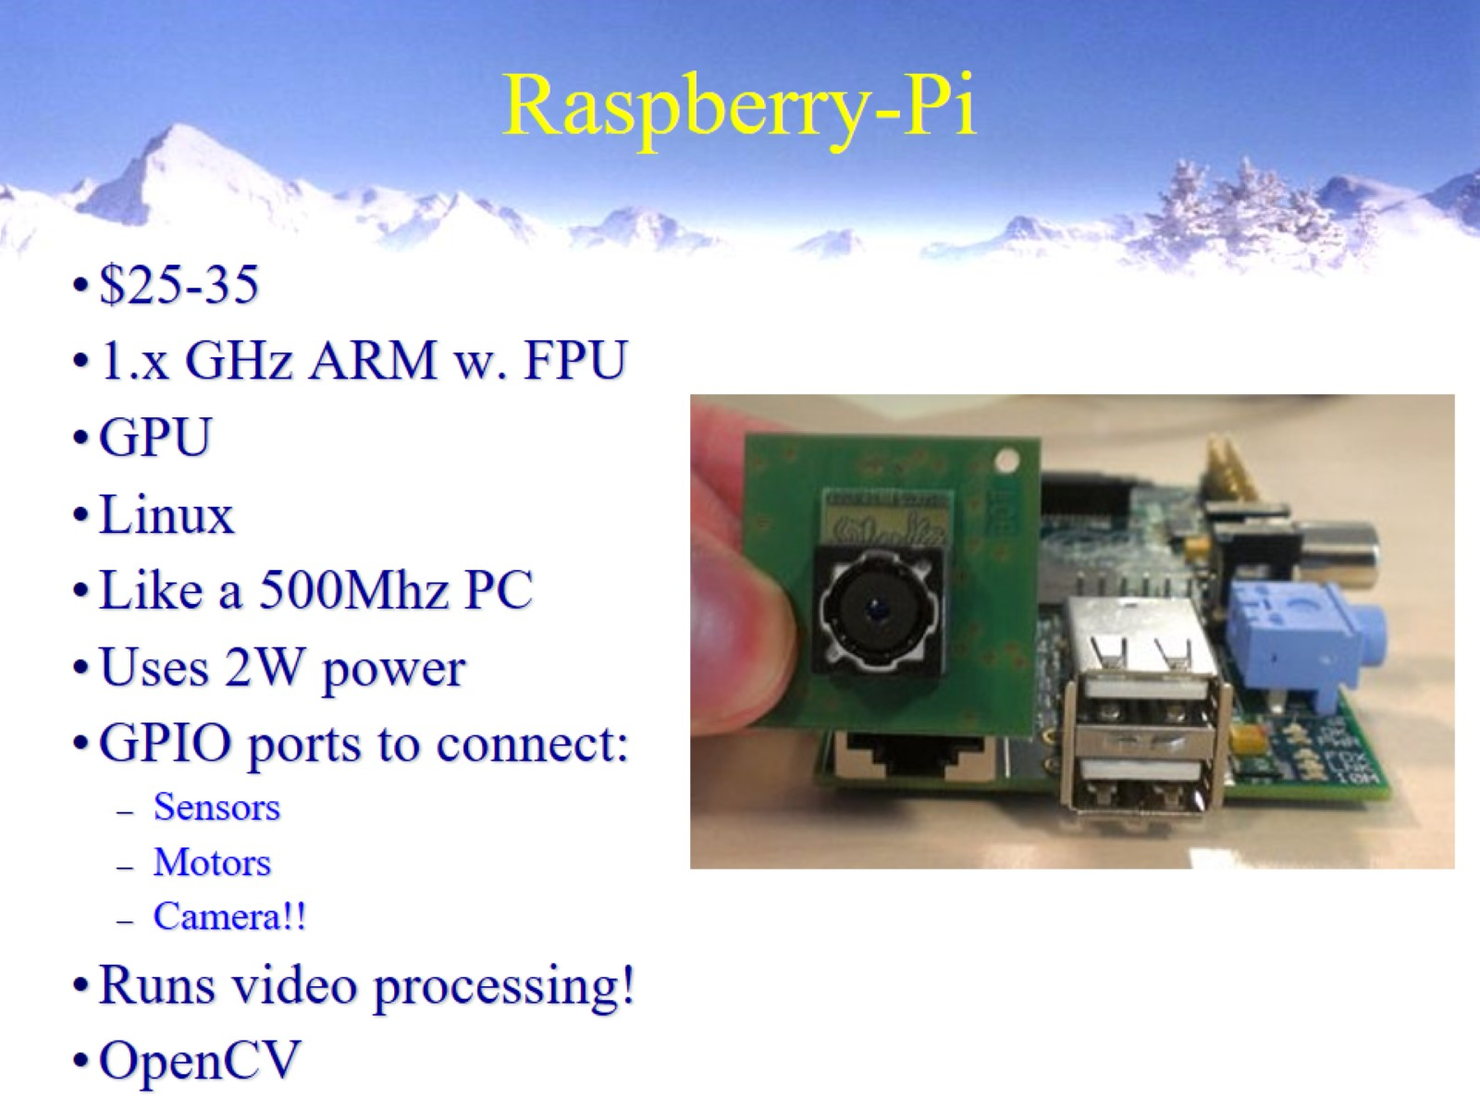
Raspberry-Pi

Slide 45
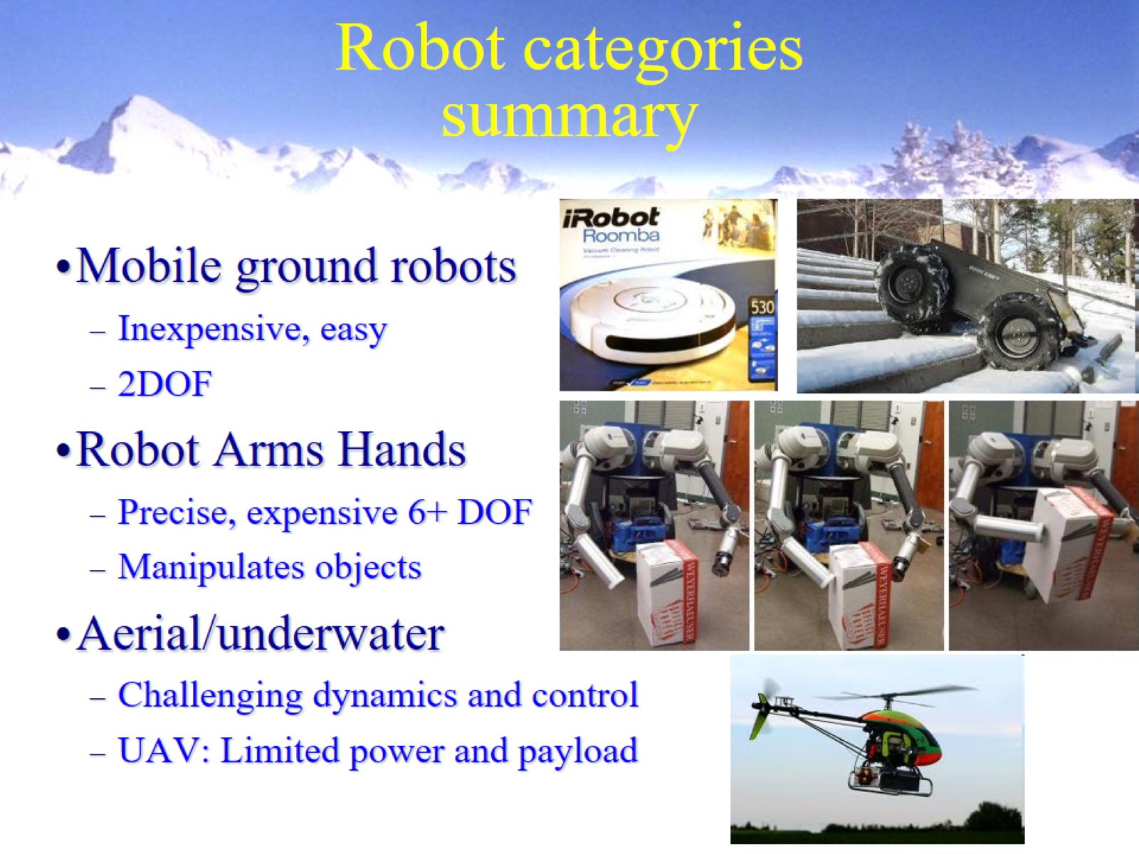
Robot categories summary

Slide 46

Summary: Parts of a Robot

Slide 47
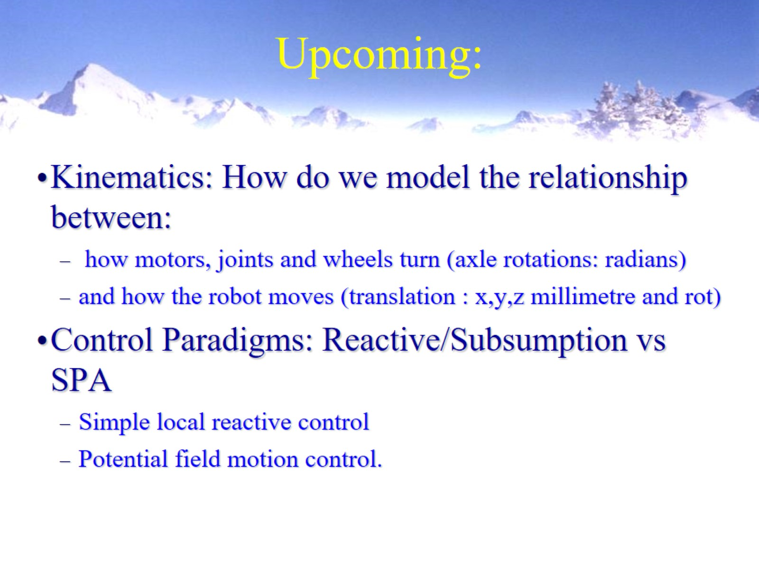
Upcoming:

Slide 48
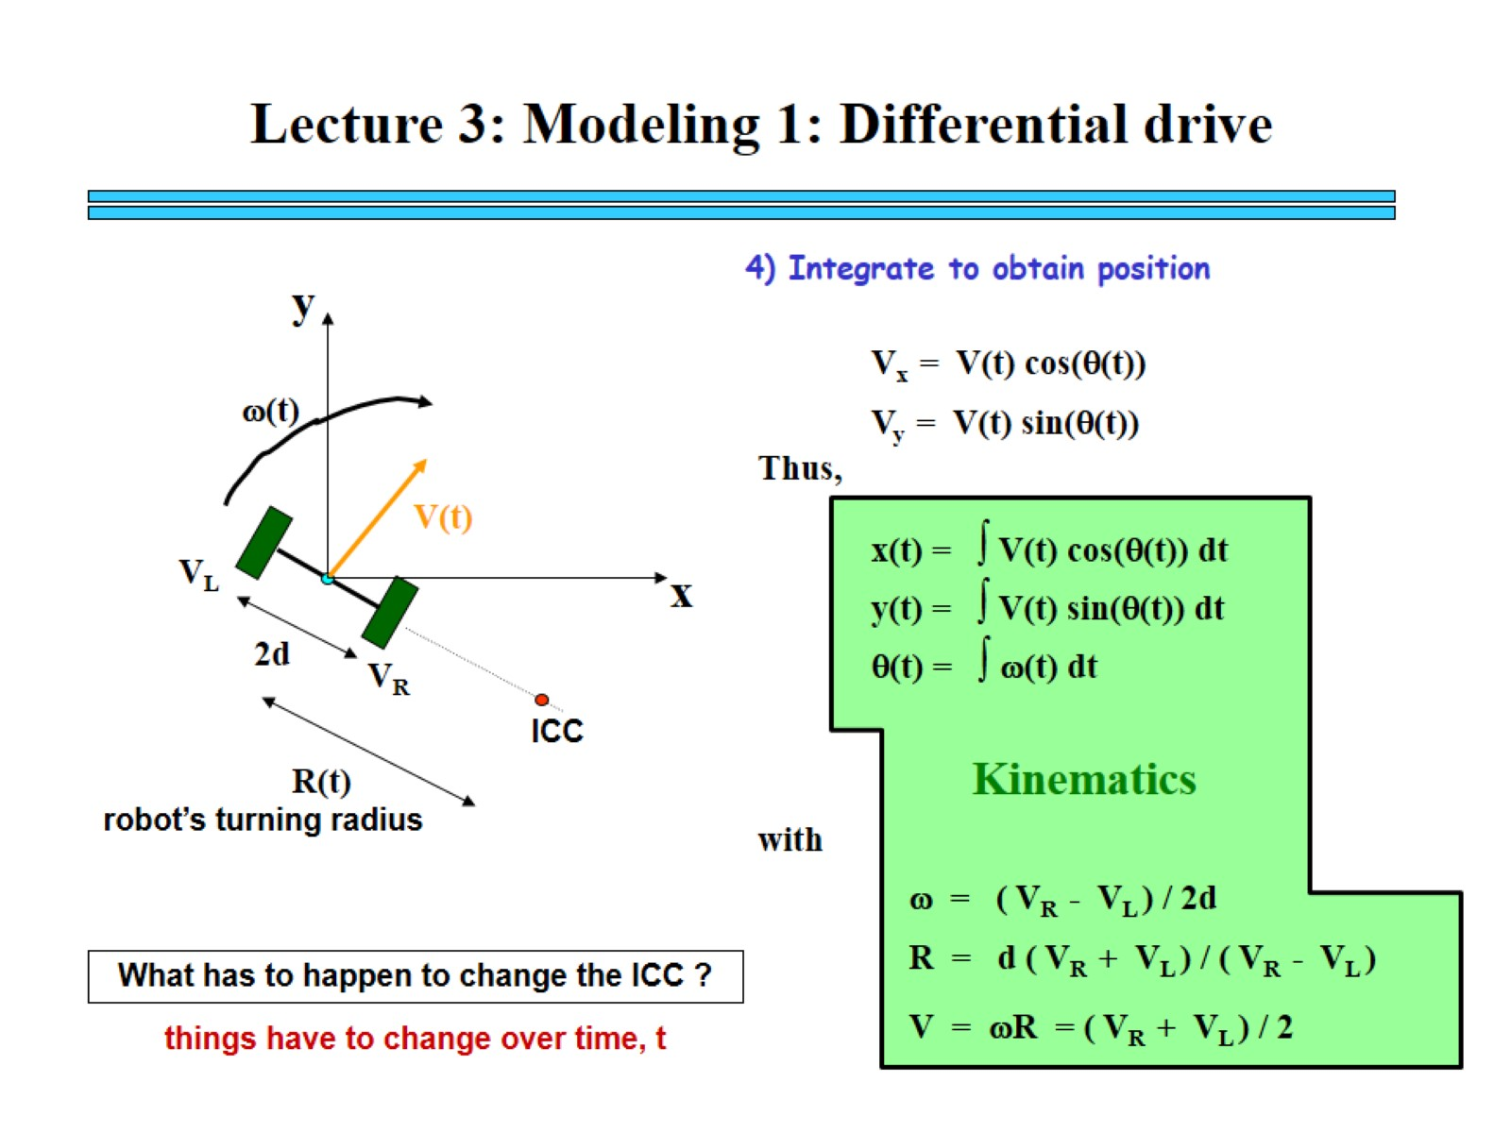

Slide 49
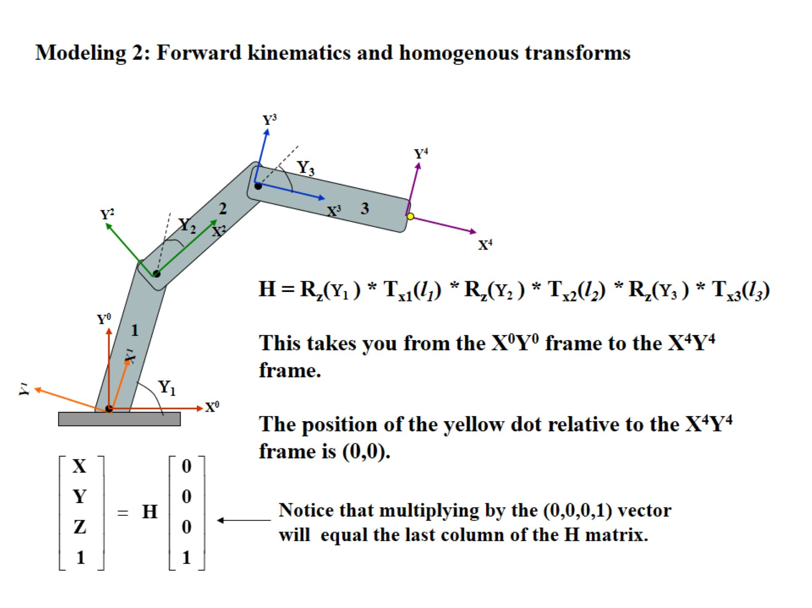

Slide 50
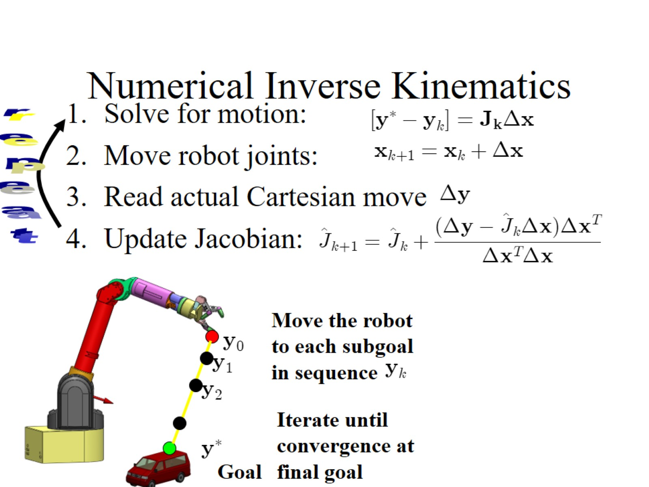
Numerical Inverse Kinematics

Slide 51
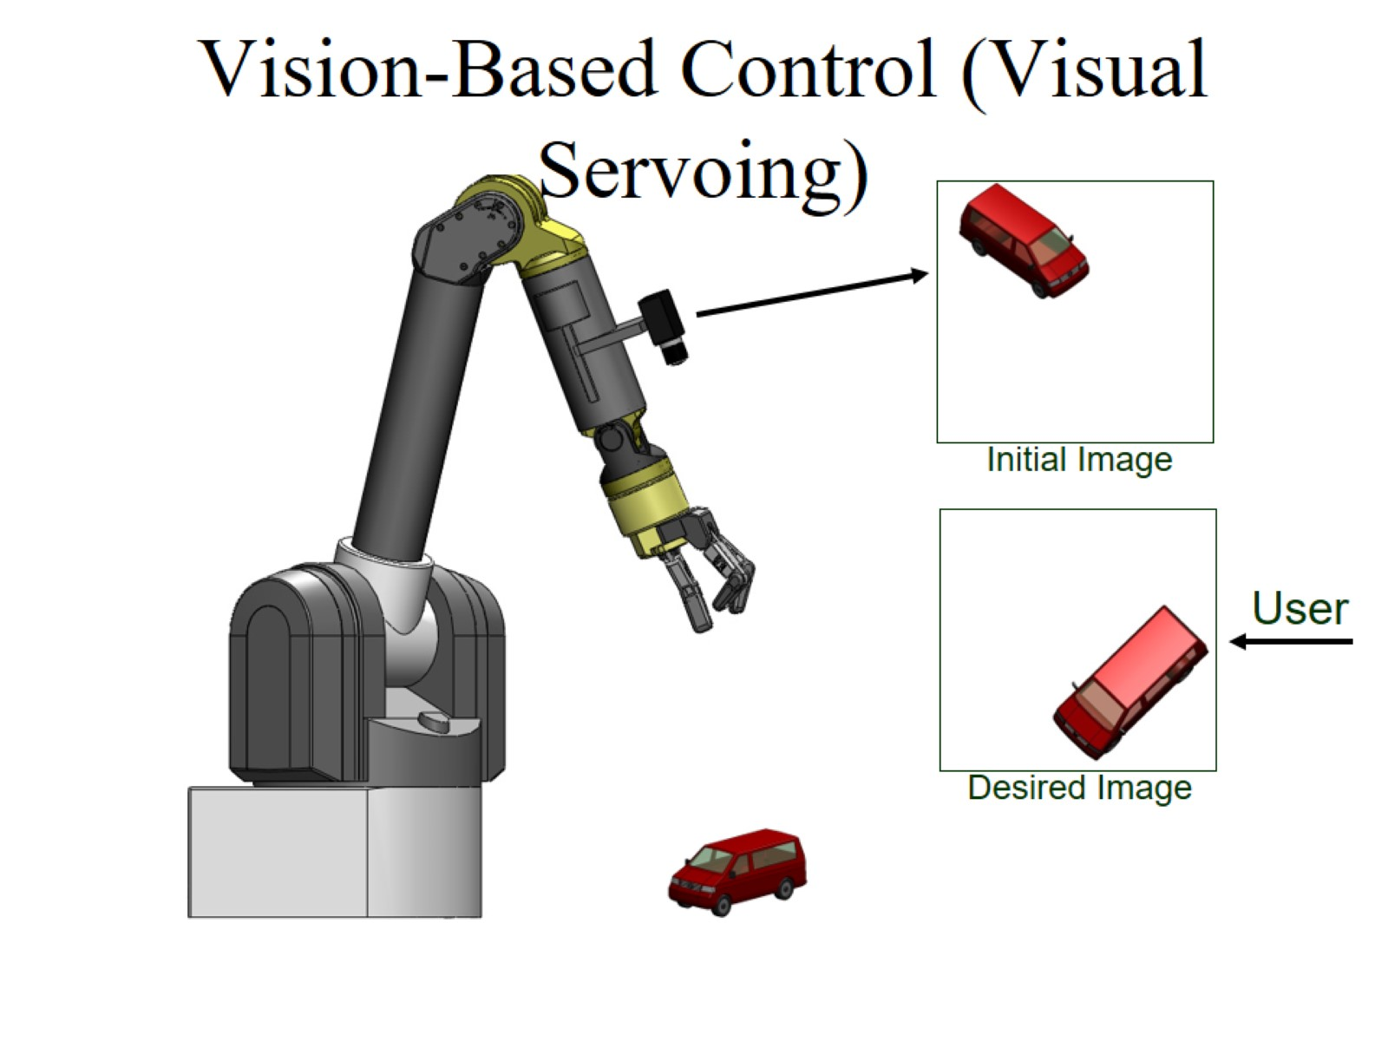
Vision-Based Control (Visual Servoing)

Slide 52
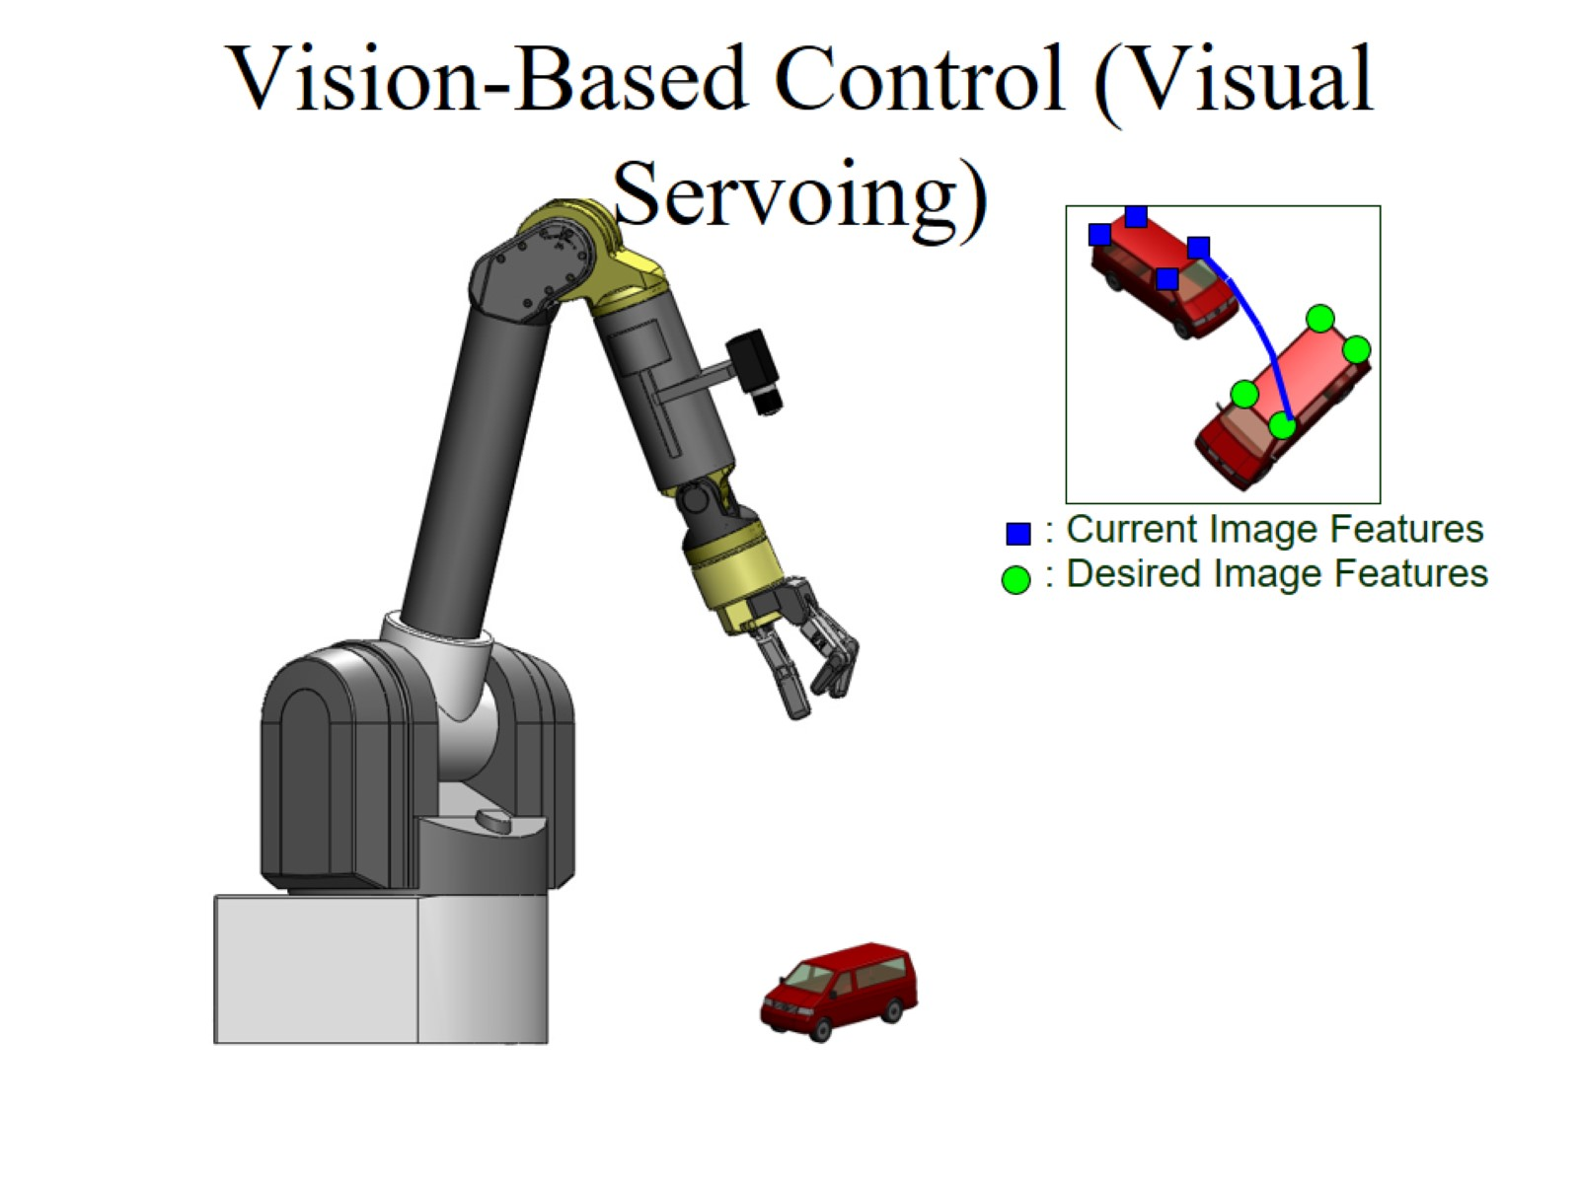
Vision-Based Control (Visual Servoing)

Slide 53

Vision-Based Control (Visual Servoing)

Slide 54

Vision-Based Control (Visual Servoing)

Slide 55

Vision-Based Control (Visual Servoing)

Slide 56

Vision-Based Control (Visual Servoing)

Slide 57

u,v Image-Space Error

Slide 58

“visual servoing” = Using 2D image geometry to control 3D robot motion from video

Slide 59


Slide 60


