Slide 1
Using 2D projective geometry to control of robot motion from video “visual servoing”
M. Jagersand

Slide 2
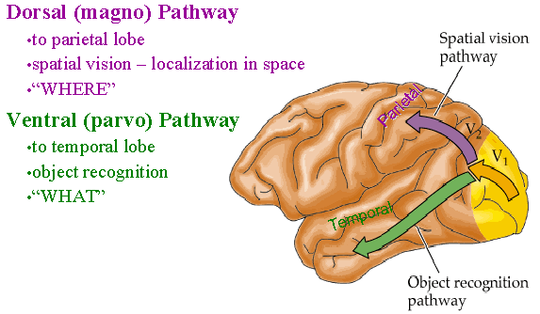
What is vision?
Two main categories
Object recognition: Use cues in 2D image
Spatial vision: Understand and invert the 3D to 2D imaging process: Two subcategories:
Full 3D scene reconstruction
Use of partial 3D information, implicitly or explicitly

Slide 3
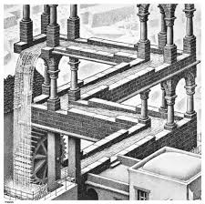
Uses of partial information from 2D-3D camera geometry
Single view measurements
Visual constraints: verify alignments, detect impossible configurations (Esher paintings)
Visual servoing
Lukas Kanade –like
Deep Learning
Visual tracking
Features instead of images
… many more

Slide 4
Geometric Cues
Vertical vanishing
point
(at infinity)
Vanishing
line
Vanishing
point
Vanishing
point

Slide 5
Estimating Height
The distance || t_{r} – b_{r} || is known
Used to estimate the height of the man in the scene

Slide 6
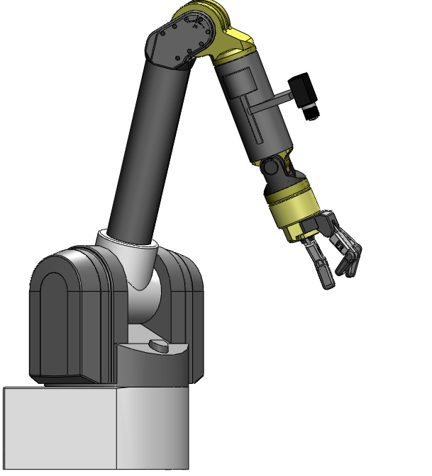
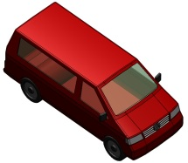
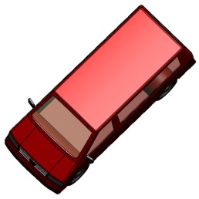
Vision-Based Control (Visual Servoing)
Initial Image
User
Desired Image

Slide 7
Vision-Based Control (Visual Servoing)
: Current Image Features
: Desired Image Features

Slide 8
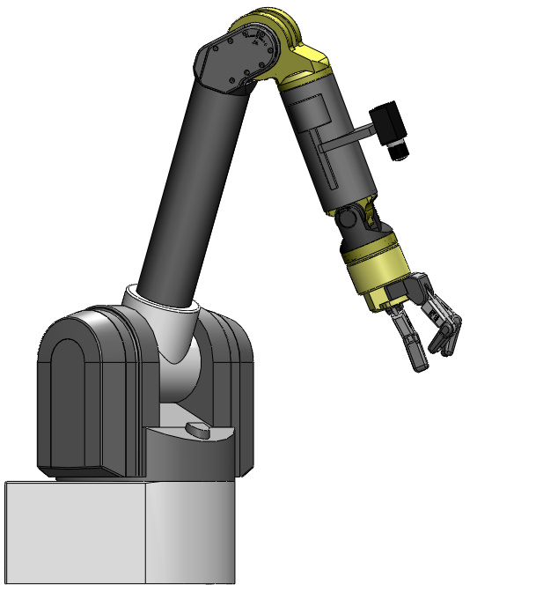
Vision-Based Control (Visual Servoing)
: Current Image Features
: Desired Image Features

Slide 9
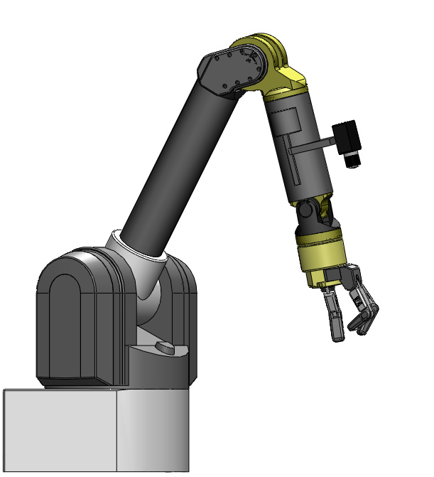
Vision-Based Control (Visual Servoing)
: Current Image Features
: Desired Image Features

Slide 10
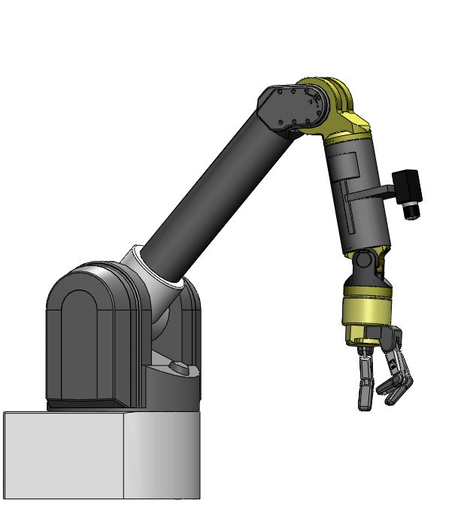
Vision-Based Control (Visual Servoing)
: Current Image Features
: Desired Image Features

Slide 11
Vision-Based Control (Visual Servoing)
: Current Image Features
: Desired Image Features

Slide 12
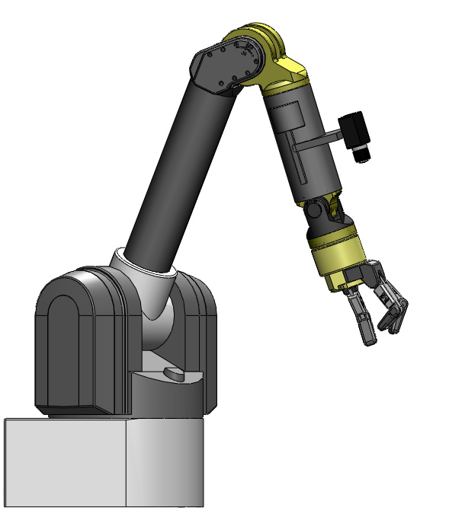
u,v Image-Space Error
v
u
: Current Image Features
: Desired Image Features
One point
Pixel coord
Many points
Notes:
Error vectors in image space -> composed total error vector

Slide 13
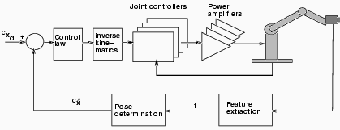
Conventional Robotics: Motion command in base coord
EE
We focus on the geometric transforms

Slide 14
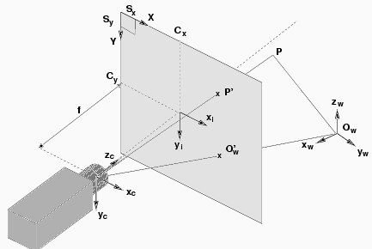
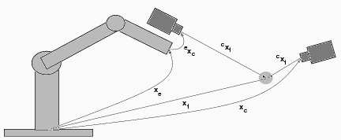
Problem: Lots of coordinate frames to calibrate
Camera
Center of projection
Different models
Robot
Base frame
End-effector frame
Object

Slide 15
Image Formation is Nonlinear
Camera
frame

Slide 16
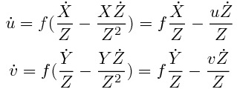
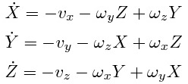
Camera Motion to Feature Motion
Camera
frame

Slide 17
Camera Motion to Feature Motion
This derivation is
for one point.
Q. How to extend
to more points?
Q. How many
points needed?
Interaction matrix is a Jacobian.
Notes:
Needs a-priori f and Z

Slide 18
Problem: Lots of coordinate frames to calibrate
Robot
Base frame
End-effector frame
Object
Camera
Center of projection
Different models
Only covered one transform!

Slide 19
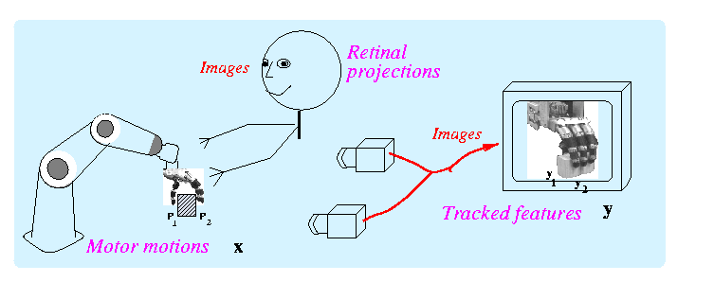
Other (easier) solution: Image-based motion control
Achieving 3d tasks
via
2d image control
Motor-Visual function: y=f(x)
Notes:
Use notes: Motivation from motion estimation.

Slide 20
Other (easier) solution: Image-based motion control
Note: What follows will work for one or two (or 3..n) cameras. Either fixed or on the robot.
Here we will use two cam
Achieving 3d tasks
via
2d image control
Motor-Visual function: y=f(x)

Slide 21
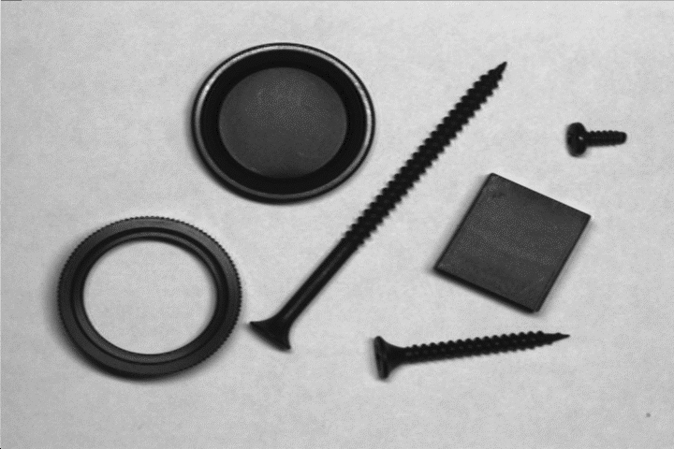
Simplest case: 2D planar world and aligned camera
This method is commonly used in industry machine vision
Usually overhead camera pointing straight down on a work table
Adjust cam position so pixel [u,v] = s[X,Y]. s = scalefactor (pix/mm)
Pixel coordinates are scaled world coord
Y
v
X
u
Camera
Thresholded image
Robot scene

Slide 22
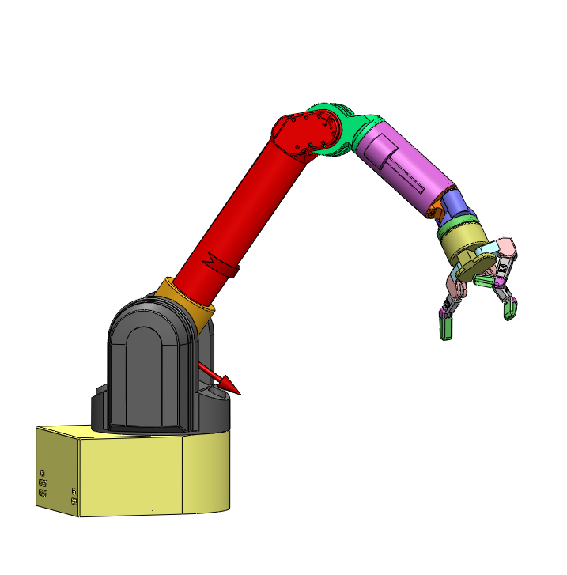
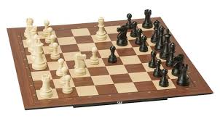
My first robotics problem

Slide 23
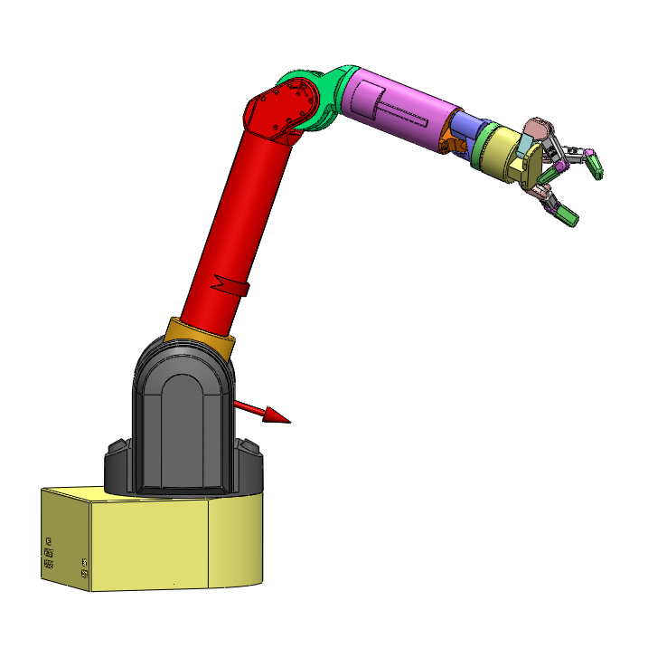
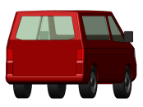
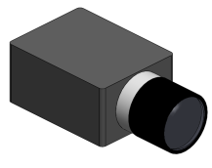
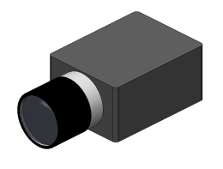
Vision-Based Control
Image 1
Image 2

Slide 24
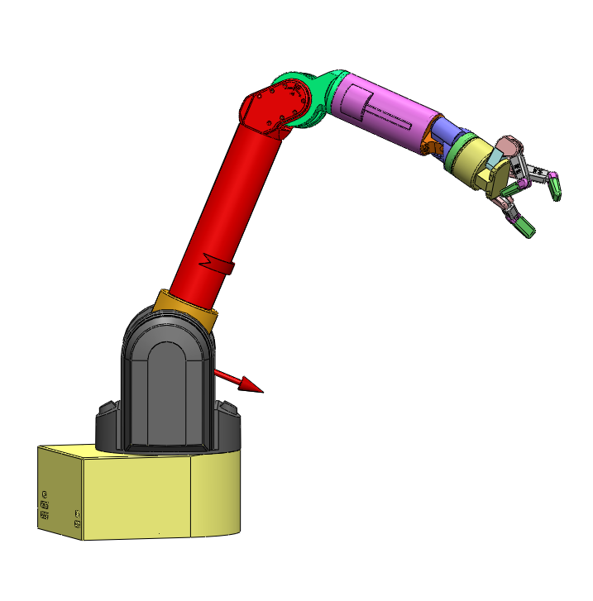
Vision-Based Control
Image 1
Image 2

Slide 25
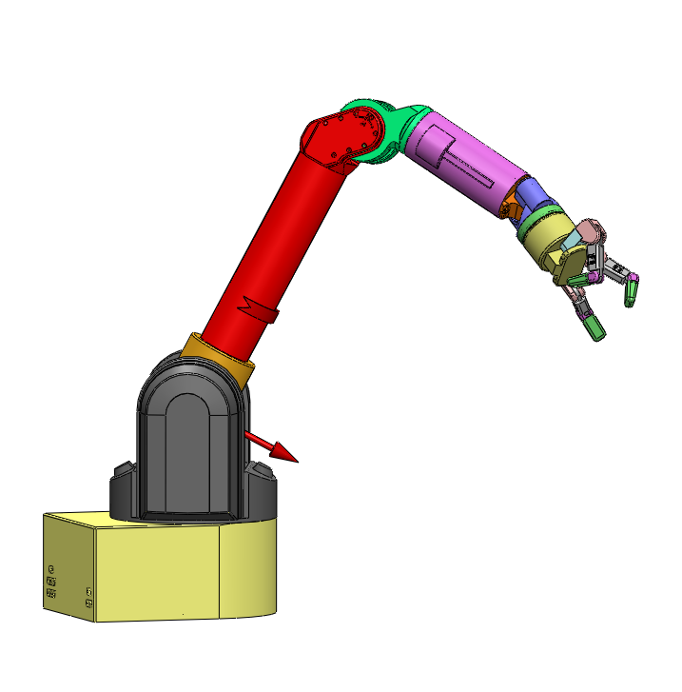
Vision-Based Control
Image 1
Image 2

Slide 26
Vision-Based Control
Image 1
Image 2

Slide 27
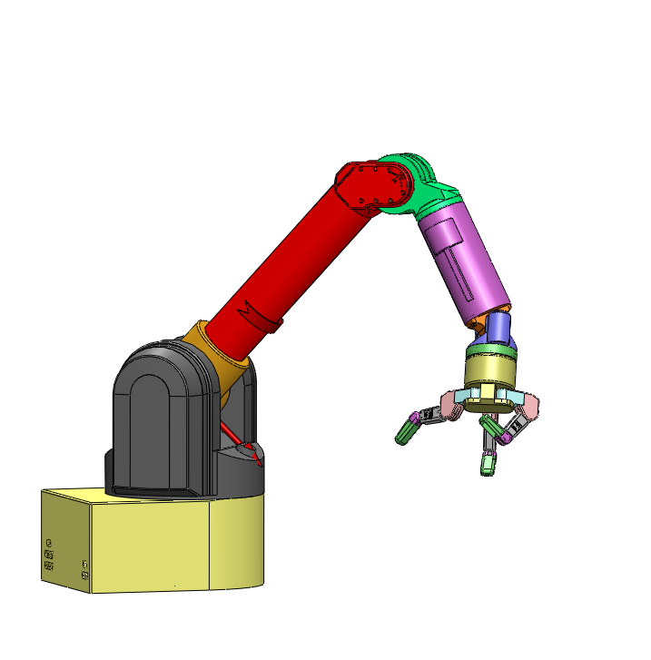
Vision-Based Control
Image 1
Image 2

Slide 28
Image-based Visual Servoing
Observed features:
Motor joint angles:
Local linear model:
Visual servoing steps: 1 Solve:
2 Update:

Slide 29
Find J Method 1: Test movements along basis
Remember: J is unknown m by n matrix
Motor moves (scale these):
Suitable
Finite difference:

Slide 30
Find J Method 2: Secant Constraints
Constraint along a line:
Defines m equations
Collect n arbitrary, but different measures y
Solve for J

Slide 31
Find J Method 3: Recursive Secant Constraints
Based on initial J and one measure pair
Adjust J s.t.
Rank 1 update:
Consider rotated coordinates:
Update same as finite difference for n orthogonal moves

Slide 32
Achieving visual goals: Uncalibrated Visual Servoing
Solve for motion:
Move robot joints:
Read actual visual move
Update Jacobian:
repeat

Slide 33
Achieving visual goals: Uncalibrated Visual Servoing
Solve for motion:
Move robot joints:
Read actual visual move
Update Jacobian:
repeat
Can we always guarantee when a task is achieved/achievable?

Slide 34
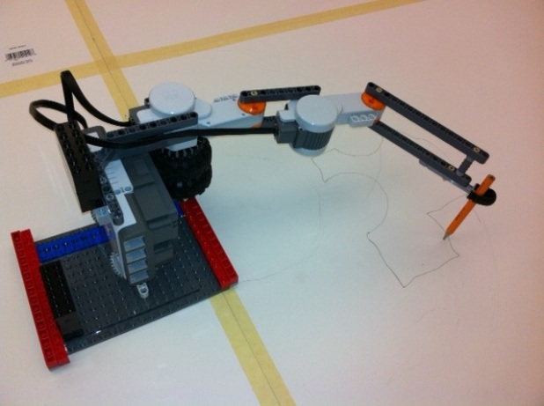
What we need for VS
v
u
Camera(s) Place for visibility and
Tracking
Markerless algorithms - MTF
Put LED on robot end-effector
Lower brightness so LED brighterest
Robot: Anywhere within reach
Control command access
Joint posiiton move
Joint velocity
Cartesian
Issues with angle representation: Euler, quatern, exp
Camera
Y
LED
X

Slide 35
Visually guided motion control
Issues:
What tasks can be performed?
Camera models, geometry, visual encodings
How to do vision guided movement?
H-E transform estimation, feedback, feedforward motion control
How to plan, decompose and perform whole tasks?

Slide 36
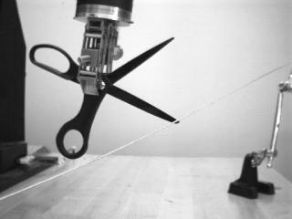
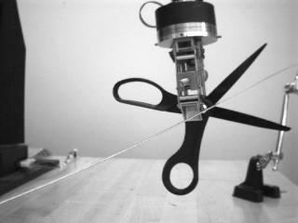
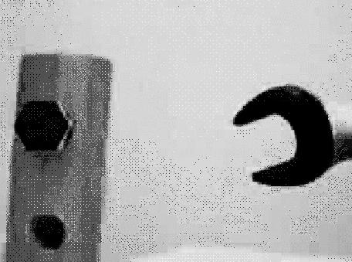
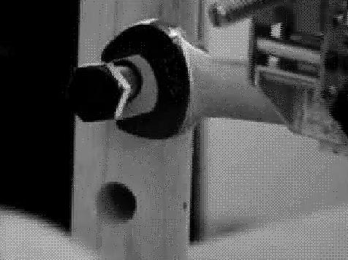
How to specify a visual task?

Slide 37
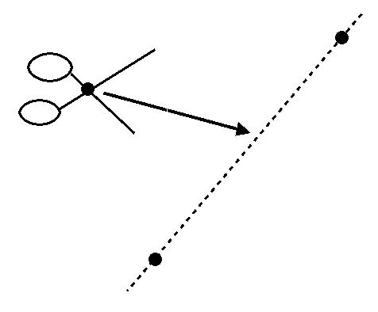
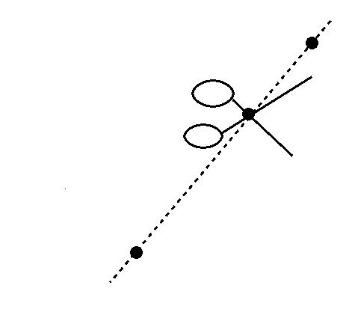
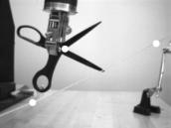
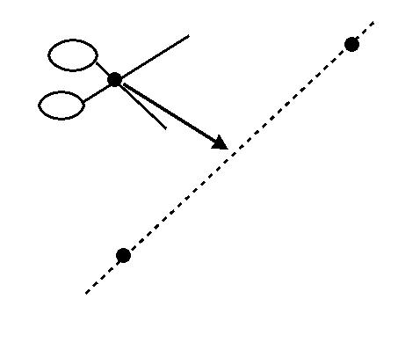
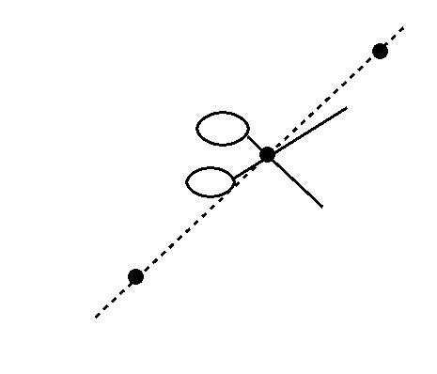
Task and Image Specifications
Task function T(x) = 0 Image encoding E(y) =0
task space error
task space satisfied
image space error
image space satisfied

Slide 38
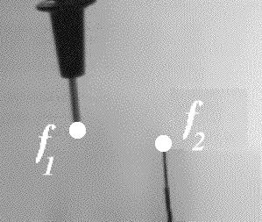
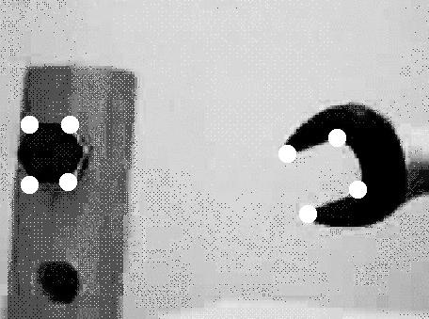
Visual specifications
Point to Point task “error”:
Why 16 elements?

Slide 39
Visual specifications 2
Point to Line
Line:
Note: y homogeneous coord.

Slide 40
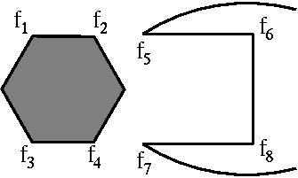
Parallel Composition example
y - y
2
5
y - y
4
7
E (y ) =
wrench
y • (y × y )
6
1
2
y • (y × y )
8
3
4
(plus e.p. checks)

Slide 41
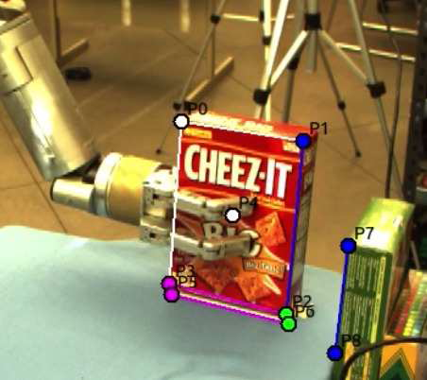
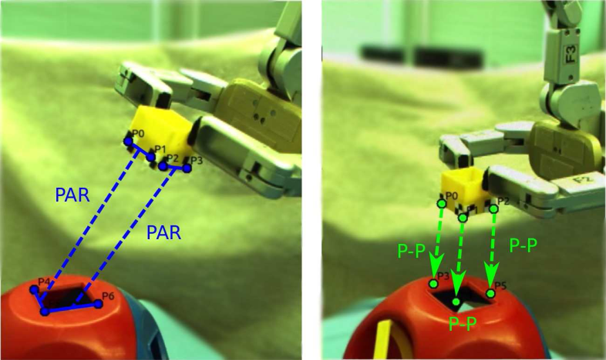
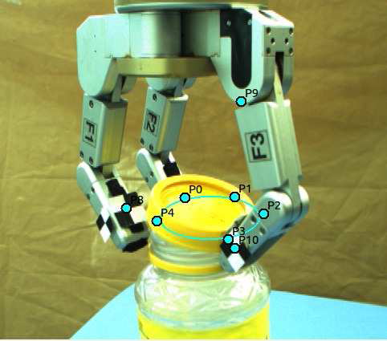
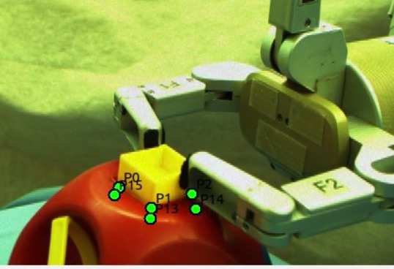
How to define a visual task?

Slide 42
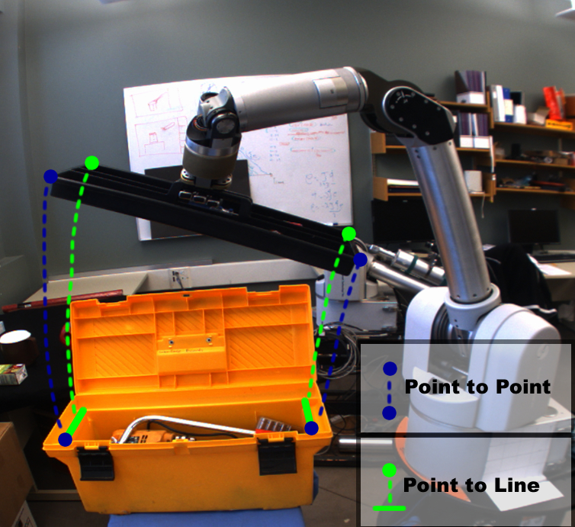
5.4. Visual specifications
Image commands = Geometric constraints in image space
HRI: User points/clicks on features in an image
Robot controller drives visual error to zero

Slide 43
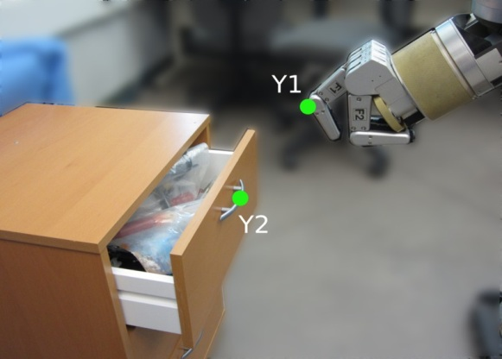
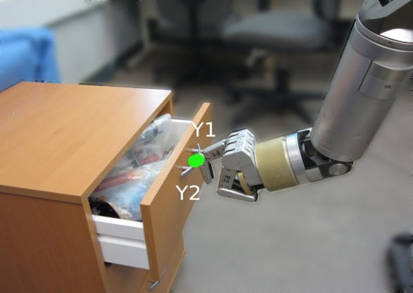
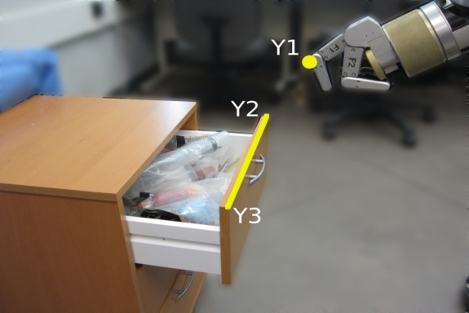
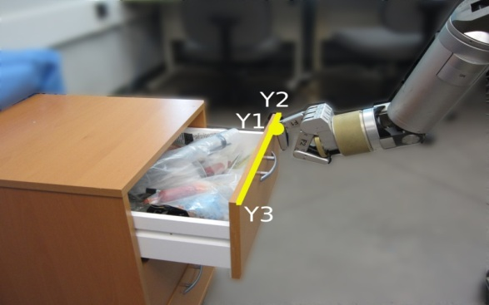
Visually defined alignment: basic
point-to-point: e_{pp}(y) = y₂ - y₁
or (homogenous coord) e_{pp}(y) = y₂ x y₁
point-to-line: e_{pl}(y) = y₁ . (y₂ x y₃)

Slide 44
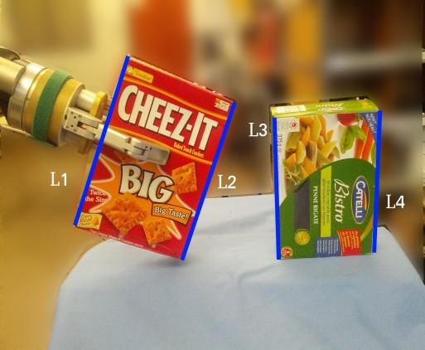
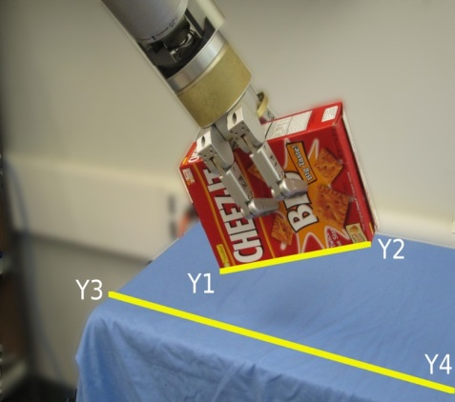
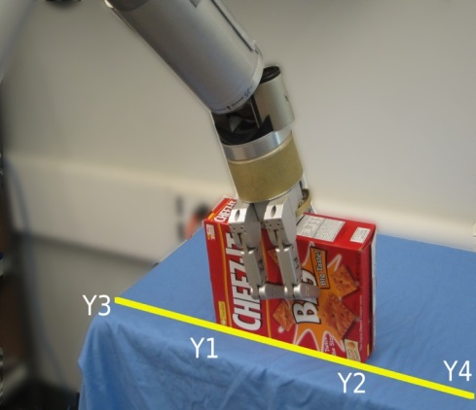
Some more visual alignments
parallel lines: e_{par}(l) = (l₁ x l₂) x (l₃ x l₄)
line-to-line: e_{ll}(y) = y₁ . (y₃ x y₄) + y₂ . (y₃ x y₄)
point-to-ellipse: e_{pe}(y) = y^{T}₁ C_{ellipse} y₁

Slide 45
Now: Language for visual alignments What else do we need?
Need: 1. Some way of entering alignments in images 2. video tracking to perform servoing!
Feature
trackers
Registration
trackers:
Download:
http://webdocs.cs.ualberta.ca/~vis/mtf/

Slide 46
ViTa: Visual Task spec. for Manip. Mona Gridseth, Martin Jagersand ICRA’16

Slide 47
Composing basic visual alignments 1. Parallel
Conceptual task
Image of task
y - y
2
5
y - y
4
7
E (y ) =
wrench
y • (y × y )
6
1
2
y • (y × y )
8
3
4
Which encoding E(y) is better? Can both reach E(y) = 0 ?
Do we need 1 or 2 cameras? Why?

Slide 48
Composing basic visual alignments 1. Parallel constrains

Slide 49
Composing basic visual alignments 2. Serial seqencing
Many tasks divide naturally into
Transportation / reaching
Coarse primitive for large movements
Low DOF control (e.g. of object centroid)
Robust to disturbances
Fine Manipulation
For high precision control of both position and orientation
6DOF control based on several object features

Slide 50
Serial Composition Solving whole real tasks
Linked task primitive
Acceptable initial (visual) conditions
Visual or Motor constraints to be maintained
Final desired condition
Task =

Slide 51
Previous alignments just examples. Can use any invariants for the level of calibration available
Group | Transformation | Invariants | Distortion
Projective 8 DOF |  | Cross ratio Intersection Tangency
Affine 6 DOF |  | Parallelism Relative dist in 1d Line at infinity
Metric 4 DOF |  | Relative distances Angles Dual conic
Euclidean 3 DOF |  | Lengths Areas
2 dof
l
∞
l
∞
2 dof
C*
C*
∞
∞

Slide 52
Achieving visual goals: Uncalibrated Visual Servoing
Solve for motion:
Move robot joints:
Read actual visual move
Update Jacobian:
repeat
Can we always guarantee when a task is achieved/achievable?

Slide 53
Task ambiguity
Will the scissors cut the paper in the middle?

Slide 54
Task ambiguity
Will the scissors cut the paper in the middle? NO!

Slide 55
Task Ambiguity
Is the probe contacting the wire?

Slide 56
Task Ambiguity
Is the probe contacting the wire? NO!

Slide 57
Task Ambiguity
Is the probe contacting the wire?

Slide 58
Task Ambiguity
Is the probe contacting the wire? NO!

Slide 59
Task decidability and invariance
A task T(f)=0 is invariant under a group G of transformations, iff
x
n
n
∀ f ∈ V , g ∈ G with g(f ) ∈ V T(f )=0 ⇔ T(g(f ))=0
x
T(f ) must be 0 here, if T is G invariant
If T(f ) = 0 here,
sim
T(f ) must be 0 here, if T is G invariant
aff
T(f ) must be 0 here, if T is G invariant
proj
T(f ) must be 0 here, if T is G invariant
inj

Slide 60
All achievable tasks...
1
1
1
1
0
0
0
1
0
1
1
0
0
0
0
0
0
0
4pt. coincidence
0
0
0
0
0
0
0
1
1
0
0
0
0
0
1
1
0
3pt. coincidence
0
0
0
0
0
1
1
0
0
0
0
0
1
0
1
0
0
0
0
Coincidence
0
2 2pt. coincidence
0
0
1
0
0
0
0
0
1
0
1
0
1
0
α
2pt. coincidence
0
1
1
0
1
0
0
0
0
0
0
0
0
Cross Ratio
0
1
0
One point
1
0
1
1
1
0
0
0
0
1
0
0
0
1
1
0
0
0
0
1
0
0
1
0
Collinearity
0
0
1
0
1
0
0
0
0
0
Noncoincidence
1
Coplanarity
0
0
0
1
0
1
0
0
0
0
0
1
are ALL projectively distinguishable coordinate systems
0
1
0
0
0
0
0
0
0
1
0
0
0
0
General Position
1
General Position

Slide 61
Composing possible tasks
T_{pp}
point-coincidence
Injective
C_{inj}
Task primitives
T_{col}
collinearity
T_{pp}
T_{copl}
coplanarity
Projective
C_{wk}
T_{crα}
cross ratios (α)
AND
OR
NOT
T₁
0 if T = 0
T₁ ∧ T₂ =
T₁ ∨ T₂ = T₁•T₂
¬T =
T₂
1 otherwise
Task operators

Slide 62
Result: Task toolkit
wrench: view 1
wrench: view 2
T_{pp}(x₁,x₅) ∧
₆
₅
₂
T_{pp}(x₃,x₇) ∧
₁
T_{wrench}(x_{1..8}) =
₈
₇
₄
T_{col}(x₄,x₇,x₈) ∧
₃
T_{col}(x₂,x₅,x₆)

Slide 63
Example: Pick and place type of movement
3. Alignment???
To match transport final to fine manipulation initial conditions

Slide 64
More primitives
4. Guarded move
Move along some direction until an external contraint (e.g. contact) is satisfied.
5. Open loop movements:
When object is obscured
Or ballistic fast movements
Note can be done based on previously estimated Jacobians

Slide 65
Solving the puzzle…

Slide 66
Conclusions
Visual servoing: The process of minimizing a visually-specified task by using visual feedback for motion control of a robot.
Is it difficult? Yes.
Controlling 6D pose of the end-effector from 2D image features.
Nonlinear projection, degenerate features, etc.
Is it important? Of course.
Vision is a versatile sensor.
Many applications: industrial, health, service, space, humanoids, etc.

Slide 67
What environments and tasks are of interest?
Not the previous examples.
Could be solved “structured”
Want to work in everyday unstructured environments

Slide 68
Use in space applications
Space station
On-orbit service
Planetary Exploration

Slide 69
Power line inspection
A electric UAV carrying camera flown over the model
Simulation: Robot arm holds camera
Model landscape: Edmonton railroad society

Slide 70
Use in Power Line Inspection
Notes:
spanish (project colobri U madrid), wales: Jones,
Photosynth some power poles.
Q: How close must illustrating examples be?
Only power lines? Or other CV capture?

Slide 71
Some References
M. Spong, S. Hutchinson, M. Vidyasagar. Robot Modeling and Control. Chapter 12: Vision-Based Control. John Wiley & Sons: USA, 2006. (Text)
S. Hutchinson, G. Hager, P. Corke, "A tutorial on visual servo control," IEEE Trans. on Robotics and Automation, October 1996, vol. 12, no 5, p. 651-670. (Tutorial)
F. Chaumette, S. Hutchinson, "Visual Servo Control, Part I: Basic Approaches," and "Part II: Advanced Approaches," IEEE Robotics and Automation Magazine 13(4):82-90, December 2006 and 14(1):109-118, March 2007. (Tutorial)
B. Espiau, F. Chaumette, P. Rives, "A new approach to visual servoing in robotics," IEEE Trans. on Robotics and Automation, June 1992, vol. 8, no. 6, p. 313-326. (Image-based)
W. J. Wilson, C. C. Williams Hulls, G. S. Bell, "Relative End-Effector Control Using Cartesian Position Based Visual Servoing", IEEE Transactions on Robotics and Automation, Vol. 12, No. 5, October 1996, pp.684-696. (Position-based)
E. Malis, F. Chaumette, S. Boudet, "2 1/2 D visual servoing," IEEE Trans. on Robotics and Automation, April 1999, vol. 15, no. 2, p. 238-250. (Hybrid)
M. Jägersand, O. Fuentes, R. Nelson, "Experimental Evaluation of Uncalibrated Visual Servoing for Precision Manipulation," Proc. IEEE Intl. Conference on Robotics and Automation (ICRA), pp. 2874-2880, 20-25 Apr. 1997. (Uncalibrated, model-free)
F. Chaumette, "Potential problems of stability and convergence in image-based and position-based visual servoing," The Confluence of Vision and Control, LNCS Series, No 237, Springer-Verlag, 1998, p. 66-78.

