Slide 1
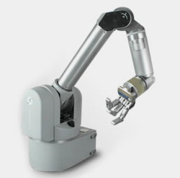
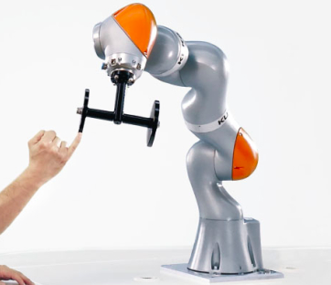
New Trends in Robotics
Collaborative robots (Co-bots)
  Safe human-robot-interaction (HRI)
  Light-weight robots (force controlled)
  Examples are WAM, KUKA iiwa, Franka, and many more
https://cobotsguide.com/cobots/

Slide 2
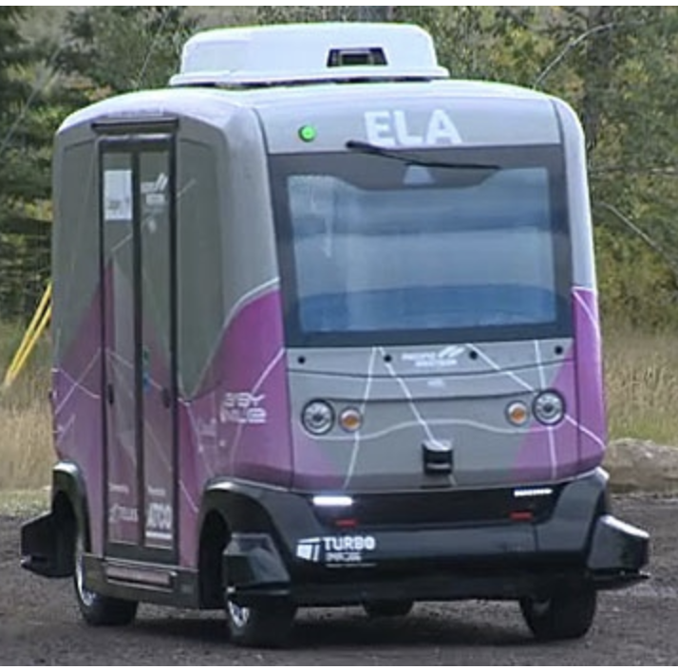
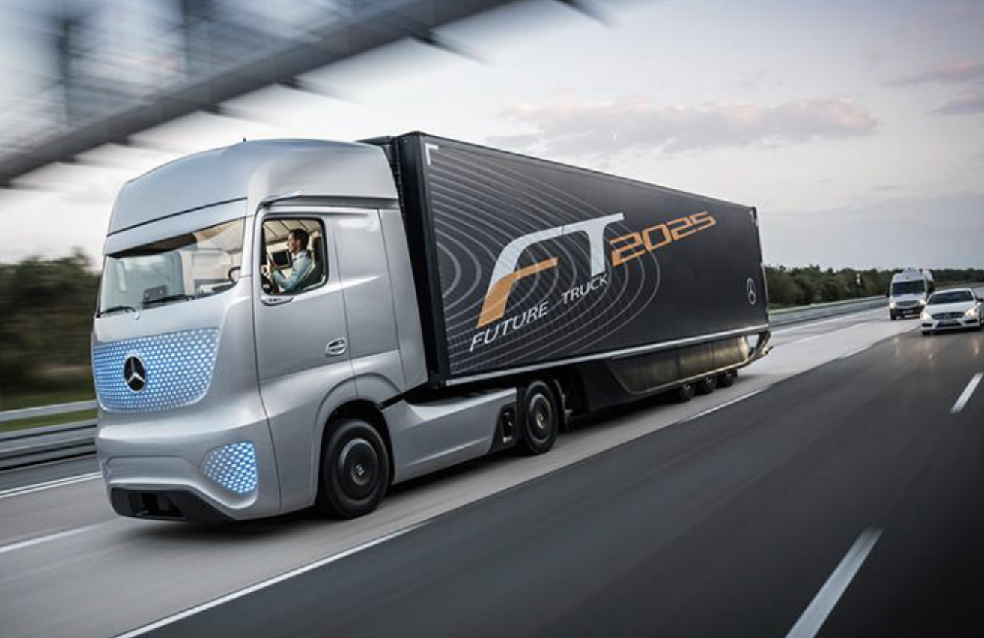
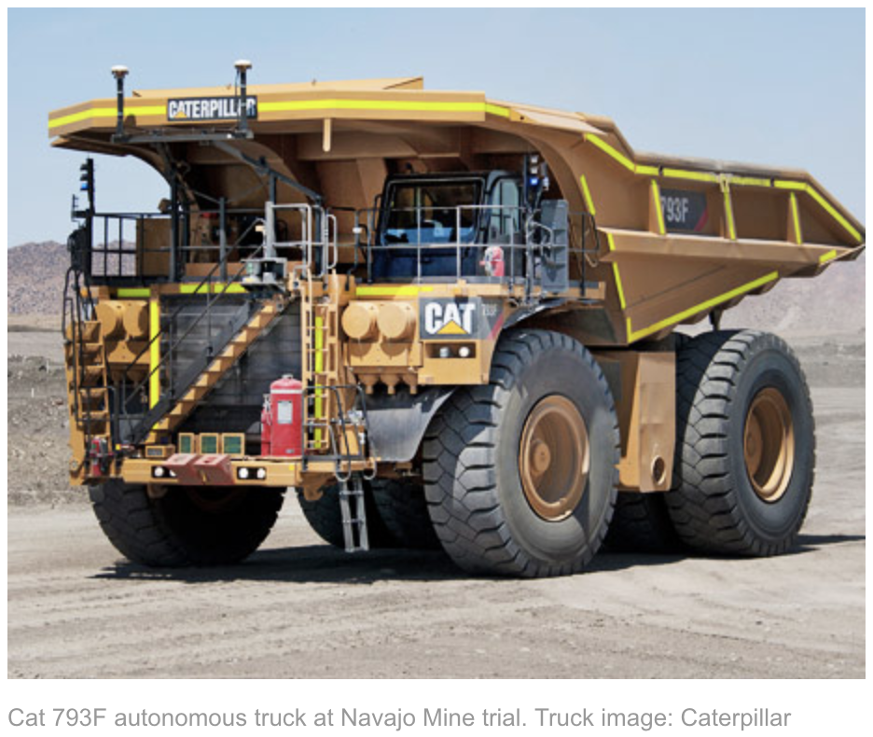
Robots are going to be everywhere!
Self-Driving Cars
  ELA, Edmonton’s electric autonomous vehicle
    Old Strathcona from October 22 to November 4
  Autonomous trucks
  Autonomous mining trucks
  UAVs, military UAVs

Slide 3
Search and Rescue Robots
DARPA Robotics Challenge 2015
Goal: develop semi-autonomous ground robots that could do ”complex tasks in dangerous, degraded, human-engineered environments”.
https://www.youtube.com/watch?v=FRkYOFR7yPA
A Compilation of Robots Falling Down at the DARPA Robotics Challenge

Slide 4
Medical Robotics
Robotic Hair Restoration can improve millions of Lives
video

Slide 5
Assistive Robotics
Assistive Arm and Hand Manipulation: How does current research intersect with actual healthcare needs?
video
http://handbookofrobotics.org/view-chapter/videodetails/64

Slide 6
Learning from Demonstrations (LfD)
Teaching a Robot to Roll Pizza Dough: A Learning from Demonstration Approach

Slide 7
Reinforcement Learning Based Control
Policy refinement after demonstration with RL

Slide 8
Deep Reinforcement Learning
AI-driven robot hand spent a hundred years teaching itself to rotate a cube

Slide 9
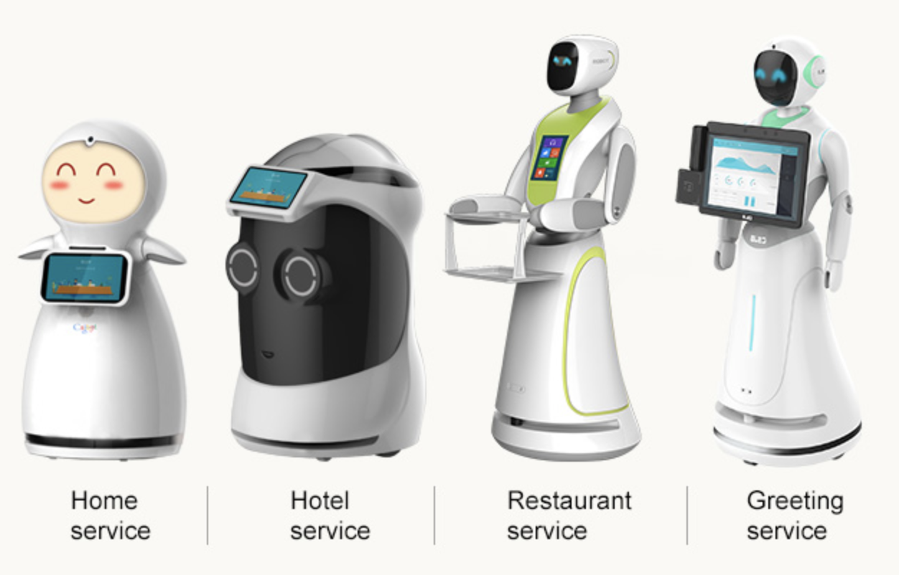
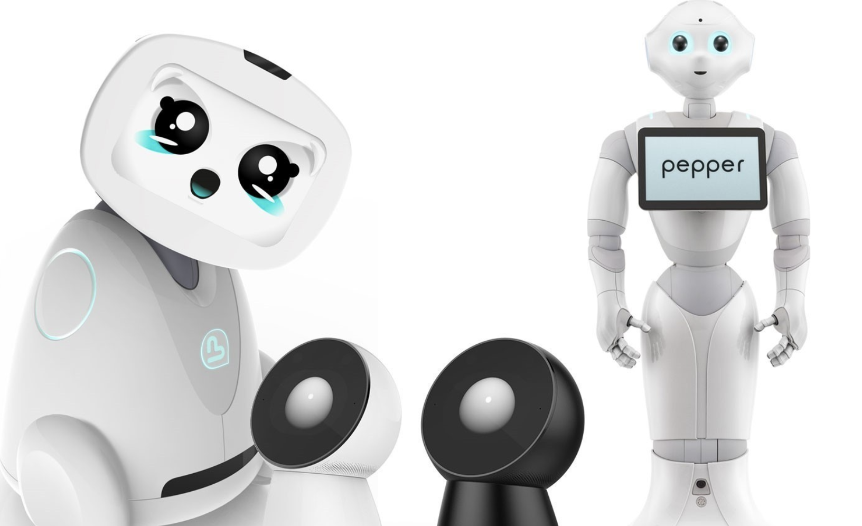
Service & Social Robotics

Slide 10

Soft Actuators
Even if you have active torque control (closed-loop), we have to handle impact (open-loop)
Variable Stiffness Actuators (VSA) ->
Inherent (passive) compliance -> optimal control

Slide 11
Compliance Control

Slide 12
Compliance Control

Slide 14
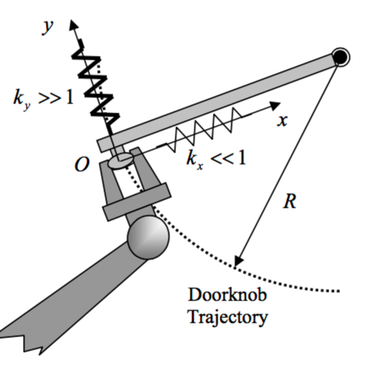
Applications
Contact with environment
IROS demo

