Slide 1
CMPUT 312 Intro Robotics & Mechatronics: Trajectory Planning Control
Slides from Prof. A. De Luca - lecture notes (Robotics 1)

Slide 3
From Task to Trajectory

Slide 4
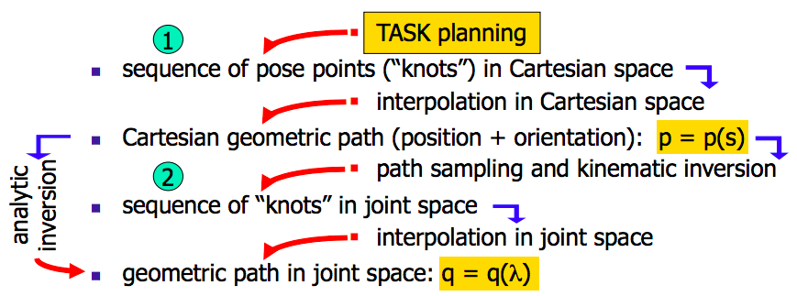
Example

Slide 5
Cartesian vs. Joint Trajectory planning

Slide 6
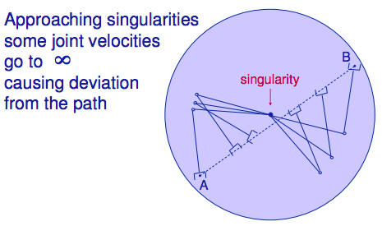
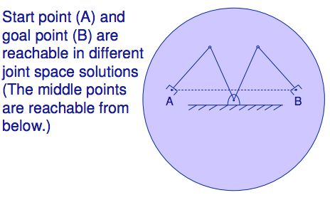
Difficulties in Cartesian Space

Slide 7
Trajectory Planning in any space:

Slide 8
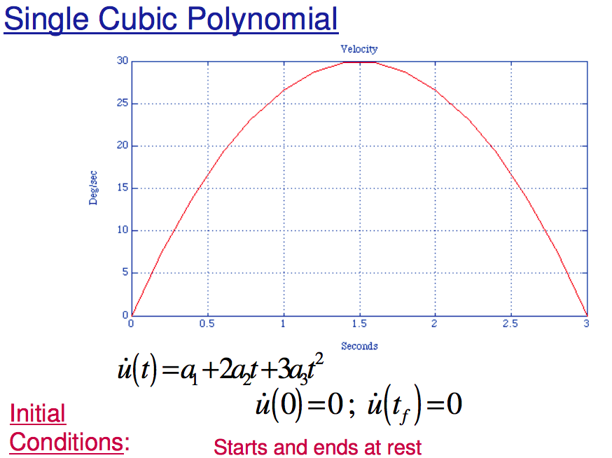
Cubic Polynomial

Slide 9
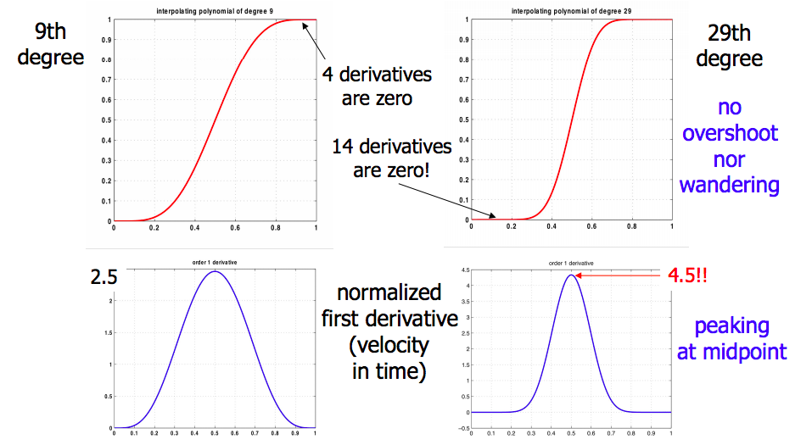
3rd order >> still non-zero accelerations
use higher order polynomials (5th , 7th , …)
higher order polynomials >> computationally more expensive
hard to handle N way-points.
oscillations arise out of the interpolation points (wandering)

Slide 10
practical solution >> spline
Problem: interpolate N knots, with continuity up to the second derivative ?

Slide 11
Algorithmic Implementation

Slide 12
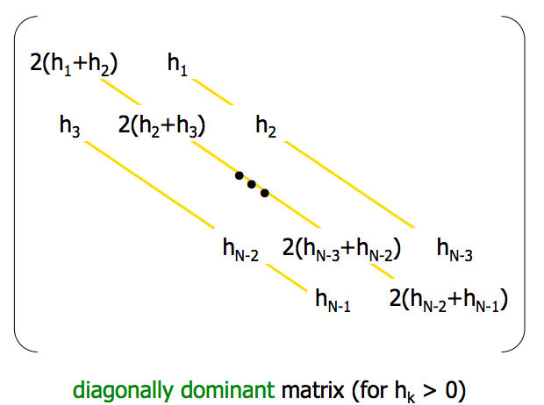
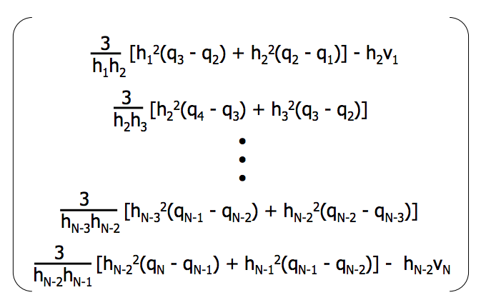

Slide 13
Example

Slide 15
Obstacle Avoidance

Slide 16
Learning from demonstration

