Slide 1
CMPUT 399
Intro Robotics & Mechatronics:
Motor Control
Some slides are taken from Northwestern University’s “ME 333 Introduction to Mechatronics” by Kevin Lynch.

Slide 2
DC motors
DC motors: cheap, most common
DC motor ?
https://www.youtube.com/watch?v=LAtPHANEfQo

Slide 3
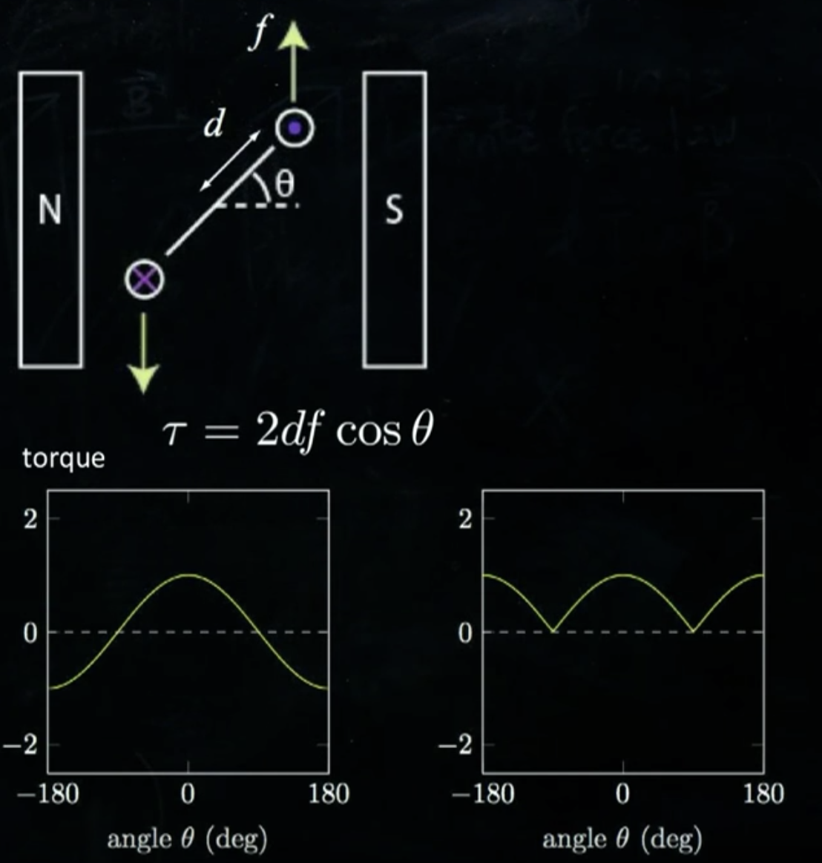
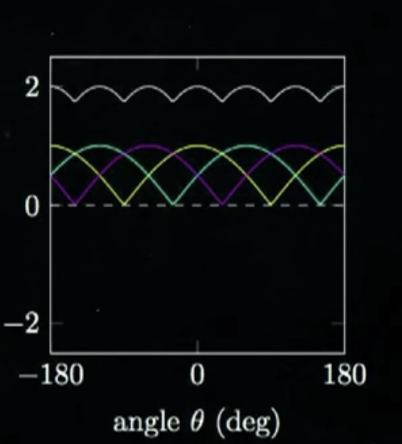
Brushed permanent magnet DC motor
Lorentz’ law: F = l I x B
  current flowing through a magnetic field creates a force on the wire carrying the current
Torque changes direction
- switch direction of current
- still torque varies
- use 3 loops
- still have torque ripple
- insufficient torque > use coil instead of wire
- commutators to switch current

Slide 4

Model of DC motor Control
𝜏,⍵
I
$I V=τ ω+RI^{2}+LI\frac{dI}{dt}+…$
$V=\frac{τ}{I} ω+RI+L\frac{dI}{dt}$
$V=k_{t} ω$
V
Electrical power (input)
(friction loss, heating, etc.)
Mechanical power (output)
k_{t} : torque constant : characteristic of motor
Open-circuit: I=0
back-emf (electro-motive force) voltage
Opposing the driving voltage

Slide 5
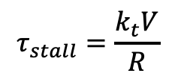






Speed-Torque curve
0
$V=k_{t}ω+RI+L\frac{dI}{dt}$
$ω=\frac{V}{k_{t}}−\frac{R}{k_{t}}\frac{τ}{k_{t}}$
$ω=ω_{0}−\frac{ω_{0}}{τ_{s}}τ$
$$ω$$
Speed-Torque curve
$$ω_{0}=\frac{V}{k_{t}}$$
nominal mechanical power
$$ω_{nom}$$
nominal operating point
continuous operating region
$$τ$$
$$τ_{nom}$$
$$τ_{stall}=\frac{k_{t}V}{R}$$
⍵₀: no-load speed
𝜏_{s}: prevent moving ⇒ large torque (𝜏=k_{t} I) ⇒
large current ⇒ (Power=RI²)⇒ overheating (over long period of time)

Slide 6









Mechanical power in speed-torque curve
$ω=ω_{0}−\frac{ω_{0}}{τ_{s}}τ$
$τ=(ω_{0}−ω)\frac{τ_{s}}{ω_{0}}$
$P_{out}=τω$
$=τ_{s} ω−\frac{τ_{s}}{ω_{0}}ω^{2}$
$$ω$$
$$P_{out}=τω$$
$$ω_{0}$$
$${P_{max}=\frac{1}{4}{ τ}_{s}ω}_{0}$$
$$\frac{ω_{0}}{2}$$
$$\frac{τ_{s}}{2}$$
$$τ_{s}$$
$$τ$$
Efficiency = $\frac{P_{out}}{P_{in}}$ = $\frac{τω}{VI}$ x 100 %

Slide 7
Mechanical power in speed-torque curve
$ω=ω_{0}−\frac{ω_{0}}{τ_{s}}τ$
$τ=(ω_{0}−ω)\frac{τ_{s}}{ω_{0}}$
$P_{out}=τω$
$=τ_{s} ω−\frac{τ_{s}}{ω_{0}}ω^{2}$
$$ω$$
$$P_{out}=τω$$
$$ω_{0}$$
$${P_{max}=\frac{1}{4}{ τ}_{s}ω}_{0}$$
$$\frac{ω_{0}}{2}$$
$$\frac{τ_{s}}{2}$$
$$τ_{s}$$
$$τ$$
Efficiency = $\frac{P_{out}}{P_{in}}$ = $\frac{τω}{VI}$ x 100 %

Slide 8
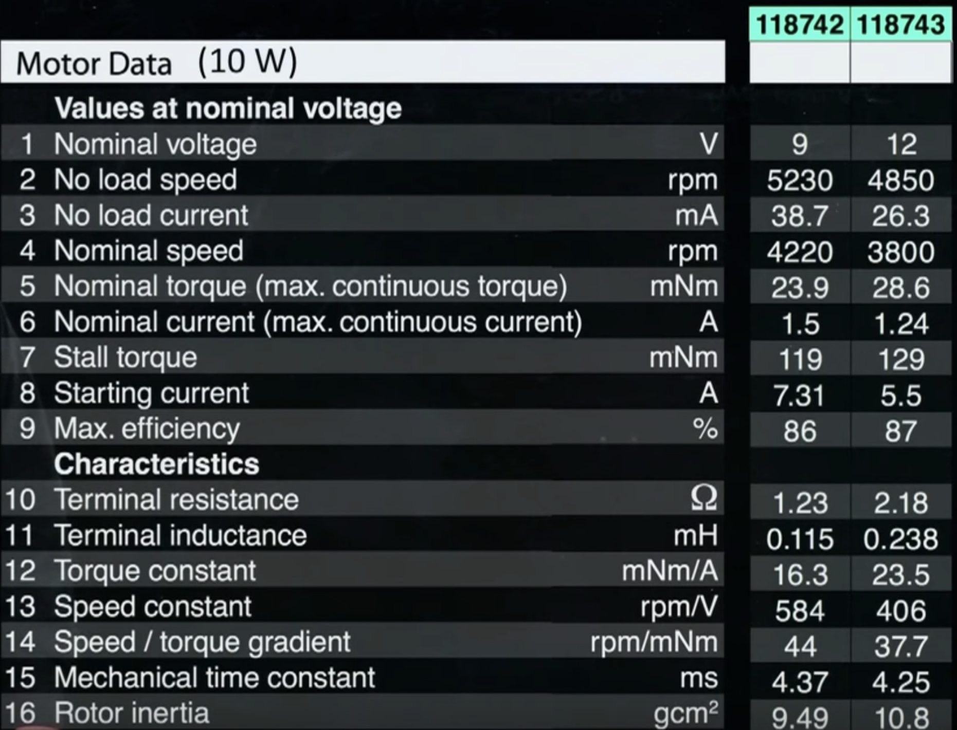
Motor specification (datasheet)

Slide 9
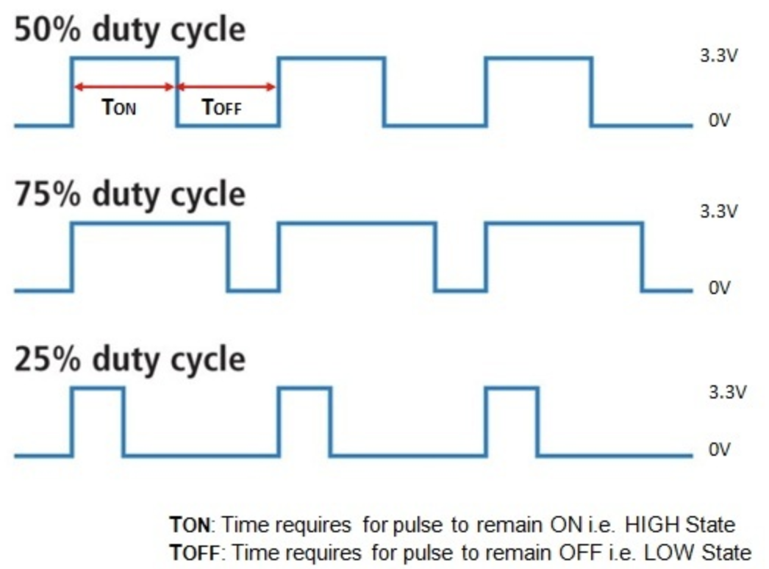
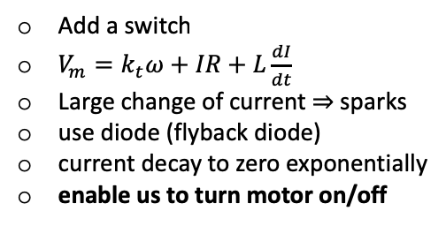
DC motor control
𝜏,⍵
Goal: drive a DC motor with micro-controller
V_{m}
+V
dig. out
dig. out
M
M
⏄
Low voltage
Low current
Add a switch
$V_{m}=k_{t}ω+IR+L\frac{dI}{dt}$
Large change of current ⇒ sparks
use diode (flyback diode)
current decay to zero exponentially
enable us to turn motor on/off
to control speed we use PWM
PWM controls duty cycle of closing/opening the switch
10 KHz < f < 40 KHz
enable us to control speed in 1-direction
bi-directional >>> H-bridge

Slide 10
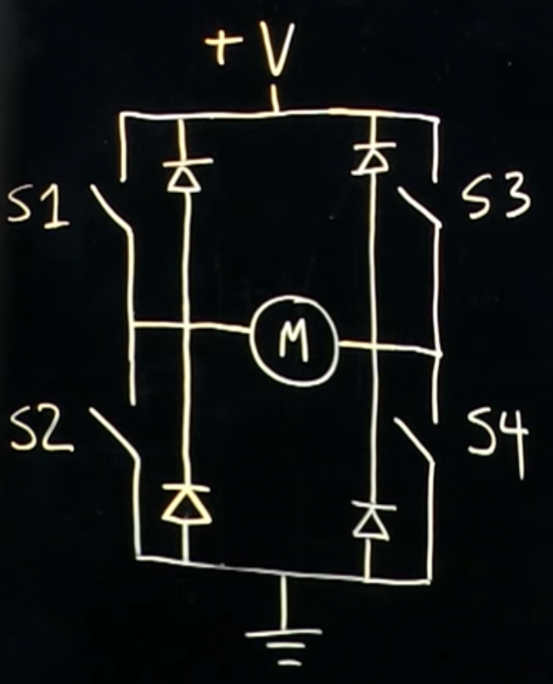
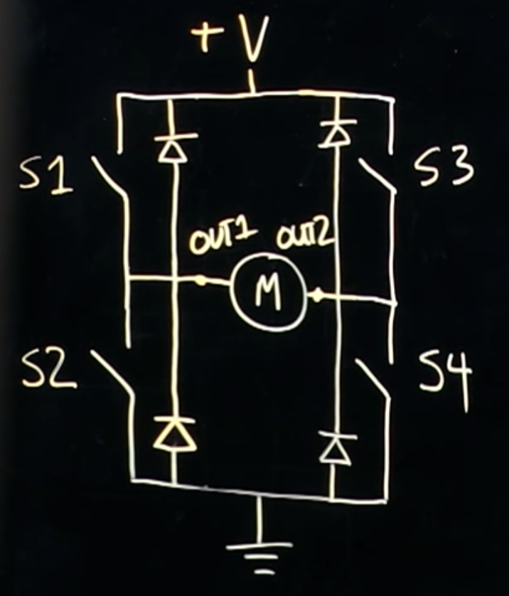
DC motor control
H-bridge
closed switches:
S1 , S4 : forward
S2 , S3 : reverse
S1 , S3 : brake
S2 , S4 : brake
one/none: coast
OUT1 OUT2
off off coast
H L forward
L H reverse
shorted brake

Slide 11
Motor Control System
Complete motor control system
ref
position
(θ_{d})
PID
torque /
Current
command
20 KHz
PWM duty
current
error
current
Motion controller
+
PI
controller
𝝨
H-bridge
motor
_
measured
position
measured
current
5 KHz
inner loop
current sensor
200-1000 Hz
outer loop
counter
encoder

Slide 12
BLDC motors
Brushless DC (BLDC) motor :
https://www.youtube.com/watch?v=bCEiOnuODac

