Slide 1
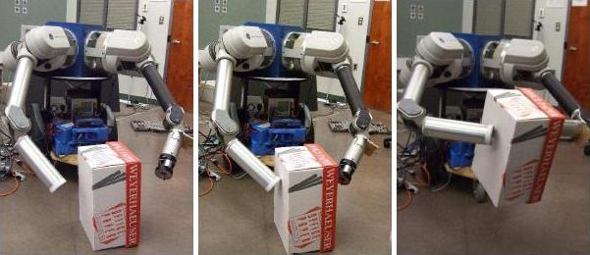
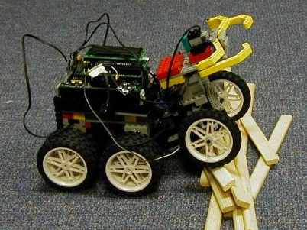
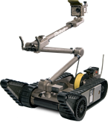
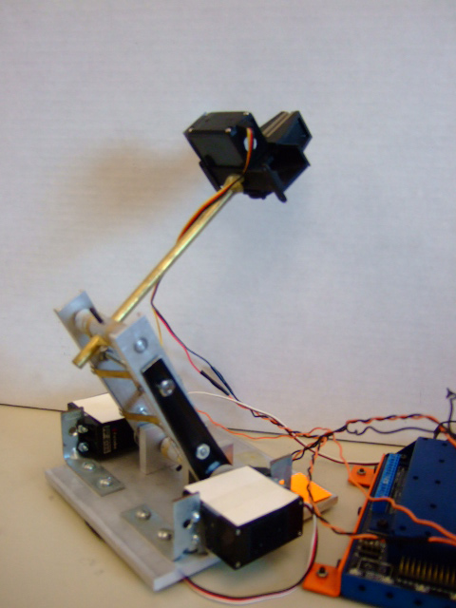
CMPUT 412 Review
WAM $100,000
Martin Jagersand
Camilo Perez
University of Alberta
Student robots
$100-500
iRobot
Packbot $100,000

Slide 2
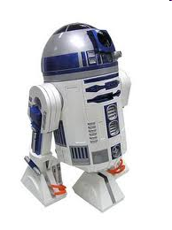
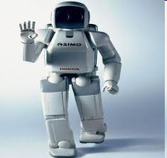
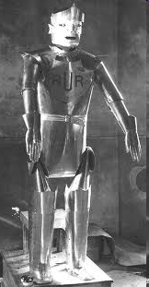
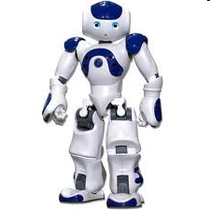
Robot?
Notes:
.^{[4]} For example Joseph Engelberger, a pioneer in industrial robotics, once remarked: "I can't define a robot, but I know one when I see one."^{[5]}

Slide 3
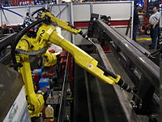
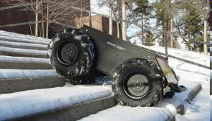
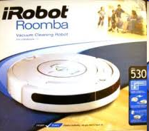
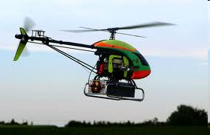
Robotics broad field:
Arms, hands, rover, UAV,…
Notes:
.^{[4]} For example Joseph Engelberger, a pioneer in industrial robotics, once remarked: "I can't define a robot, but I know one when I see one."^{[5]}

Slide 4
How do we categorize these robots?
What they can do?
What sensors they have?
How they move
Most robots can move things (but varying distances)
We can generally equip any robot with any type of sensor.
The motion properties of an arm is different from a mobile robot/car and a UAV/helicopter

Slide 5
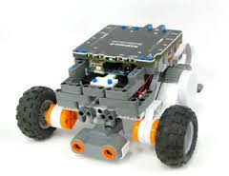
Mobile Robots
(ground)
Moves on 2D ground surface
Needs just 2 motors
Inexpensive
Easy to model and control
Large range of motion
Hard to exactly localize
Cannot generally pick things up and manipulate them

Slide 6
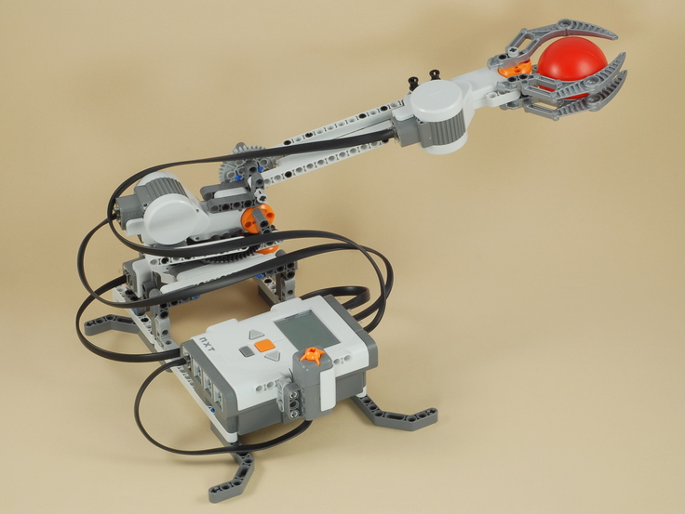
Robot arms and hands
(linkages)
Moves in 6DOF (3D position, 3D orientation)
Min 6 motors in linkage
(near) Perfect localization
Expensive
Easy to control
Manipulates!

Slide 7
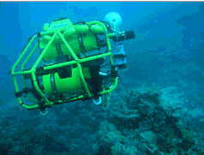
Free-flying robots
Aerial and Underwater
Moves in 6DOF (3D position, 3D orientation)
Generally underactuated (4DOF)
Hard to model and control
User error = Crash and break
Hard to exactly localize
RC heli inexpesive,
Military UAV expensive

Slide 8
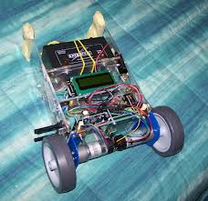
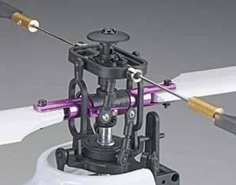
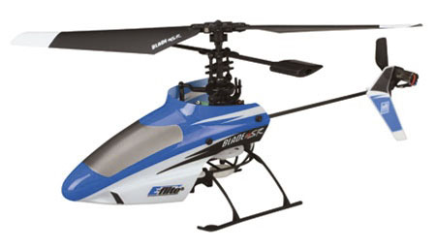
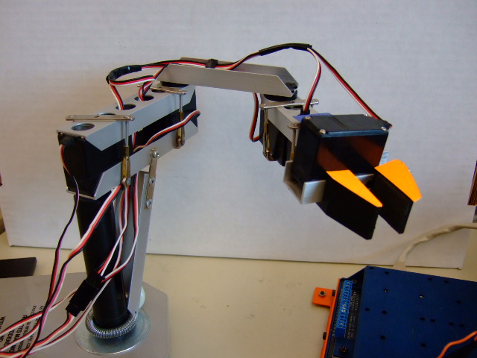
Parts of a Robot
Motors
Motor controllers
Transmission
Linkages
Sensors
Computer

Slide 9
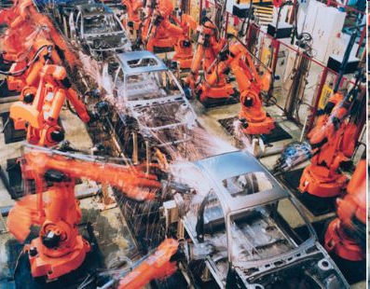
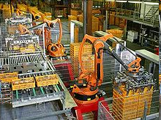
Majority Robotics in practice: Robot arms in Manufacturing
Engineered environment
Repeated motion
1 million arms in operation worldwide
http://en.wikipedia.org/wiki/Industrial_robot

Slide 10
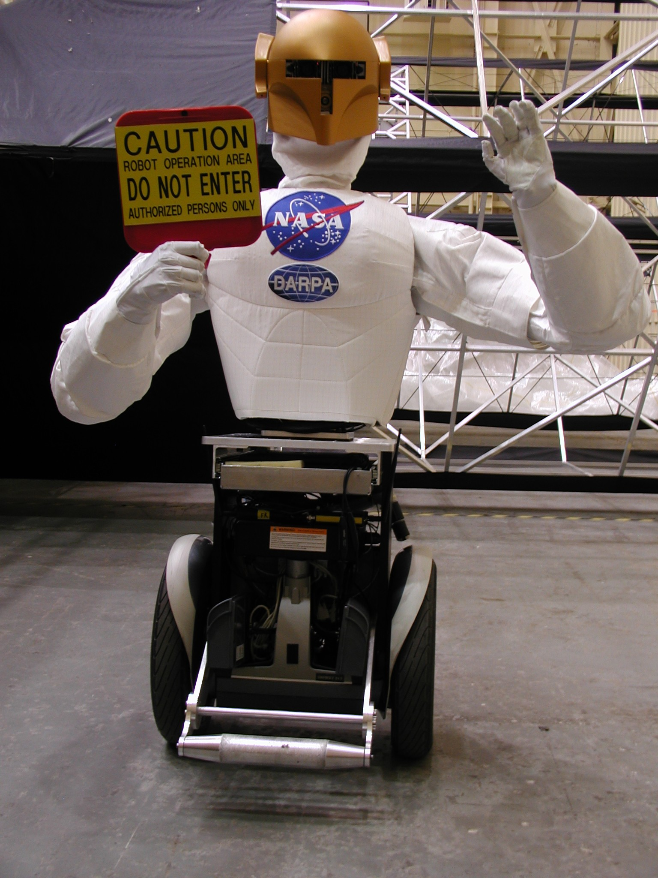
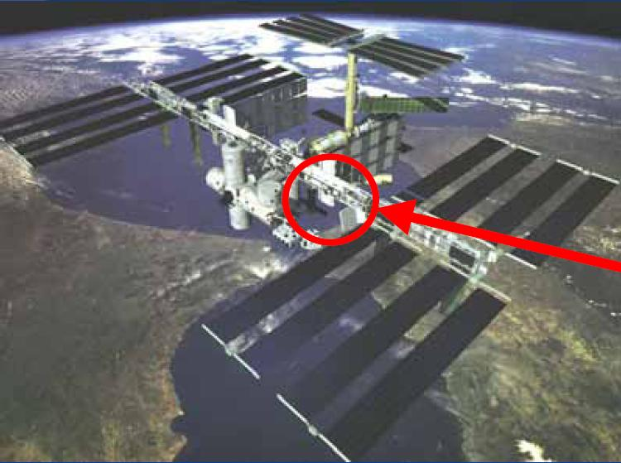
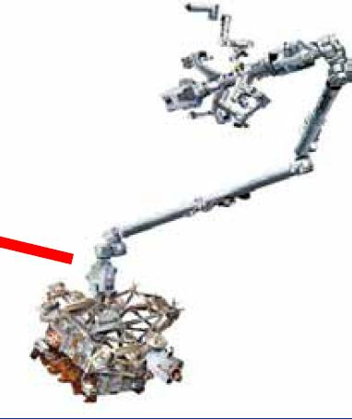
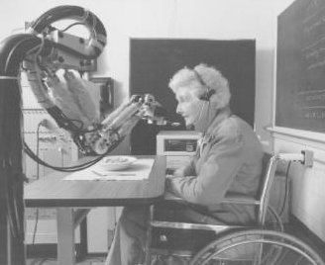
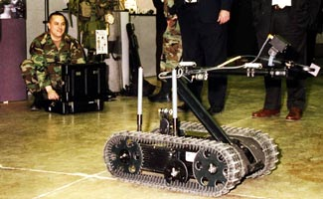
Emerging Robotics Applications
Space - in-orbit, repair and maintenance, planetary exploration anthropomorphic design facilitates collaboration with humans
Basic Science - computational models of cognitive systems, task learning, human interfaces
Health - clinical applications, "aging-in-place,” physical and cognitive prosthetics in assisted-living facilities
Military or Hazardous - supply chain and logistics support, re-fueling, bomb disposal, toxic/radioactive cleanup
No or few robots currently operate reliably in these areas!

Slide 11
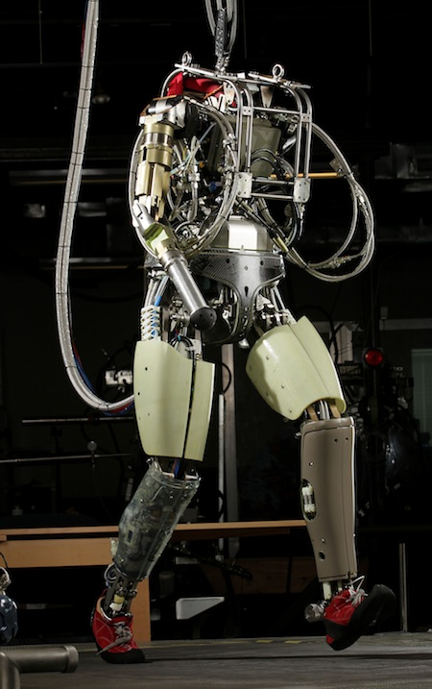
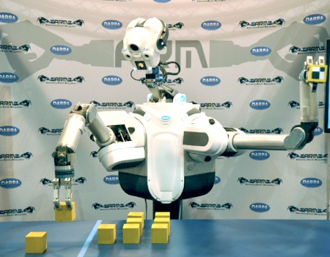
Newer robots
DARPA WAMs
Boston dynamics
UofA’sRobotics and Vision group

Slide 12
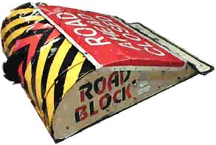
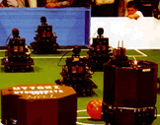
What is a robot?
A physical system that (semi-) “autonomously” senses the environment and acts in it.
Robot :
Autonomy might be a continuous, not a discrete attribute
Researchers disagree on what kind and how much autonomy is needed
none
full
Robot Wars, Battlebots
Canada Arm2
Robocup
DARPA Manipulation Challenge
There may be other axes along which to evaluate robots, too…
Notes:
go through…
robots!
the next slide presents three axes along which you might evaluate a robot system…

Slide 13
World Modeling
How much information about the world does the robot internalize?
more
Capabilities
wow (10)
less
Who's making the decisions?
huh? (1)
human-controlled
Autonomy
independent
Notes:
there has been considerable tension among roboticists along this axis – how much of the word to model and how to do so…
capabilities: probably at LEAST two axes here: coolness and there's sensor richness – the density or quantity of sensory information that a particular system deals with… Since there are only three dimensions on this slide… I'm combining those two…
others: - ask?
robust!

Slide 14
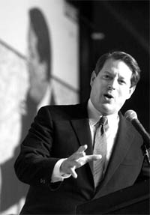

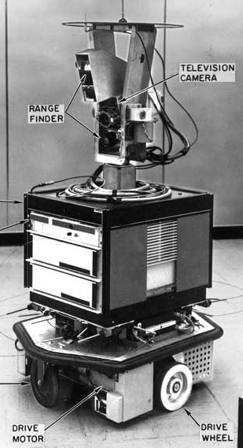
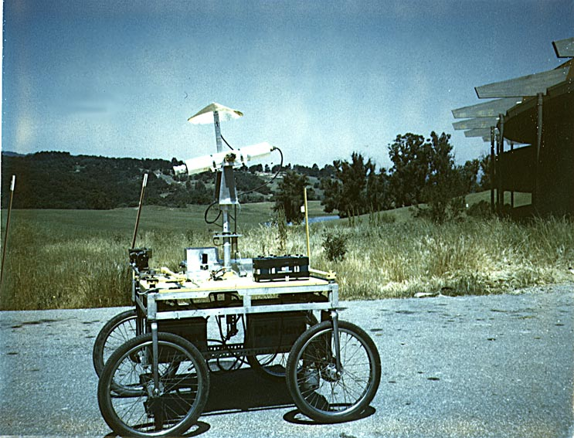
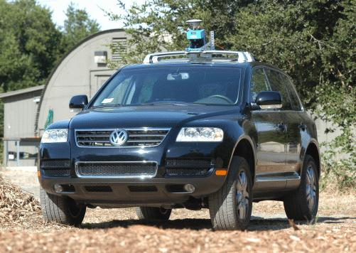
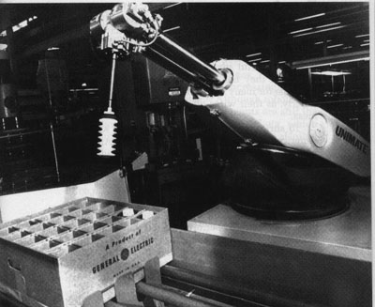
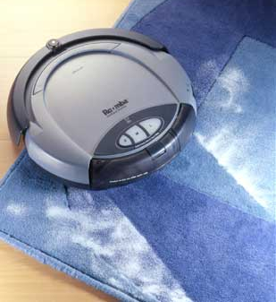
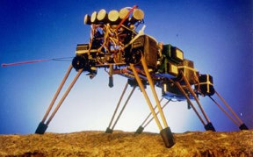
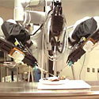
World Modeling
Capability (0-10)
Robot Plot
more
Al Gore (11)
Sims (5)
Stanley/Boss (9)
Shakey (3)
MERs (8)
Stanford Cart (3)
Bar Monkey (9)
less
da Vinci (2)
Unimate (4)
Roomba (7)
Genghis (3)
human-controlled
Autonomy
CS 154: algorithms for programming autonomous robots

Slide 15
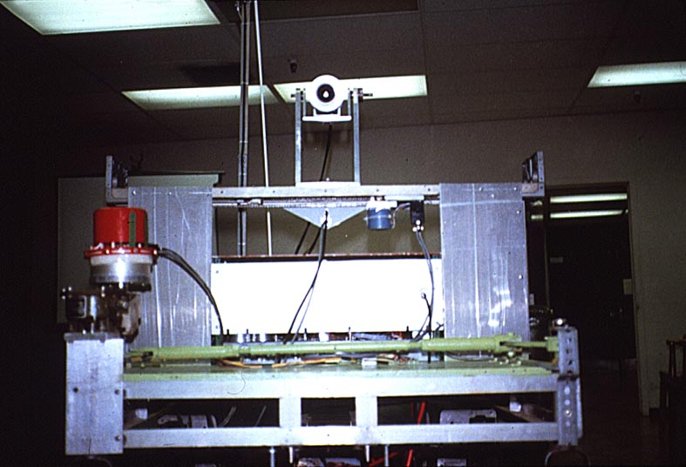
Sense Plan Act (SPA) Stanford Cart
Hans Moravec @ SAIL
“functional” task decomposition
SENSING
ACTING
perception
Planning
task execution
world modeling
motor control
“horizontal” subtasks
...
...
1976
Notes:
The field moved slowly, mostly because computation moved slowly!

Slide 16
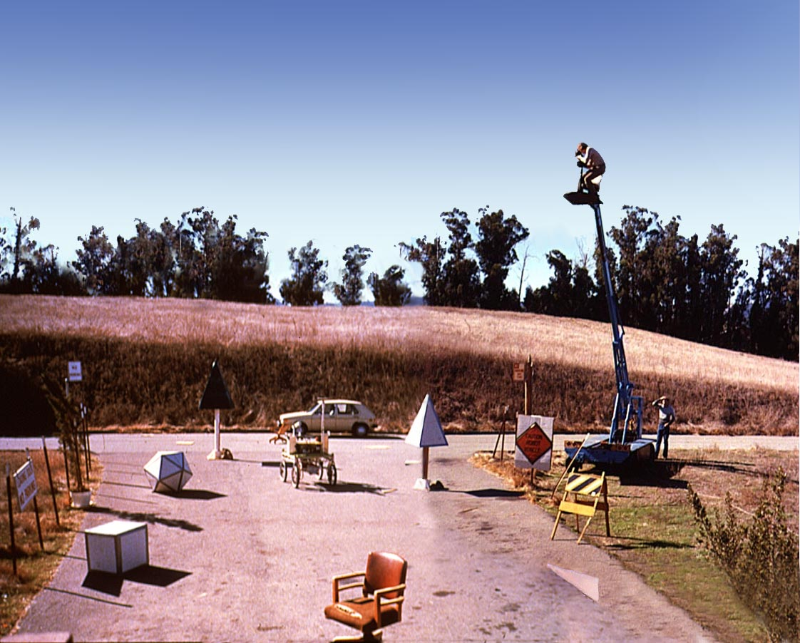
Cartland (outdoors)
Notes:
Video… see Lec 2 for large video…

Slide 17
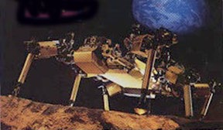
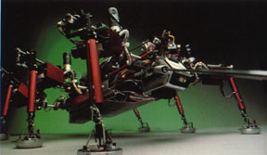
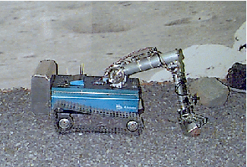
Reactive, Subsumption “Robot Insects”
Rodney Brooks @ MIT
planning and reasoning
“behavioral” task decomposition
identify objects
“vertical” subtasks
SENSING
build maps
ACTING
explore
wander
avoid objects
...
...
1985
Notes:
picture of Rodney Brooks – his paper!!

Slide 18
Subsumption
Genghis
1) Standing by tuning the parameters of two behaviors: the leg “swing” and the leg “lift”
2) Simple walking: one leg at a time
3) Force Balancing: via incorporated force sensors on the legs
4) Obstacle traversal: the legs should lift much higher if need be
5) Anticipation: uses touch sensors (whiskers) to detect obstacles
6) Pitch stabilization: uses an inclinometer to stabilize fore/aft pitch
7) Prowling: uses infrared sensors to start walking when a human approaches
8) Steering: uses the difference in two IR sensors to follow
57 modules wired together !

Slide 19
Subsumption Architecture
navigate behavior
wander behavior
runaway behavior
Notes:
If you squint at it, what is this diagram?

Slide 20
Robot Architecture
how much / how do we represent the world internally ?
As much as possible!
sense
plan
act
SPA paradigm
Not at all
sense
act
Reactive paradigm
stimulus – response == "behavior"
Task-specific
Behavior-based architecture
Subsumption paradigm
different ways of composing behaviors
Potential Fields (later)
As much as possible.
Hybrid approaches

Slide 21
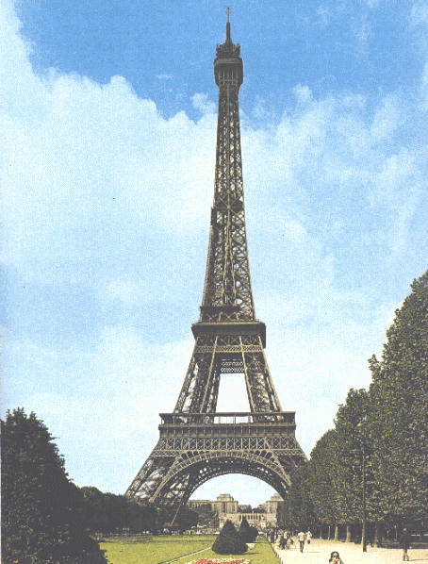
Environment Representation: The Map Categories
Recognizable Locations
Topological Maps
Courtesy K. Arras
Metric Topological Maps
Fully Metric Maps (continuos or discrete)

Slide 22
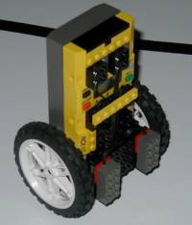
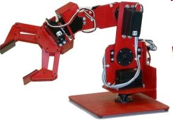
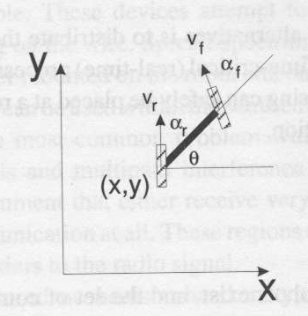
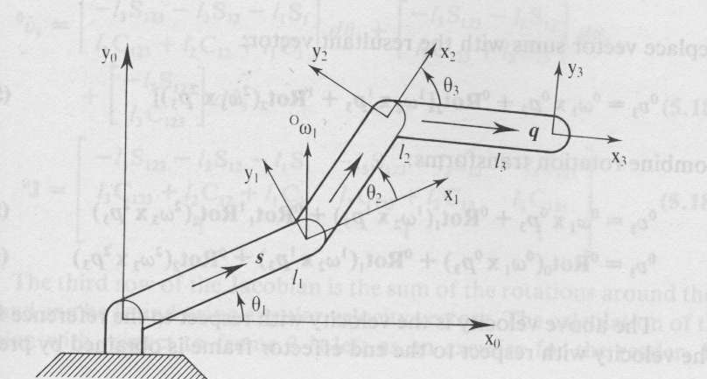
Kinematics
If we move a wheel one radian, how does the robot center move?
Robot geometry and kinematic analysis gives answers!
from sort of simple to sort of complex
wheeled platforms
manipulator modeling

Slide 23
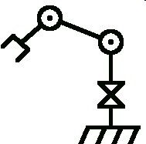
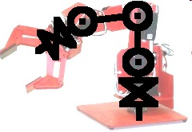
Kinematic modeling: Arm
Robot
Strategy:
Model each joint separately
Combine joints and linkage lengths
A simple example follows here.
More general treatment of next lecture
Abstract model
http://www.societyofrobots.com/robot_arm_tutorial.shtml

Slide 24

01_20
Coordinate frames & forward kinematics
Three coordinate frames:
Positions:
Orientation of the tool frame:
0
1
2
2
0
1
Notes:
‘0’ is the base frame, ‘2’ is the tool frame. The orientation of the tool frame is the projection of the tool frame onto the base frame (i.e. dot product)
01_20.jpg

Slide 25


01_21
Inverse kinematics
Find the joint angles for a desired tool position
Two solutions!: elbow up and elbow down
Notes:
These are simple examples… this becomes more complex for higher DOFs
01_21.jpg

Slide 26

Homogenous coordinates: Uniform matrix representation of translation and rotation
The yellow dot is the origin of a tool coordinate X⁴Y⁴ frame
Y³
₃
Y⁴
Y²
2
X³
3
₂
X²
X⁴
H = R_{z}(₁ ) * T_{x1}(l₁) * R_{z}(₂ ) * T_{x2}(l₂) * R_{z}(₃ ) * T_{x3}(l₃)
This takes you from the X⁰Y⁰ frame to the X⁴Y⁴ frame.
The position of the yellow dot relative to the X⁴Y⁴ frame is (0,0).
Y⁰
1
X¹
Y¹
₁
X⁰
Notice that multiplying by the (0,0,0,1) vector will equal the last column of the H matrix.

Slide 27


Numerical Inverse Kinematics
Cartesian Location
Motor joint angles:
Local linear model:
Numerical steps: 1 Solve:
2 Update:

Slide 28
The Numeric solution: How to solve?
Newton’s Method
Y³
x₃
Y⁴
Y²
2
X³
3
x₂
X²
X⁴
Function:
Jacobian J = matrix of partial derivatives:
Analytic J: Take derivatives of H
Numeric estimation: Test movements or Broydens method (cmput 340, Heath Ch 5,6)
Y⁰
1
X¹
Y¹
x₁
X⁰

Slide 29

Numerical Inverse Kinematics
Solve for motion:
Move robot joints:
Read actual Cartesian move
Update Jacobian:
Move the robot to each subgoal in sequence
Iterate until convergence at final goal
Goal

Slide 30
Kinematics: Differential drive
1) Specify system measurements
y
- consider possible coordinate systems
2) Determine the point (the radius) around which the robot is turning.
ω
- each wheel must be traveling at the same angular velocity around the ICC
V
V_{L}
x
3) Determine the robot’s speed around the ICC and its linear velocity
2d
V_{R}
ICC
ω(R+d) = V_{L}
R
ω(R-d) = V_{R}
robot’s turning radius
Thus,
ω = ( V_{R} - V_{L} ) / 2d
R = d ( V_{R} + V_{L} ) / ( V_{R} - V_{L} )
So, where’s the robot?
So, the robot’s velocity is
V = ωR = ( V_{R} + V_{L} ) / 2

Slide 31
Kinematics: Differential drive
4) Integrate to obtain position
y
V_{x} = V(t) cos(θ(t))
ω(t)
V_{y} = V(t) sin(θ(t))
Thus,
V(t)
x(t) = ∫ V(t) cos(θ(t)) dt
V_{L}
x
y(t) = ∫ V(t) sin(θ(t)) dt
2d
θ(t) = ∫ ω(t) dt
V_{R}
ICC
R(t)
Kinematics
robot’s turning radius
with
ω = ( V_{R} - V_{L} ) / 2d
R = d ( V_{R} + V_{L} ) / ( V_{R} - V_{L} )
What has to happen to change the ICC ?
things have to change over time, t
V = ωR = ( V_{R} + V_{L} ) / 2

Slide 32


Uncertain motion: Probabilistic kinematics
Repeated application of the sensor model for short movements.
For a motion command u, and starting position x’, what is the probability to end at x?
p(x|u,x’)
x’
x’
u
u

Slide 33
holonomicity
Mobile robots mentioned thus far share an important (if frustrating) property: they are nonholonomic .
- makes it more difficult to navigate between two arbitrary points
- need to resort to techniques like parallel parking
By definition, a robot is holonomic if it can move to change its pose instantaneously in all available directions.
But the Nomad’s differential motion is constrained.
Synchro Drive
two DOF are freely controllable; the third is only indirectly accessible

Slide 34


Sensors:
Cameras Laser range finder Cameras and 3D TOF laser
Our robot
CMU Herb
Darpa Manip challenge

Slide 35


Sensors on a $300 UAV
Front and down facing camera
AR.Drone
Ultrasonic distance
(height)

Slide 36
Classification of Sensors
Where is the information coming from?
  Inside: Proprioceptive sensors
    motor speed, wheel load, heading of the robot, battery status
  Outside: Exteroceptive sensors
    distances to objects, intensity of the ambient light, unique features
How does it work? Requires energy emission?
  No: Passive sensors
    temperature probes, microphones, CCD
  Yes: Active sensors
    Controlled interaction -> better performance
    Interference
Simple vs. composite (sonar vs. wheel sensor)

Slide 37

Simple visual sensing:
LED markers
v
Put camera overhead pointing straight down on worktable.
  Adjust cam position so pixel [u,v] = s[X,Y]. Pixel coordinates are scaled world coord
  Lower brightness so LED brightest
Put LED on robot end-effector
Detection algorithm:
  Threshold brightest pixels I(u,v)>200
  Find centroid [u,v] of max pixels
Variations:
  Blinking LED can enhance detection in ambient light.
  Different color LED’s can be detected separately from R,G,B color video.
u
Camera
Y
LED
X

Slide 38
01_24
Robot motor (joint) control
(More of an Engineering discipline than CS)
We can create a desired tool path/velocity
  Use inverse kinematics and Jacobian to create desired joint trajectories
desired trajectory
error
PID controller
system dynamics
measured trajectory (w/ sensor noise)
actual trajectory
Notes:
01_24.jpg

Slide 39


PID control
Proportional + Integral + Derivative Control
[wikipedia: PID control]

Slide 40

PID: digital implementation
Discrete integral
Derivative (backward finite difference)
Pseudocode

Slide 41

Accuracy, Repeatability and Resolution
An classic arm - The PUMA 560
Accuracy
  Factory about 10mm
  Calibrated 1-5mm
Repeatability 1mm
Resolution 0.1mm

Slide 42




Upcoming: More accurate control though Visual Servoing
: Current Image Features
: Desired Image Features

