Slide 1
CMPUT 399
Intro Robotics & Mechatronics:
Control
Masood Dehghan
Sep. 2019
with slides from Chad Jenkins (U Michigan) and Oussama Khatib (Stanford)

Slide 2
Outline
Control
  2nd Order ODEs
  Natural (passive) systems
  PID Control

Slide 3
Motivation
Control >>> design the behavior of your mechatronic system.
Boston Dynamics' Atlas robot can backflip now

Slide 4
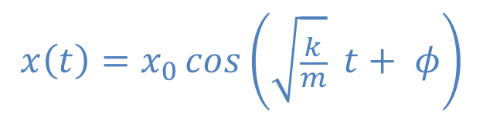
Natural (passive) systems
Mass-spring system 2nd order system:
  Newton's Law: F = m.a
$$x\left(t\right)=x_{0}\cos\left(\sqrt{\frac{k}{m}} t+ φ\right)$$
Normalized
https://www.myphysicslab.com/springs/single-spring-en.html

Slide 5
Dissipative systems
Dissipative systems
Normalized:

Slide 6
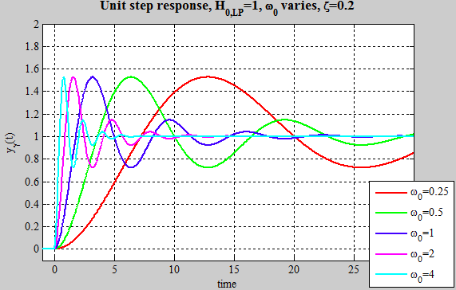
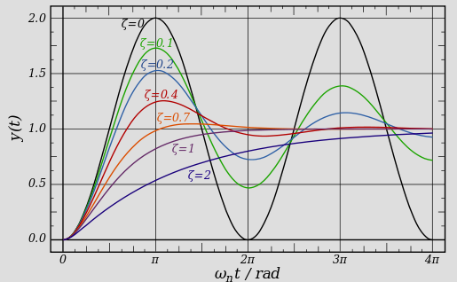
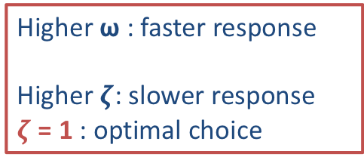
2nd order system
https://www.myphysicslab.com/springs/single-spring-en.html
Higher ω : faster response
Higher $ζ$: slower response
$ζ$ = 1 : optimal choice

Slide 7
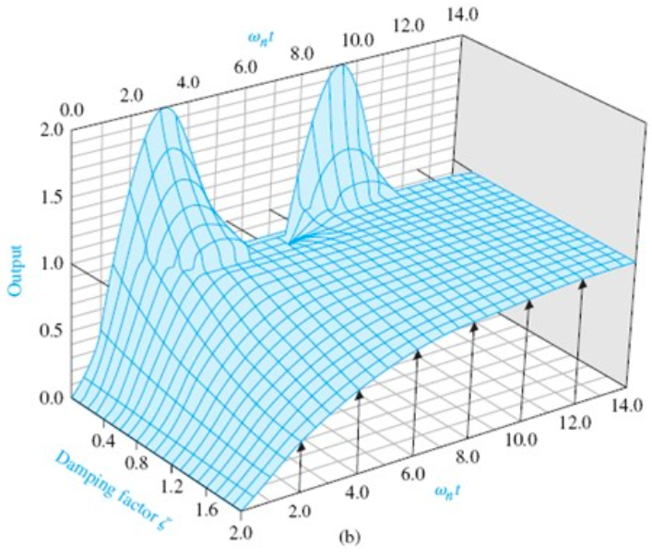
2nd order system
https://www.myphysicslab.com/springs/single-spring-en.html
Higher ω : faster response
Higher $ζ$: slower response
$ζ$ = 1 : optimal choice

Slide 8

2nd order systems are Practical
Cool animation with multiple spring-dampers:
https://codepen.io/dissimulate/pen/KrAwx
Control >>> Design how your system behave.

Slide 9
Use Control to make robots behave like a dissipative system
: goal of controller is to move robot to x_{d}
input
robot
output
f (x_{d} , x)
x
PD – control
Proportional + Derivative
Change behavior with k_{p} , k_{d}

Slide 10
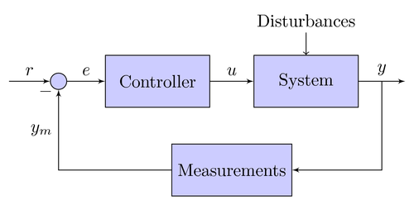
Control Systems
Overall block diagram
  System (+actuator)
  Feedback (sensors)
  Controller (design)
Control Methods:
  Model-based
    Requires an approximate (linear / nonlinear) model of system.
    Uncertainties (un-modeled dynamics) are modeled as disturbance
  Model-free
    Learning-based approaches, e.g. RL , adaptive, etc.

Slide 11
PID control
Proportional + Integral + Derivative
PID:
  simple, easy to implement, practical, model-free
  need heuristics for tuning the gains
Proportional + Integral + Derivative Control

Slide 12
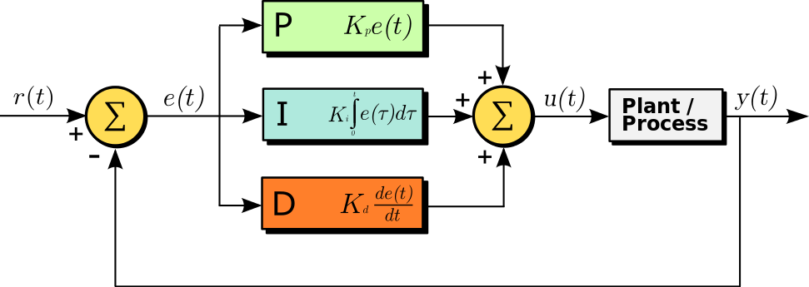
PID control
Proportional + Integral + Derivative
Proportional + Integral + Derivative Control
P term is proportional to the current value
I term accounts for past values
D term is a best estimate of the future trend
Based on mass-spring-damper system

Slide 13
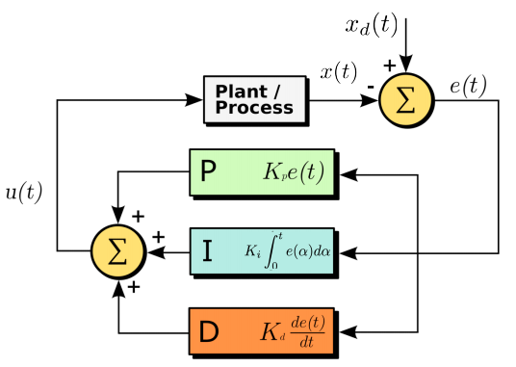
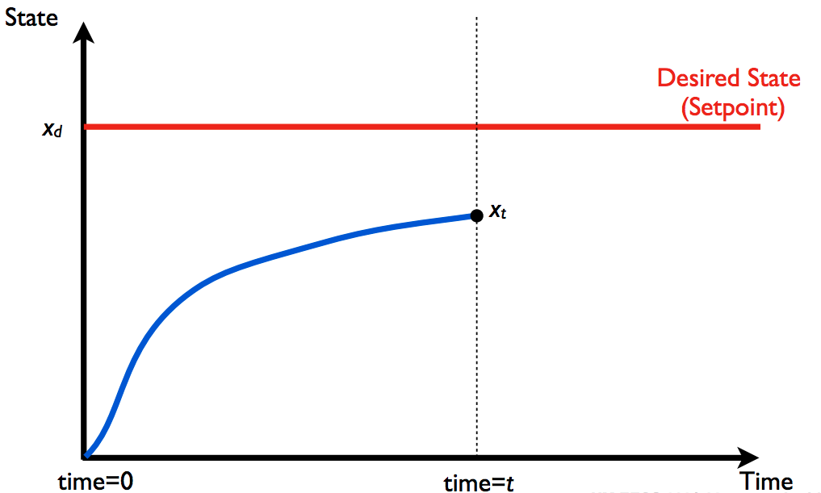
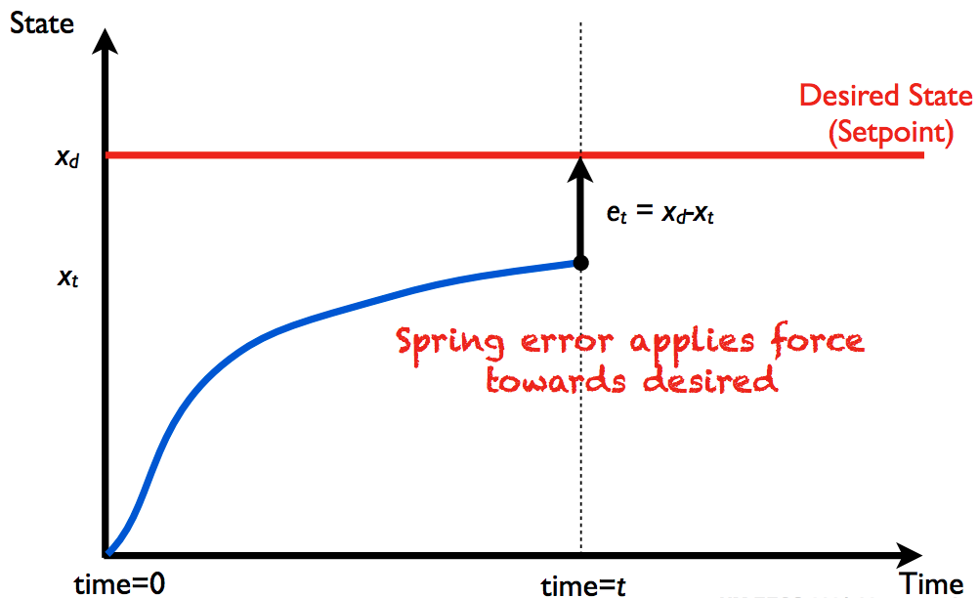
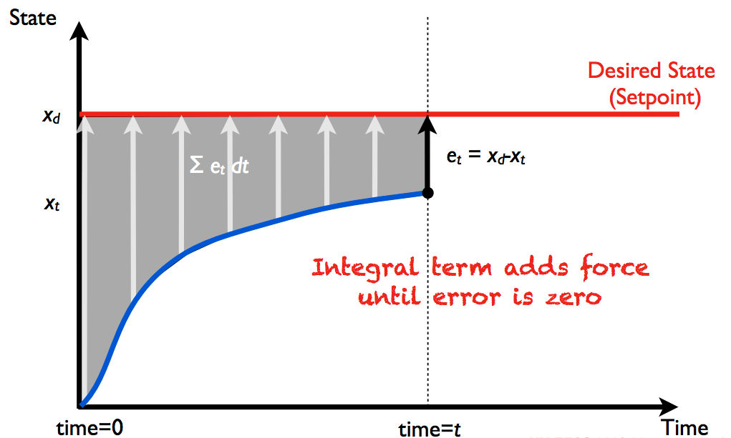
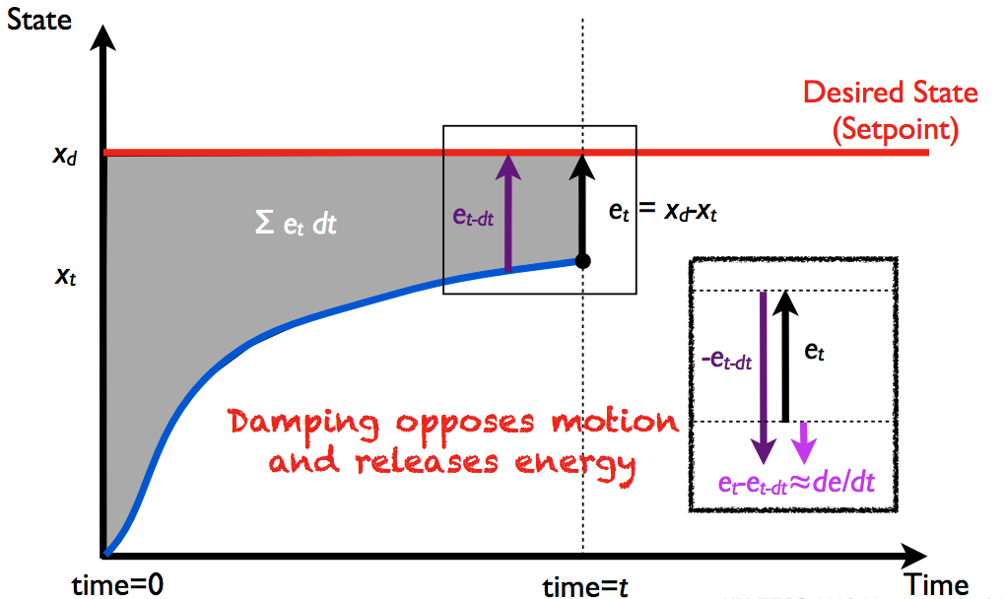
PID control
e(t) = x_{d}(t) -x(t)

Slide 14
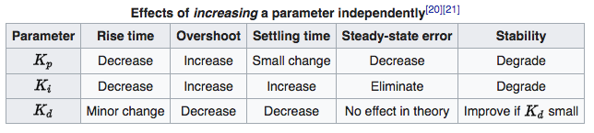
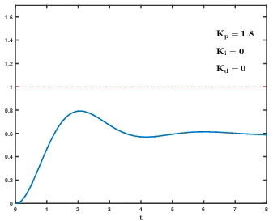
PID control
Proportional + Integral + Derivative Control
[wikipedia: PID control]

Slide 15
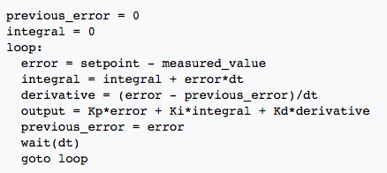
PID: digital implementation
Discrete integral
Derivative (backward finite difference)
Pseudocode

Slide 16
PID gain tuning
Start will all gains at zero: K_{p}=K_{d}=K_{i}=0
Increase K_{p} until system roughly meets desirable state
  Overshoot & oscillation are acceptable
Increase K_{d} until system is stable
Increase K_{i} until system consistently reaches x_{d}
Refine gains to improve performance
Will test this in lab 2, for Lego actuators

Slide 17
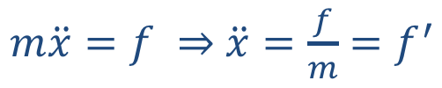

Tracking Control
What if we want to track a trajectory, i.e. x_{d} is changing with time: x_{d}(t)
$m\ddot{x}=f ⇒$ $\ddot{x}=\frac{f}{m}=f^{′}$
$f^{′}={\ddot{x}}_{d}−k_{v}\left(\dot{x}−{\dot{x}}_{d}\right)−k_{p}(x−x_{d})$

Slide 18
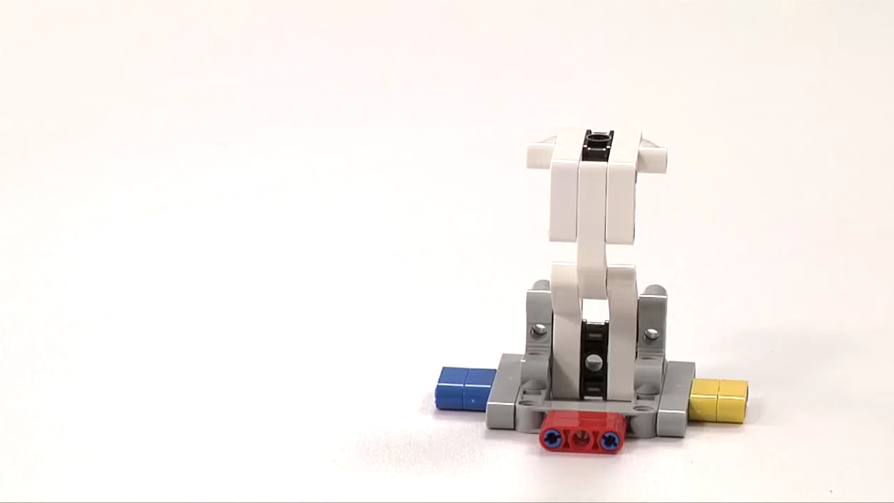
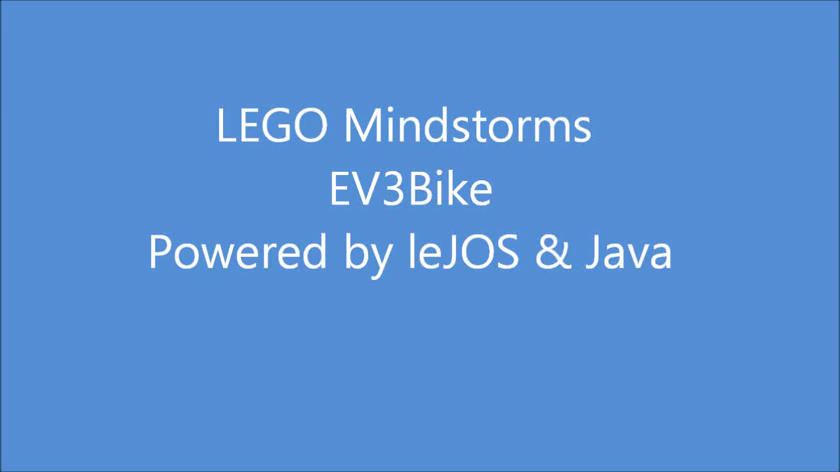
Motivation
Control >> Design how your mechatronic system behave.

Slide 19
Control of Nonlinear Systems

Slide 20
Disturbance Rejection

Slide 22
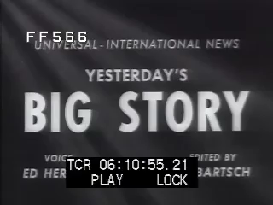
Practical issues for choosing Controller Gains
Tacoma Narrows Bridge (1940)
Rule of thumb:
ω = (3 to 10 Hz)*2π
ζ = 1

