Slide 1
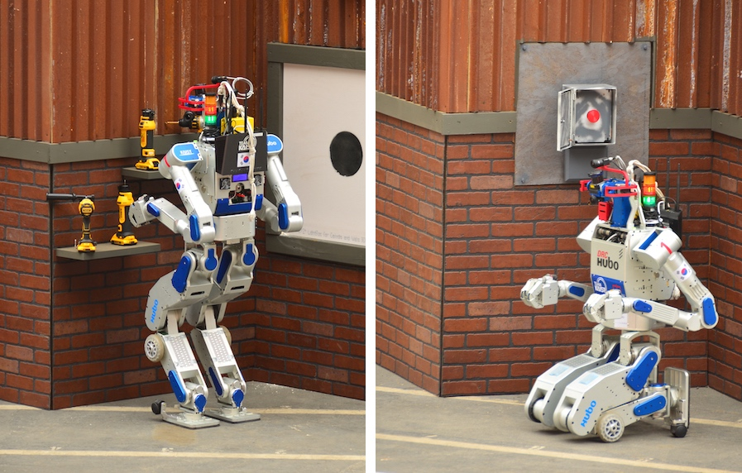
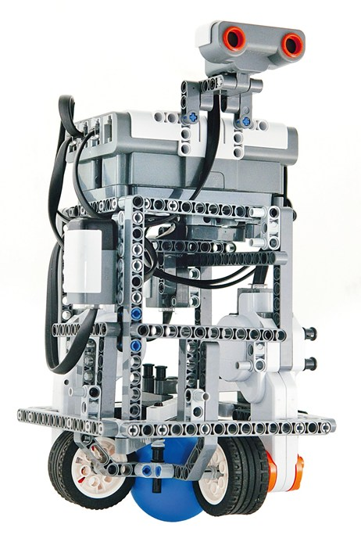
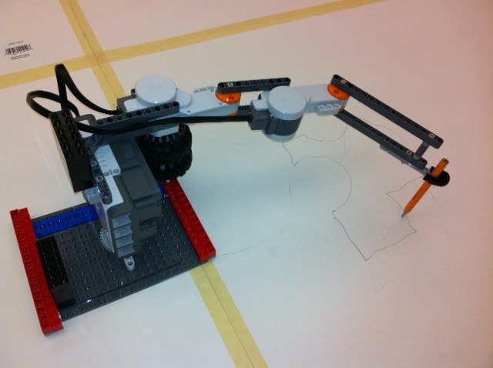
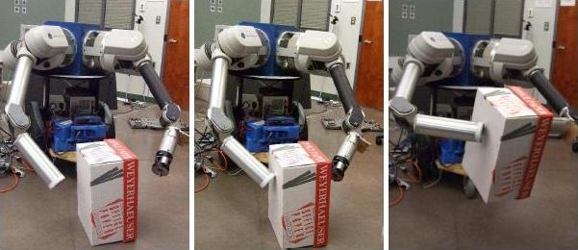
Experimental Robotics
CMPUT 399
Martin Jagersand
Masood Dehghan
Laura Petrich

Slide 2
Course Questions
Why study robotics?
What, exactly, is robotics about?
What work is involved?
and other questions as well!

Slide 3
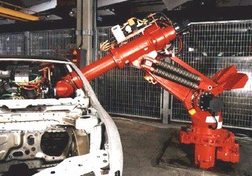
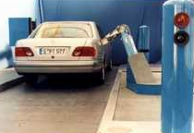
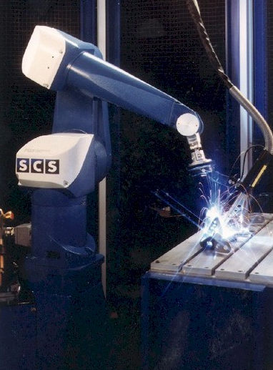
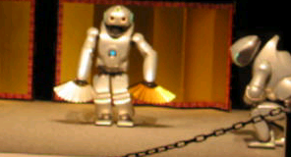
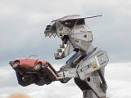
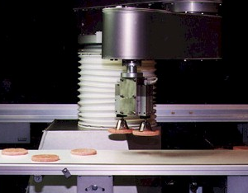
Why Robotics?
shift in robot numbers… !
assembly
pumping gas
Practice
welding
dancing
eating automobiles
Promise
packaging
http://www.youtube.com/watch?v=wg8YYuLLoM0&feature=player_embedded#
Notes:
show sony_0.wmv
useful – but not utilitarian
Original flex picker:
http://www.youtube.com/watch?v=wg8YYuLLoM0&feature=player_embedded#
Lots ‘o applications:
http://www.youtube.com/watch?v=xHuDvVa7mkw&feature=player_embedded
Lego!:
http://www.youtube.com/watch?v=YoXCn4Gh_HA&feature=player_embedded

Slide 4
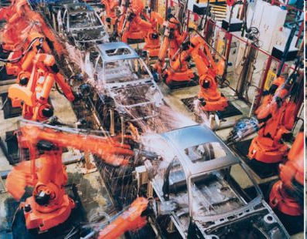
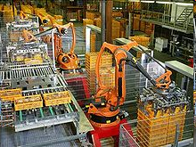
Current Robot Arm Applications
Manufacturing
Engineered environment
Repeated motion
1 million arms in operation worldwide
http://en.wikipedia.org/wiki/Industrial_robot

Slide 5
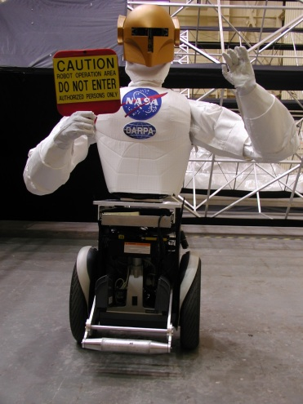
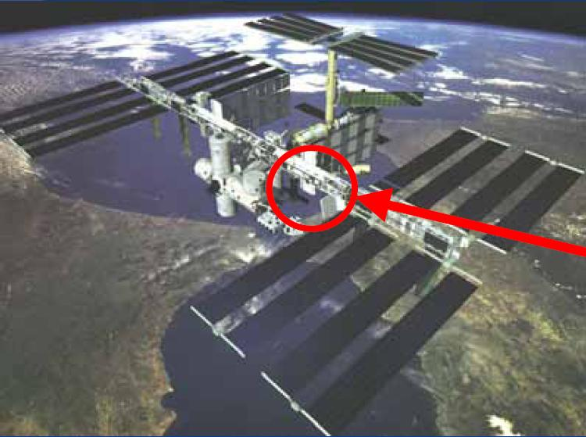
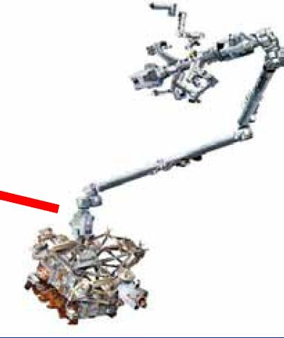
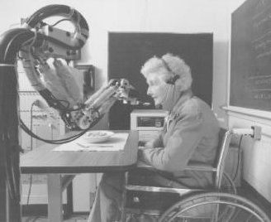
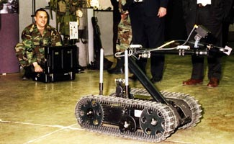
Emerging Robotics Applications
Space - in-orbit, repair and maintenance, planetary exploration anthropomorphic design facilitates collaboration with humans
Basic Science - computational models of cognitive systems, task learning, human interfaces
Health - clinical applications, "aging-in-place,” physical and cognitive prosthetics in assisted-living facilities
Military or Hazardous - supply chain and logistics support, re-fueling, bomb disposal, toxic/radioactive cleanup
No or few robots currently operate reliably in these areas!

Slide 6

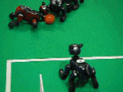

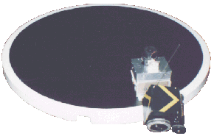

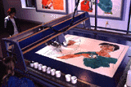
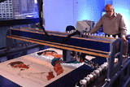
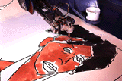
kismet
Why Robotics?
Sony Aibo dogs – had to LEARN to run
Vibrant field
other competitions
Harold Cohen’s Aaron
Notes:
robocup 4-legged league
remarkably, the fastest gait had to be learned and was not at all intuitive…
I guess you can describe them as "dogged" !
Robots unleashed…

Slide 7

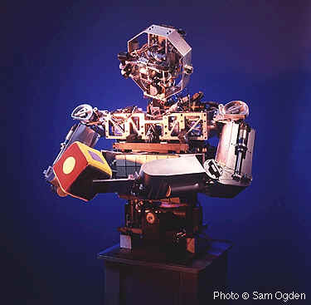
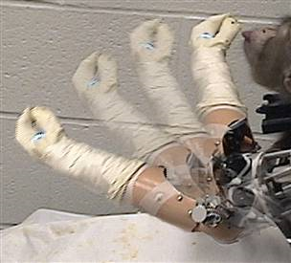
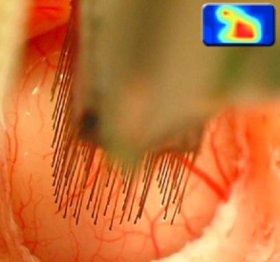
Why Robotics?
A window to the soul...
MIT’s robotic fish with an unusual actuator!
Monkey/machine interface at the Univ. of Pittsburgh
Rodney Brooks’s Cog
Advances in AI and in Robotics are one and the same.
AI-complete…
Notes:
http://www.msnbc.msn.com/id/6989239/ <- monkey raising a cucumber to its mouth using only thoughts to actuate that arm…
see cog video on desktop with Brian Scasselati

Slide 8
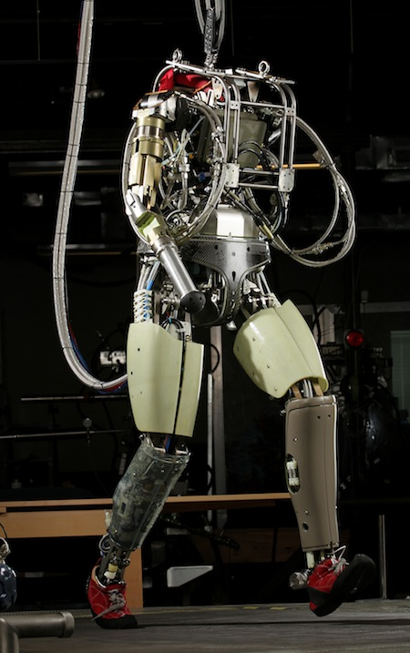
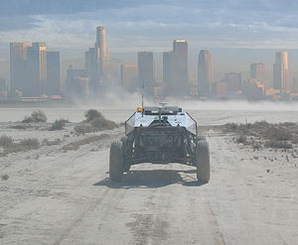
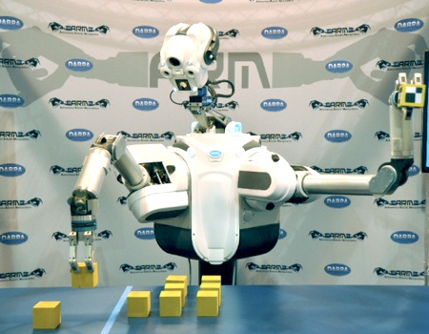
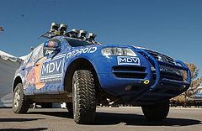
Robotics challenges
Manipulation ‘11-14
Navigation ‘05
Humanoids ’12-15

Slide 9
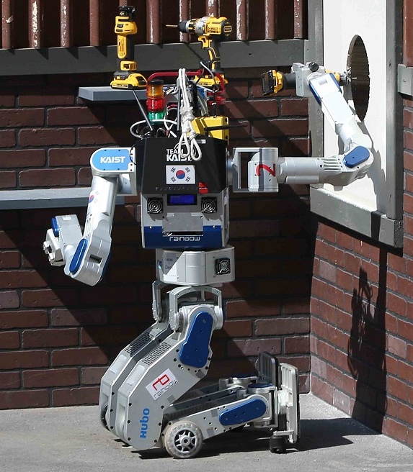
DARPA Robotics Challenge

Slide 10
Course Questions
Why study robotics?
What, exactly, is robotics about?
Or at least what we learn here
What work is involved?

Slide 11
What is a robot?
Unicycling
Autonomous : Robot :: : Student
Awake
Autonomous
Choose one !
Notes:
For this course, the word robot has a more narrow connotation than it sometimes does in informal use…
here's an analogy question to make this point…
for us, it'll be awake – that is to say, almost always true – and, at the very least, we strive to make it always true…
it might be reasonable to choose "awake" since for the purposes of this course, all of our "robots" will be autonomous – and all of us (I think I count as a Mudder, too) are "awake…"
Ideas for staying awake at 9:35 am !!

Slide 12
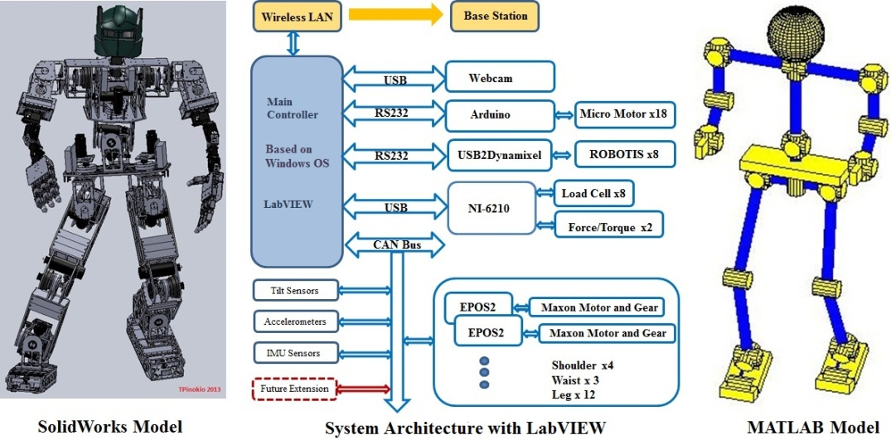
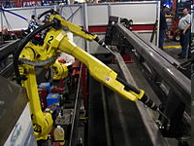
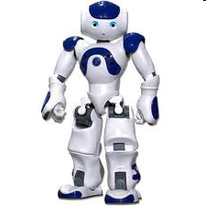
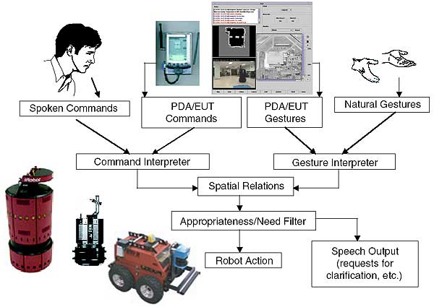
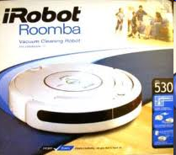
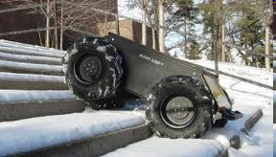
What is a robot?
Physical instantiation
(Hardware)
System and properties

Slide 13
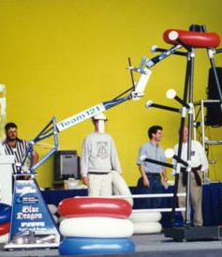
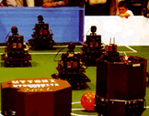
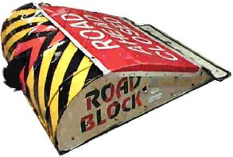
What is a robot?
Robot :
A physical system that “autonomously” senses the environment and acts in it.
Autonomy might be a continuous, not a discrete attribute
Researchers disagree on what kind and how much autonomy is needed
none
full
Robot Wars, Battlebots
FIRST Robotics
Robocup
There may be other axes along which to evaluate robots, too…
Notes:
go through…
robots!
the next slide presents three axes along which you might evaluate a robot system…

Slide 14
World Modeling
How much information about the world does the robot internalize?
more
Capabilities
wow (10)
less
Who's making the decisions?
huh? (1)
human-controlled
Autonomy
independent
Notes:
there has been considerable tension among roboticists along this axis – how much of the word to model and how to do so…
capabilities: probably at LEAST two axes here: coolness and there's sensor richness – the density or quantity of sensory information that a particular system deals with… Since there are only three dimensions on this slide… I'm combining those two…
others: - ask?
robust!

Slide 15
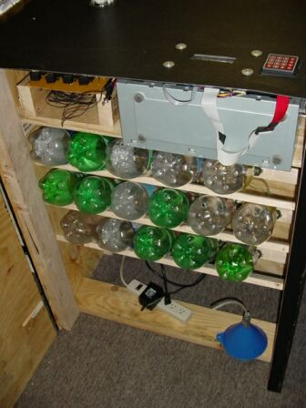
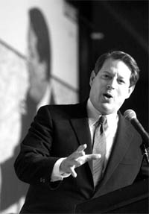
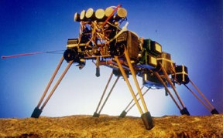
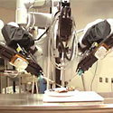
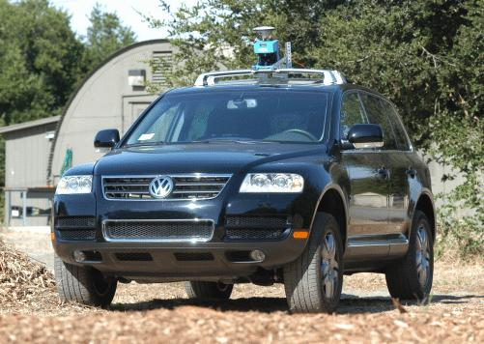
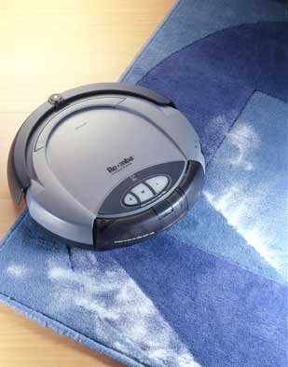

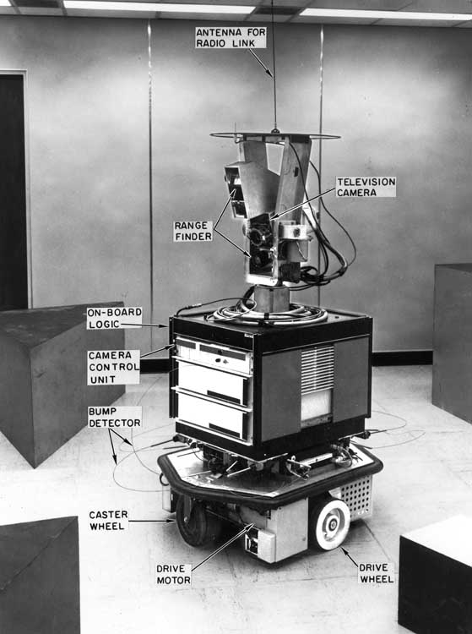
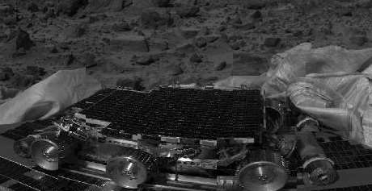
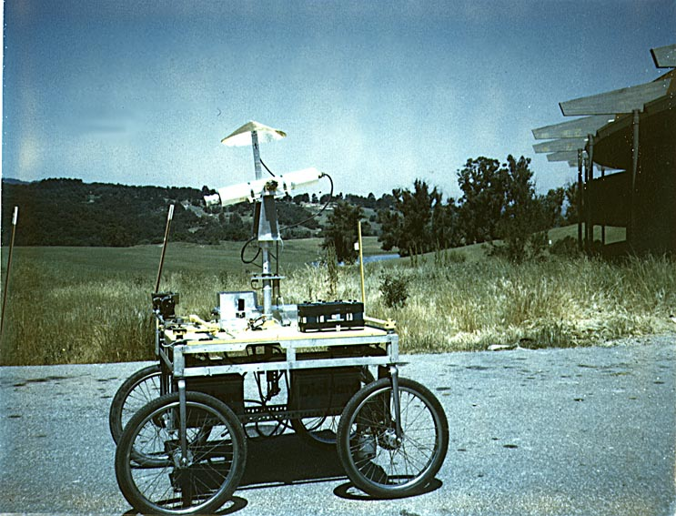
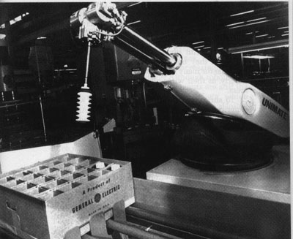
C
A
B
Genghis
Robotic Insect
da Vinci
D
Bar Monkey
Al Gore
Robotic Surgeon
ex-VP, Nobelian
11 “robotic” systems
H
F
E
G
Roomba
Sims
Robotic vacuum cleaner
now with professor!
Stanford's Stanley/CMU's Boss
I
each a $2 million winner
J
K
Shakey
object-”manipulator” (pusher) from SRI
Sojourner/Spirit/Opportunity
(1969)
Mars Exploration Rovers: 1997, 2004-now
Unimate
Stanford Cart
Perhaps include a robot of your own choosing…
vision-based obstacle-avoider
first industrial robotic arm, '61 (now in the hall of fame)
(1976)
Notes:
So, let me ask you to think a bit about these axes – as they describe these 11 systems on this slide here…, all of which have at least been accused of being robotic…
now, some or all of these might be new -

Slide 16
World Modeling
more
B
Al Gore (11)
Capabilities
wow (10)
less
huh? (1)
human-controlled
Autonomy
independent
Notes:
joke about political neutrality and unary or binary ☺

Slide 17
C
A
B
Genghis
Robotic Insect
da Vinci
D
Bar Monkey
Al Gore
Robotic Surgeon
robotic barkeep
ex-VP, Nobelian
11 “robotic” systems
H
F
E
G
Roomba
Sims
Robotic vacuum cleaner
now with professor!
Stanford's Stanley/CMU's Boss
I
each a $2 million winner
J
K
Shakey
object-”manipulator” (pusher) from SRI
Sojourner/Spirit/Opportunity
(1969)
Mars Exploration Rovers: 1997, 2004-now
Unimate
Stanford Cart
Perhaps include a robot of your own choosing…
vision-based obstacle-avoider
first industrial robotic arm, '61 (now in the hall of fame)
(1976)
Notes:
So, let me ask you to think a bit about these axes – as they describe these 11 systems on this slide here…, all of which have at least been accused of being robotic…
now, some or all of these might be new -

Slide 18
World Modeling
Capability (0-10)
Robot Plot
more
E
B
Al Gore (11)
J
Shakey (3)
Stanford Cart (3)
Capabilities
C
wow (10)
less
huh? (1)
Genghis (3)
human-controlled
Autonomy
independent
Notes:
3 – early era of robotics: single-minded architecture
try it & see where you place robots – also add one of your own…
(draw the answers here, then show others…)

Slide 19
World Modeling
Capability (0-10)
Robot Plot
more
Al Gore (11)
Sims (5)
Stanley/Boss (9)
Shakey (3)
MERs (8)
Stanford Cart (3)
Bar Monkey (9)
less
da Vinci (2)
Unimate (4)
Roomba (7)
Genghis (3)
human-controlled
Autonomy
independent

Slide 20
World Modeling
Capability (0-10)
Robot Plot
more
Al Gore (11)
Sims (5)
Stanley/Boss (9)
Shakey (3)
MERs (8)
Stanford Cart (3)
Bar Monkey (9)
less
da Vinci (2)
Unimate (4)
Roomba (7)
Genghis (3)
human-controlled
Autonomy
CS 154: algorithms for programming autonomous robots

Slide 21
Course Timeline
Low-level robotics
  architecture
  motors/actuators
  sensors
Vision
  regions and recognition
  features and matching
Spatial Reasoning
  reasoning with uncertainty
  filtering and state estimation
  localization
  mapping
  localizing and mapping
Spatial Planning
  configuration space
  kinematics, dynamics
  path planning
  pursuer/evader algorithms
2wks
What am I? robots ~ bodies…
2wks
is seeing believing?
5wks
where am I?
5wks
how do I get there?
Notes:
what topics will we be covering?
two assignments in each of the first two parts…
one assignment in each of the last two parts – plus the final project demos

Slide 22
399 Course topics
Introduction
Robot hardware for mobile robots, arms and UAV's
Reactive robotics
Modeling mobile robots, kinematics, navigation
Robot sensors
Motor Control
Robot arm types and kinematics
Analytic and numerical arm inverse kinematics
Machine vision and image processing
Visual servo motion control
Robot systems, mechatronics
What am I? robots ~ bodies…
where am I?
how do I get there?
is seeing believing?
Notes:
what topics will we be covering?
two assignments in each of the first two parts…
one assignment in each of the last two parts – plus the final project demos

Slide 23
Robot timeline?
...
1921
1950
2020
2150
2421

Slide 24
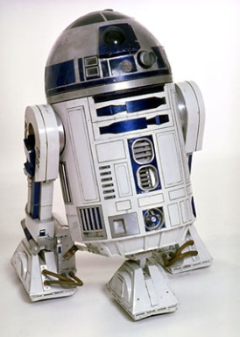






Fictional Robot timeline
Putting these robots in chronological order?
...
1921
2020
2150
2421
Notes:
protectors and terminators
as well as _ex_terminators…

Slide 25

Fictional robot timeline
Karl Capek
Rossum’s Universal Robots
I, Robot
Asimov
...
1921
1950
2020
2150
2421
Notes:
exterminate all humans sound <- mac iTunes
robots: need to be freed from their work! RUR

Slide 26
Robot timeline
Karl Capek
Isaac Asimov’s Laws of Robotics
Rossum’s Universal Robots
First Law:
A robot may not injure a human being, or, through inaction, allow a human being to come to harm.
Second Law:
A robot must obey orders given it by human beings, except where such orders would conflict with the First Law.
Third Law:
A robot must protect its own existence as long as such protection does not conflict with the First or Second Law.
I, Robot
...
1921
1950
Notes:
robots as protectors…

Slide 27
Real robot timeline
...
1951
1968
1976
1985

Slide 28



Real robot timeline
Tortoise “Elsie”
by Neurophysiologist Grey Walter
...
1951

Slide 29
Shakey
Nils Nilsson @ Stanford Research Inst.
first “general-purpose” mobile platform
Living Room (L)
Kitchen (K)
sp
sh
tv
rem
Bedroom (B)
...
...
1968

Slide 30
Robotics's Shakey start
START
Go(from,to)
Preconditions: At(sh,from)
Postconditions: At(sh,to)
Push(obj,fr,to)
Preconditions: At(sh,fr) ∧ At(obj,fr)
Postconditions: At(sh,to) ∧ At(obj,to)
ACTIONS
At(sh,L) ∧ At(sp,K) ∧ At(rem,B) ∧ At(tv,L)
Go(L,B)
Push(tv,L,B)
Go(L,K)
Push(tv,L,K)
At(sh,K) ∧ At(sp,K) ∧ At(rem,B) ∧ At(tv,K)
for details, see CS 151!
At(sh,L) ∧ At(sp,L) ∧ At(rem,L) ∧ At(tv,L)
GOAL
Notes:
STRIPS planning
explicit representation of high-level environmental states…
-- low-level engineering of actuation and control had to be improved
- -algorithms for reasoning about the robot's environment had to be improved
VIDEO!

Slide 31

Stanford Cart: SPA
Hans Moravec @ SAIL
“functional” task decomposition
SENSING
ACTING
perception
Planning
task execution
world modeling
motor control
“horizontal” subtasks
...
...
1976
Notes:
The field moved slowly, mostly because computation moved slowly!

Slide 32

Cartland (outdoors)
Notes:
Video… see Lec 2 for large video…

Slide 33

Cartland (indoors)

Slide 34



“Robot Insects”
Rodney Brooks @ MIT
planning and reasoning
“behavioral” task decomposition
identify objects
“vertical” subtasks
SENSING
build maps
ACTING
explore
wander
avoid objects
...
...
1985
Notes:
picture of Rodney Brooks – his paper!!

Slide 35
Subsumption Architecture
Genghis in action!
complex behavior = simple rules + complex environment
http://www.youtube.com/watch?v=BUxFfv9JimU
Notes:
Video of Genghis

Slide 36
Subsumption
Genghis
1) Standing by tuning the parameters of two behaviors: the leg “swing” and the leg “lift”
2) Simple walking: one leg at a time
3) Force Balancing: via incorporated force sensors on the legs
4) Obstacle traversal: the legs should lift much higher if need be
5) Anticipation: uses touch sensors (whiskers) to detect obstacles
6) Pitch stabilization: uses an inclinometer to stabilize fore/aft pitch
7) Prowling: uses infrared sensors to start walking when a human approaches
8) Steering: uses the difference in two IR sensors to follow
57 modules wired together !

Slide 37
Subsumption Architecture
navigate behavior
wander behavior
runaway behavior
Notes:
If you squint at it, what is this diagram?

Slide 38
Finite-state Architecture
navigate behavior
wander behavior
runaway behavior
FSM / DFA
Notes:
If you squint at it, what is this diagram?

Slide 39

Probabilistic robotics
Start

Slide 40

Sensory guided robotics
Camera or Kinect vision

Slide 41
Robot timeline
Robots - a 50 year journey [Video @ ICRA 2000]
https://vimeo.com/137042620
The journey continues:
https://vimeo.com/173394878
I, Robot
...
1921
1950
2000
Notes:
robots as protectors…

Slide 42

Robotics (turnover over $40 billion*)
Industrial Robotics - Service Robotics
*IFA robotics, 2016

Slide 43


Trends in robotics
1.7 million new industrial robots by 2020
Double-digit average annual increase

Slide 44

Trends in robotics
Continued increase in major industries

Slide 45

Trends in industrial robotics

Slide 46



Trends in service robotics

Slide 47

Trends in service robotics

Slide 48

Trends in service robotics

Slide 49
Canadian Robotic Startups
Kinova robotics (2006): assistive robotic platform
  $25M funding Sept., 2017
  Brain-controlled robot arm https://www.youtube.com/watch?time_continue=52&v=-Vh0IJRbOsY
RobotiQ (2008): Adaptive Grippers (Laval Uni.)
Clearpath Robotics (2009): self-driving mobile robots (U-waterloo)
  from 365K VC founding … $30 million in a Series B (2016)
SkyX (2015): Drone for monitoring pipelines in oil and gas sector (Ontario)
Kindred.ai (2014): AI grasping technology based on techniques in deep learning and reinforcement learning
  ($28 million)

Slide 50
Course Questions
Why study robotics?
What, exactly, is robotics about?
What work is involved?

Slide 51
Details
Reading
Calendar
Web Page
Assignments ...
First week's paper:
Achieving Artificial Intelligence through Building Robots
no required text
Rodney Brooks
class meetings: Tue, Th 3:30-4:50
Lab CSC 229: M 5:00-7:50 pm
real office hours: after class or W,F by appt
http://ugweb.cs.ualberta.ca/~vis/courses/robotics/
Three lab assignments
An individual reading and presentation
A group project
Two in class exams
Notes:
no required text…
of course there are lots of texts… (show)

Slide 52

Lab Projects - Options
Choose a platform
The EV3 Lego Robot Kit
Default
Lego EV3
Other possibilities:
Robot arm
AIBO dog
Pioneer
UAV
Choose a task
Others… !
spatial reasoning
itself publishable…
tag / hide & seek
fire extinguisher
Vision guided motion
Tele-operation
Beyond Botball

Slide 53

Robot and Project Options

Slide 54

Robot and Project Options

Slide 55


Robot and Project Options
Pic of our small arm and controller
Home built arm

Slide 56


Robot and Project Options
Sony's AIBO Robot Dog
1 AIBO
Robotics, unleashed
Soccer, machine learning, human-robot interaction
'06: aligning and scoring a goal
'07-'08: line-following and landmarks
lots of software on which to build
CMU's Tekkotsu

Slide 57



Unmanned Autonomous Ground Vehicle
Heading Outdoors…
With Engineeering!
International Ground Vehicle Competition
cooper union's roberto
Mini Grand Challenge

Slide 58


Robot and Project Options
Mobilizing laptop computers
'05: AAAI Scavenger Hunt
someday…
framework for almost any design
Notes:
Movie from last spring…

Slide 59




Other Options…
'04: NES Duck Hunt
Wii, anyone?
A robot system that partners in a game…
robotics.cs.brown.edu/projects/embodied_gaming/
A Turing machine…
Design and build a platform from scratch: wheeled or walking (not aerial or underwater, however…)

