Slide 1
Geometric Computer Vision Review and Outlook

Slide 2
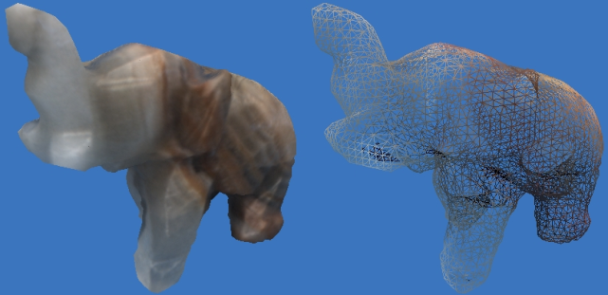
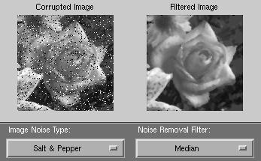
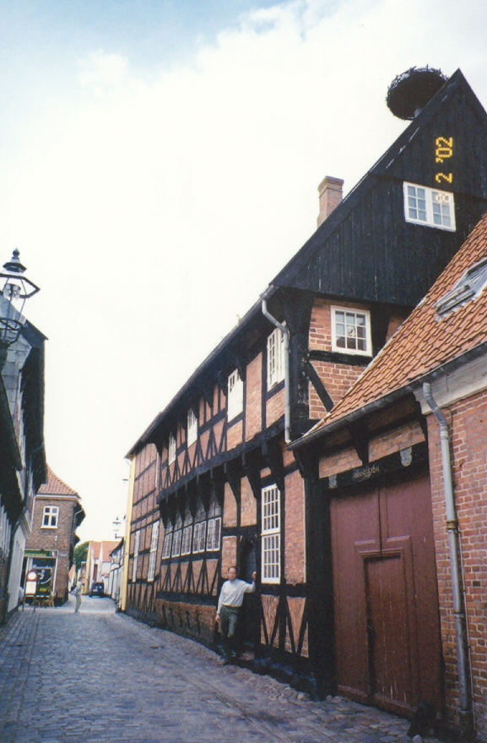
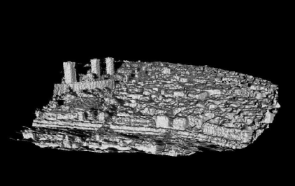
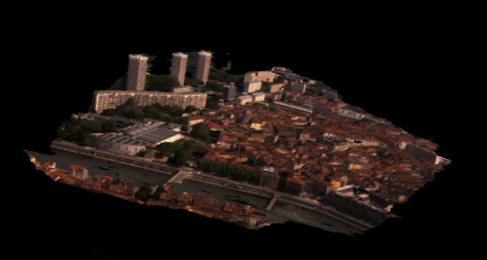
What is Computer Vision?
Computer Graphics
Image Processing
Three Related fields
Image Processing: Changes 2D images into other 2D images
Computer Graphics: Takes 3D models, renders 2D images
Computer vision: Extracts scene information from 2D images and video
e.g. Geometry, “Where” something is in 3D,
Objects “What” something is”
What information is in a 2D image?
What information do we need for 3D analysis?
CV hard. Only special cases can be solved.
90
Computer Vision
horizon
Computer Vision
Notes:
Image processing, CV, CG
Zach’s geometry confusion
Wikidef

Slide 3
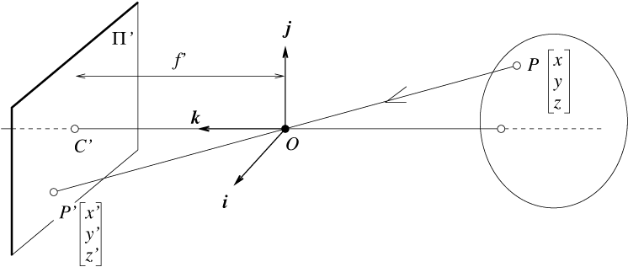
The equation of projection
Intuitively:
Mathematically:
Cartesian coordinates:
Projectively:
Projection matrix
Camera matrix (internal params)
Rotation, translation (ext. params)
Notes:
How do we develop a consistent mathematical framework for projection calculations?

Slide 4
The 2D projective plane
l∞
X∞
Projective point
Homogeneous coordinates
X
X
Y
≡
s
Y
Z
Z
s ≠ 0
x
1
X
=
Inhomogeneous equivalent
y
Z
Y
Perspective imaging models 2d projective space
Each 3D ray is a point in P² : homogeneous coords.
Ideal points
P² is R² plus a “line at infinity”
X
X∞
=
Y
0
l∞

Slide 5
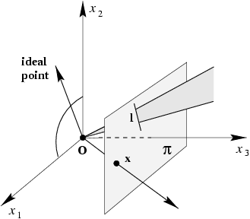
Lines
X
A
Projective line ~ a plane through the origin
Y
=
X
l
=
B
l^{T}X = X^{T}l = AX + BY + CZ = 0
Z
C
X
X
0
l
X∞
=
Y
l∞
=
0
0
1
“line at infinity”
HZ
Ideal line ~ the plane parallel to the image
For any 2d projective property, a dual property holds when the role of points and lines are interchanged.
Duality:
l
=
X₁
X₂
X
=
l₁
l₂
The line joining two points
The point joining two lines

Slide 6
Projective transformations
Homographies, collineations, projectivities
3x3 nonsingular H
maps P² to P²
8 degrees of freedom
determined by 4 corresponding points
Transforming Lines?
subspaces preserved
substitution
dual transformation

Slide 7
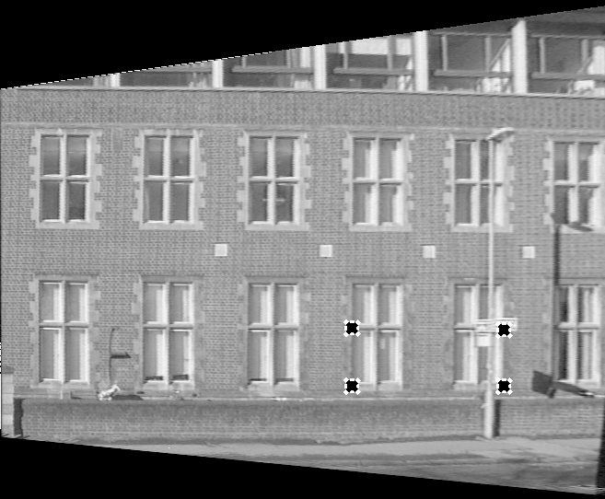
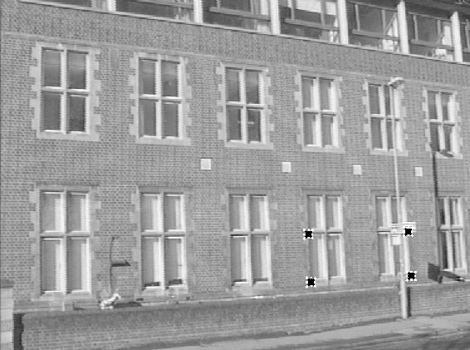
Planar Projective Warping
HZ
A novel view rendered via four points with known structure

Slide 8
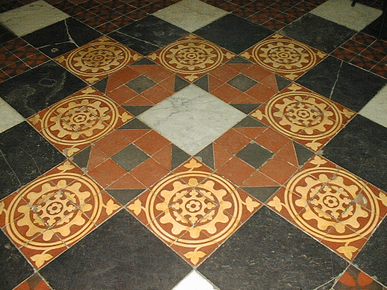
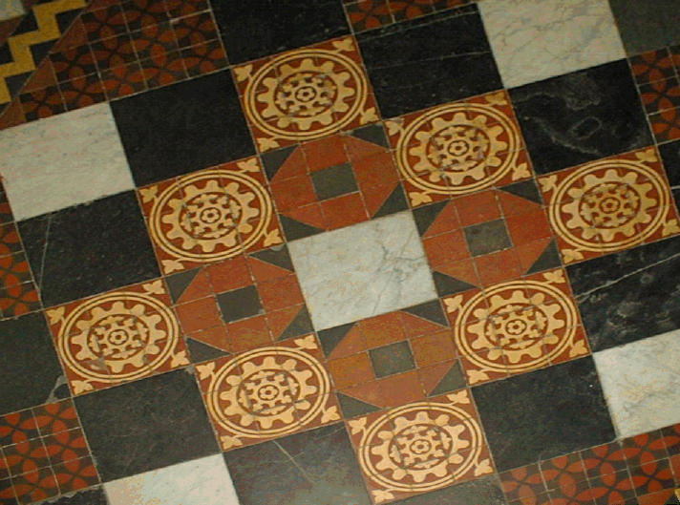
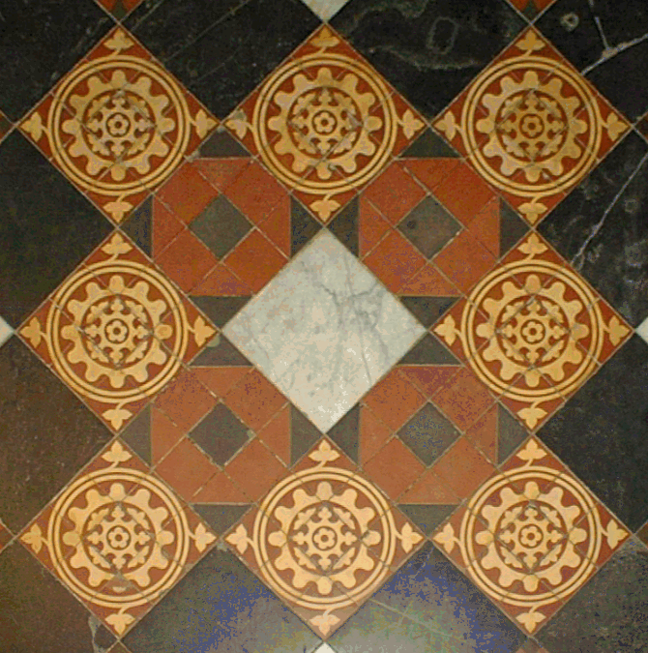
Geometric strata: 2d overview
Group | Transformation | Invariants | Distortion
Projective 8 DOF |  | Cross ratio Intersection Tangency
Affine 6 DOF |  | Parallelism Relative dist in 1d Line at infinity
Metric 4 DOF |  | Relative distances Angles Dual conic
Euclidean 3 DOF |  | Lengths Areas
2 dof
l
∞
l
∞
2 dof
C*
C*
∞
∞

Slide 9
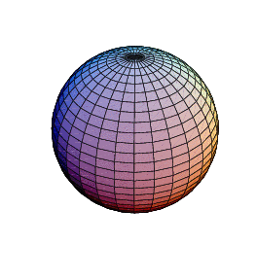
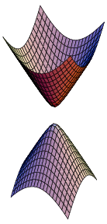
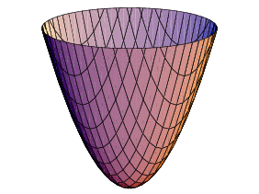
Projective 3D space
Points
Points and planes are dual in 3d projective space.
Planes
Lines: 5DOF, various parameterizations
Projective transformation:
4x4 nonsingular matrix H
Point transformation
Plane transformation
Quadrics: Q Dual: Q*
4x4 symmetric matrix Q
9 DOF (defined by 9 points in general pose)

Slide 10
Geometric strata: 3d overview
Group | Transformation | Invariants | Distortion
Projective 15 DOF |  | Cross ratio Intersection Tangency
Affine 12 DOF |  | Parallelism Relative dist in 1d Plane at infinity
Metric 7 DOF |  | Relative distances Angles Absolute conic
Euclidean 6 DOF |  | Lengths Areas Volumes
3DOF
5DOF
Faugeras ‘95

Slide 11
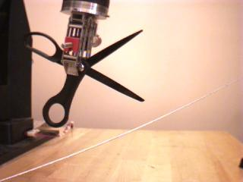
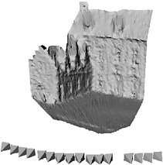
Tasks in Geometric Vision
Tracking: Often formulated in 2D, but tracks 3D objects/scene
Visual control: Explicit 2D geometric constraints implicitly fulfills a 3D motion alignment
3D reconstruction: Computes an explicit 3D model from 2D images
₁
y₁
₁
y₃
₁
y₂

Slide 12
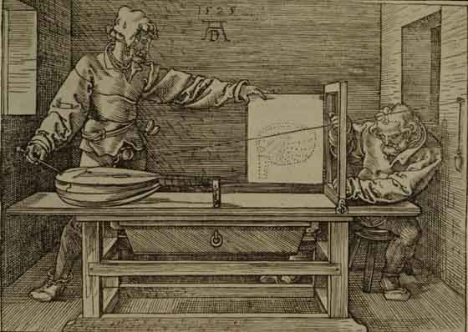
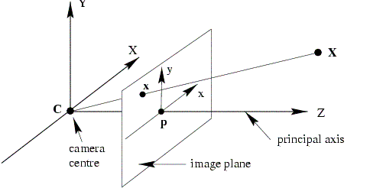
Camera model: Relates 2D – 3D
[Dürer]
Projection matrix
Camera matrix (internal params)
Rotation, translation (ext. params)

Slide 13
2D-3D geometry - resection
Projection equation
x_{i}=P_{i}X
Resection:
x_{i},X P_{i}
Given image points and 3D points calculate camera projection matrix.

Slide 14
2D-3D geometry - intersection
Projection equation
x_{i}=P_{i}X
Intersection:
x_{i},P_{i} X
Given image points and camera projections in at least 2 views calculate the 3D points (structure)

Slide 15
2D-3D geometry - SFM
Projection equation
x_{i}=P_{i}X
Structure from motion (SFM)
x_{i} P_{i}, X
Given image points in at least 2 views calculate the 3D points (structure) and camera projection matrices (motion)
Estimate projective structure
Rectify the reconstruction to metric (autocalibration)

Slide 16
Reconstructing scenes
‘Small’ scenes (one, few buildings)
SFM + multi view stereo
man made scenes: prior on architectural elements
interactive systems
City scenes (several streets, large area)
aerial images
ground plane, multi cameras
SFM + stereo [+ GPS]
depth map fusions

Slide 17
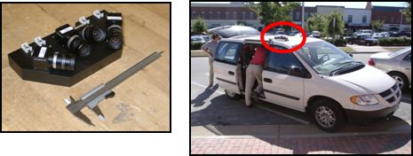
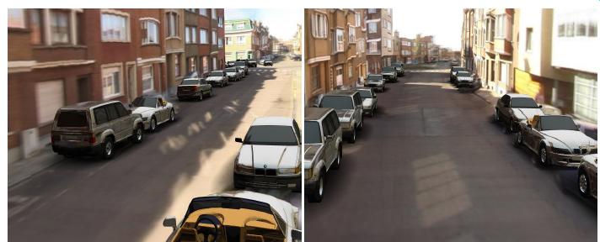
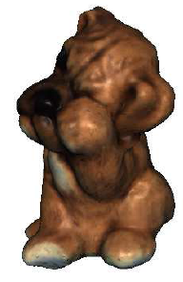
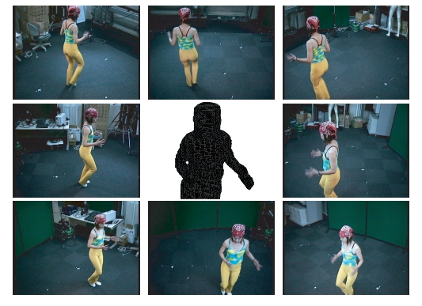
Large scale (city) modeling
Modeling dynamic scenes
time

Slide 18
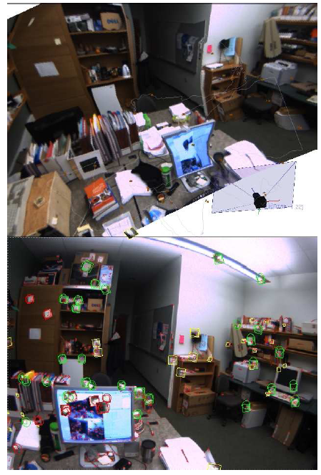
Modeling (large scale) scenes
[Adam Rachmielowski ]

Slide 19
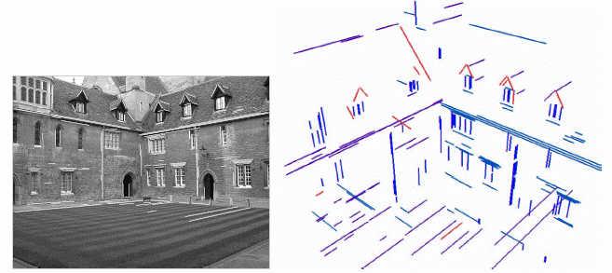
SFM + stereo
Man-made environments :
straight edges
family of lines
vanishing points
[Dellaert et al 3DPVT06 ]
[Zisserman, Werner ECCV02 ]

Slide 20
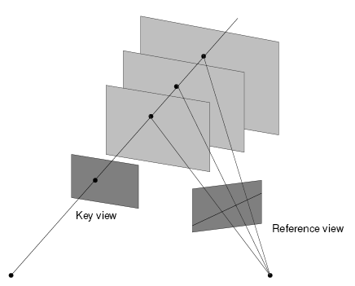
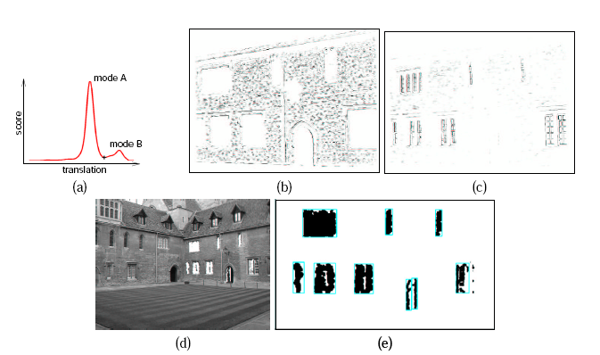
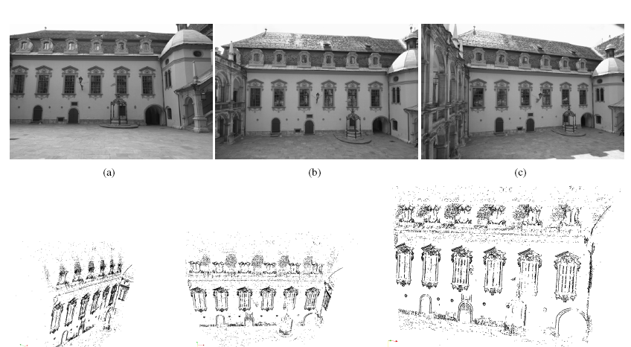
SFM + stereo
dominant planes
plane sweep – homog between 3D pl. and camera pl.
one parameter search – voting for a plane
[Zisserman, Werner ECCV02 ]
[Bischof et al 3DPVT06 ]

Slide 21
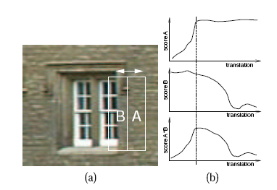
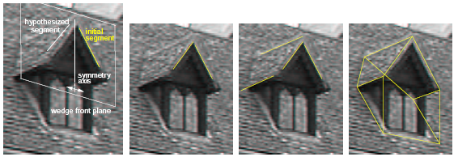
SFM + stereo
refinement – architectural primitives
[Zisserman, Werner ECCV02 … ]

Slide 22
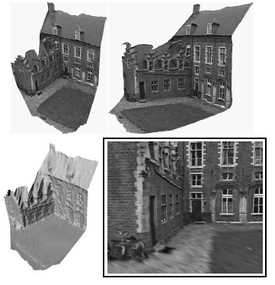
SFM+stereo
Refinement – dense stereo
www.arc3d.be
[Pollefeys, Van Gool 98,00,01]

Slide 23
Façade – first system
Based on SFM
(points, lines, stereo)
Some manual modeling
View dependent texture
[Debevec, Taylor et al. Siggraph 96]

Slide 24
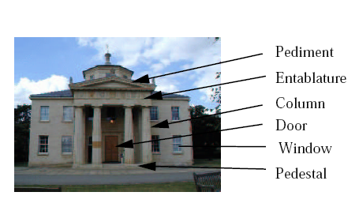
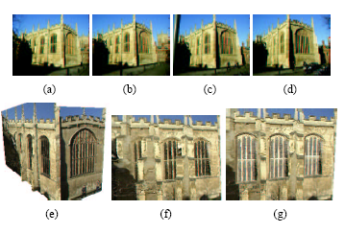
Priors on architectural primitives
prior
θ – parameters for architectural priors
type, shape, texture
M – model
D – data (images)
I – reconstructed structures (planes, lines …)
[Cipolla, Torr, … ICCV01]
Occluded windows

Slide 25
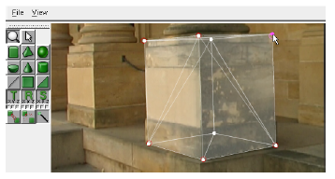
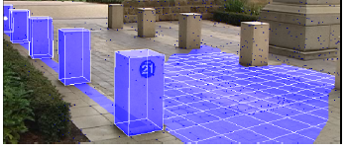
Interactive systems
Video, sparse 3D points, user input
M – model primitives
D- data
I – reconstructed geometry
Solved with graph cut
[Torr et al. Eurogr.06, Siggraph07]

Slide 27
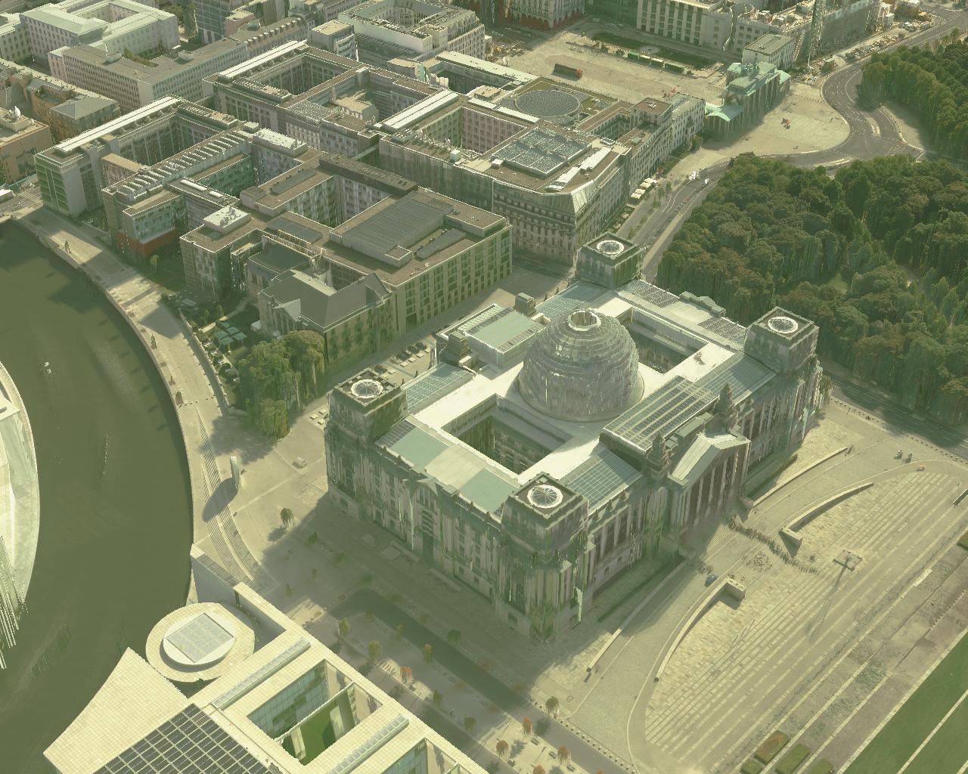
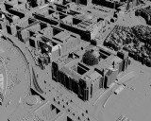
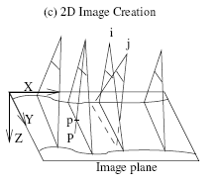
City modeling – aerial images
Airborne pushbroom camera
Semi-global stereo matching (based on mutual information)
[Heiko Hirschmuller et al - DLR]

Slide 28
City modeling – ground plane
Camera cluster
car + GPS
Video: Cannot do frame-frame correspondences
Calibrated cameras – relative pose
GPS – car position - 3D tracking
2D feature tracker
SFM
[Nister, Pollefeys et al 3DPVT06, ICCV07]
[Cornelis, Van Gool CVPR06…]
3D points
Dense stereo+fusion
Texture
3D MODEL

Slide 29
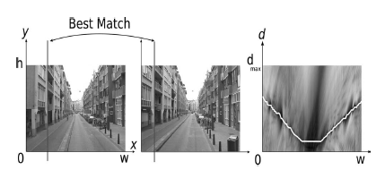
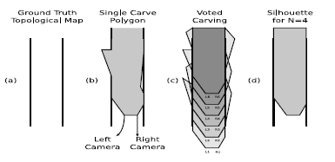
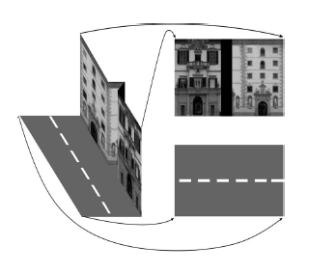
City modeling - example
[Cornelis, Van Gool CVPR06…]
1. feature matching = tracking
2. SFM – camera pose + sparse 3D points
3. Façade reconstruction
– rectification of the stereo images
- vertical line correlation
4. Topological map generation
- orthogonal proj. in the horiz. plane
- voting based carving
5. Texture generation
- each line segment – column in texture space
VIDEO

Slide 30
On-line scene modeling : Adam’s project
On-line modeling from video
Model not perfect but enough for scene visualization
Application predictive display
Tracking and Modeling
New image
Detect fast corners (similar to Harris)
SLAM (mono SLAM [Davison ICCV03])
Estimate camera pose
Update visible structure
Partial bundle adjustment – update all points
Save image if keyframe (new view – for texture)
Visualization
New visual pose
Compute closet view
Triangulate
Project images from closest views onto surface
SLAM
Camera pose
3D structure
Noise model
Extended Kalman Filter

Slide 31
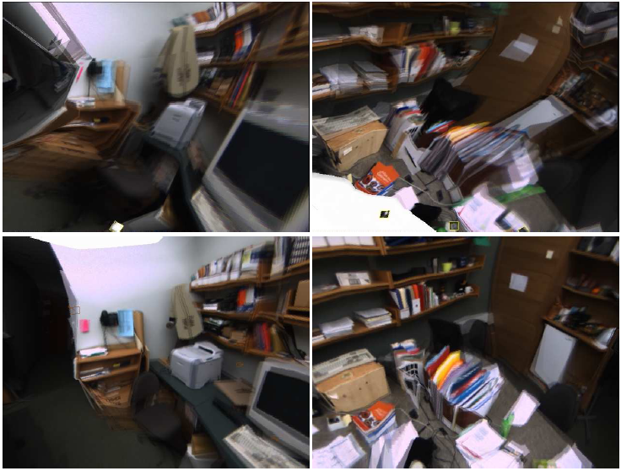
Model refinement

Slide 33
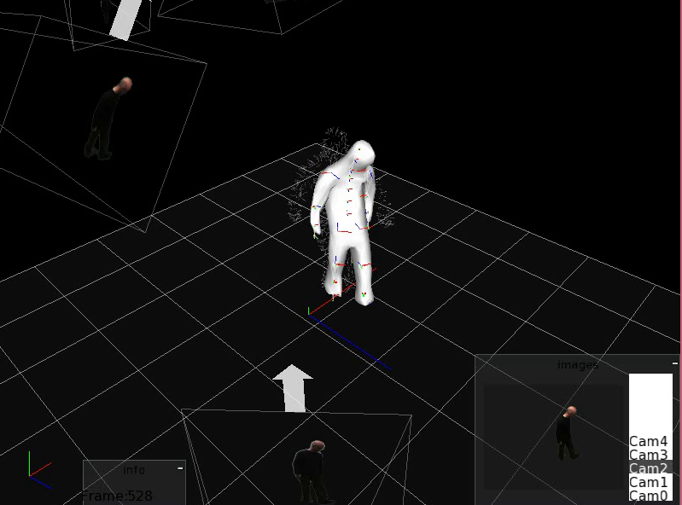
Modeling dynamic scenes
[Neil Birkbeck]

Slide 34
Multi-camera systems
time
Several cameras mutually registered (precalibrated)
Video sequence in each camera
Moving object

Slide 35
Techniques
Naïve : reconstruct shape every frame
Integrate stereo and image motion cues
Extend stereo in temporal domain
Estimate scene flow in 3D from optic flow and stereo
Representations :
Disparity/depth
Voxels / level sets
Deformable mesh – hard to keep time consistency
Knowledge:
Camera positions
Scene correspondences (structured light)

Slide 36
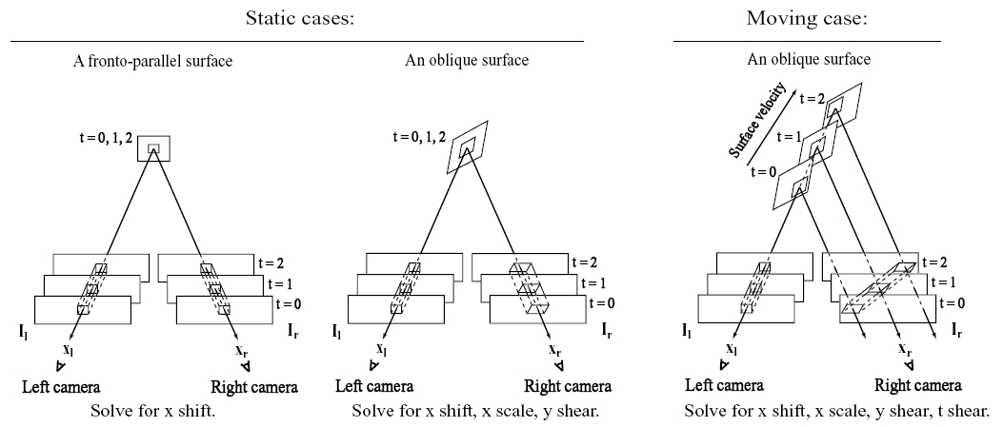
Spacetime stereo
[Zhang, Curless, Seitz: Spacetime stereo, CVPR 2003]
Extends stereo in time domain: assumes intra-frame correspondences
Static scene: disparity
Dynamic scene:

Slide 37
Spacetime stereo: Results

Slide 38
Spacetime stereo:video

Slide 39
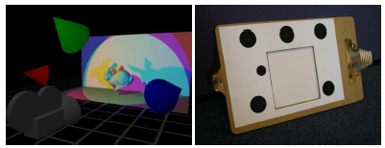
Spacetime photometric stereo
[Hernandez et al. ICCV 2007]
One color camera
projectors – 3 different positions
Calibrated w.r. camera
Each channel (R,G,B) – one colored light pose
Photometric stereo

Slide 40
Spacetime PS - Results

Slide 41
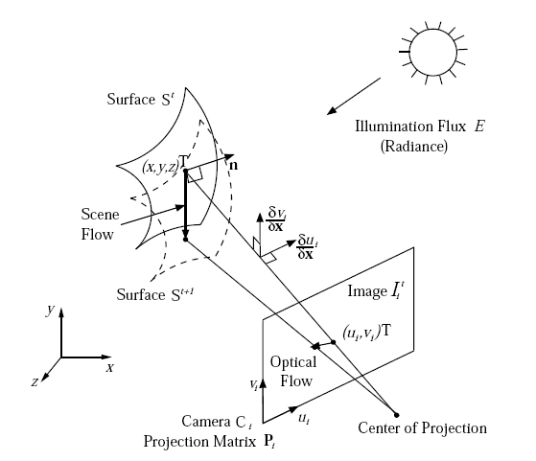
3. Scene flow
[Vedula, Baker, Rander, Collins, Kanade: Three dimensional scene flow, ICCV 99]
2D Optic flow
3D Scene flow
Scene flow on tangent plane
Motion of x along a ray

Slide 42
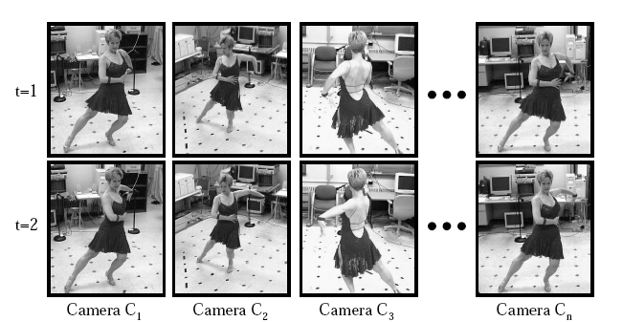
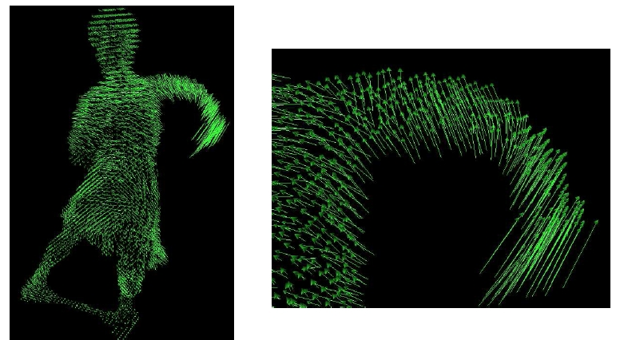
Scene flow: results
[Vedula, et al. ICCV 99]

Slide 43
Scene flow: video
[Vedula, et al. ICCV 99]

Slide 44
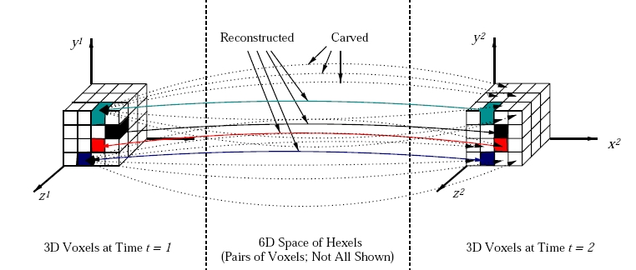
4. Carving in 6D
[Vedula, Baker, Seitz, Kanade: Shape and motion carving in 6D]
Hexel:
6D photo-consistency:

Slide 45
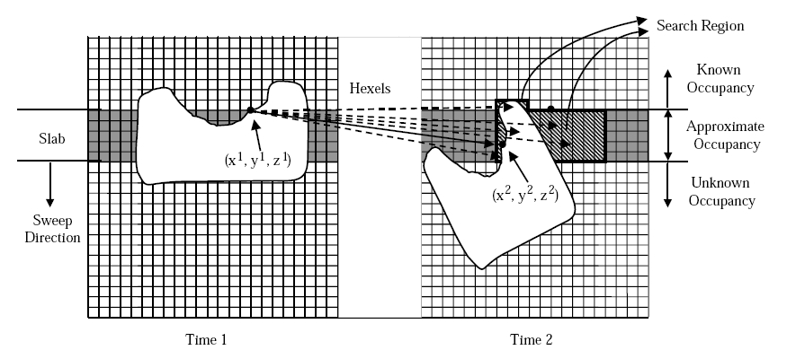
6D slab sweeping
Slab = thickened plane (thikness = upper bound on the flow magnitude)
compute visibility for x¹
determine search region
compute all hexel photo-consistency
carving hexels
update visibility
(Problem: visibility below the top layer in the slab before carving)

Slide 46
Carving in 6D: results

Slide 47
7. Surfel sampling
[ Carceroni, Kutulakos: Multi-view scene capture by surfel samplig, ICCV01]
Surfel: dynamic surface element
shape component : center, normal, curvature
motion component:
reflectance component: Phong parameters

Slide 48
Reconstruction algorithm
c_{i} – camera i
l_{l}- light l
visibility
Phong reflectance
shadow

Slide 49
Surfel sampling : results

Slide 50
Modeling humans in motion
Goal: 3D model of the human
Instantaneous model that can be viewed from different poses (‘Matrix’) and inserted in an artificial scene (tele-conferences)
Multiple calibrated cameras
Human in motion
Our goal: 3D animated human model
capture model deformations and appearance change in motion
animated in a video game
GRIMAGE platform- INRIA Grenoble

Slide 51
Articulated model
Model based approach
[Neil Birkbeck]
Geometric Model
Skeleton + skinned mesh (bone weights )
50+ DOF (CMU mocap data)
Tracking
visual hull – bone weights by diffusion
refine mesh/weights
Components
silhouette extraction
tracking the course model
learn deformations
learn appearance change

Slide 52
Neil- tracking results

Slide 53
Beyond 3D Non-rigid and articulated motion
Humans ubiquitous in graphics applications
A practical, realistic model requires
Skeleton
Geometry (manually modeled, laser scanned)
Physical simulation for clothes, muscle
Texture/appearance (from images)
Animation (mocap, simulation, artist)

Slide 54
Beyond 3D: Non-rigid and articulated motion
PhD work of Neil Birkbeck, Best thesis prize winner

Slide 55
Computer Vision
Questions?

