Slide 1
Registration tracking
(Lucas Kanade)

Slide 2
Video Motion estimation related areas
Parametric motion (image alignment)
Tracking
Optical flow

Slide 3
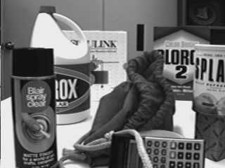
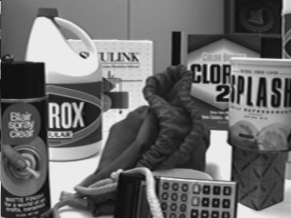
Motion, optic flow, Tracking

Slide 4
Three assumptions
Brightness consistency
Spatial coherence
Temporal persistence

Slide 5
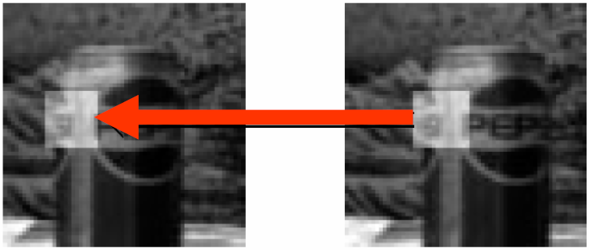
Brightness consistency
Image measurement (e.g. brightness) in a small region remain the same although their location may change.

Slide 6
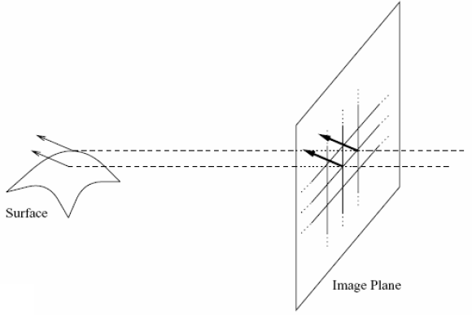
Spatial coherence
Neighboring points in the scene typically belong to the same surface and hence typically have similar motions.
Since they also project to nearby pixels in the image, we expect spatial coherence in image flow.

Slide 7
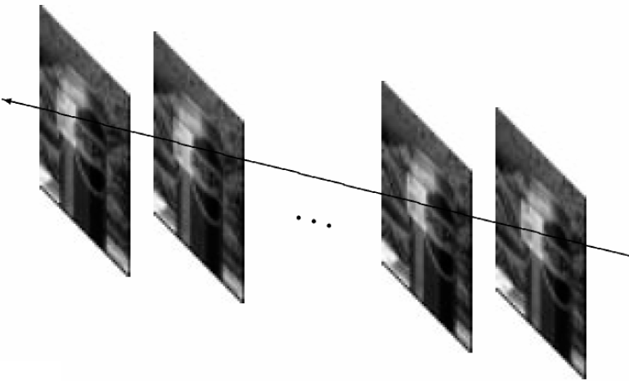
Temporal persistence
The image motion of a surface patch changes gradually over time.

Slide 8
Image registration
Goal: register a template image T(x) and an input image I(x), where x=(x,y)^{T}. (warp I so that it matches T)
Image alignment: I(x) and T(x) are two images
Tracking: T(x) is a small patch around a point p in the image at t. I(x) is the image at time t+1.
Optical flow: T(x) and I(x) are patches of images at t and t+1.
warp
T
I
fixed

Slide 9
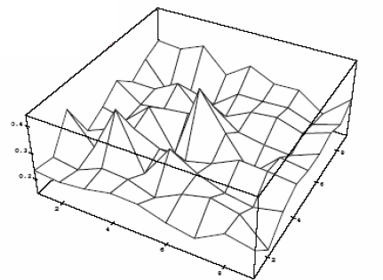
Simple approach (for translation)
Minimize brightness difference

Slide 10
Simple SSD algorithm
For each offset (u, v)
compute E(u,v);
Choose (u, v) which minimizes E(u,v);
Problems:
Not efficient
No sub-pixel accuracy

Slide 11
Lucas-Kanade algorithm

Slide 12
Optic Flow Lucas-Kanade algorithm
Solving for the translational motion of a patch
Over determined equation system:
-Im_t = M u
Can be solved in least squares using matlab
u = M\Im_t
Draw optic flow vector u
t
t+1

Slide 13
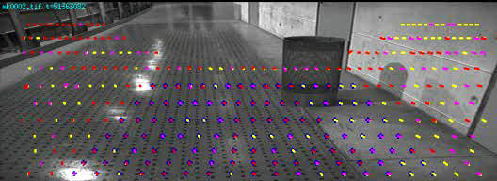
Optic flow /Visual motion detecton
Relating two adjacent frames: (small differences):

Slide 14
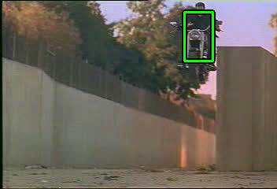
“Visual Tracking” / Stabilization
Globally relating all frames: (large differences):
…

Slide 15
Manually select template T in first video frame
Manually selected template T = I(t=0)
Matlab ginput()
Optic flow
- Compute u between frames
Tracking:
- Keep track of global motion p
u
p
p + u
…
T=0
t=1
t-1
t
MTF Usage Example – Multi Target Tracking

Slide 16
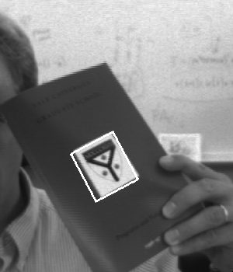
Tracking Cycle
Prediction
  Prior states predict new appearance
Image warping
  Generate a “normalized view”
Model inverse
  Compute error from nominal
State integration
  Apply correction to state
Reference
Image
Warping
-
p
Δp
Model
Inverse

Slide 17
From Optic Flow to Tracking
Solving for the translational motion of a patch
Over determined equation system:
-Im_t = M u
Can be solved in least squares using matlab
u = M\Im_t
Update tracking state: ……
p = p + u
For t=2,2,… Im_t = Im(t,x+p) – Im(0, x)
t=0 : Template image T
t=1
t=2
…
T=0
t=1
t-1
t

Slide 18
Tracking Lucas-Kanade algorithm
Create tracking loop, iterate for each new image
Init p=0, Template T
For t = 1…
Receive I(t+1)
Compute dIm = I(t+1, x+p) – T
Solve -Im_t = M u
  - Use u = M\Im_t
Update p = p + u
Notice: Template is
Manually selected
In first frame
u
T
p
p + u
…
T=0
t=1
t-1
t

Slide 19
Tracking Lucas-Kanade algorithm
Create tracking loop, iterate for each new image
Init p=0, Template T
For t = 1…
Receive I(t+1)
Compute dIm = I(t+1, x+p) – T
Solve -Im_t = M u
  - Use u = M\Im_t
Update p = p + u
Notice: Template is
Manually selected
In first frame
u
T
p
p + u
…
T=0
t=1
t-1
t

Slide 20
Manually select template T in first video frame
Manually selected:
Matlab ginput()
…
T=0
t=1
t-1
t
MTF Usage Example – Multi Target Tracking

Slide 21


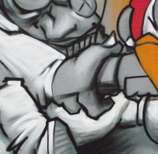

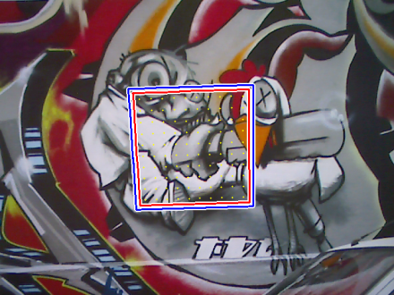
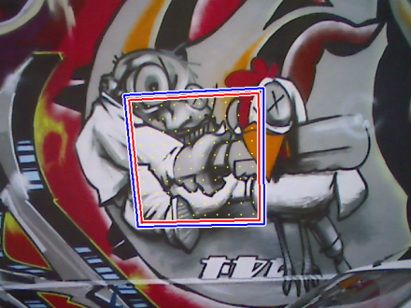
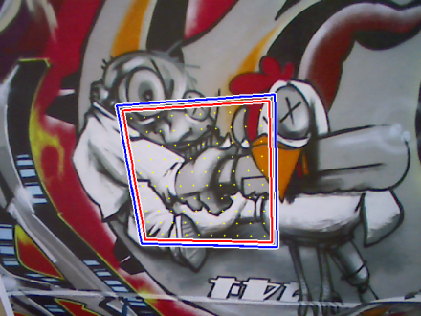
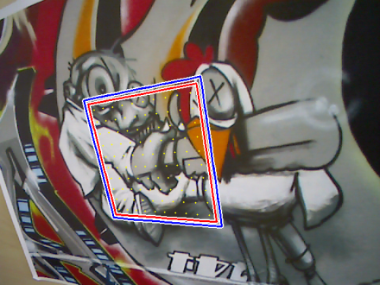
Registration: from trans u to warp w(x,p)
Find parameters of a warping function such that:
for all template points
Notes:
Considering only the current image of an image sequence,
the goal of intensity-based tracking can be formulated as finding the parameters of a transformation, for example a homography,
such that all the pixels of the template I_T are warped to their corresponding positions in the current frame I (with the same intensity value).

Slide 22




Intensity-based Template Tracking
Goal
Find parameters of a warping function such that:
for all template points
Reformulate the goal using a prediction as approximation of :
Find the parameters‘ increment such that
by minimizing
This is a non-linear minimization problem.
Notes:
Since we have a prediction of the warp parameters from the previous frame of the image sequence,
we can use this as an approximation and reformulate the goal to find a parameter increment such that the combination of both gives the desired result.
This is done by minimizing the length of the intensity error vector between the template and the warped current frame.
This is a non-linear optimization problem, even if the warp is linear, since the pixel values are in general unrelated to their positions.

Slide 23
Intensity-based Template Tracking
Lukas-Kanade
Uses the Gauss-Newton method for minimization:
Applies a first-order Taylor series approximation
Minimizes iteratively
B. D. Lucas and T. Kanade. An iterative image registration technique with an application to stereo vision, 1981.
Notes:
For this minimization the Lucas-Kanade algorithm uses the Gauss-Newton method,
which applies a first-order Taylor series approximation to the error vector
and minimizes this iteratively.

Slide 24

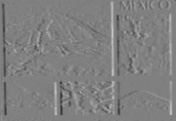
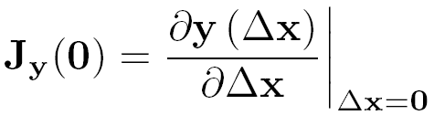
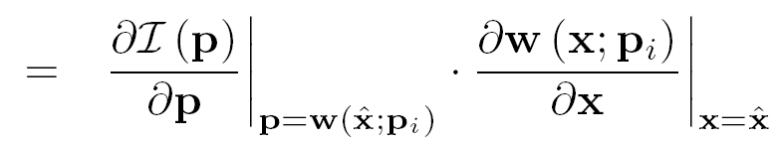
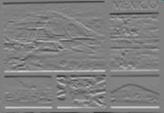


Lukas-Kanade
Approximation by linearization
First-order Taylor series approximation:
where the Jacobian matrix is:
gradient images
Jacobian of the current image
Jacobian of the warp
Notes:
Assuming that the parameter increment is small we can use a first-order Taylor series to get a linear approximation of the error vector, where the Jacobian contains the partial derivatives of y in delta-x.
By using the chain rule, the ith line of the Jacobian can be computed using the Jacobian of the current image evaluated at the warped point p_i and the Jacobian of the warp.
The Jacobian of the image can hereby be computed by warping the gradient images of the current image.

Slide 25
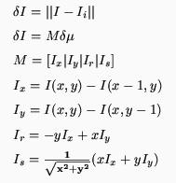
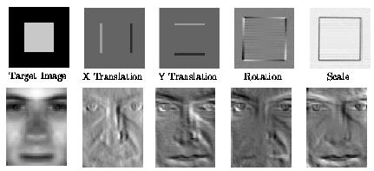
Image Derivatives
4DoF
Generalize to many Degrees of freedooms (DOFs)
Im = Mu

Slide 26
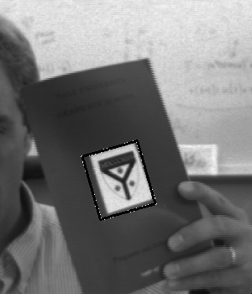
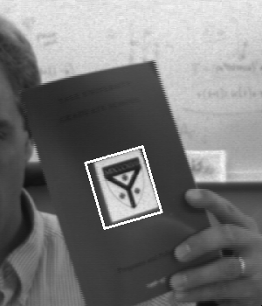
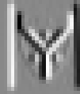
Image Derivatives
6 DoF
Template
Difference images
X Y Rotation Scale Aspect Shear

Slide 27
Planar Texture Variability 1
Affine Variability
Affine warp function
Corresponding image variability
Discretized for images

Slide 28
Planar Texture Variability 2
Projective Variability
Homography warp
Projective variability:
Where ,
and

Slide 29
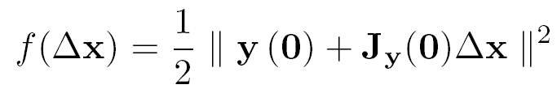



Lukas-Kanade
Iterative minimization
The following steps will be iteratively applied:
Minimize a sum of squared differences
where the parameter increment has a closed form solution (Gauss-Newton)
        Better (Matlab): dx = J\y0
Update the parameter approximation
This is repeated until convergence is reached.
Notes:
This approximation is minimized as sum-of-squared-differences cost function, which is solved using the inverse of the Gauss-Newton approximation of the Hessian.
The obtained parameter increment is then used to update the approximation and the whole procedure is repeated until convergence is reached, for example of the norm of the delta or of the error vector is below a certain threshold.

Slide 30



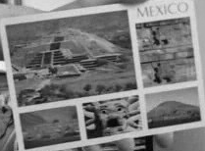

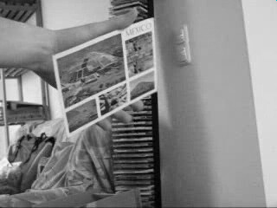
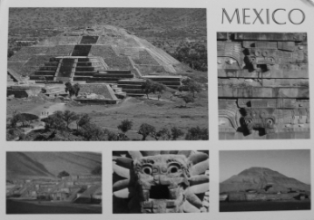

Lukas-Kanade
Illustration
At each iteration:
Warp
Compute
Update
template image
current frame
Notes:
To shortly illustrate the tracking procedure,
we first warp the current frame using the parameter approximation,
then compute the Jacobian and the error vector in order to get the update vector.
Using this we update our approximation of the warp and repeat this until we get a satisfying result.

Slide 31
Compare simple case translation
Create tracking loop, iterate for each new image
Init p=0, Template T
For t = 1…
Receive I(t+1)
Compute dIm = I(t+1, x+p) – T
Solve -Im_t = M u
  - Use u = M\Im_t
Update p = p + u
Notice: Template is
Manually selected
In first frame
u
T
p
p + u
…
T=0
t=1
t-1
t

Slide 32
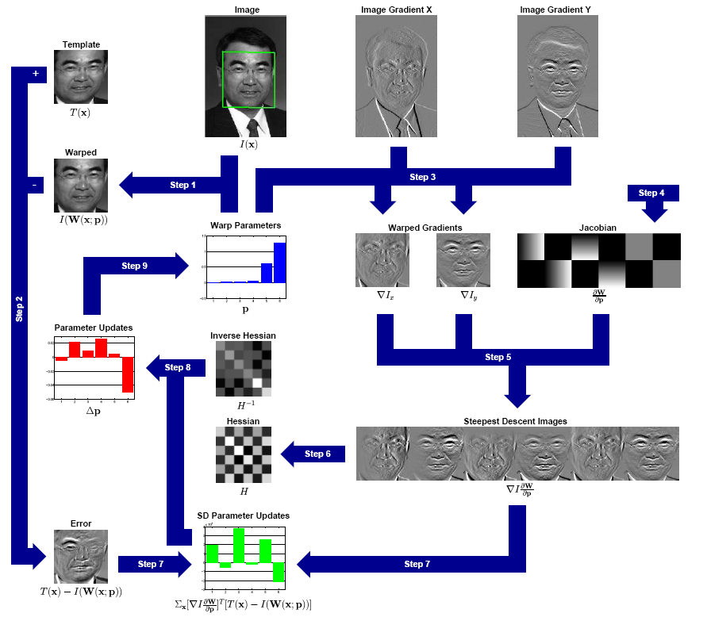

Slide 43
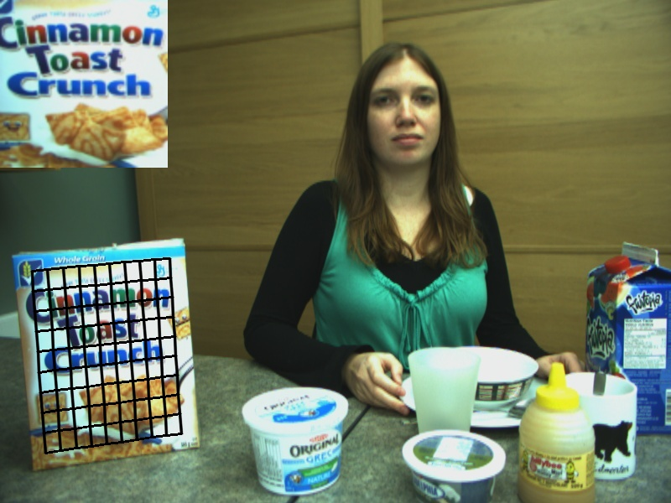




















Registration based Tracking
$$I_{0}$$
$$I_{t}$$
$$x_{8}$$
$$x_{9}$$
$$x_{10}$$
$$x_{5}$$
$$x_{6}$$
$$x_{7}$$
$$x_{2}$$
$$x_{3}$$
$$x_{4}$$
$$x_{1}$$
$$x_{18}$$
$$x_{19}$$
$$x_{20}$$
$$x_{15}$$
$$x_{16}$$
$$x_{17}$$
Notes:
Here we see registration based tracking in action using an 8 DOF warping function;
$I_{0}$ is the first image where the tracker is initialized by specifying its bounding box corners and $I_{t}$ is the current image where the tracker has to find the object’s location
The region enclosed by the bounding box is sampled by a grid of points as shown here and denoted by x in this equation.
As the tracking progresses, the grid gets warped to this and this is the rectified patch
The grid shown here has been sub sampled to 10x10 for better visibility
in practice we need a resolution of at least 25x25 to get good tracking performance
in fact these patches were actually sampled at 100x100 otherwise they would be a lot blurrier

Slide 44
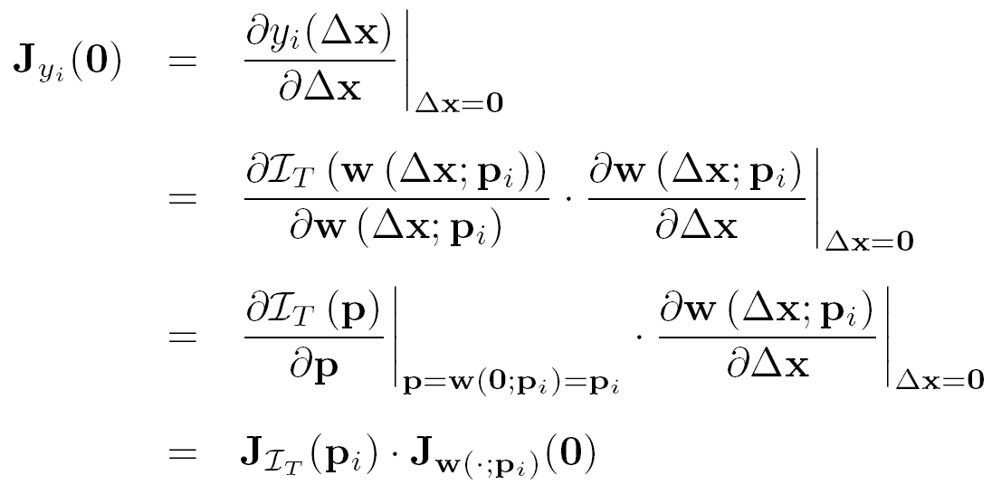
Inverse Compositional
Overview
Differences to the Lukas-Kanade algorithm
  Reformulation of the goal:
Jacobian of the template image
Jacobian of the warp
Notes:
As just mentioned the inverse compositional algorithm reformulates the image alignment process such that we now search for a delta-x which warps the template and not the current frame.
This way the roles of the template and the current image are switched and therefore the i-th line of the Jacobian can be computed using the Jacobian of the template image and the Jacobian of the warp.

Slide 45
Inverse Compositional
Overview
Differences to the Lukas-Kanade algorithm
  Reformulation of the goal
  and can be precomputed
  only needs to be computed at each iteration
  Parameter update changes
S. Baker and I. Matthews. Equivalence and efficiency of image alignment algorithms, 2001.
Notes:
Since none of the Jacobians depends on the parameter approximation, they can be set constant for all iterations. Only the error vector hast to be re-computed in each iteration.
Using this reformulation, the parameter update using a summation is no longer valud but has to be done using a composition, where the update is inverted. This is why the approach is called „Inverse Compositional“.

Slide 46
Efficient Second-Order Minimization
Short Overview
Uses second-order Taylor approximation of the cost function
Fewer iterations needed to converge
Larger area of convergence
Avoiding local minima close to the global
Jacobian needs to be computed at each iteration
S. Benhimane and E. Malis. Real-time image-based tracking of planes using efficient second-order minimization, 2004.
Notes:
Only a very short overview for the ESM algorithm.
In contrast to the previous two methods the ESM algorithm uses a second-order approximation, which leads to a
lower number of necessary iterations,
a larger area of convergence and
a better avoidance of local minima close to the global minimum.
Besides these advantages the necessary Jacobians need to be computed at each iteration, which makes each iteration computationally more expensive.

Slide 47
Lukas-Kanade
Variations
Inverse Compositional (IC):
reduce time per iteration
Efficient Second-Order Minimization (ESM):
improve convergence
Approach of Jurie & Dhome (JD):
reduce time per iteration
and improve convergence
Adaptive Linear Predictors (ALPs):
learn and adapt template online
Notes:
In the following we take a look at some improvements of this algorithm,
where the first one, the inverse compositional algorithm, addresses the computation of the Jacobian, which can be fixed by reformulating the image alignment process.
Then we will take a very brief look at the Efficient Second-Order Minimization, which applies a second-order approximation to improve convergence.
After that we focus on learning based approaches where we first focus on the approach of Jurie and Dhome and then talk about an extension which allows to efficiently adapt templates online.

Slide 48


Jurie & Dhome
Overview
Motivation:
  Computing the Jacobian in every iteration is expensive
  Good convergence properties are desired
Approach of JD:
pre-learn relation between image differences and parameter update:
  relation can be seen as linear predictor
  is fixed for all iterations
  learning enables to jump over local minima
F. Jurie and M. Dhome. Hyperplane approximation for template matching. 2002
Notes:
Now, to get a tracking which is as fast as possible, computing a Jacobian at every iteration is too expensive,
but since we also want to have convergence properties which are as good as possible, Jurie and Dhome came up with a learning based approach.
Here, the key idea is to pre-learn the relation between the error vector and the parameter update, which is here specified by the matrix A.
This relation can be seen as linear predictor which is fixed for all iterations.
The learning phase makes it also possible to jump over local minima and get a large convergence basin.

Slide 49

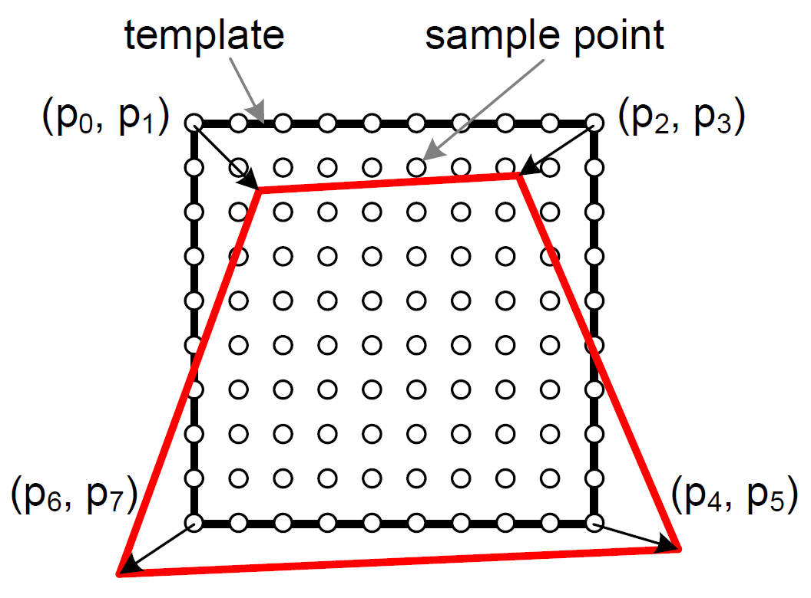

Jurie & Dhome
Template and Parameter Description
Template consists of sample points
  Distributed over the template region
  Used to sample the image data
Deformation is described using
the 4 corner points of the template
Image values are normalized
(zero mean, unit standard deviation)
Error vector specifies the differences between the normalized image values
Notes:
We represent the template we want to track by n_p sample points which are equally distributed over the template region and used to sample the image data.
As deformation model we use a homography which is parameterized by the 4 corner points of the template.
To make the tracking more robust against illumination changes the image values are normalized to zero mean and unit standard deviation.
This is done for the template as well as during tracking and therefore the error vector specifies the differences between the normalized image values.

Slide 50












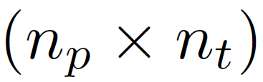







Jurie & Dhome
Learning phase
Apply set of random transformations to initial template
Compute corresponding image differences
Stack together the training data
(
)
=
(
)
=
Notes:
So, for the learning we first apply a set of n_t random transformations tot he initial template and compute the corresponding error vectors. These error vectors and the corresponding transformation parameters are then stacked into two matrices X and Y, where X is a 8 times n_t matrix and Y a n_p times n_t matrix.

Slide 51

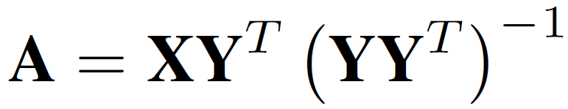
Jurie & Dhome
Learning phase
Apply set of random transformations to initial template
Compute corresponding image differences
Stack together the training data
The linear predictor should relate these matrices by:
So, the linear predictor can be learned / computed as
Note: Matlab: At = Y‘\X‘
Notes:
The linear predictor we want to learn should now relate these two matrices as X is equal to A times Y. So, A can be learned by multiplying the X with the pseudo-inverse of Y.

Slide 52
Jurie & Dhome
Tracking phase
Warp sample points according to current parameters
Use warped sample points to extract image values and to compute error vector
Compute update using
Update current parameters
Improve tracking accuracy:
  Apply multiple iterations
  Use multiple predictors trained for different amouts of motions
Notes:
For the tracking we simply warp the sample points according to the current parameters
and use them to compute the corresponding error vector.
Using the error vector we compute the parameter update
and update the current parameters using it.
To improve the tracking accuracy we apply this procedure multiple times and also learn multiple predictors for different amounts of motions, where we start with a predictor learned for large motions and then switch to predictors for smaller motions.

Slide 53
Jurie & Dhome
Limitations
Learning large templates is expensive
not possible online
Shape of template cannot be adapted
template has to be relearned after each modification
Tracking accuracy is inferior to LK, IC, …
use JD as initialization for one of those
Notes:
However, also the approach of Jurie and Dhome has some limitations.
First, learning large templates is quite expensive since it includes the inversion of a large matrix which size corresponds to the number of sample points. So, this is not possible to be done online.
Because of that we also cannot adapt the shape of a template since for this the template has to be relearned after each modification.
Additionally the accuracy of the tracking is in general worse than of the mentioned analytic approaches, so if you want to get a similar accuracy you should apply one of these algorithms after refinement using the Jurie/Dhome approach.

Slide 54
MTF Usage Example – Multi Target Tracking
Registration tracking
MTF examples
UAV Trajectory Estimation
Online Image Mosaicing

