Slide 1
Tracking surfaces / objects across video frames
Readings:
Paper, First dozen pages: Baker&Matthews, IJCV
“Lukas-Kanade 20 years on”
Szeliski 8.1.3, 4.1
Ma et al Ch 4.
Forsythe and Ponce Ch 17.

Slide 2
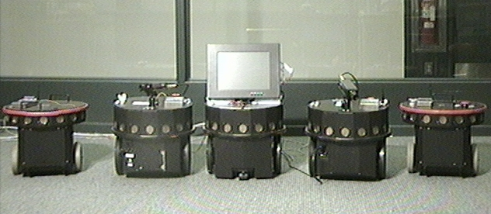
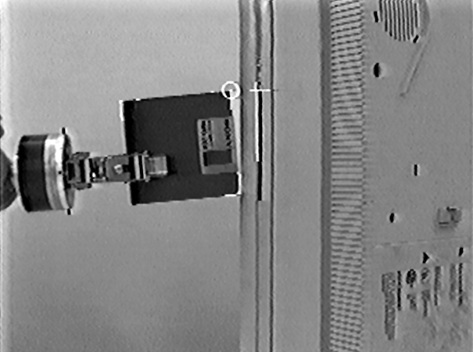

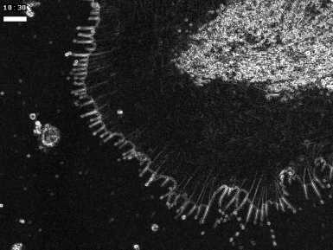
Why Visual Tracking?
Computers are fast enough!
Related technology is cheap!
Applications abound
Motion Control
HCI
Measurement

Slide 3
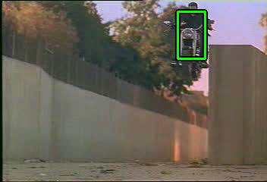
Applications:
Watching a moving target
Camera + computer can determine how things move in an scene over time.
Uses:
Security: e.g. monitoring people moving in a subway station or store
Measurement: Speed, alert on colliding trajectories etc.

Slide 4
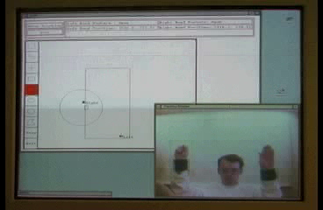
Applications
Human-Computer Interfaces
Camera + computer tracks motions of human user and interprets this in an on-line interaction.
Can interact with menus, buttons and e.g. drawing programs using hand movements as mouse movements, and gestures as clicking
Furthermore, can interpret physical interactions

Slide 5

Applications
Interpreting tasks and functinality
Use tracking to interpret:
Physics of a mechanism
How a car is repaired.
3. How a human cooks in a kitchen

Slide 6
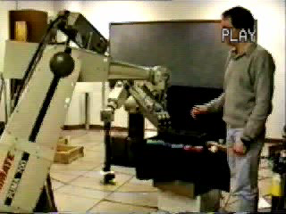
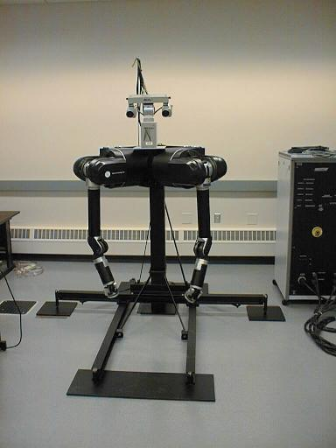
Applications
Human-Machine Interfaces
Camera + computer tracks motions of human user, interprets this and machine/robot carries out task.
Remote manipulation
Service robotics for the handicapped and elderly

Slide 7

Applications
Human-Human Interfaces
Camera + computer tracks motions and expressions of human user, interprets, codes and transmits to render at remote location
Ultra low bandwidth video communication
Handheld video cell phone

Slide 8
BANDWIDTH and PROCESSIN REQUIREMENTS: TV camera
Binary
1 bit * 640x480 * 30 = 9.2 Mbits/second
Grey
1 byte * 640x480 * 30 = 9.2 Mbytes/second
Color
3 bytes * 640x480 * 30 = 27.6 Mbytes/second (actually about 37 mbytes/sec)
Typical operation: 8x8 convolution on grey image
64 multiplies + adds ➔ 600 Mflops
Consider 800x600, 1200x1600 (2MP)…
Today’s PC’s are getting to the point they
can process images at frame rate
For real time: process small window in image

Slide 9
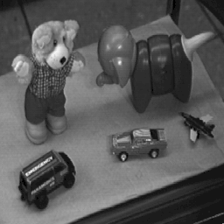
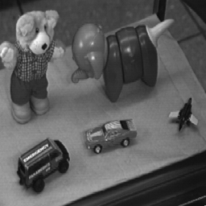
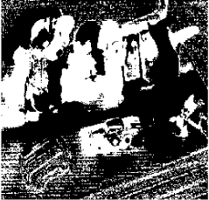
Characteristics of Video Processing
abs( Image 1 - Image 2) = ?
Note: Almost all pixels change!
Constancy: The physical scene is the same
How do we make use of this?

Slide 10
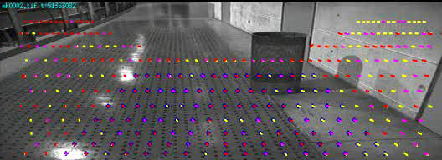
Fundamental types of video processing “Visual motion detecton”
Relating two adjacent frames: (small differences):

Slide 11
Fundamental types of video processing
“Visual Tracking” / Stabilization
Globally relating all frames: (large differences):
…

Slide 12
Types of tracking
Point tracking
Extract the point (pixel location) of a particular image feature in each image.
Segmentation based tracking
Define an identifying region property (e.g. color, texture statistics). Repeatedly extract this region in each image.
Stabilization based tracking
Formulate image geometry and appearance equations and use these acquire image transform parameters for each image.

Slide 13
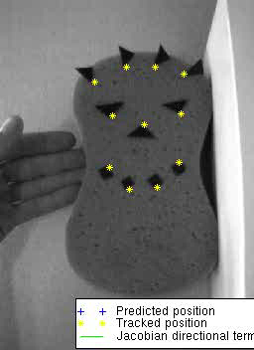
Point tracking
Simplest technique. Already commercialized in motion capture systems.
Features commonly LED’s (visible or IR), special markers (reflective, patterns)
Detection: e.g. pick brightest pixel(s), cross correlate image to find best match for known pattern.

Slide 14
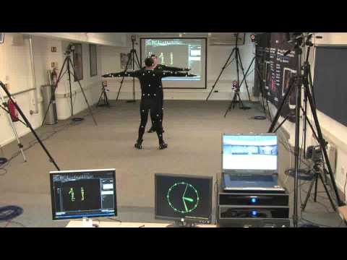
Commercial point trackers:
“Motion capture”

Slide 15
Region Tracking
(Segmentation-Based)
Select a “cue:”
  foreground enhancement
  background subtraction
Segment
  threshold
  “clean up”
Compute region geometry
  centroid (first moment)
  orientation (second moment)
  scale (second moment)

Slide 16
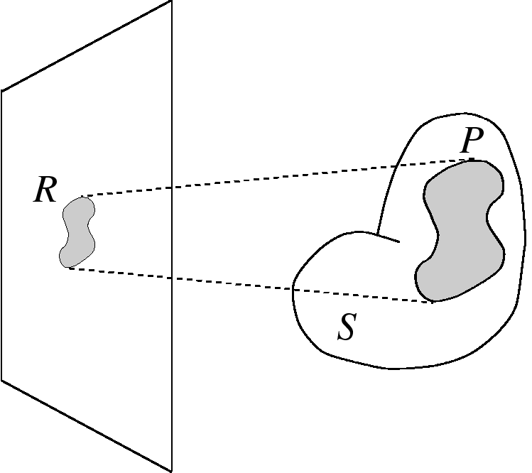
Regions
(color space): intrinsic coloration
  Homogeneous region: is roughly constant
  Textured region: has significant intensity gradients horizontally and vertically
  Contour: (local) rapid change in contrast

Slide 17




Homogeneous Color Region: Photometry

Slide 18
Color Representation
is irradiance of region R
Color representation
  DRM [Klinker et al., 1990]: if P is Lambertian, has matte line and highlight line
  User selects matte pixels in R
  PCA fits ellipsoid to matte cluster
  Color similarity is defined by Mahalanobis distance

Slide 19
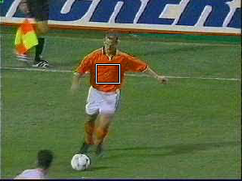
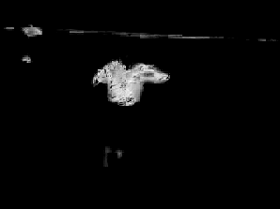
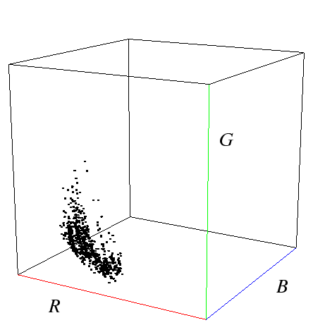
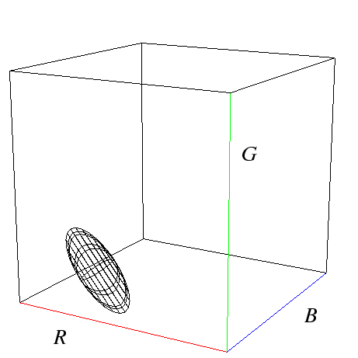
Homogeneous Region: Photometry
PCA-fitted
ellipsoid
Sample
Notes:
For a given homogeneous region, the first component of the prediction it makes about the image concerns its color.
In early work, I developed a novel way of defining an object’s color
by sampling pixels from it, fitting an ellipsoid to those pixels’ colorspace projection using principal
components analysis, and quantifying color similarity by the Mahalanobis distance, as you see here, where
brighter pixels are more orange.

Slide 20
Color Extension (Contd.)
Color Histograms (Swain et al.)
H_{i} = number of pixels in class i
Histograms are vectors of bin counts
Given histograms H and G, compare by
  dense, stable signature
  relies on segmentation
  relative color and feature locations lost
  affine transformations preserve area ratios of planar objects

Slide 21
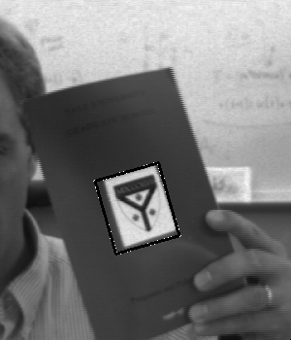
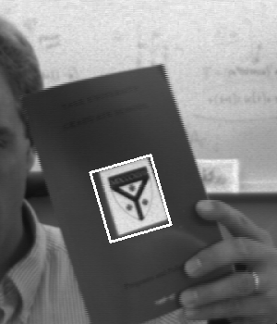
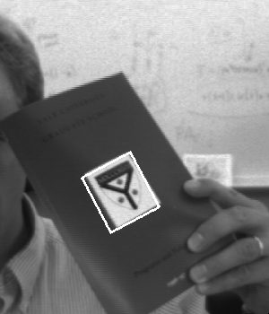
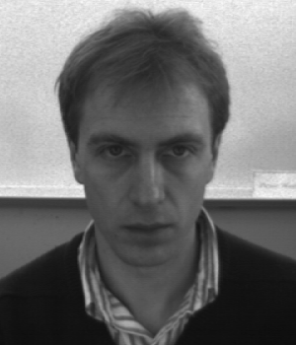

Intro to Registration Tracking
p_{t}
I₀
I_{t}
Variability model:
I_{t} = g(I₀, p_{t})
Incremental Estimation:
From I₀, I_{t+1} and p_{t} compute Δp_{t+1}
|| I₀ - g(I_{t+1}, p_{t+1}) ||² ==> min
Visual Tracking = Visual Stabilization

Slide 22
Tracking Cycle
Prediction
  Prior states predict new appearance
Image warping
  Generate a “normalized view”
Model inverse
  Compute error from nominal
State integration
  Apply correction to state
Reference
Image
Warping
-
p
Δp
Model
Inverse

Slide 23
Stabilization tracking: Planar Case
Planar Object +
Linear camera => Affine motion model:
u’_{i} = A u_{i} + d
Subtract these: - - = nonsense
Warping
But these: - - = small variation
I_{t} = g(p_{t}, I₀)

Slide 24





















Registration based Tracking
$$I_{0}$$
$$I_{t}$$
$$x_{8}$$
$$x_{9}$$
$$x_{10}$$
$$x_{5}$$
$$x_{6}$$
$$x_{7}$$
$$x_{2}$$
$$x_{3}$$
$$x_{4}$$
$$x_{1}$$
$$x_{18}$$
$$x_{19}$$
$$x_{20}$$
$$x_{15}$$
$$x_{16}$$
$$x_{17}$$
Notes:
Here we see registration based tracking in action using an 8 DOF warping function;
$I_{0}$ is the first image where the tracker is initialized by specifying its bounding box corners and $I_{t}$ is the current image where the tracker has to find the object’s location
The region enclosed by the bounding box is sampled by a grid of points as shown here and denoted by x in this equation.
As the tracking progresses, the grid gets warped to this and this is the rectified patch
The grid shown here has been sub sampled to 10x10 for better visibility
in practice we need a resolution of at least 25x25 to get good tracking performance
in fact these patches were actually sampled at 100x100 otherwise they would be a lot blurrier

Slide 25
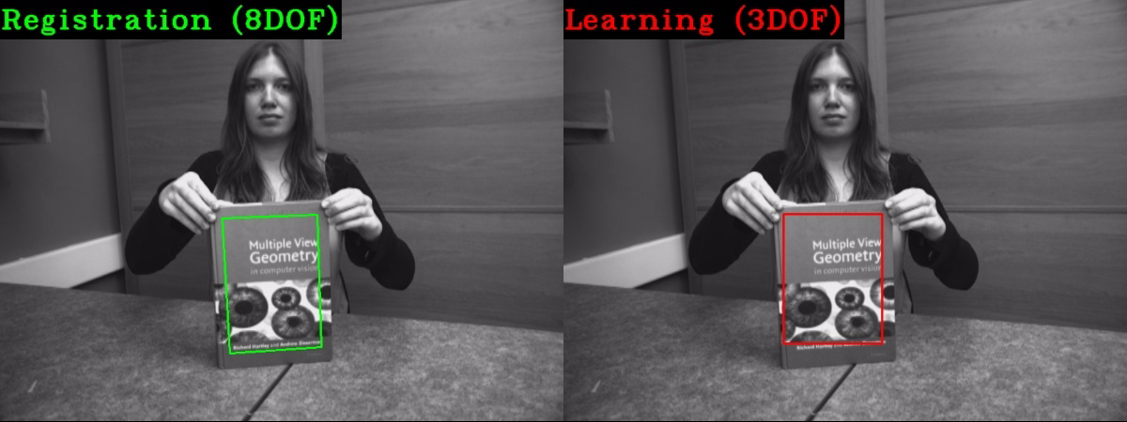
Motivation
Learning/detection based trackers are not suitable for tasks requiring fast and high precision tracking
  Visual Servoing
  Virtual reality
  SLAM
Notes:
The reason we need registration based trackers is that most popular detection and online learning based trackers are not suitable for applications like visual servoing, virtual and augmented reality, SLAM and autonomous navigation where very precise object pose is required for subsequent higher level tasks to work correctly.
though they may be robust to failures, they are often limited to estimating only low DOF motion including only translation and maybe scaling as we can see here
this is a state of the art learning based tracker called DSST and though it follows the object fine, it does not estimate its pose accurately.

Slide 26
Image Pyramids

Slide 27
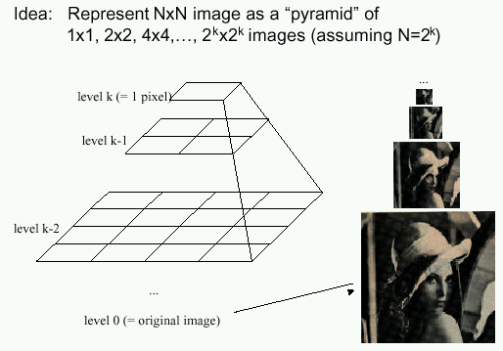
Image Pyramids

Slide 28
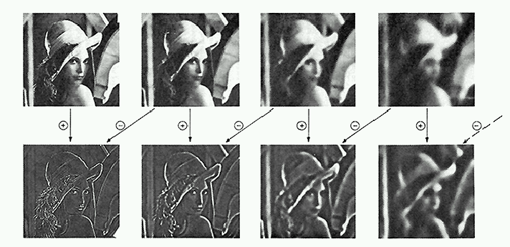
Pyramid Creation
filter mask
“Gaussian” Pyramid
“Laplacian” Pyramid
  Created from Gaussian
  pyramid by subtraction
  L_{l} = G_{l} – expand(G_{l+1})

Slide 29
Octaves in the Spatial Domain
Lowpass Images
Bandpass Images

Slide 30
Pyramids
Advantages of pyramids
  Faster than Fourier transform
  Avoids “ringing” artifacts
Many applications
  small images faster to process
  good for multiresolution processing
  compression
  progressive transmission
Known as “mip-maps” in graphics community
Precursor to wavelets
  Wavelets also have these advantages

Slide 31
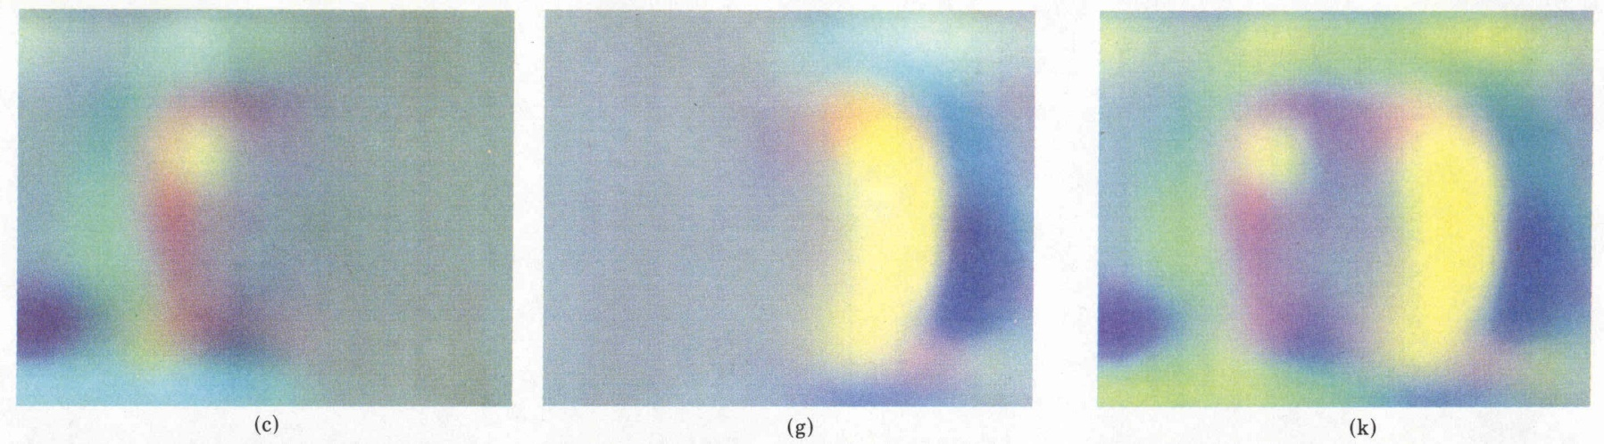
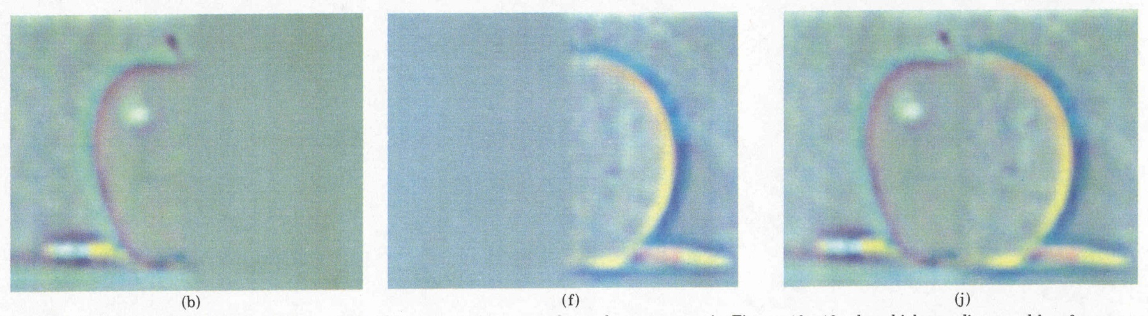
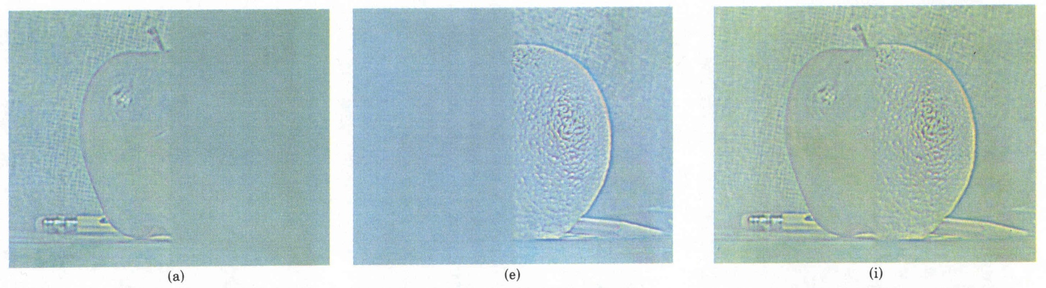
Laplacian
level
4
Laplacian
level
2
Laplacian
level
0
left pyramid
right pyramid
blended pyramid

Slide 32
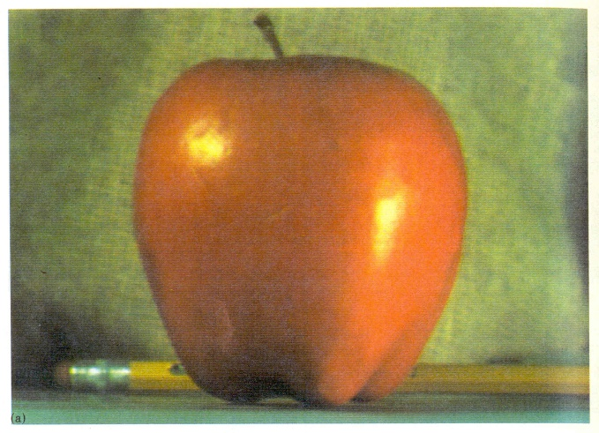
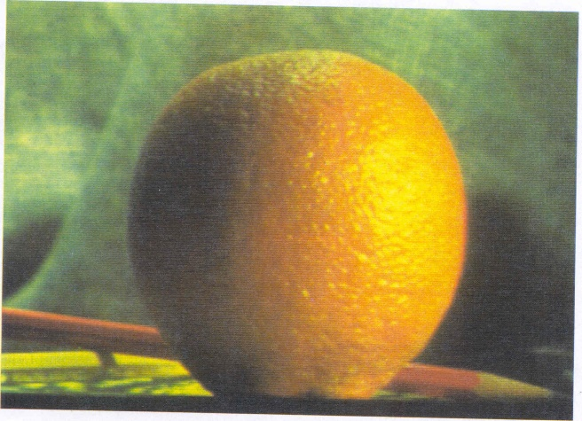
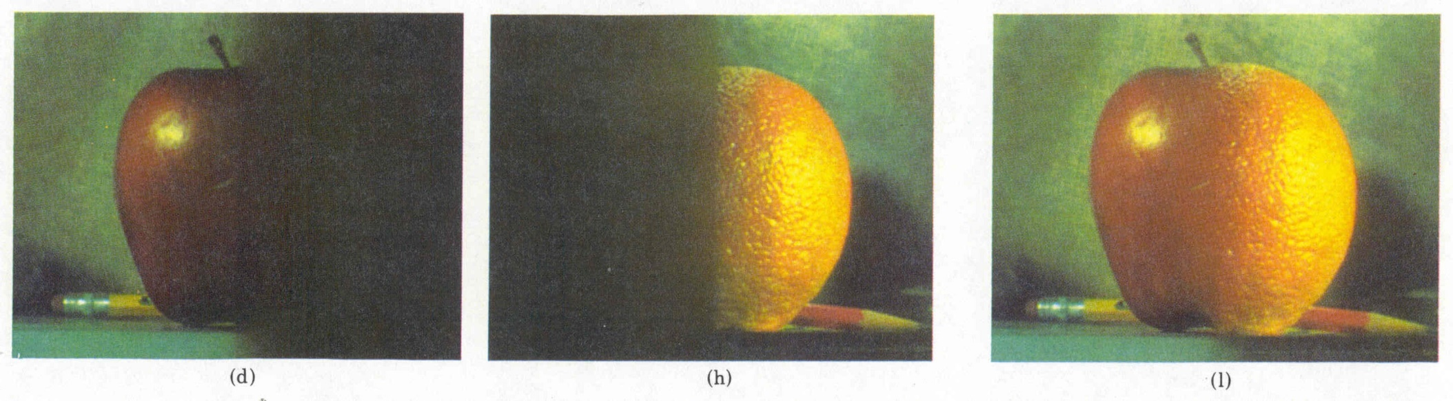
Pyramid Blending

Slide 33
Image Warping

Slide 34
Image Warping
image filtering: change range of image
g(x) = h(f(x))
image warping: change domain of image
g(x) = f(h(x))
f
f
h
x
x
f
f
h
x
x

Slide 35
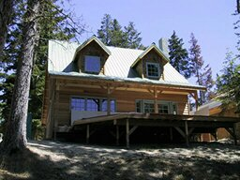
Image Warping
image filtering: change range of image
g(x) = h(f(x))
image warping: change domain of image
g(x) = f(h(x))
f
g
h
f
g
h

Slide 36
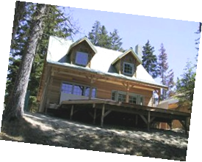
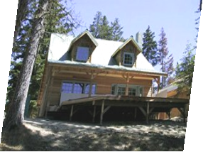
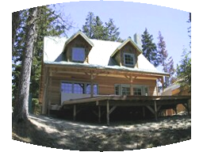
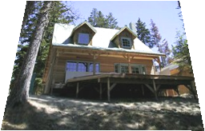
Parametric (global) warping
Examples of parametric warps:
translation
rotation
aspect
perspective
affine
cylindrical

Slide 37
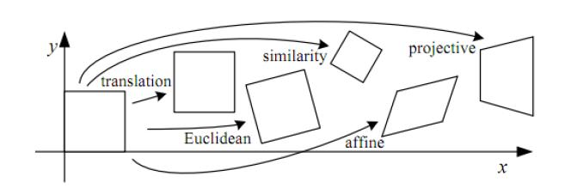
2D coordinate transformations
translation: x’ = x + t x = (x,y)
rotation: x’ = R x + t
similarity: x’ = s R x + t
affine: x’ = A x + t
perspective: x’ ≅ H x x = (x,y,1)
(x is a homogeneous coordinate)
These all form a nested group (closed w/ inv.)

Slide 38
Image Warping
Given a coordinate transform x’ = h(x) and a source image f(x), how do we compute a transformed image g(x’) = f(h(x))?
h(x)
x
x’
f(x)
g(x’)

Slide 39
Forward Warping
Send each pixel f(x) to its corresponding location x’ = h(x) in g(x’)
What if pixel lands “between” two pixels?
h(x)
x
x’
f(x)
g(x’)

Slide 40
Forward Warping
Send each pixel f(x) to its corresponding location x’ = h(x) in g(x’)
What if pixel lands “between” two pixels?
Answer: add “contribution” to several pixels, normalize later (splatting)
h(x)
x
x’
f(x)
g(x’)

Slide 41
Inverse Warping
Get each pixel g(x’) from its corresponding location x = h⁻¹(x’) in f(x)
What if pixel comes from “between” two pixels?
h⁻¹(x’)
x
x’
f(x)
g(x’)

Slide 42
Inverse Warping
Get each pixel g(x’) from its corresponding location x = h⁻¹(x’) in f(x)
What if pixel comes from “between” two pixels?
Answer: resample color value from interpolated (prefiltered) source image
x
x’
f(x)
g(x’)

Slide 43
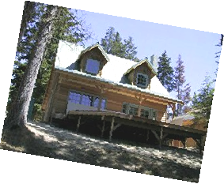
Interpolation
Possible interpolation filters:
  nearest neighbor
  bilinear
  bicubic (interpolating)
  sinc / FIR
Needed to prevent “jaggies”
and “texture crawl” (see demo)

Slide 44
Prefiltering
Essential for downsampling (decimation) to prevent aliasing
MIP-mapping [Williams’83]:
  build pyramid (but what decimation filter?):
    block averaging
    Burt & Adelson (5-tap binomial)
    7-tap wavelet-based filter (better)
  trilinear interpolation
    bilinear within each 2 adjacent levels
    linear blend between levels (determined by pixel size)

Slide 45
Prefiltering
Essential for downsampling (decimation) to prevent aliasing
Other possibilities:
  summed area tables
  elliptically weighted Gaussians (EWA) [Heckbert’86]

Slide 46
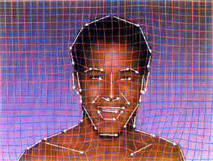
Image Warping – non-parametric
Specify more detailed warp function
Examples:
  splines
  triangles
  optical flow (per-pixel motion)

Slide 47
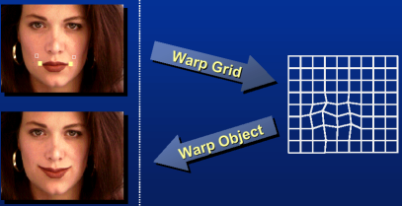
Image Warping – non-parametric
Move control points to specify spline warp

Slide 48

Image Morphing

Slide 49
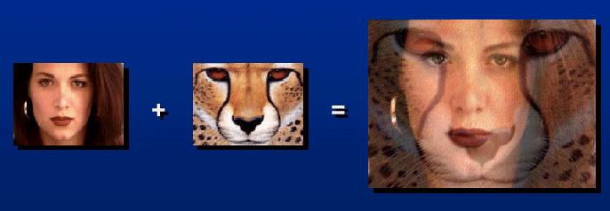
Image Morphing
How can we in-between two images?
  Cross-dissolve
  (all examples from [Gomes et al.’99])

Slide 50
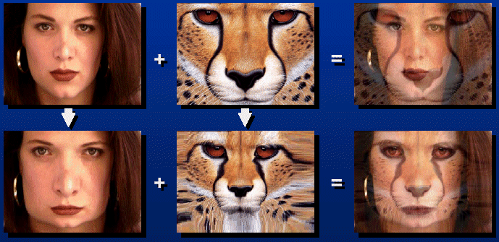
Image Morphing
How can we in-between two images?
  Warp then cross-dissolve = morph

Slide 51
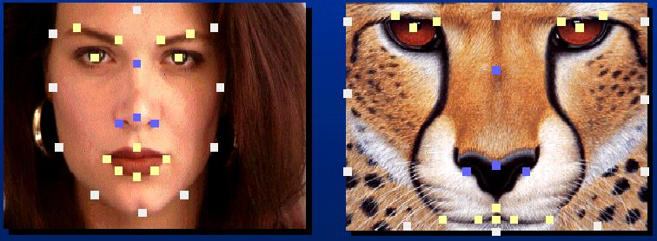
Warp specification
How can we specify the warp?
  Specify corresponding points
    interpolate to a complete warping function
    Nielson, Scattered Data Modeling, IEEE CG&A’93]

Slide 52
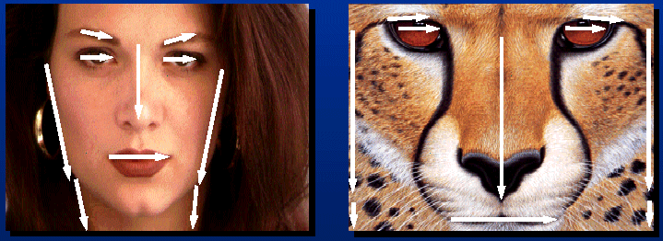
Warp specification
How can we specify the warp?
  Specify corresponding vectors
    interpolate to a complete warping function

Slide 53
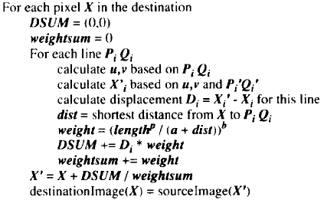
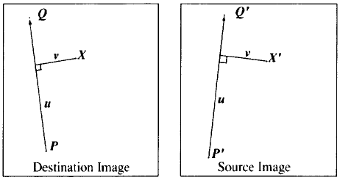
Warp specification
How can we specify the warp?
  Specify corresponding vectors
    interpolate [Beier & Neely, SIGGRAPH’92]

Slide 54
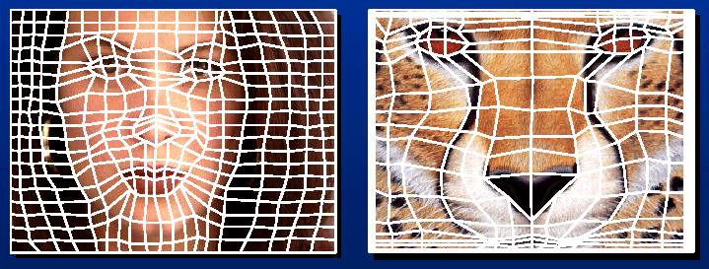
Warp specification
How can we specify the warp?
  Specify corresponding spline control points
    interpolate to a complete warping function

Slide 55

Final Morph Result

Slide 56
Intro to Registration Tracking
p_{t}
I₀
I_{t}
Variability model:
I_{t} = g(I₀, p_{t})
Incremental Estimation:
From I₀, I_{t+1} and p_{t} compute Δp_{t+1}
|| I₀ - g(I_{t+1}, p_{t+1}) ||² ==> min
Visual Tracking = Visual Stabilization

Slide 57
Tracking Cycle
Prediction
  Prior states predict new appearance
Image warping
  Generate a “normalized view”
Model inverse
  Compute error from nominal
State integration
  Apply correction to state
Reference
Image
Warping
-
p
Δp
Model
Inverse

Slide 58
Stabilization tracking: Planar Case
Planar Object +
Linear camera => Affine motion model:
u’_{i} = A u_{i} + d
Subtract these: - - = nonsense
Warping
But these: - - = small variation
I_{t} = g(p_{t}, I₀)

Slide 59
Registration based Tracking
$$I_{0}$$
$$I_{t}$$
$$x_{8}$$
$$x_{9}$$
$$x_{10}$$
$$x_{5}$$
$$x_{6}$$
$$x_{7}$$
$$x_{2}$$
$$x_{3}$$
$$x_{4}$$
$$x_{1}$$
$$x_{18}$$
$$x_{19}$$
$$x_{20}$$
$$x_{15}$$
$$x_{16}$$
$$x_{17}$$
Notes:
Here we see registration based tracking in action using an 8 DOF warping function;
$I_{0}$ is the first image where the tracker is initialized by specifying its bounding box corners and $I_{t}$ is the current image where the tracker has to find the object’s location
The region enclosed by the bounding box is sampled by a grid of points as shown here and denoted by x in this equation.
As the tracking progresses, the grid gets warped to this and this is the rectified patch
The grid shown here has been sub sampled to 10x10 for better visibility
in practice we need a resolution of at least 25x25 to get good tracking performance
in fact these patches were actually sampled at 100x100 otherwise they would be a lot blurrier

Slide 60
Motivation
Learning/detection based trackers are not suitable for tasks requiring fast and high precision tracking
  Visual Servoing
  Virtual reality
  SLAM
Notes:
The reason we need registration based trackers is that most popular detection and online learning based trackers are not suitable for applications like visual servoing, virtual and augmented reality, SLAM and autonomous navigation where very precise object pose is required for subsequent higher level tasks to work correctly.
though they may be robust to failures, they are often limited to estimating only low DOF motion including only translation and maybe scaling as we can see here
this is a state of the art learning based tracker called DSST and though it follows the object fine, it does not estimate its pose accurately.

Slide 61
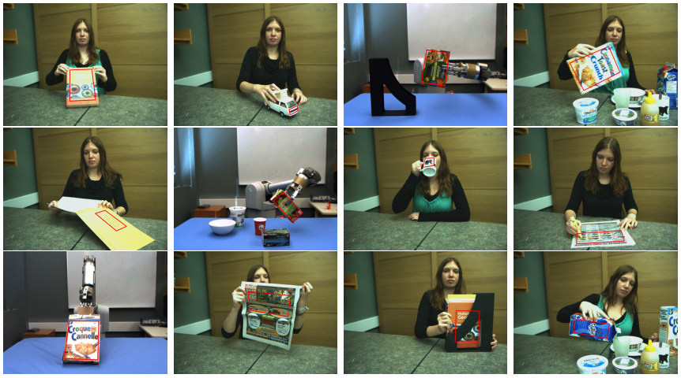
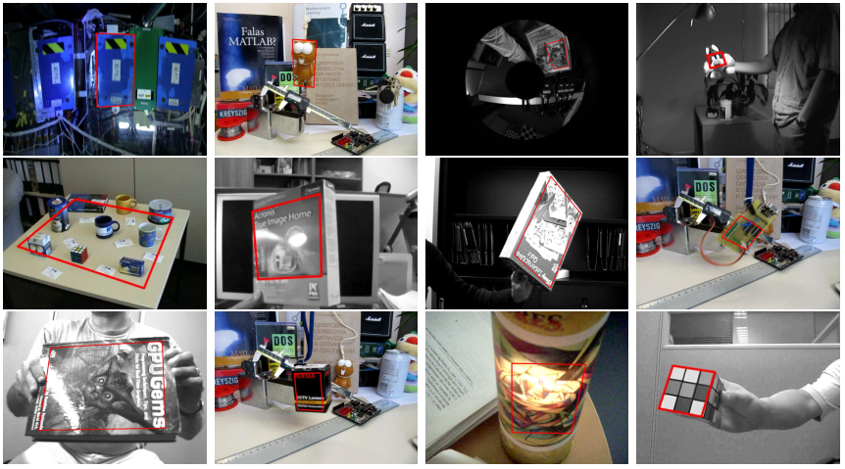


Evaluation Benchmarks
TMT
PAMI
UCSB
LinTrack

Slide 62
Results: Learning vs. 2DOF Registration Based Trackers (Accuracy)
Euclidean pixel registration error
Notes:
We start results by comparing 9 state of the art learning based trackers with low DOF registration based trackers to validate the advantage that the latter have in the kind of scenarios present in our datasets
generated using 2DOF ground truth that we saw earlier
learning with dotted lines
NN1K and NN10K refer to NN with 1000 and 10k samples respectively
Learning based trackers have far lower SR than registration based trackers for smaller thresholds as they tend to be somewhat less precise and have a tendency to move around slightly about the object’s true location.
So while they may be more robust to completely losing track of the object they are less precise about its location even compared to 2 DOF registration based trackers
in fact with the exception of DSST none manage to surpass the best RB trackers even for high thresholds
shows their unsuitability for tracking motions involving complex warps in image space
We can also see the great speed difference that exists between the two types of trackers
note that the speed graph has logarithmic scaling on the x axis
however, the actual values are also shown here in FPS and we can see that the registration based trackers, with the exception of PF, are 10-30 times faster

Slide 63

RBT vs Learn vs GoTurn

Slide 64

Results: Learning vs. 2DOF Registration Based Trackers (Accuracy – VOT 2016)
Notes:
We start results by comparing 9 state of the art learning based trackers with low DOF registration based trackers to validate the advantage that the latter have in the kind of scenarios present in our datasets
generated using 2DOF ground truth that we saw earlier
learning with dotted lines
NN1K and NN10K refer to NN with 1000 and 10k samples respectively
Learning based trackers have far lower SR than registration based trackers for smaller thresholds as they tend to be somewhat less precise and have a tendency to move around slightly about the object’s true location.
So while they may be more robust to completely losing track of the object they are less precise about its location even compared to 2 DOF registration based trackers
in fact with the exception of DSST none manage to surpass the best RB trackers even for high thresholds
shows their unsuitability for tracking motions involving complex warps in image space
We can also see the great speed difference that exists between the two types of trackers
note that the speed graph has logarithmic scaling on the x axis
however, the actual values are also shown here in FPS and we can see that the registration based trackers, with the exception of PF, are 10-30 times faster

Slide 65
Results: Learning vs. 2DOF Registration Based Trackers (Speed)
Notes:
We end by comparing 9 state of the art learning based trackers with low DOF registration based trackers to validate the advantage that the latter have in the kind of scenarios present in our datasets
generated using 2DOF ground truth that we saw earlier
learning with dotted lines
NN1K and NN10K refer to NN with 1000 and 10k samples respectively
Learning based trackers have far lower SR than registration based trackers for smaller thresholds as they tend to be somewhat less precise and have a tendency to move around slightly about the object’s true location.
So while they may be more robust to completely losing track of the object they are less precise about its location even compared to 2 DOF registration based trackers
in fact with the exception of DSST none manage to surpass the best RB trackers even for high thresholds
shows their unsuitability for tracking motions involving complex warps in image space
We can also see the great speed difference that exists between the two types of trackers
note that the speed graph has logarithmic scaling on the x axis
however, the actual values are also shown here in FPS and we can see that the registration based trackers, with the exception of PF, are 10-30 times faster

Slide 66
References
S. Baker and I. Matthews, “Equivalence and Efﬁciency of Image Alignment Algorithms”, CVPR 2001
S. Benhimane and E. Malis, “Real-time image-based tracking of planes using efficient second-order minimization ”, IROS 2004
A. Dame and E. Marchand, “Accurate Real-time Tracking Using Mutual Information”, ISMAR 2010
T. Dick, C. Perez, A. Shademan and M. Jagersand, “Realtime Registration-Based Tracking via Approximate Nearest Neighbor Search”, RSS 2013
S. Gauglitz, T. Hollerer and M. Turk. “Evaluation of interest point detectors and feature descriptors for visual tracking”, IJCV 2011
J. Kwon, H. S. Lee, F. C. Park, and K. M. Lee, “A Geometric Particle Filter for Template-Based Visual Tracking”, TPAMI 2014
R. Richa, R. Sznitman, R. Taylor and G. Hager, “Visual Tracking Using the Sum of Conditional Variance”, IROS 2011

Slide 67
References (cont’d)
R. Richa, R. Sznitman and G. Hager, “Robust Similarity Measures for Gradient-based Direct Visual Tracking”, CIRL Technical Report 2012
R. Richa, M. Souza, G. Scandaroli, E. Comunello and A. Wangenheim, “Direct visual tracking under extreme illumination variations using the sum of conditional variance”, ICIP 2014
A. Roy, X. Zhang, N. Wolleb, C. P. Quintero and M. Jagersand, “Tracking Benchmark and Evaluation for Manipulation Tasks ”, ICRA 2015
L. Ruthotto, “Mass-preserving registration of medical images”, Thesis 2010
G. G. Scandaroli, M. Meilland and R. Richa, “Improving NCC-Based Direct Visual Tracking”, ECCV 2012
A. Singh and M. Jagersand, “Modular Tracking Framework: A Uniﬁed Approach to Registration based Tracking”, arXiv:1602.09130, 2016

