Slide 1
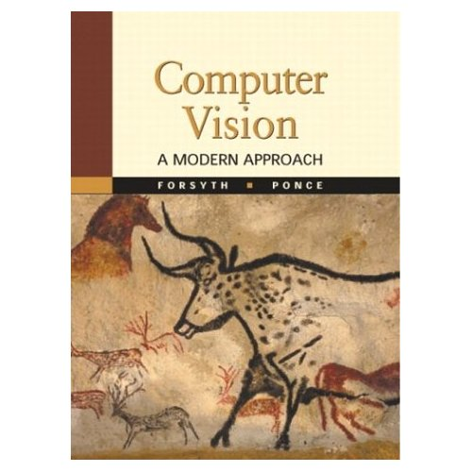
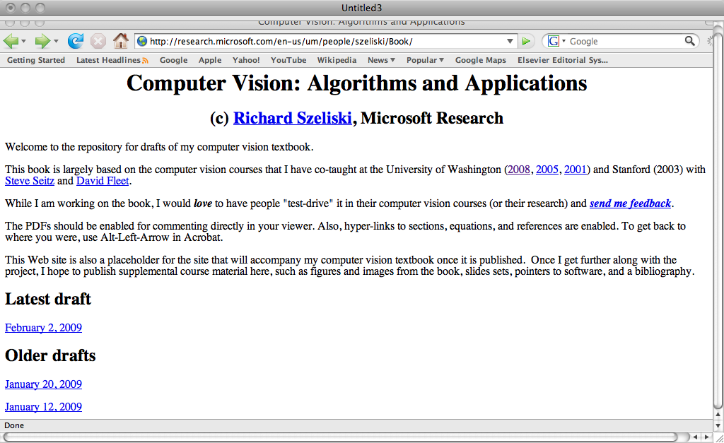
Computer Vision
cmput 428/615
Lecture 2:
Cameras and Images
Martin Jagersand
Readings: HZ Ch 1, 6
Sz 2.3, FP: Ch 1, 3DV: Ch 3

Slide 2
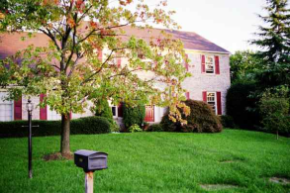
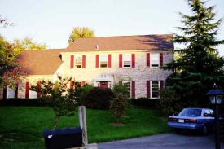
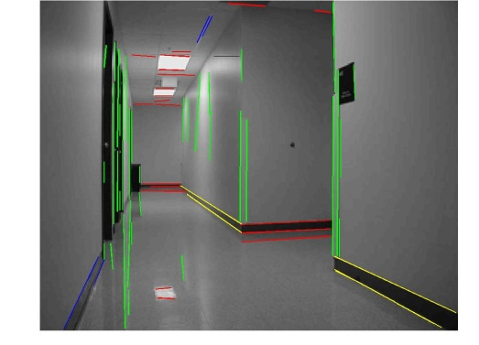
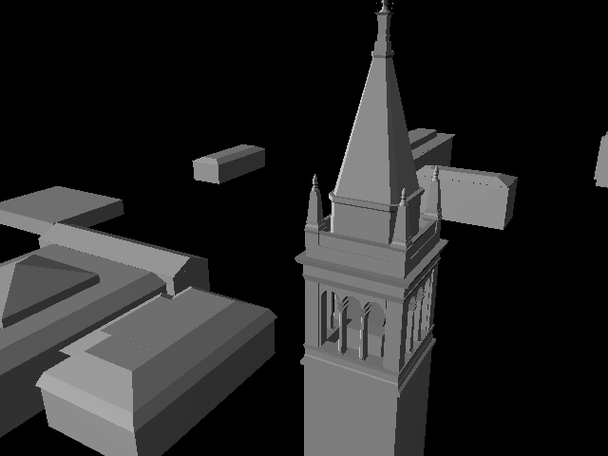
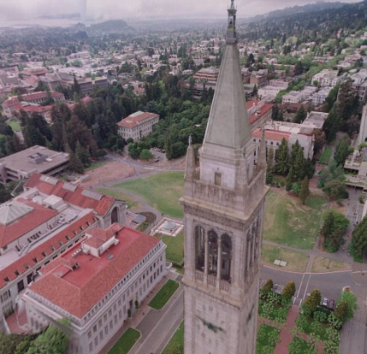
Learn the details of each stage
Stages in processing:
Physical properties
  Camera calibration, reflectance models etc.
Low level processing
  Extraction of local features: points, lines/edges, color, texture
Midlevel
  3D reconstruction. Regional grouping and interpretation of features
High level
  Task dependent global integration, e.g.
  Robotics: How to move toward object
  AI: make inference in scene,
  Graphics: Render 3D scene model
Now: Learn about cameras and how they form images Readings: HC Ch 1, 6, Sz 2.3 FP: Ch 1, 3DV: Ch 3

Slide 3
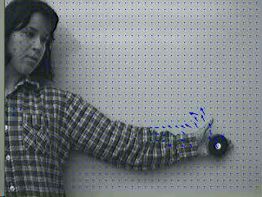
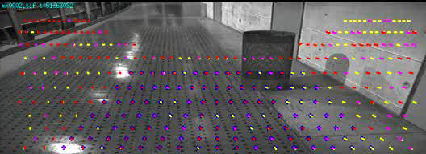
Low level video processing “Visual motion detecton”
Relating two adjacent frames: (small differences):

Slide 4
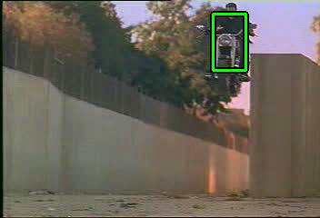
Mid-level video processing
“Video Object Tracking” / Registration
Globally relating all frames: (large differences):
…

Slide 5
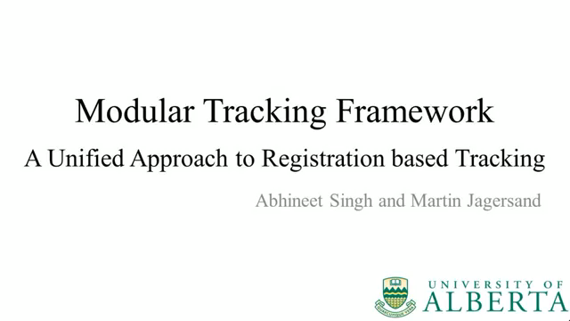
MTF – Modular Tracking Framework
Open source
C++ implementation
ROS interface
Matlab/Pyhton
Cross platform

Slide 6
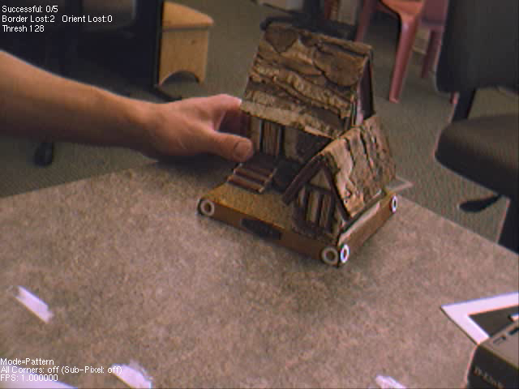
Application:
Augmenter Reality

Slide 7
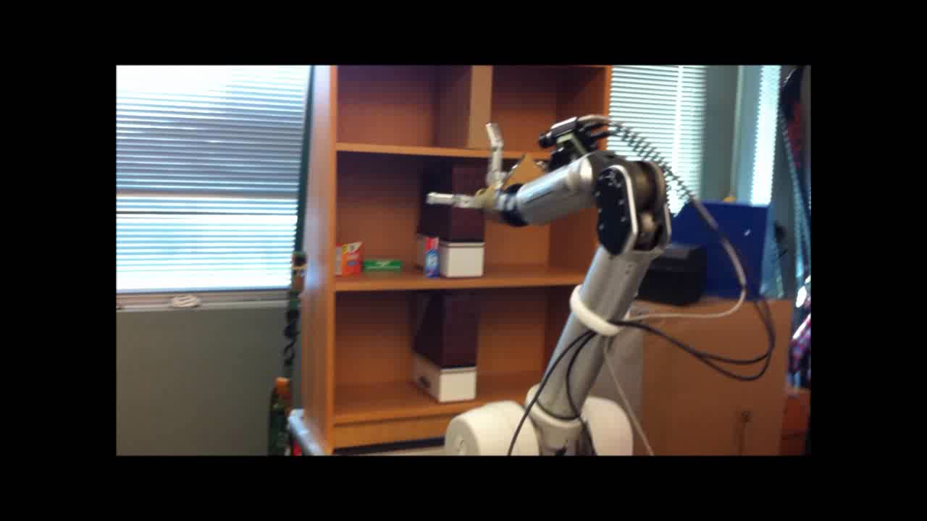
Vision-guided robot motion using Multi-view geometry
Carry out manipulation tasks
http://webdocs.cs.ualberta.ca/~vis/ibmr/
Training for Amazon manipulation challenge
And many other usages…

Slide 8
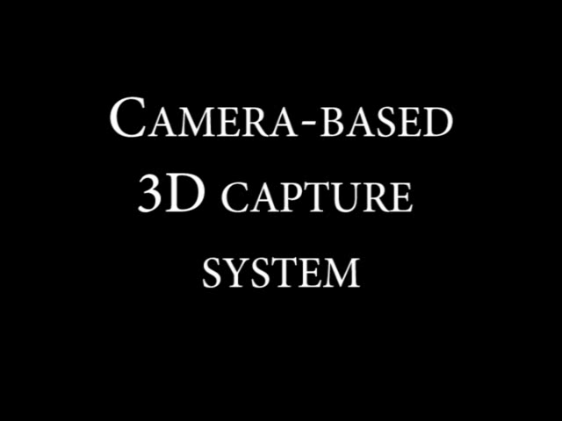
Multi-view geometry
Build 3D models from images
Carry out manipulation tasks
http://webdocs.cs.ualberta.ca/~vis/ibmr/
Training for Amazon manipulation challenge
And many other usages…

Slide 9
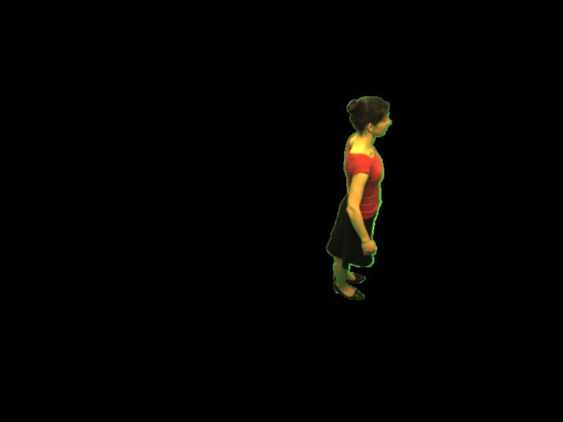
Beyond 3D:
Non-rigid and articulated motion
PhD work of Neil Birkbeck, Best thesis prize winner

Slide 10
How the 3D physical world is
captured on a 2D image plane
x
z
y
y
x
z
y
x

Slide 11
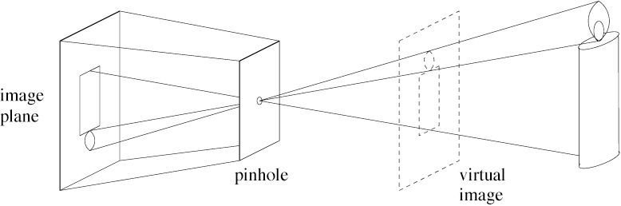
Pinhole cameras
Abstract camera model - box with a small hole in it
Image formation described by geometric optics
Note: equivalent image formation on virtual and real image plane

Slide 12
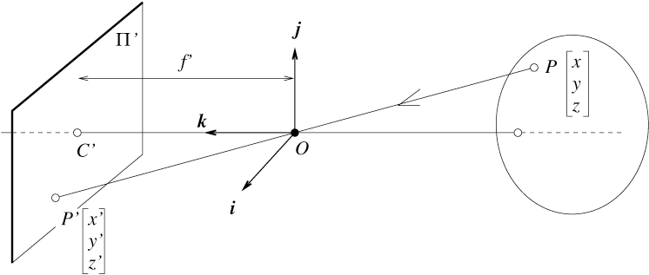
The equation of projection
How do we develop a consistent mathematical framework for projection calculations?
Mathematically:
Cartesian coordinates:
Projectively: x = PX
Intuitively:

Slide 13
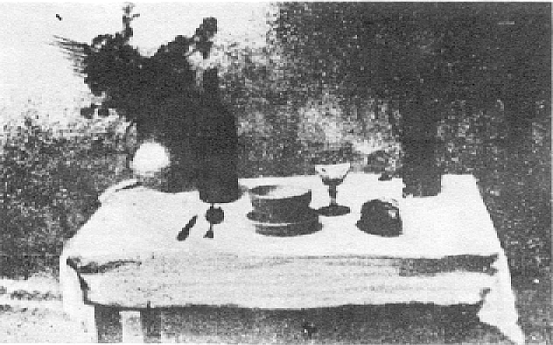
Pinhole cameras: Historic and real
First photograph due to Niepce,
First on record shown - 1822
Basic abstraction is the pinhole camera
  lenses required to ensure image is not too dark
  various other abstractions can be applied

Slide 14
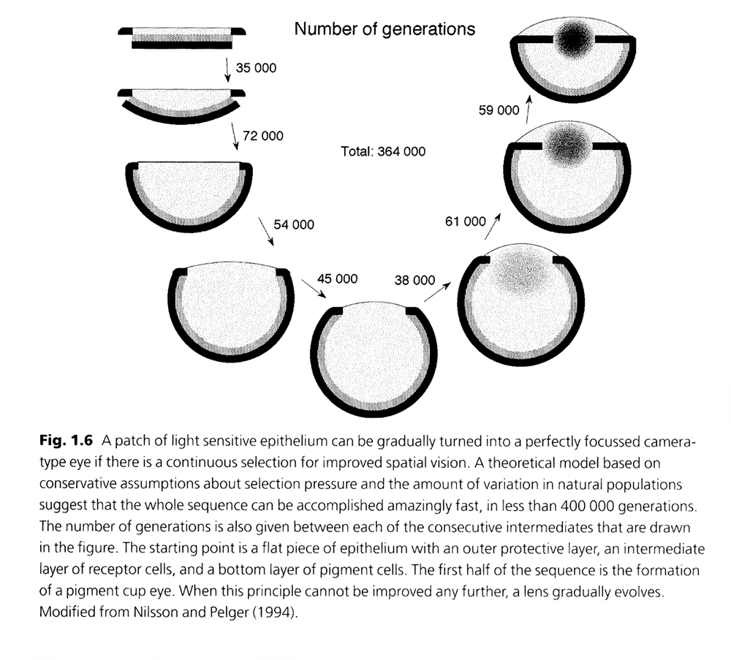
Animal Eyes
Land & Nilsson.
Oxford Univ. Press

Slide 15
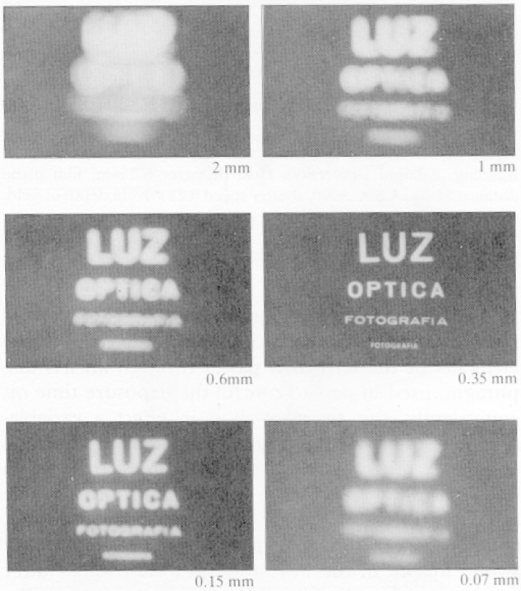
Real Pinhole Cameras
Pinhole too big -
many directions are
averaged, blurring the
image
Pinhole too small-
diffraction effects blur
the image
Generally, pinhole
cameras are dark, because
a very small set of rays
from a particular point
hits the screen.

Slide 16
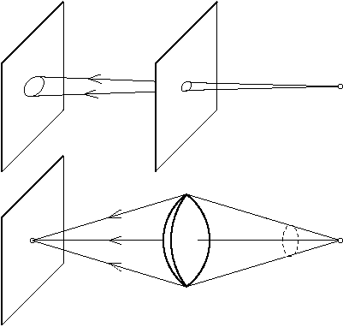
Lenses: bring together more rays
Note: Each world point projects to many image points.
With a 1mm pinhole and f=10mm how many points at 1m distance?

Slide 17
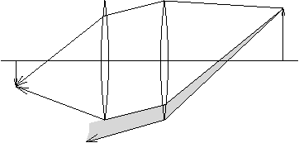
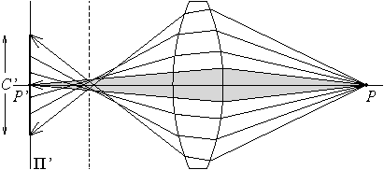
Lens Realities
Real lenses have a finite depth of field, and usually
suffer from a variety of defects
Spherical Aberration
vignetting

Slide 18
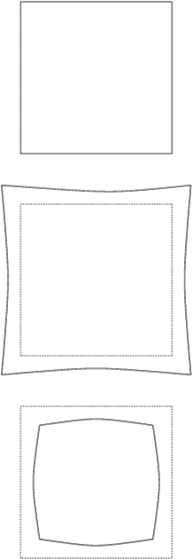
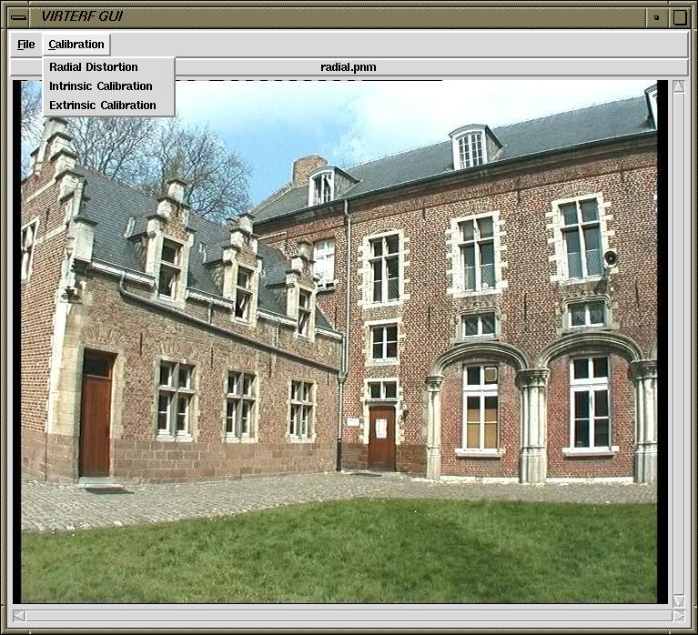
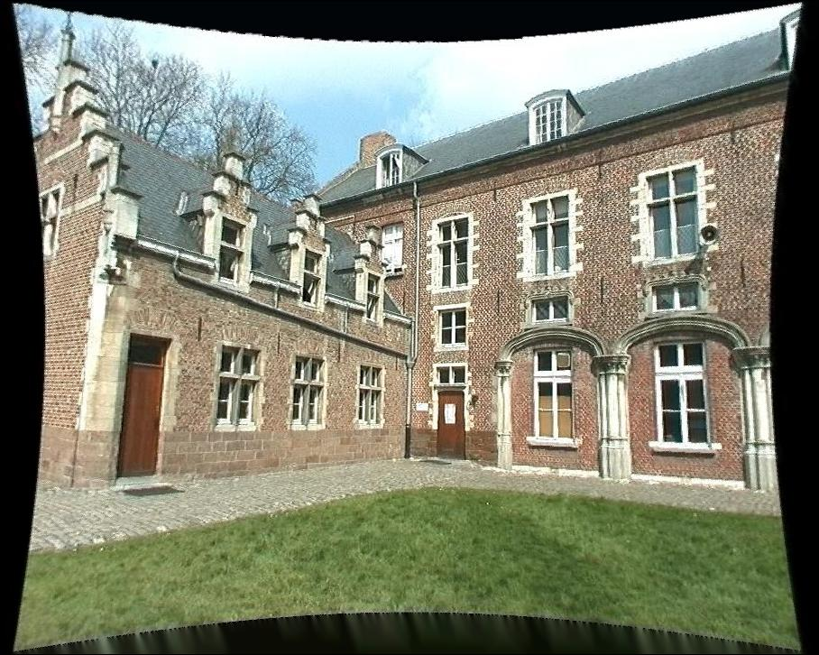
Lens Distortion
magnification/focal length different
for different angles of inclination
pincushion
(tele-photo)
barrel
(wide-angle)
Can be corrected! (if parameters are know)

Slide 19
Image streams -> Computer
Digital Signal
Image
Processor
Host
Computer
Camera
Digitizer
DISPLAY
Analog Signal

Slide 20
A Modern Digital Camera (Firewire)
IEEE 1394
Host
Computer
Camera
Two main camera types :
DISPLAY
1. CCD
X window
2. CMOS
Digital Signal

Slide 21
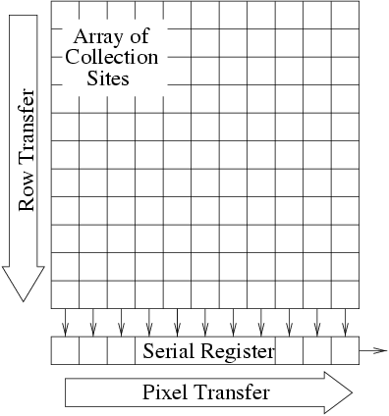
CCD camera
separate photo sensor at regular positions
no scanning
charge-coupled devices (CCDs)
area CCDs and linear CCDs
2 area architectures :
interline transfer and frame transfer
photosensitive
storage
➔

Slide 22
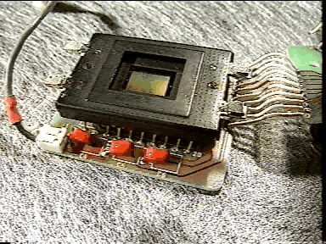
The CCD camera

Slide 23
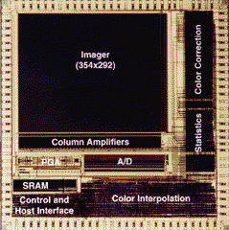
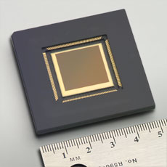
CMOS
Same sensor elements as CCD
Each photo sensor has its own amplifier
  More noise (reduced by subtracting ‘black’ image)
  Lower sensitivity (lower fill rate)
Uses standard CMOS technology
  Allows to put other components on chip
  ‘Smart’ pixels
Foveon
4k x 4k sensor
0.18μ process
70M transistors

Slide 24
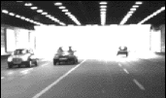

CCD vs. CMOS
Recent technology
Standard IC technology
Cheap
Low power
Less sensitive
Per pixel amplification
Random pixel access
Smart pixels
On chip integration with other components
Mature technology
Specific technology
High production cost
High power consumption
Higher fill rate
Blooming
Sequential readout
Low noise

Slide 25
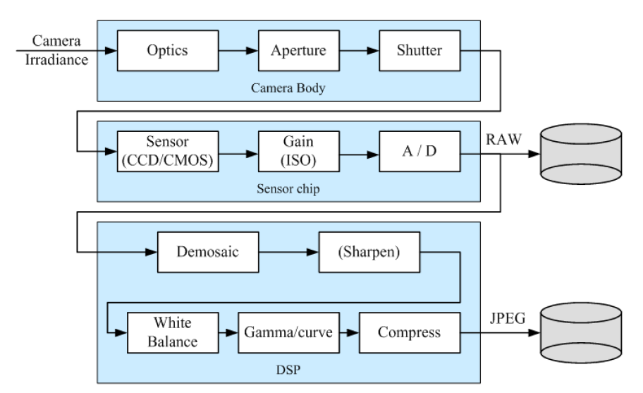
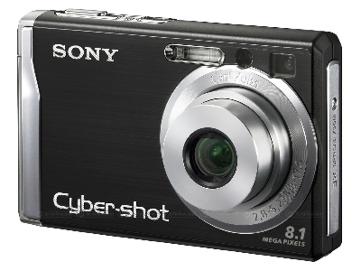
A consumer camera
gamma
Note: Gamma curve Ijpeg = I
Warning: Non-linear response!!

Slide 26
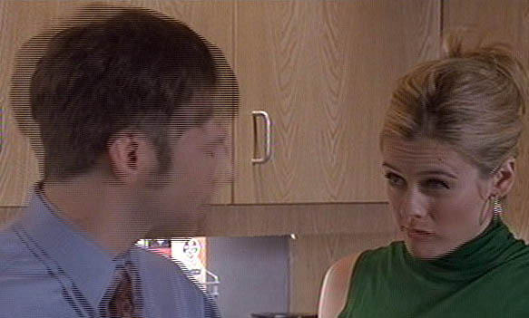
Interlacing
Some video cameras read even lines then odd…

Slide 27
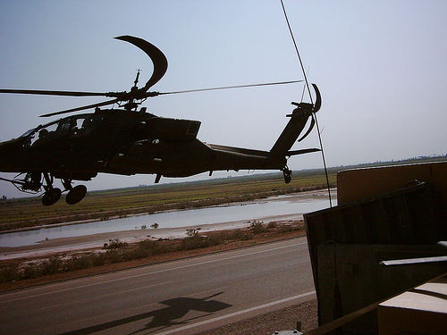
Rolling shutter
Some cameras read out one line at a time:

Slide 28
Colour cameras
We consider 3 concepts:
  Prism (with 3 sensors)
  Filter mosaic
  Filter wheel
  … and X3

Slide 29
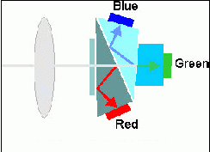
Prism colour camera
Separate light in 3 beams using dichroic prism
Requires 3 sensors & precise alignment
Good color separation

Slide 30
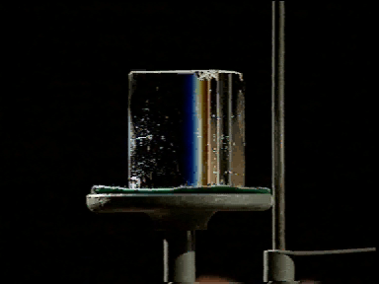
Prism colour camera

Slide 31
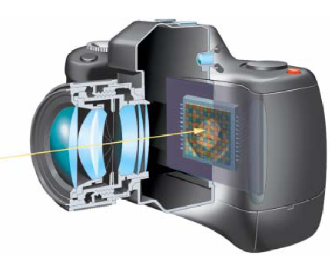
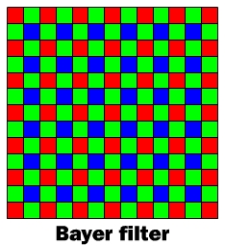
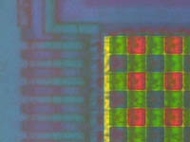
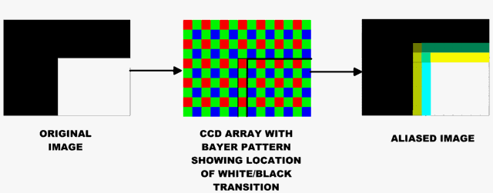
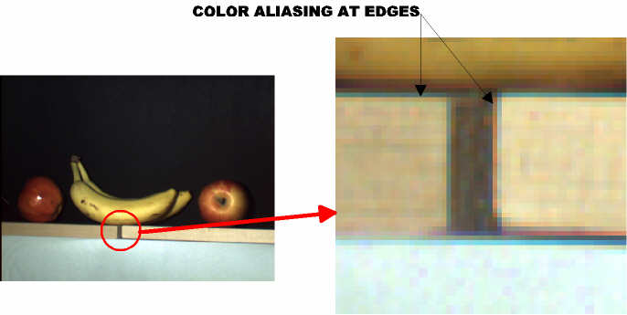
Filter mosaic
Coat filter directly on sensor
Demosaicing (obtain full colour & full resolution image)

Slide 32
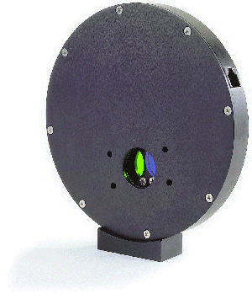
Filter wheel
Rotate multiple filters in front of lens
Allows more than 3 colour bands
Only suitable for static scenes

Slide 33
Prism vs. mosaic vs. wheel
approach
# sensors
Separation
Cost
Framerate
Artefacts
Bands
Use:
Prism
3
High
High
High
Low
3
High-end
cameras
Mosaic
1
Average
Low
High
Aliasing
3
Low-end
cameras
Wheel
1
Good
Average
Low
Motion
3 or more
Scientific applications

Slide 34
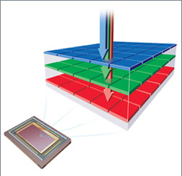
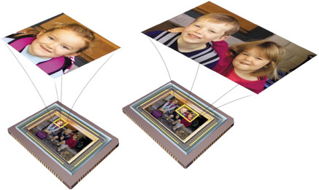
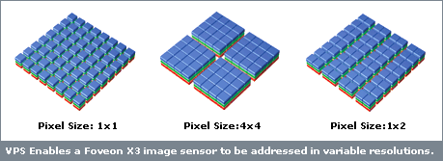
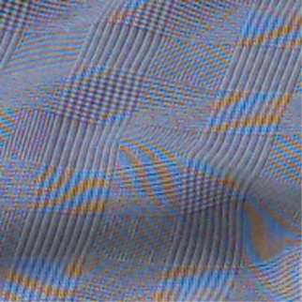
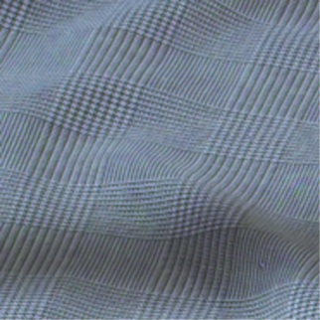
new color CMOS sensor
Foveon’s X3
smarter pixels
better image quality

Slide 35
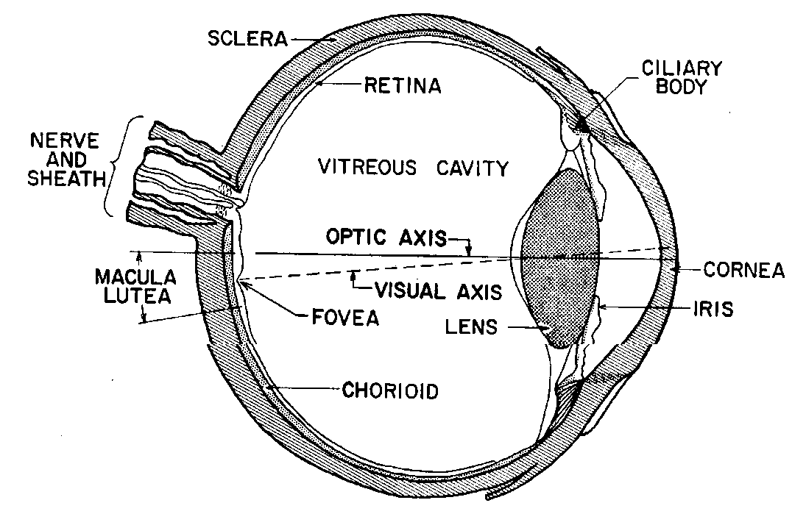
Biological implementation of camera:
the eye
The Human Eye is a camera…
  Iris - colored annulus with radial muscles
  Pupil - the hole (aperture) whose size is controlled by the iris
  Lens - changes shape by using ciliary muscles (to focus on objects at different distances)
  What’s the “film”?
    photoreceptor cells (rods and cones) in the retina

Slide 36
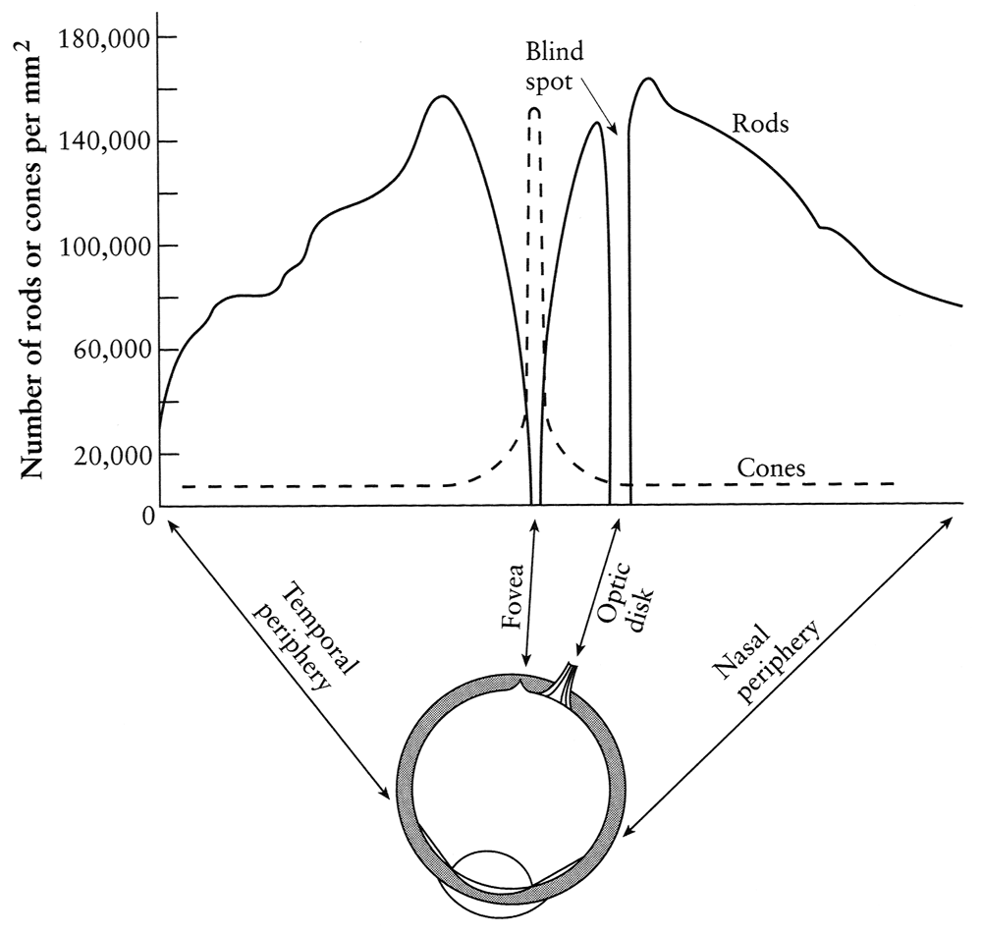
Density of rods and cones
pigment
molecules
Rods and cones are non-uniformly distributed on the retina
  Rods responsible for intensity, cones responsible for color
  Fovea - Small region (1 or 2°) at the center of the visual field containing the highest density of cones (and no rods).
  Less visual acuity in the periphery—many rods wired to the same neuron
Slide by Steve Seitz
Notes:
36

Slide 37


Blindspot
color? structure? motion?
http://ourworld.compuserve.com/homepages/cuius/idle/percept/blindspot.htm
Left eye
Right eye
Notes:
37
http://ourworld.compuserve.com/homepages/cuius/idle/percept/blindspot.htm

Slide 38

Rod / Cone sensitivity
Why can’t we read in the dark?
Slide by A. Efros
Notes:
38

Slide 39
THE ORGANIZATION OF A 2D IMAGE
Pixel
Binary
1 bit
Grey
1 byte
Color
3 bytes

Slide 40
Mathematical / Computational
image models
Continuous mathematical:
I = f(x,y)
Discrete (in computer) adressable 2D array:
I = matrix(i,j)
Discrete (in file) e.g. ascii or binary sequence:
023 233 132 232
125 134 134 212

Slide 41


Sampling
Standard video: 640x480
Subsample ½, ¼…
Quantization: typ 8 bit, sometimes lower

Slide 42
THE ORGANIZATION OF AN IMAGE SEQUENCE
Frames
Frames are
acquired at 30Hz
(NTSC)
Frames are composed of
two fields consisting
of the even and odd
rows of a frame

Slide 43
BANDWIDTH REQUIREMENTS
Standard VGA (web-cam) video:
Standard VGA video:
Binary
1 bit * 640x480 * 30 = 9.2 Mbits/second
Grey
1 byte * 640x480 * 30 = 9.2 Mbytes/second
Color
3 bytes * 640x480 * 30 = 27.6 Mbytes/second (actually about 37 mbytes/sec)
Typical operation: 3x3 convolution
9 multiplies + 9 adds ➔ 180 Mflops

Slide 44
Digitization Effects
The “diameter” d of a pixel determines the highest frequency representable in an image
Real scenes may contain higher frequencies resulting in aliasing of the signal.
In practice, this effect is often dominated by other digitization artifacts.

Slide 45
Other image sources:
Optic Scanners (linear image sensors)
Laser scanners (2 and 3D images)
Radar
X-ray
NMRI

Slide 46
Image display
VDU
LCD
Printer
Photo process
Plotter (x-y table type)

Slide 47
Image representation for display
True color, RGB, ….
(R,G,B) (R,G,B) … (R,G,B)
:
(R,G,B)

Slide 48
Image representation for display
Indexed image
(I) (I) … (I)
:
(I)
(R,G,B)
(R,G,B)
:
(R,G,B)

Slide 49
Matlab Programming
Raw Material: Images = Matrices
Themes: Build systems, experiment, visualize!
Platform: Matlab
(“ matrix laboratory ”)
Widely-used mathematical scripting language
Easy prototyping of systems
Lots of built-in functions, data structures
GUI-building support
All in all, hopefully a labor-saving tool

Slide 50
Matlab availability
In lab, machines ub01 to ub08
For remote logins: ssh to a server, then ubXX
For your own use: Download Matlab from UofA OnTheHub
Homework: Go though exercises in matlab compendium posted on lab www-page.

Slide 51


Slide 52
Matlab basics
Starting, stopping, help, demos, math, & variables
Matrix definition and indexing
> > A = [ 1 2 3 ; 4 5 6 ; 7 8 9 ]
or
1 2 3
4 5 6
7 8 9
> > A(3,2)
> > A(3,:)
> > A(3,1:2) = [ 0 0 ]
> > A’
How would you set the middle row to be the first column?
> > A(:,:,2) = A
> > size(A)
See Assignment 1, part 1 for a more thorough introduction.

Slide 53

Image Matrix
size(A)
Matlab matrix A
A(1:10,1:10,:)
A(200, 50:300, 3)
The large “M”?
The spam’s location?

Slide 54
Matlab Built-Ins
for, if, while, switch -- execution control
who, whos, clear -- variable listing and removing
save, load <file> -- saving or restoring a workspace
diary <file> -- start recording to a file
path, addpath -- display or add to search path
close, close all, clc -- close windows, clear console
double vs. uint8 -- data casting functions
zeros(x,y,…) -- creates an all-zero x by y … matrix
diary off ; diary on
used for basic memory allocation

Slide 55
Images in Matlab (& Functions)
Built-in functions:
Types
A =imread(<filename>, <type>) -- pull from file
imwrite(A, <filename>, <type>) -- write to file
image(A) -- display image
imshow(A) -- display image
’tif’
’jpg’
’bmp’
’png’
’hdf’
’pcx’
’xwd’
functions:
single-quoted strings
Add:
show(A) -- display and tools for

