Slide 1
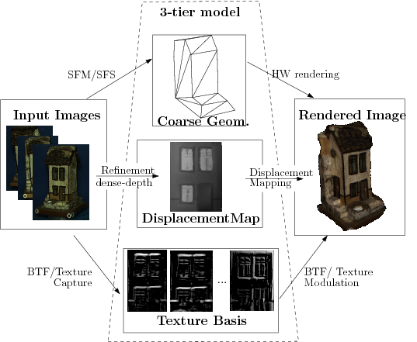
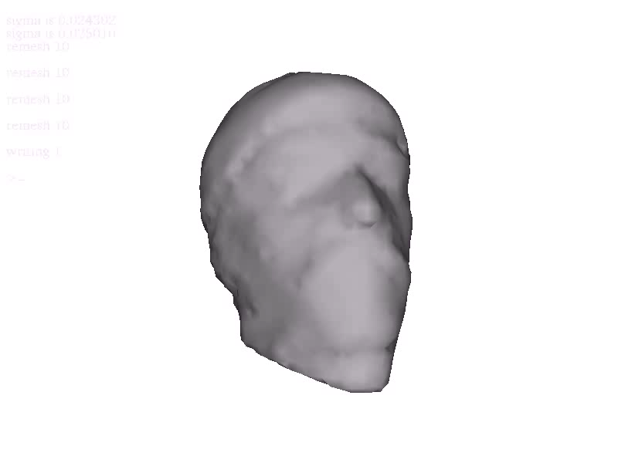
View Dependent Texturing using a Linear Basis
Neil Birkbeck, Dana Cobzas, Martin Jagersand, Adam Rachmielowski, Keith Yerex
University of Alberta
Computing Science
video

Slide 2
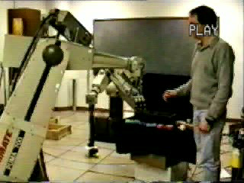
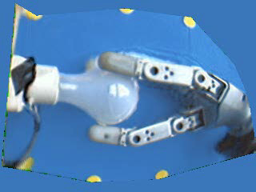
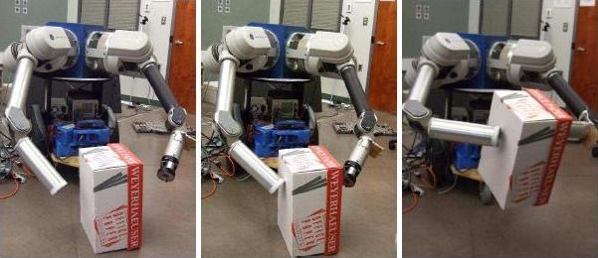
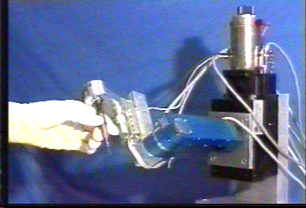
1. Overview of
Research Interests & Projects
Mathematical imaging models
Computer vision
Medical imaging
Robotics
Visual Servoing

Slide 3
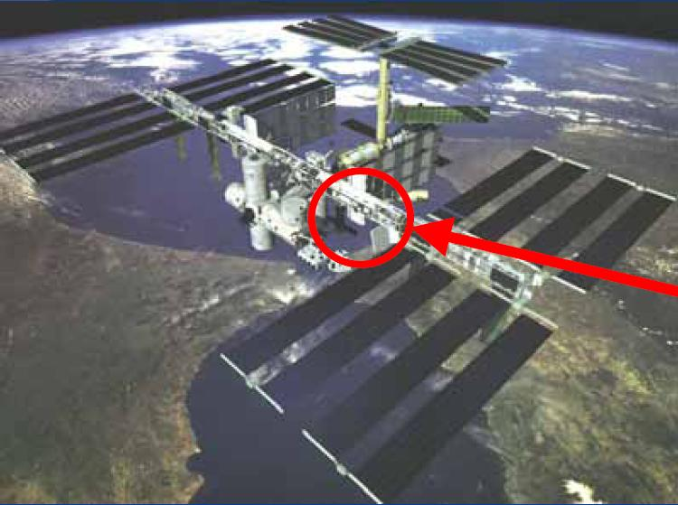
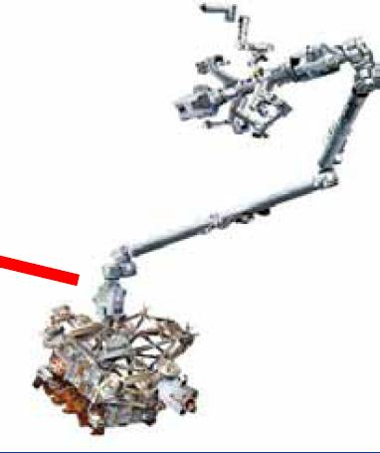
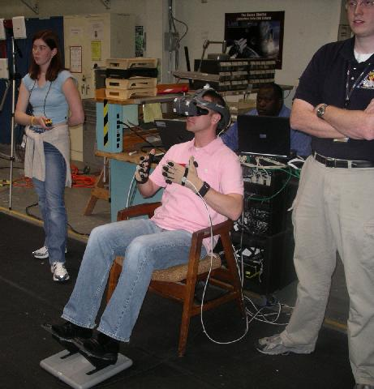
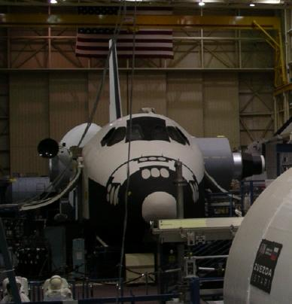
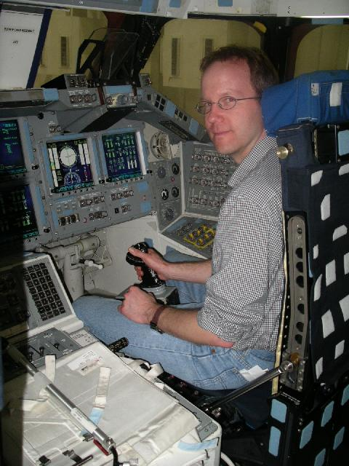
Robotics project with
CSA, Neptec, Xiphos and Barrett in
Space Tele-robotics
Human-in-the-loop teleoperation is a current mission bottleneck
Current ground-based tele-manipulation inefficient
  Transmission delays
  Non-anthophomorphic arms
Space craft don’t fit
enough operators
Tele-operator
Shuttle flight trainer, Johnson Space Ctr

Slide 4
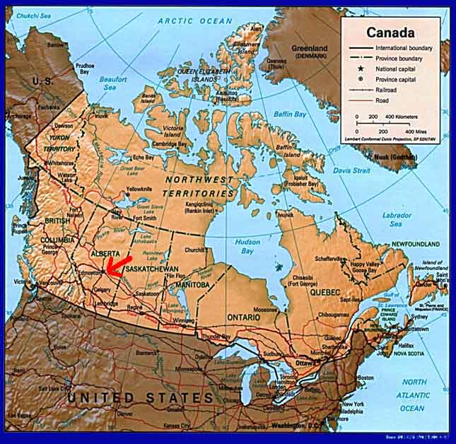
Where we are?
Western Canada!

Slide 5
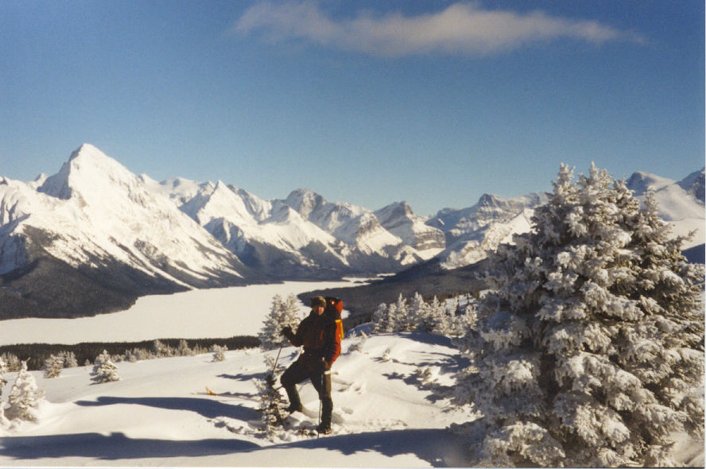
Winter in the Rockies

Slide 6
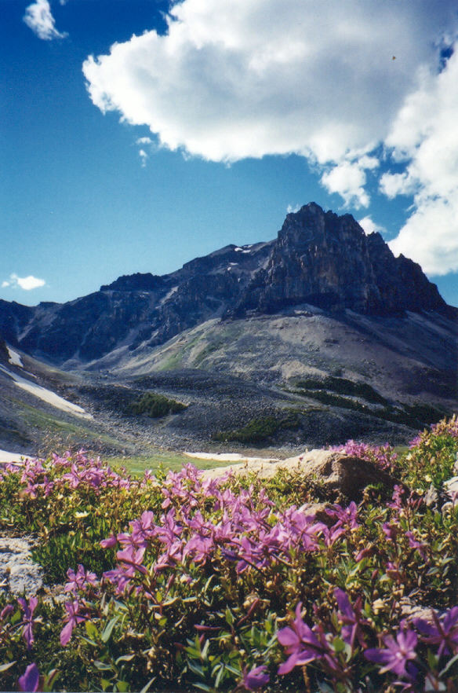
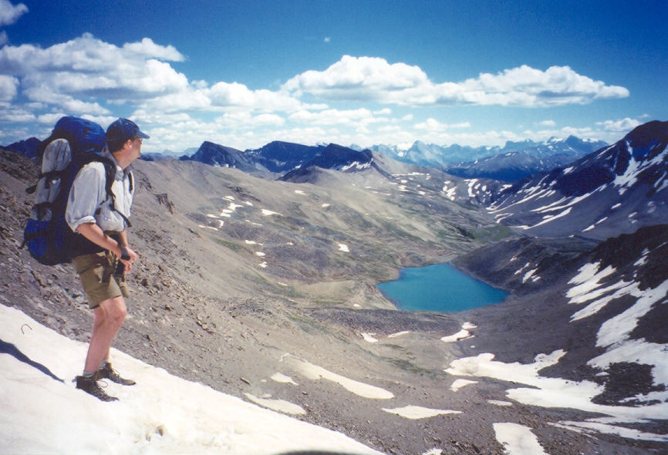
And summer …

Slide 7
Low budget 3D from video example
Capture objects
Inexpensive
Quick and convenient for the user
Integrates with existing SW e.g. Blender, Maya

Slide 8
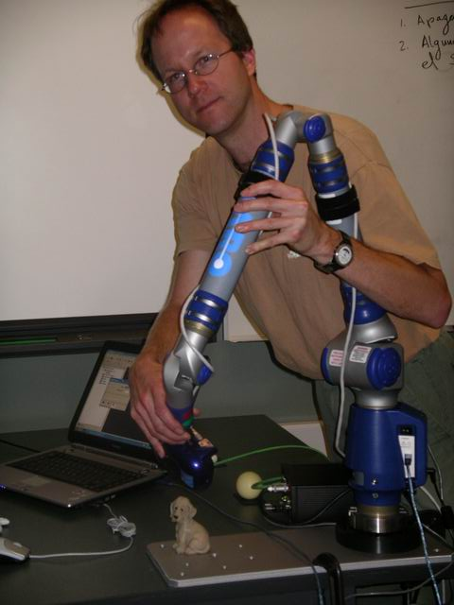
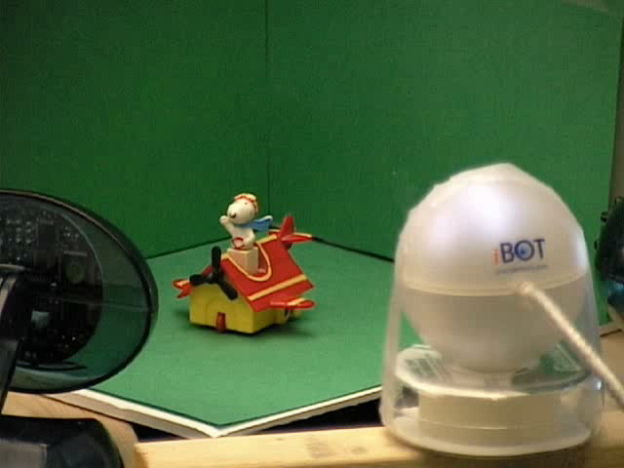
Low budget 3D from video
Inexpensive
Quick and convenient for the user
Integrates with existing SW e.g. Blender, Maya
$100: Webcams, Digital Cams
$100,000 Laser scanners etc.

Slide 9
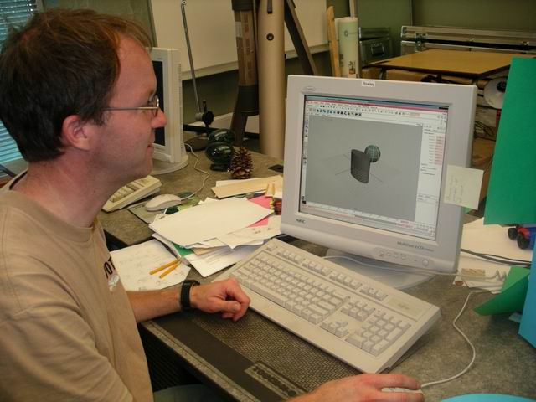
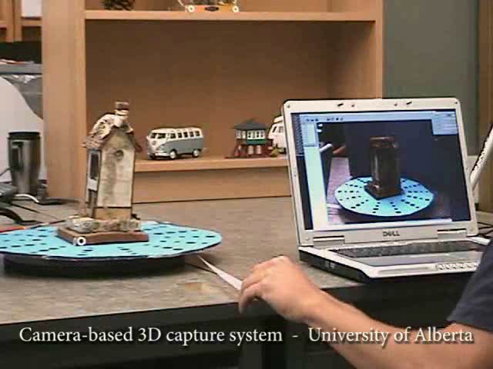
Low budget 3D from video
Inexpensive
Quick and convenient for the user
Integrates with existing SW e.g. Blender, Maya
Modeling geom primitives into scenes: >>Hours
Capturing 3D from 2D video: minutes

Slide 10
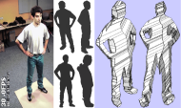
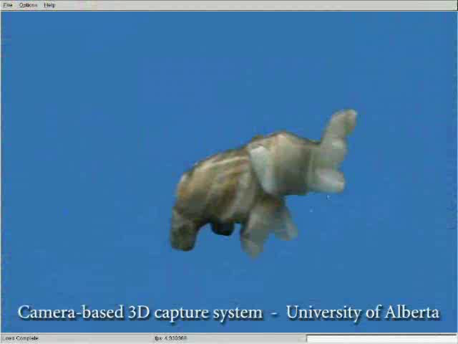
Low budget 3D from video
Inexpensive
Quick and convenient for the user
Integrates with existing SW e.g. Blender, Maya

Slide 11
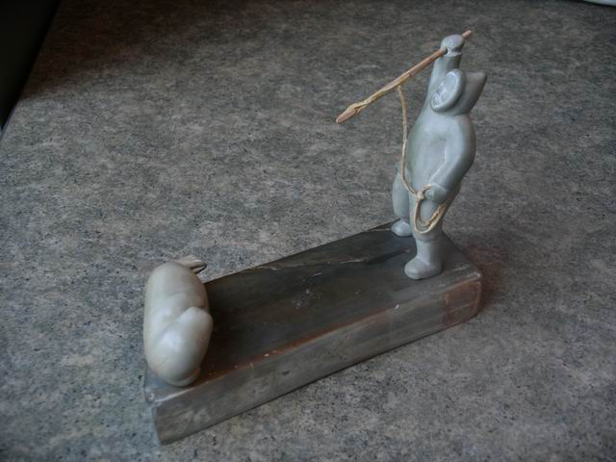
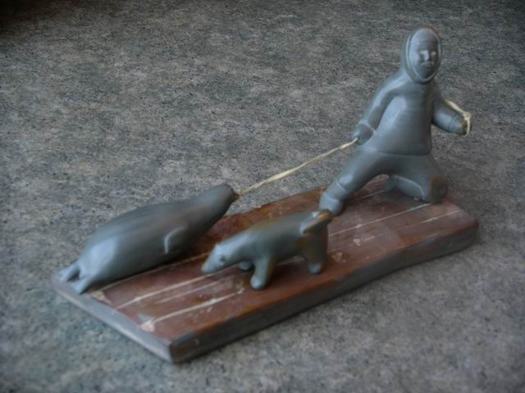
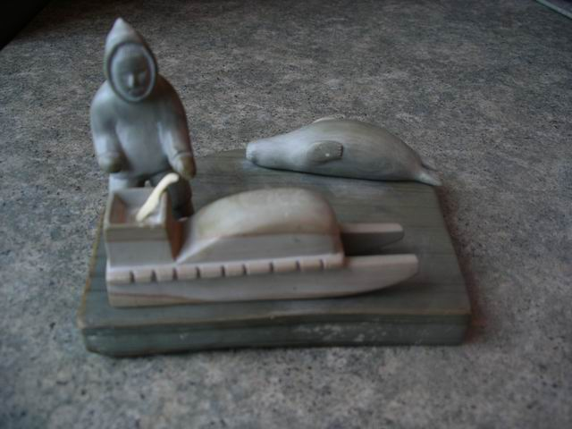
Application Case Study
Modeling Inuit Artifacts
New acquisition at the UofA: A group of 8 sculptures depicting Inuit seal hunt
Acquired from sculptor by Hudson Bay Company

Slide 12
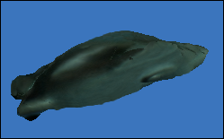
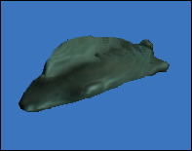
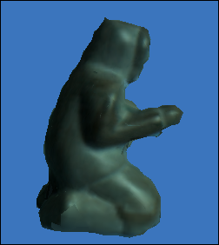
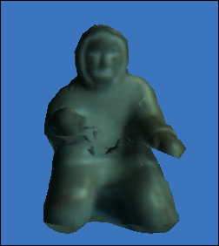
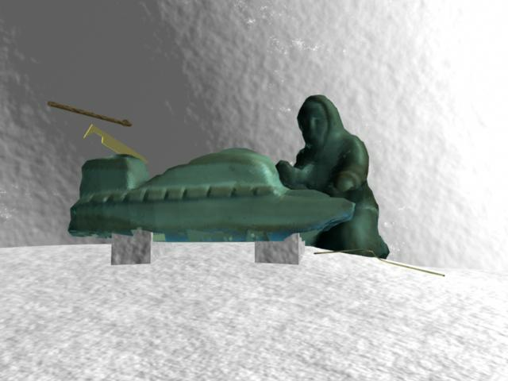
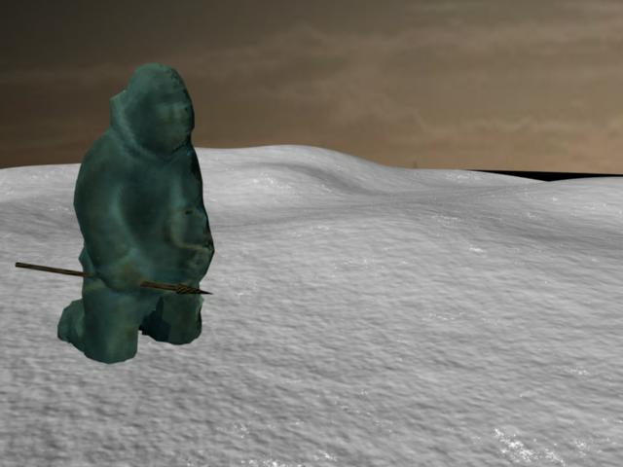
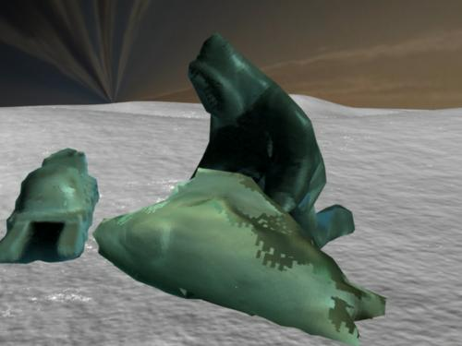
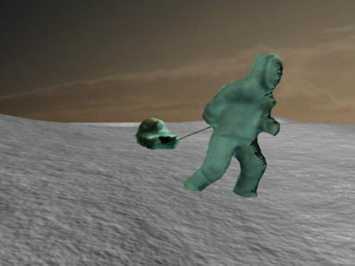
Application Case Study
Modeling Inuit Artifacts
Results:
A collection of 3D models of each component
Assembly of the individual models into animations and Internet web study material.

Slide 13
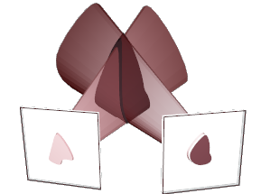
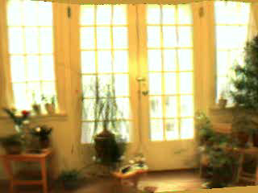
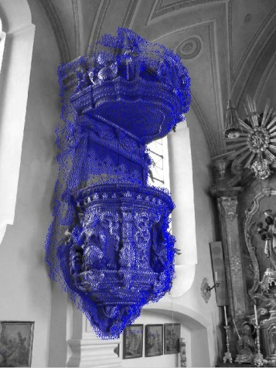
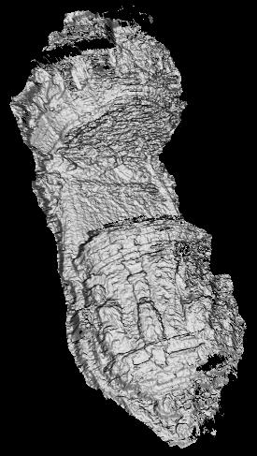
Preliminaries:
Capturing Macro geometry:
Shape From Silhouette
  Works for objects
  Robust
  Visual hull not true object surface
Structure From Motion
  Works for Scenes
  Typically sparse
  Sometimes fragile (no salient points in scene)
Space carving
  Use free space constraints
(Dense “Stereo” -- later)
  Use as second refinement step

Slide 14
Incremental Free-Space Carving
2D Example
Cameras
Freespace
Uncarved/
occupied
In 3D: Triang ➔ Tetrahedra
Conflicts
(a) Initial
(b) New point event
(d) New camera event
(c) Retriangulation
& carving

Slide 15
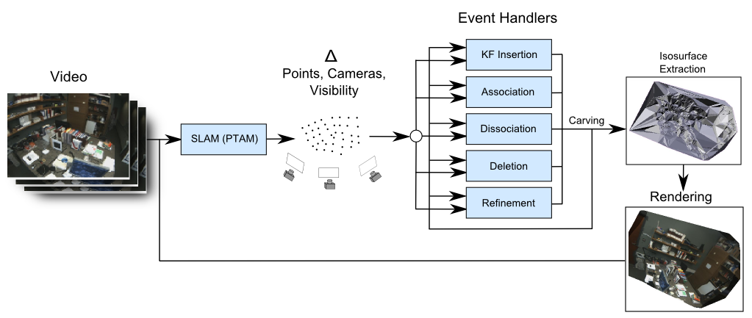
3D Modeling System
Online, incremental handling of new-information events
  Inputs continuously change online
  Different types of changes trigger tailored processing

Slide 16
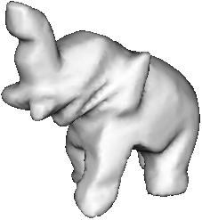
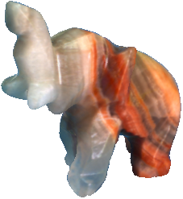
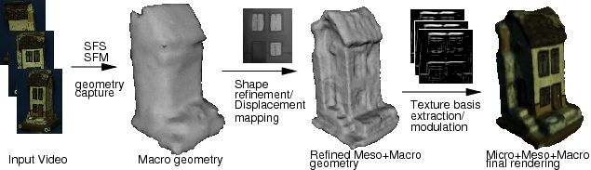
3-tier Macro, Meso, Micro model
Multi-Tiered Models:
  Commonly:
    Two tiers: 3D Geometry and appearance (* texture mapping)‏
    Used in graphics applications, recovered in Vision applications
  Three-Tier
    Macro scale: describes scene geometry (triangulated mesh)‏
    Meso scale: fine scale geometric detail (displacement map)‏
    Micro: fine scale geometry and reflectance (Texture basis)‏
  Captured by sequential refinement

Slide 17
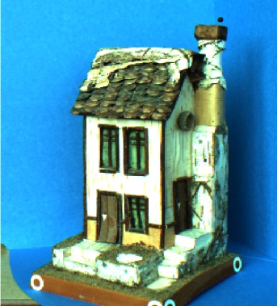
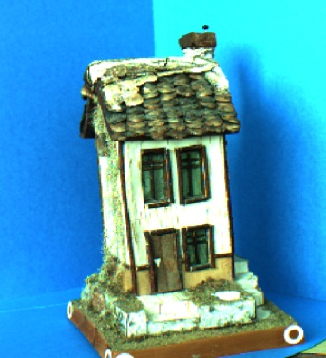


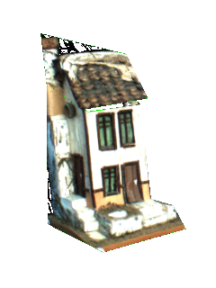


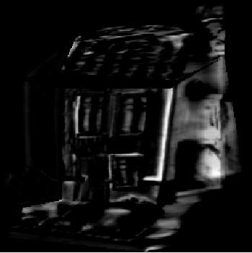
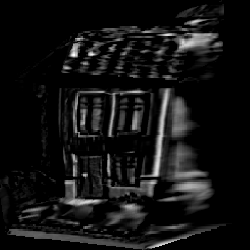
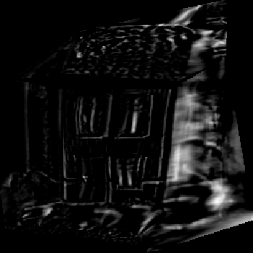
Geometry alone does not solve modeling!
Need: Multi-Scale Model
Geometry
Modeling
(Computer vision)
Rendering
(Computer Graphics)
Depth
Dynamic texture
Demo
Multi-Scale model: Macro geometry, Meso depth, Micro texture

Slide 18
Three scales map naturally to CPU and GPU hardware layers
Key issue: Efficient memory access and processing
1. Macro: Conventional geometry
processing
2. Meso: Pixel shader
  Fixed code, variable data access
3. Micro: Shader or Register comb.
  Fixed code, fixed data access
Speedup
10x
10x

Slide 19
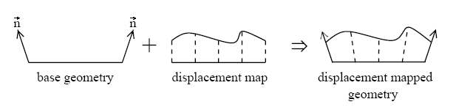
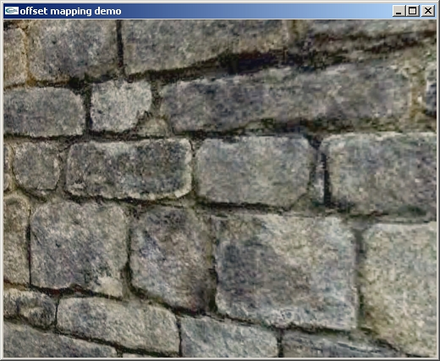
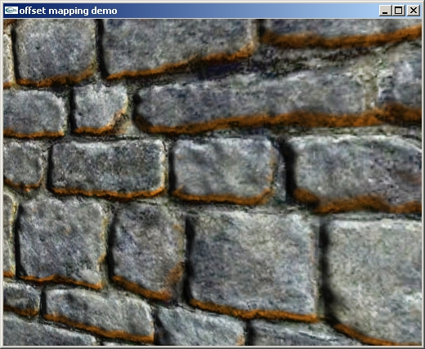
2. Meso Structure:
Depth with respect to a plane
Displacement mapped
Flat texture

Slide 20
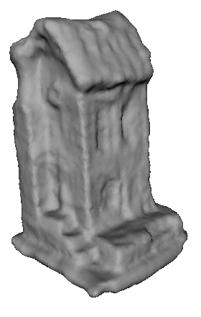



Computing Meso structure:
Variational shape and reflectance
Per-point cost function
Visibility+sampling
reflectance
Deformable mesh
Depth from Base

Slide 21

Rendering Meso Structure:
GPU: 83 pixel shader instructions
Sample d and ray at N (say15) points.
Find point location j of intersection
Approximate d with line, calculate intersection
Potentially iterate if needed for accuracy

Slide 22


Results:
Over 100 fps on consumer graphics cards
Video

Slide 23

3. Micro structure:
Spatial texture basis
Render a temporally varying dynamic texture by modulating a linear basis:
Basis contains spatial derivatives of image
Rendered by linear blending
  => fixed execution and data access pattern
  => very fast implementation in graphics hardware
y₁*
+y₂*
+…+y_{m}*

Slide 24



How/why do dynamic textures work?
3D geometry and texture warp map between views and texture images
View
Re-projected geometry
Texture
CAPTURE
Texture warp
I
1
=
Problem:
Texture images different
I
t

Slide 25
Sources of errors:
3D geometry and texture warp map between views and texture images
View
Re-projected geometry
Texture
CAPTURE
Texture warp
I
1
2: Out of plane error:
Object surface /= texture plane
t
1: Planar error: Incorrect texture coordinates

Slide 26
Spatial basis intro
Moving sine wave can be modeled:
Small image motion
Spatially fixed basis
2 basis vectors
6 basis vectors
Spatially fixed basis

Slide 27
Linear basis for spatio-temporal variation
On the object/texture plane:
  Variation resulting from small warp perturbations
  Taylor expansion:
Small if small
and smooth
…
Similarly: Can derive linear basis for out of plane and light variation!

Slide 28
Geometric spatio-temporal variability
Image “warp”
Image variability caused by an imperfect warp
First order approximation
Concrete examples
    Image plane
    Out of plane

Slide 29




Variability due to a planar projective warp (homography)
Homography warp
Projective variability:
Where ,
and

Slide 30
Out-of-plane variability
Let angle for ray to scene point
Pre-warp texture plane rearrangement:
Texture basis
Scene
c1
Depth w.r.t. model facet
Texture plane
c2

Slide 31
Photometric variation
Analytic formula for irradiance for a convex Lambertian object under distant illumination (with attached shadows) - spherical harmonics
[Barsi and Jacobs, Ramamoorthi and Hanrahan 2001]

Slide 32


Example of photometric variation

Slide 33
Composite variability
Similarly, composite texture intensity variability
Can be modeled as sum of basis
Planar Depth Light Res Err

Slide 34
How to compute?
From a 3D graphics model:
  Texture intensity derivatives
  Jacobian of warp or displacement function
Results in about 20 components:
  T₀
  8 for planar,
  2 out-of plane (parallax),
  3-9 light
From video:
We can expect an approximately 20dim variation in the space of all input texture images.
=> Extract this subspace

Slide 35
How to compute from images (cont)…
1. Take input video sequence, use SFS/SFM geometry to warp into texture space
Input Images
Geometry
Texture warp
CAPTURE
…
…
I
1
PCA
2. Extract a 20-dim subspace through PCA
…
TexDemo
t

Slide 36

Are analytic image derivatives and PCA basis the same?
Same up to a linear transform!
Experimental verification: planar homog
Derivatives
99% agreement
1
4
7
PCA

Slide 37

Mapping from Images to Texture

Slide 38


Example renderings from 3D models

Slide 39

Recap: hierarchical model scale levels
1. Macro:
  SFM, SFS can generate coarse geometry but not detailed enough for realistic rendering
  Integrate tracking and structure computation
  Scale: dozen pixels and up
2. Meso :
  Refine coarse geometry and acquire reflectance– variational surface evolution
  Scale: 1-dozen pixels
3. Micro spatial basis :
  Represents appearance and corrects for small geometric texture errors limited by linearity of image Scale: 0-5 pixels

Slide 40
Comparison
Static texturing: (Many, e.g. Baumgartner et al. 3DSOM)
  Average color projected to point.
  Better: Pick color minimizing reprojection error over all input images
  Works when model geometry is close to ground truth and light simple
Viewdependent texture (Debevec et al)
  Pick color from closest input photograph (or interpolate from nearest 3)
  Works when possible to store large numbers of images
Lumigraph / Surface light field (Buehler et al / Wood et al)
  Store all ray colors (plenoptic function) intersecting a proxy surface
  Works if proxy surface close to true geometry
Dynamic texture (Ours: Jagersand ’97/ Matusik / Ikeuchi99 /Vasilescu04...
  Derive a Taylor expansion and represent derivatives of view dependency
  Works for light and small (1-5 pixel) geometric displacements.
videos

Slide 41




From Simple to Complex Scenes
4 test cases
Simple Geom: SFS alone ok
General Geom: SFS + Variational Shape and Reflectance fitting (+View dep texture)
Complex Light: Dynamic Texture / Lumigraph
Challenge for Computer Vision

Slide 42


From Simple to Complex Scenes
4 test cases
Simple Geom: SFS alone ok
General Geom: SFS + Variational Shape and Reflectance fitting (+View dep texture)
Complex Light: Dynamic Texture / Lumigraph
Challenge for Computer Vision

Slide 43





Example of render differences
Jade Elephant
  Complex Reflectance (specularities and scattering)‏
  Input Static ViewDep Lumigr. DynTex
Specular highlight

Slide 44

Tracking with a dyntex model + AR

Slide 45

Capturing non-rigid animatable models current PhD project, Neil Birkbeck

Slide 46

Capturing non-rigid animatable models current PhD project, Neil Birkbeck
For better movies see: http://webdocs.cs.ualberta.ca/~birkbeck/phd/

Slide 47



Beyond 3D:
Non-rigid and articulated motion
Our approach
-displacement and flow on proxy
-variational formulation
-represent motion with linear basis
PhD work of Neil Birkbeck, Best thesis prize winner

Slide 48

Beyond 3D:
Non-rigid and articulated motion
PhD work of Neil Birkbeck, Best thesis prize winner

Slide 49



Beyond 3D
Non-rigid and articulated motion
Humans ubiquitous in graphics applications
A practical, realistic model requires
  Skeleton
  Geometry (manually modeled, laser scanned)
    Physical simulation for clothes, muscle
  Texture/appearance (from images)
  Animation (mocap, simulation, artist)

Slide 50

Questions?
More information:
Downloadable renderer+models
  www.cs.ualberta.ca/~vis/ibmr
Capturing software + IEEE VR tutorial text
  www.cs.ualberta.ca/~vis/VR2003tut
Main references for this talk:
Jagersand et al “Three Tier Model” 3DPVT 2008 ….
Jagersand “Image-based Animation…” CVPR 1997
More papers: www.cs.ualberta.ca/~jag

Slide 51

Computer vision
engineer

