Slide 1
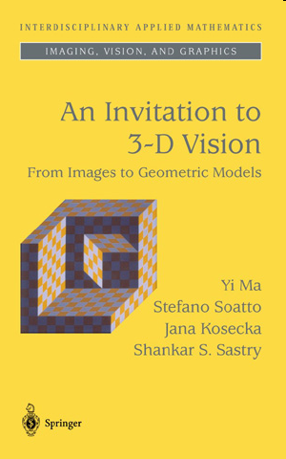
Optic Flow and Motion Detection
Computer Vision
Martin Jagersand
Readings:
3DV Ma, Kosecka, Sastry Ch 4.3
Szeliski Ch 5

Slide 2
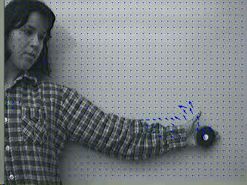
Image motion
Somehow quantify the frame-to-frame differences in image sequences.
Image intensity difference.
Vector motion=optic flow
When computable?
Numerical conditioning!
Resolution pyramids
3-6 dim image motion computation

Slide 3
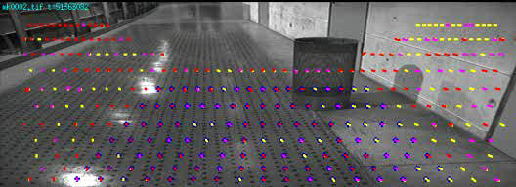
Low level video processing “Visual motion detecton / optic flow”
Relating two adjacent frames: (small differences):

Slide 4
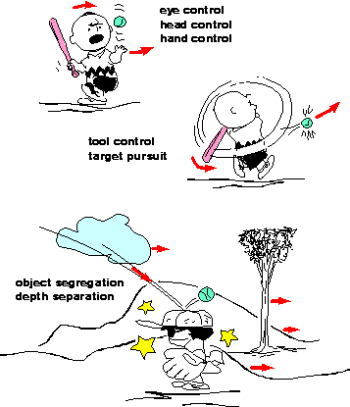
Motion is used to:
Attention: Detect and direct using eye and head motions
Control: Locomotion, manipulation, tools
Vision: Segment, depth, trajectory

Slide 5
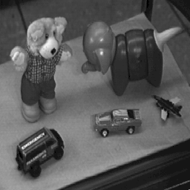
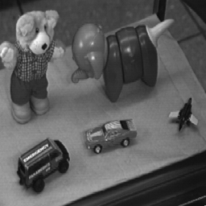
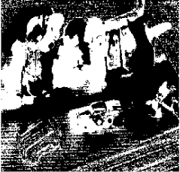
Small camera re-orientation
Note: Almost all pixels change!

Slide 6
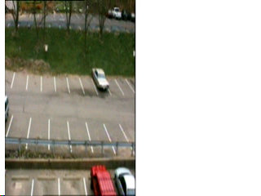
Classes of motion
Still camera, single moving object
Still camera, several moving objects
Moving camera, still background
Moving camera, moving objects

Slide 7
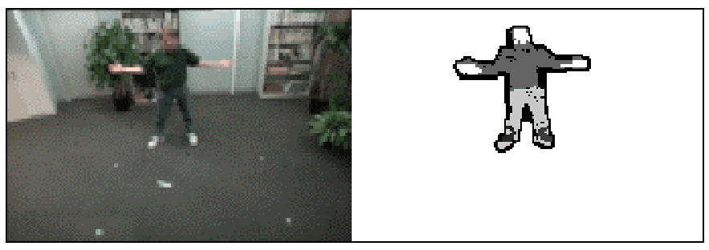
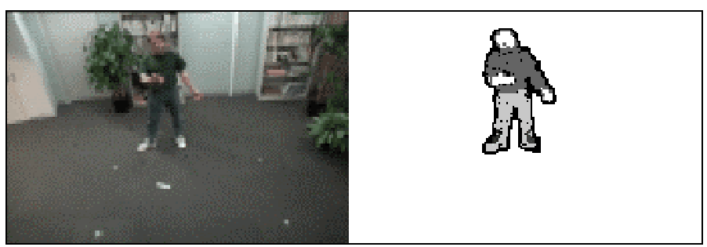
Fixed video camera
Background subtraction
  A static camera is observing a scene
  Goal: separate the static background from the moving foreground
How to come up with background frame estimate without access to “empty” scene?

Slide 8
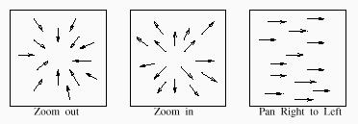
The optic flow field
Vector field over the image:
[u,v] = f(x,y), u,v = Vel vector, x,y = Im pos
FOE, FOC Focus of Expansion, Contraction

Slide 9
optic flow field
[u,v] = f(x,y), u,v = Vel vector, x,y = Im pos
Relating two adjacent frames: (small differences):

Slide 10
For a static scene a moving camera is like stereo
The change in spatial location
between the two cameras (the “motion”)
Locations of
points on the object
(the “structure”)

Slide 11
Correspondance for a box
The change in spatial location
between the two cameras (the “motion”)
Locations of
points on the object
(the “structure”)

Slide 12
Motion/Optic flow vectors
How to compute?
  Solve pixel correspondence problem
    given a pixel in Im1, look for same pixels in Im2
Possible assumptions
  color constancy: a patch in I(t) looks the same in I(t)
    For grayscale images, this is brightness constancy
  small motion: points do not move very far
    This is called the optical flow problem

Slide 13
Image Correspondance problem
Given an image point in left image, what is the (corresponding) point in the right
image, which is the projection of the same 3-D point

Slide 14
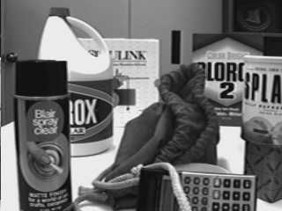
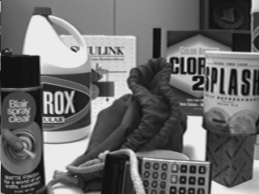
What pixels/patches correspond?
Time t
t+1
(Correspondence between image points – a common challenge:
Optic flow, Tracking, Features)

Slide 15
Image correspondence: Three assumptions
Brightness consistency
Spatial coherence
Temporal persistence

Slide 16
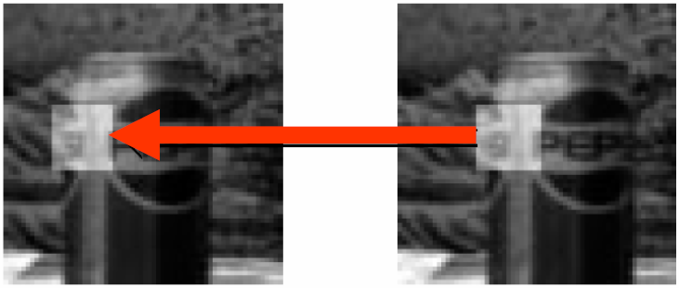
Brightness consistency
Image measurement (e.g. brightness) in a small physical surface region remain the same although their image location may change.

Slide 17
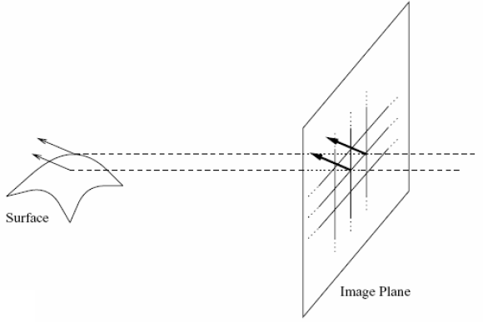
Spatial coherence
Neighboring points in the scene typically belong to the same surface and hence typically have similar motions.
Since they also project to nearby pixels in the image, we expect spatial coherence in image flow.

Slide 18
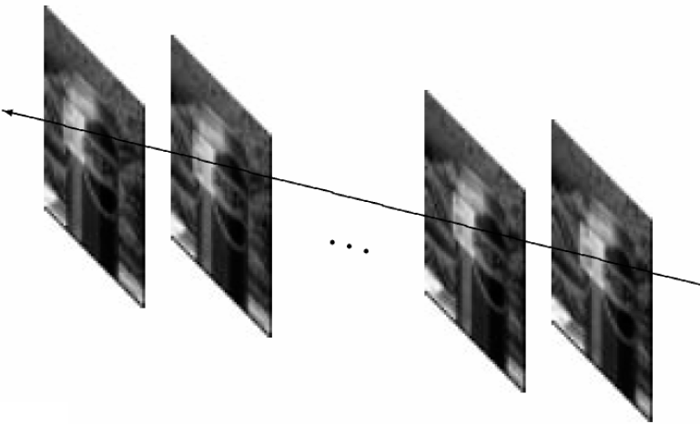
Temporal persistence
The image motion of a surface patch changes gradually over time – no more than 2-5pixels/frame

Slide 19
Image registration: Three applications
Goal: register a template image T(x) and an input image I(x), where x=(x,y)^{T}. (warp I so that it matches T)
Image alignment: I(x) and T(x) are two images
Tracking: T(x) is a small patch around a point p in the first video image, t=0. I(x) is the image at time t+1.
Optical flow: T(x) and I(x) are patches of images at t and t+1.
warp
T
I
fixed

Slide 20
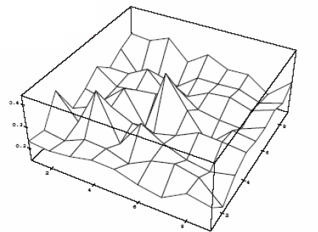
Simple approach (for translation)
Minimize brightness difference

Slide 21
Simple image registration algorithm
SSD error norm
For each offset (u, v)
compute E(u,v);
Choose (u, v) which minimizes E(u,v);
Problems:
Not efficient
No sub-pixel accuracy

Slide 22
Simple image registration algorithm
SSD error norm
For each offset (u, v)
compute E(u,v);
Choose (u, v) which minimizes E(u,v);

Slide 23
Optic/image flow
Assume:
  Image intensities from object points remain constant over time
  Image displacement/motion small
Brightness
consistency
(Later:
Subdivide image)
Small rectange of image

Slide 24
Taylor expansion of intensity variation
Taylor expansion:
Keep linear terms
Use consistency assumption and rewrite:
Notice: Linear constraint, but no unique solution
Brightness
consistency

Slide 25
What are the partial derivatives?

Slide 26
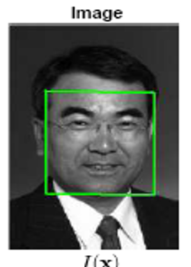
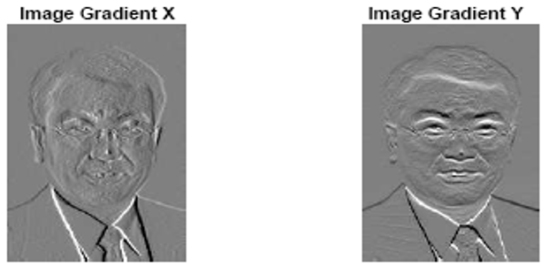
What are the partial derivatives?

Slide 27
What are the partial derivatives?
dIm_t = I(t+1)-I(t)
Heath Ch 9

Slide 28
What are the partial derivatives?
dIm_t = I(t+1)-I(t)
Heath Ch 9
dIm_x = I(x+1,y)-I(x,y)
Matlab: dIm_x = I(:,2:n)-I(:,1:n-1)

Slide 29
Solving for optic flow
f
n
f
Rewrite as dot product
Each pixel gives one equation in two unknowns:
  k = n*f
  Image spatial gradient normal n: rIm, later: M
  The image motion / optic flow f = (îx îy) ^{T}, later u
  Image temporal gradient k: @Im/@t, later dIm
Min length solution: Can only detect vectors normal to gradient direction
The motion of a line cannot be recovered using only local information
ò
ó
ò
ó
ð
ñ
î
x
î
@
I
m
@
x
I
m
@
I
à
ît
=
;
m
á
=
r
I
á
m
@
t
@
x
@
y
î
y
î
y

Slide 30
Flatten 2D images into vectors
Equation for one pixel:
ò
ó
ò
ó
ð
ñ
î
x
î
@
I
m
@
x
I
m
@
I
à
ît
=
;
m
=
r
I
m
@
t
@
x
@
y
î
y
î
y
Equations for many pixels:

Slide 31
Solve for optic flow using several simultaneous equations
Typically solve for motion in 2x2, 4x4, 8x8 or larger image patches.
Over determined equation system:
dIm = M*u
Can be solved in least squares sense using Matlab
u = M\dIm
Can also be expressed using QR factorization:
(Q^{T}M)u = Q^{T}dIm [Q, R] = qr(M), Q^{T}M=R
(Don’t compute u = (M^{T}M)⁻¹*M^{T}dIm Ill conditioned – see 340)

Slide 32
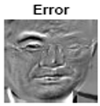
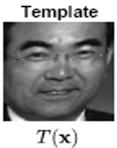
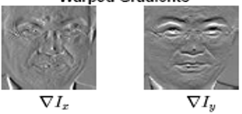
Intuitive connection images - equations
I(t+1)-I(t);
=
+

Slide 33
Summary: Solve for optic flow using several simultaneous equations
Taylor expansion for each patch:
Over determined equation system:
dIm = M*u
Can be solved in least squares sense using Matlab
u = M\dIm
Brightness
consistency

Slide 34
Matlab
dIm = I(t+1)-I(t);
[dUm,dVm] = gradient(I(t)) % Or mean of I(t), I(t+1))
%Get an 8x8 patch:
dI = dIm(k:k+8, l:l+8);
(same for dU, dV)
% Flatten into vector
dIv = dI(:);
M = [dUv dVv];
u = M\dIv
k
1 2
3 4
1
2
3
4
l

Slide 35
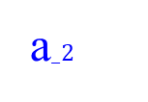
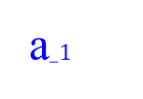
Geometric view of overdetermined equations
b = Ax
b
a$_2$
a$_1$

Slide 36
Aperture problem
f
n
f
Rewrite as dot product
Each pixel gives one equation in two unknowns:
  n*f = k
Min length solution: Can only detect vectors normal to gradient direction
The motion of a line cannot be recovered using only local information
ò
ó
ò
ó
ð
ñ
î
x
î
@
I
m
@
x
I
m
@
I
à
ît
=
;
m
á
=
r
á
I
m
@
t
@
x
@
y
î
y
î
y

Slide 37
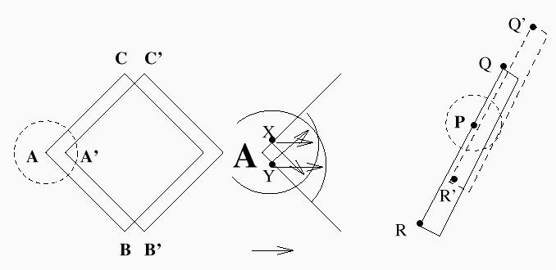
Aperture problem 2

Slide 38
The flow continuity constraint
Flows of nearby pixels or patches are (nearly) equal
Two equations, two unknowns:
  n₁ * f = k₁
  n₂ * f = k₂
Unique solution f exists, provided n₁ and n₂ not parallel
f
n
f
f
n
f

Slide 39
Sensitivity to error
n₁ and n₂ might be almost parallel
Tiny errors in estimates of k’s or n’s can lead to huge errors in the estimate of f
f
n
f
f
n
f

Slide 40
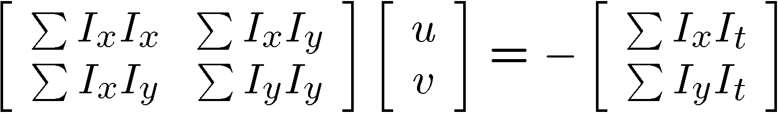


Conditions for solvability
  SSD Optimal (u, v) satisfies Optic Flow equation
  Better: [u,s,v] = svd(A), s=diag(λ₁, λ₂) Heath Ch3.5
When is this solvable?
  A^{T}A should be invertible
  A^{T}A entries should not be too small (noise)
  A^{T}A should be well-conditioned
  Study eigenvalues:
    λ₁/ λ₂ should not be too large (λ₁ = larger eigenvalue)

Slide 41
Simple image registration algorithm
SSD error norm
For each offset (u, v)
compute E(u,v);
Choose (u, v) which minimizes E(u,v);

Slide 42
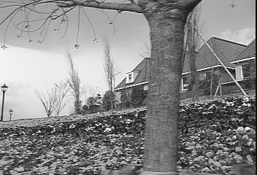
Optic Flow Real Image Challenges:
Can we solve for accurate optic flow vectors everywhere using this image sequence?

Slide 43
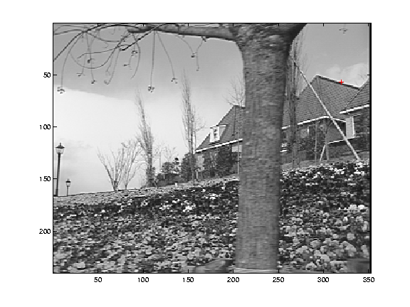
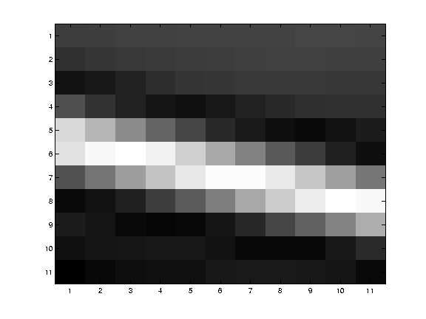
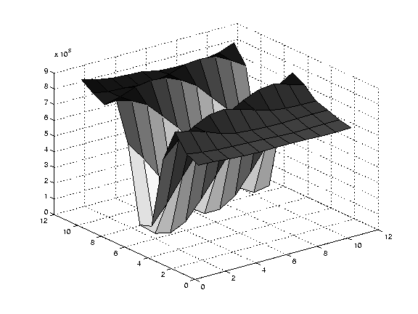
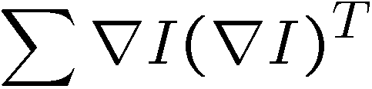
Edge
gradients very large or very small
large λ₁, small λ₂

Slide 44
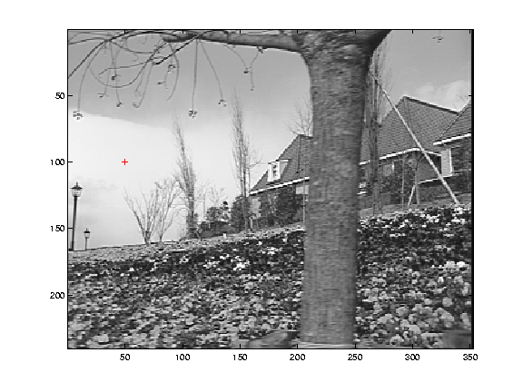
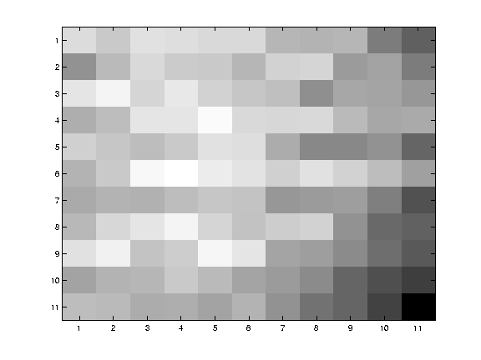
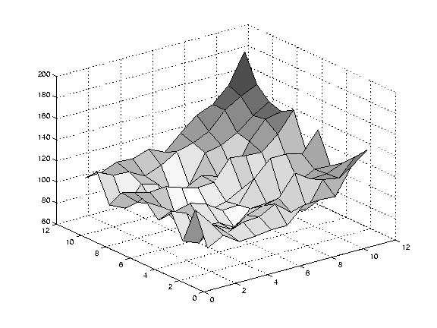
Low texture region
gradients have small magnitude
small λ₁, small λ₂

Slide 45
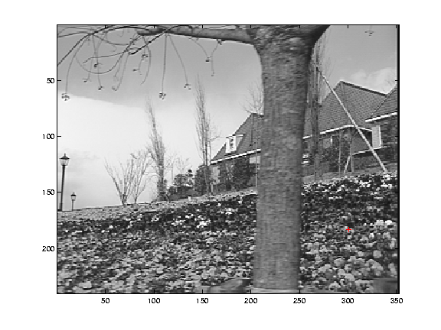
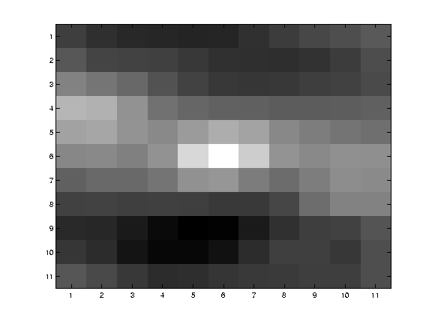
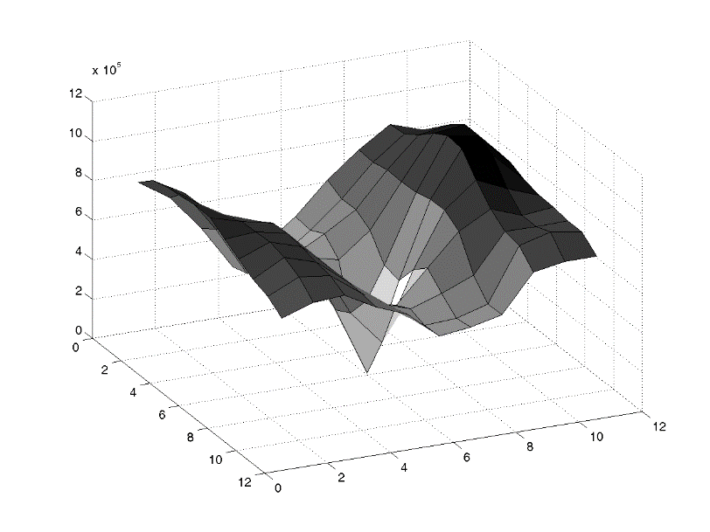
High textured region
gradients are different, large magnitudes
large λ₁, large λ₂

Slide 46
Observation
This is a two image problem BUT
  Can measure sensitivity by just looking at one of the images!
  This tells us which pixels are easy to track, which are hard
    very useful later on when we do feature tracking...

Slide 47
Review “Visual motion detection / optic flow”
Relating two adjacent frames: (small differences):
Vector
Field
[ ]

Slide 48
Correspondence between image points
Motion, Optic flow, Tracking, Features
Time t
t+1

Slide 49
Image correspondence: Three assumptions
Brightness consistency
Spatial coherence
Temporal persistence

Slide 50
Solve for optic flow using several simultaneous equations
Taylor expansion for each patch:
Over determined equation system:
dIm = M*u
Can be solved in least squares sense using Matlab
u = M\dIm
Brightness
consistency

Slide 51
Intuitive connection images - equations
I(t+1)-I(t);
=
+

Slide 52
Matlab
dIm = I(t+1)-I(t);
[dUm,dVm] = gradient(I(t)) %dUm = I(x+1,y,t) - I(x,y,t)
%Get an 8x8 patch:
dI = dIm(k:k+8, l:l+8);
(same for dU, dV)
% Flatten into vector
dIv = dI(:);
M = [dUv dVv];
u = M\dIv
k
1 2
3 4
1
2
3
4
l

Slide 53
Problems in Optic flow computation
What are the potential causes of errors in this procedure?
  Suppose A^{T}A is easily invertible
  Suppose there is not much noise in the image
When our assumptions are violated
  Brightness constancy is not satisfied
  The motion is not small
  A point does not move like its neighbors
    window size is too large
    what is the ideal window size?

Slide 54
Iterative Refinement
Used in SSD/Lucas-Kanade tracking algorithm
  Estimate velocity at each pixel by solving Lucas-Kanade equations
  Warp / shift pixels I(t+1) = H towards I(t) using the estimated flow field
    - use image warping techniques – ie OpenGL texture rendering
  Repeat until convergence
  (Iteration just like in 340 Newton methods, Heath Ch 5.)

Slide 55
Tracking Lucas-Kanade algorithm
Solving for the translational motion of a patch H
Over determined equation system:
-Im_t = M u
Solve least squares using matlab
u = M\Im_t
Update: “Newton step” ……
p = p + u
For k=1,2,… Im_t = Im(t+1,x+p) – Im(t, x)
p
k=0
k=1
k=2

Slide 56
How to source Im(.,x+p) ?
When p is not integer interpolate pixels
Im(.,x+[1.2,1.5]) = .8*.5*Im(.,x+1,y+1) +.2*.5*Im(.,x+2,y+1)+…
p
k=0
k=1
k=2

Slide 57
Revisiting the small motion assumption
Is this motion small enough?
  Probably not—it’s much larger than one pixel (2nd order terms dominate)
  How might we solve this problem?

Slide 58
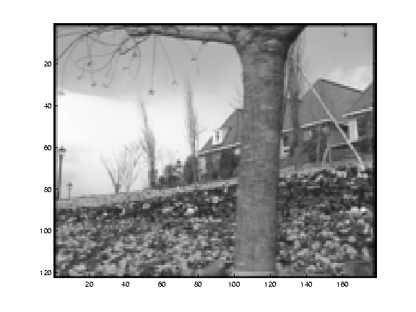
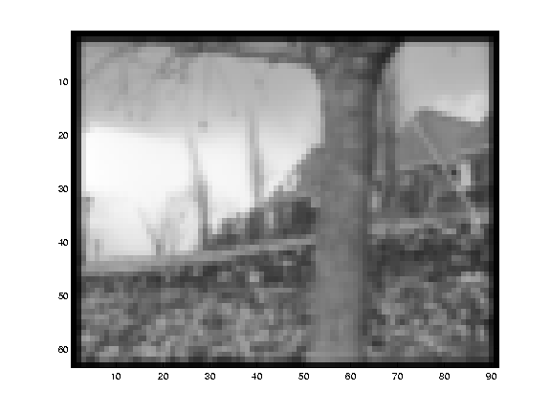
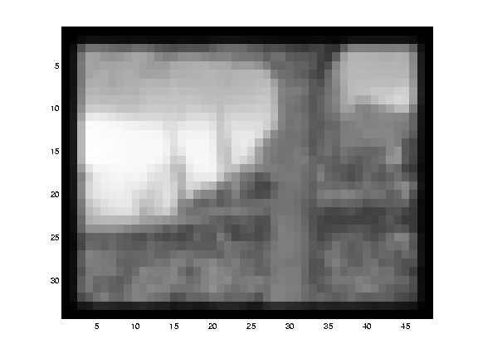
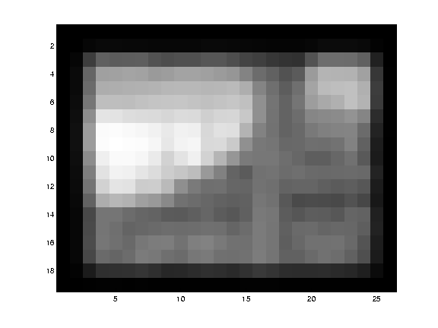
Reduce the resolution!

Slide 59
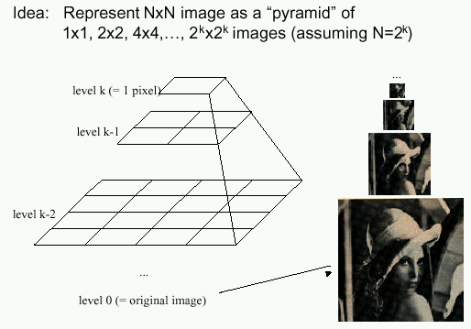
Image Pyramids

Slide 60
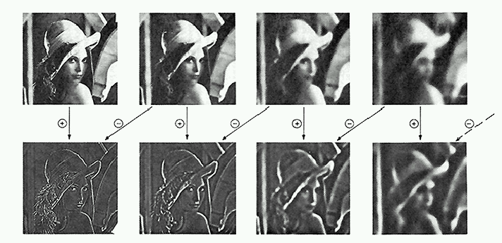
Pyramid Creation
filter mask
“Gaussian” Pyramid
“Laplacian” Pyramid
  Created from Gaussian
  pyramid by subtraction
  L_{l} = G_{l} – expand(G_{l+1})

Slide 61
Octaves in the Spatial Domain
Lowpass Images
Bandpass Images

Slide 62
Pyramids
Advantages of pyramids
  Faster than Fourier transform
  Avoids “ringing” artifacts
Many applications
  small images faster to process
  good for multiresolution processing
  compression
  progressive transmission
Known as “mip-maps” in graphics community
Precursor to wavelets
  Wavelets also have these advantages

Slide 63
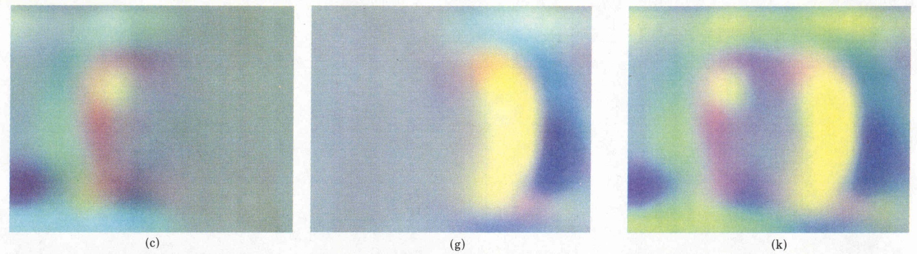
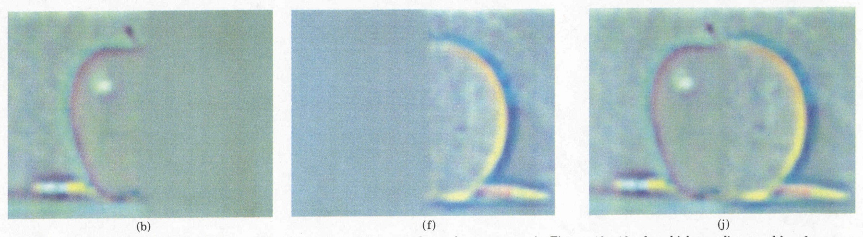
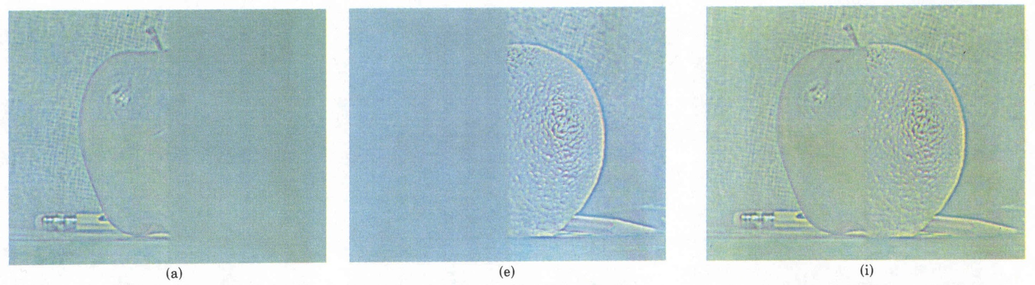
Laplacian
level
4
Laplacian
level
2
Laplacian
level
0
left pyramid
right pyramid
blended pyramid

Slide 64
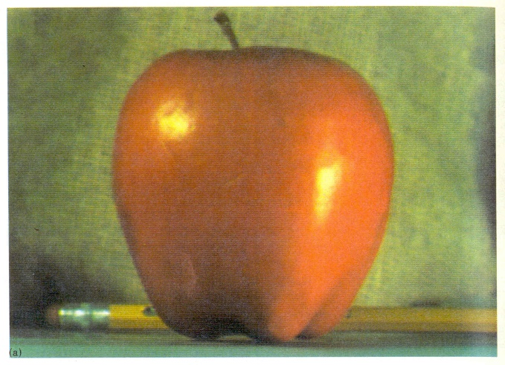
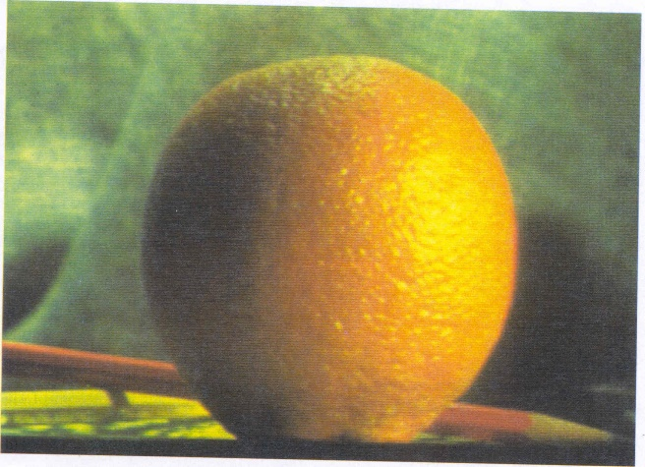
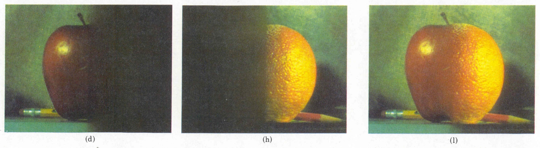
Pyramid Blending

Slide 65
Coarse-to-fine optical flow estimation
u=1.25 pixels
u=2.5 pixels
u=5 pixels
image H
u=10 pixels
image I
image H
image I
Gaussian pyramid of image H
Gaussian pyramid of image I

Slide 66
Coarse-to-fine optical flow estimation
run iterative L-K
warp & upsample
run iterative L-K
.
.
.
image J
image I
image H
image I
Gaussian pyramid of image H
Gaussian pyramid of image I

Slide 67
Video compression codec
Q=f(B)
B: Buffer Occupancy
+
Input
MCFD
-
DCT
Q
VLC
Mux
Output
Intra/Non-intra
Q⁻¹
Buffer
Prediction
IDCT
Decoded Picture
MC/Frame Buffer
Motion Vectors
Uses optic flow computation

Slide 68
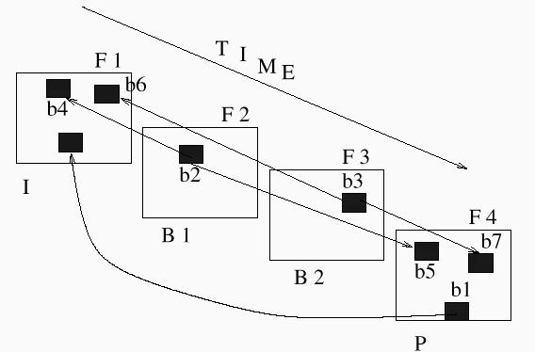
Compressed movie decoding
I = intensity frame(s) (DCT compressed)
P = motion vectors
B=reconstr.
interpolated
motion
Stream:
IPBBB…
Frames P,B also residual im

Slide 69

HW accelerated computation of flow vectors
Norbert’s trick: Use an mpeg-card to speed up motion computation
Notes:
http://www.lpr.ei.tum.de/~stoffler/mep/sod.html

Slide 70
Other applications:
Video tracking – Next lecture topic and L1.2
Motion control, robots and animals (we will cover later)
Image segmentation
Recursive depth recovery:

Slide 71
Lab:
Assignment1:
Purpose:
  Intro to image capture and processing
  Hands on optic flow experience
See www page for details.
Suggestions welcome!

Slide 72

Image registration
WHAT is image registration
Transform
a “source” image
to match a “target” image

Slide 73

Image registration
WHAT is image registration
Transform a “source” image to match a “target” image

Slide 74
Image registration: Three applications
Goal: register a template image T(x) and an input image I(x), where x=(x,y)^{T}. (warp I so that it matches T)
Image alignment: I(x) and T(x) are two images
Tracking: T(x) is a small patch around a point p in the first video image, t=0. I(x) is the image at time t+1.
Optical flow: T(x) and I(x) are patches of images at t and t+1.
Quadrilaterals, triangles, pixels…
warp
T
I
fixed

Slide 75

Medical image registration
WHAT is image registration
Transform a “source” image to match a “target” image
Medical image registration

Slide 76

Medical image registration
WHAT is image registration
Transform a “source” image to match a “target” image
Medical image registration

Slide 77





Medical applications
  Data (source, target)
    different medical images modalities (MRI, XRay, CT…)
    pre-acquired medical images with real-time images (video)
    patient data with an atlas
  For:
    atlas generation
    augmented reality (surgery)
    better diagnosis
    data analysis

Slide 78
Formulation
Very similar to tracking and optic flow.
Transform a “source” image to match a “target” image
Find best transformation T through the minimization of an energy
min_{T} Sim(I_{A} - T(I_{B}))
I_{A}
I_{B}

Slide 79


Formulation
Very similar to tracking and optic flow.
Transform a “source” image to match a “target” image
Find best transformation T through the minimization of an energy
min_{T} Sim(I_{A} - T(I_{B}))
I_{A}
I_{B}
Maching – similarity score : Sim
- depends on data
- simple – same type of data - SSD : sum (I_{A}(x) - T(I_{B}(x)))²
- different illumination : NCC normalized cross correlation
- different imaging modalities : MI mutual information
Transformation : T
- (linear) rigid, affine [ex. Same patient]
-(nonliear) image points are allowed to move differently

Slide 80



Non-rigid registration
Looking for a deformation field (vector field) v that will move each voxel in image A to the corresponding voxel in image B
min_{v} sum_{x} (I_{A}(x) – I_{B}(x+v))²
Gradient descent: solve for v iteratively adding small updates delta δv
Each step is similar to an optic flow problem
min_{δv} sum_{x} (I_{A}(x) – I_{B}(x+v+δv))²
δv=-(I_{A}(x) – I_{B}(x+v))/grad I_{B}(x+v)

Slide 81
Non-rigid registration
Looking for a deformation field (vector field) v that will move each voxel in image A to the corresponding voxel in image B
min_{v} sum_{x} (I_{A}(x) – I_{B}(x+v))²
Gradient descent: solve for v iteratively adding small updates delta δv
Each step is similar to an optic flow problem
In practice – motion between images is not small > needs regularization and image pyramid to solve robustly
min_{v} sum (I_{A}(x) – I_{B}(x+v(x)))² + R(v)

Slide 82
Organizing Optic Flow
Ugrad: Optional
Grad: Cursory reading
All: optional from the PCA on vectors (slide 48)
Martin Jagersand

Slide 83
Organizing different kinds of motion
Two examples:
Greg Hager paper: Planar motion
Mike Black, et al: Attempt to find a low dimensional subspace for complex motion

Slide 84
Remember:
The optic flow field
Vector field over the image:
[u,v] = f(x,y), u,v = Vel vector, x,y = Im pos
FOE, FOC Focus of Expansion, Contraction

Slide 85
Remember last lecture:
Solving for the motion of a patch
Over determined equation system:
Imt = Mu
Can be solved in e.g. least squares sense using matlab u = M\Imt
t
t+1

Slide 86


3-6D Optic flow
Generalize to many freedooms (DOFs)
Im = Mu

Slide 87




Example:
All 6 freedoms
Template
Difference images
X Y Rotation Scale Aspect Shear

Slide 88
Know what type of motion
(Greg Hager, Peter Belhumeur)
E.g. Planar Object => Affine motion model:
u’_{i} = A u_{i} + d
I_{t} = g(p_{t}, I₀)

Slide 89
Mathematical Formulation
Define a “warped image” g
  f(p,x) = x’ (warping function), p warp parameters
  I(x,t) (image a location x at time t)
  g(p,I_{t}) = (I(f(p,x₁),t), I(f(p,x₂),t), … I(f(p,x_{N}),t))’
Define the Jacobian of warping function
  M(p,t) =
Model
  I₀ = g(p_{t}, I_{t} ) (image I, variation model g, parameters p)
  ΔI = M(p_{t}, I_{t}) Δp (local linearization M)
Compute motion parameters
  Δp = (M^{T} M)⁻¹ M^{T} ΔI where M = M(p_{t},I_{t}) (Remember solve with QR or SVD)

Slide 90
Planar 3D motion
From geometry we know that the correct plane-to-plane transform is
for a perspective camera the projective homography
for a linear camera (orthographic, weak-, para- perspective) the affine warp

Slide 91
Planar Texture Variability 1
Affine Variability
Affine warp function
Corresponding image variability
Discretized for images

Slide 92
On The Structure of M
Planar Object + linear (infinite) camera
-> Affine motion model
u’_{i} = A u_{i} + d
X Y Rotation Scale Aspect Shear

Slide 93


Planar motion under perspective projection
Perspective plane-plane transforms defined by homographies

Slide 94
Planar Texture Variability 2
Projective Variability
Homography warp
Projective variability:
Where ,
and

Slide 95

Planar-perspective motion 3
In practice hard to compute 8 parameter model stably from one image, and impossible to find out-of plane variation
Estimate variability basis from several images:
Computed Estimated

Slide 96


Another idea Black, Fleet) Organizing flow fields
Express flow field f in subspace basis m
Different “mixing” coefficients a correspond to different motions

Slide 97


Example:
Image discontinuities

Slide 98




Mathematical formulation
Let:
Mimimize objective function:
=
Where
Robust error norm
Motion basis

Slide 99

Experiment
Moving camera
4x4 pixel patches
Tree in foreground separates well

Slide 100

Experiment:
Characterizing lip motion
Very non-rigid!

Slide 101
Questions to think about
Readings: Book chapter, Fleet et al. paper.
Compare the methods in the paper and lecture
Any major differences?
How dense flow can be estimated (how many flow vectore/area unit)?
How dense in time do we need to sample?

Slide 102
Summary
Three types of visual motion extraction
  Optic (image) flow: Find x,y – image velocities
  3-6D motion: Find object pose change in image coordinates based more spatial derivatives (top down)
  Group flow vectors into global motion patterns (bottom up)
Visual motion still not satisfactorily solved problem

Slide 103
(Parenthesis)
Euclidean world motion -> image
Let us assume there is one rigid object moving with
velocity T and w = d R / dt
For a given point P on the object, we have
p = f P/z
The apparent velocity of the point is
V = -T – w x P
Therefore, we have v = dp/dt = f (z V – V_{z} P)/z²

Slide 104
Component wise:
Motion due to translation:
depends on depth
Motion due to rotation:
independent of depth

Slide 105
Sensing and Perceiving Motion
Martin Jagersand

Slide 106



Counterphase sin grating
Spatio-temporal pattern
  Time t, Spatial x,y

Slide 107
Counterphase sin grating
Spatio-temporal pattern
  Time t, Spatial x,y
Rewrite as dot product:
= +
Result: Standing wave is superposition of two moving waves
Notes:
Standing wave

Slide 108
Analysis:
Only one term: Motion left or right
Mixture of both: Standing wave
Direction can flip between left and right

Slide 109

Reichardt detector
QT movie

Slide 110

Several motion models
Gradient: in Computer Vision
Correlation: In bio vision
Spatiotemporal filters: Unifying model

Slide 111


Spatial response:
Gabor function
Definition:

Slide 112


Temporal response:
Adelson, Bergen ’85
Note: Terms from
taylor of sin(t)
Spatio-temporal D=DsDt

Slide 113

Receptor response to
Counterphase grating
Separable convolution

Slide 114
Simplified:
For our grating: (Theta=0)
Write as sum of components:
= exp(…)*(acos… + bsin…)

Slide 115
Space-time receptive field

Slide 116



Combined cells
Spat: Temp:
Both:
Comb:

Slide 117

Result:
More directionally specific response

Slide 118

Energy model:
Sum odd and even phase components
Quadrature rectifier

Slide 119
Adaption:
Motion aftereffect

Slide 120

Where is motion processed?

Slide 121





Higher effects:

Slide 122

Equivalence:
Reich and Spat

Slide 123
Conclusion
Evolutionary motion detection is important
Early processing modeled by Reichardt detector or spatio-temporal filters.
Higher processing poorly understood

