Slide 1
Multi-view shape reconstruction

Slide 2
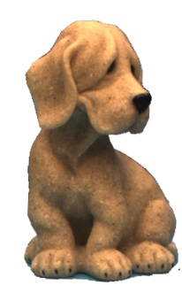
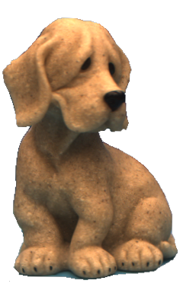
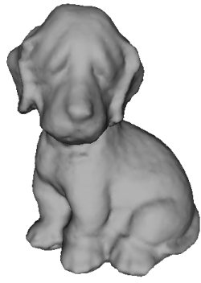
Shape reconstruction
Given
  A set of images (views) of an object / scene
  Camera calibration information
  [Light calibration information]
Find the surface that best agrees with the input images.
…
Approach:
chose a surface representation
define a photo-consistency function
[in practice photo-consistency+regularization]
solve the following minimization

Slide 3
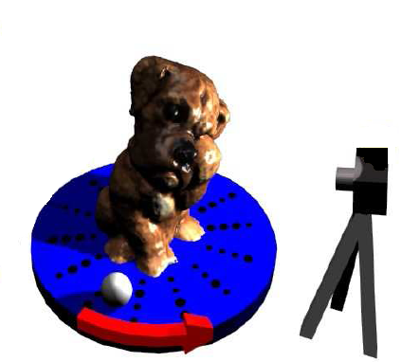
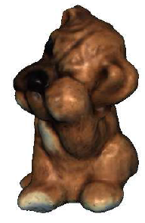
Photo-consistency function(al)
Based on image cues (shading, stereo, silhouettes, …)
Extension SFS/PS to multi-view:
Needs camera/light calibration !
Move camera
Move object
SFS
PS

Slide 4
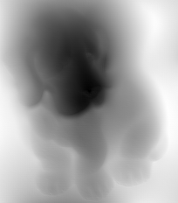
Surface representation
Image-centered
Object-centered
Depth/disparity w.r. to image plane
Voxels
Level sets (implicit)
Mesh
Depth with respect to a base mesh
Local patches
time
3D point
Image plane
Partial object reconstr.
Limited resolution
Viewpoint dependent
3D plane

Slide 5
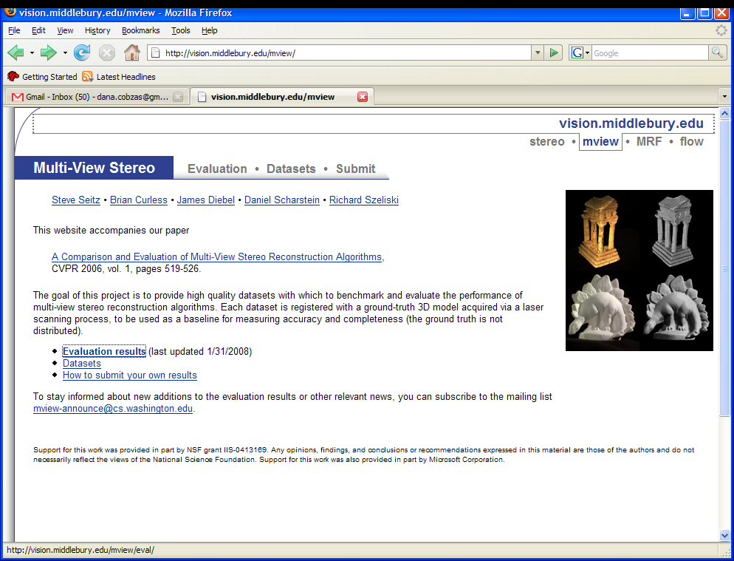
Comparison of different methods
2 datasets
No light
(moving camera)

Slide 6
Volumetric representation
Object : collection of voxels
Normals : ?
Method: carve away voxels that are not photo-consistent with images
(purely discrete)
Regularization: no way of ensuring smoothness
Visibility: ensured by the order of traversal (in general a problem!)

Slide 7
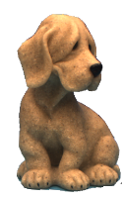
Disparity/Depth map
Reference
image
3D point
Reference image plane
Object (surface) :
Normals :
Method: find f that best agrees with the input images (minimize the cost functional integrated over the surface)
Regularization: smoothness on
Visibility: ? (mesh defined on image plane + Zbuffering)

Slide 8
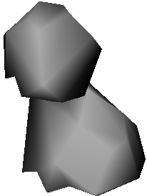
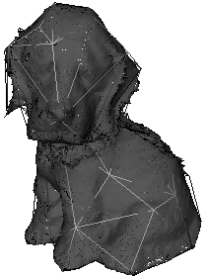
Depth w.r. base mesh
Object (surface) : , d – displacement direction (displacement map)
Normals : local (per triangle) transform to global CS
Method:
Regularization: smoothness on (local / global)
Visibility: ? (fine mesh to connect points on each plane + Zbuffering)
How to deal with boundaries ?

Slide 9

Mesh
Object (surface) : mesh vertices
Normals : interpolated
Method: move vertices along interpolated normals based on photo-consistency of neighboring triangles.
Regularization: smooth normals
Visibility: Zbuffering
Topologiocal changes ?

Slide 10
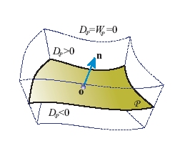
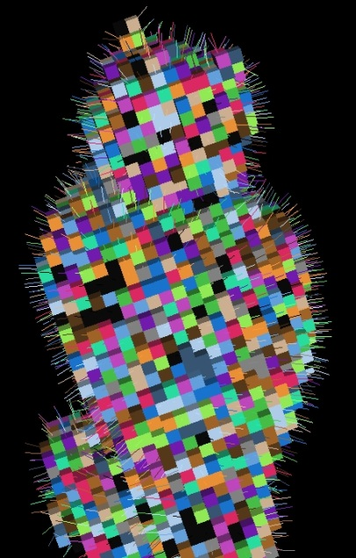
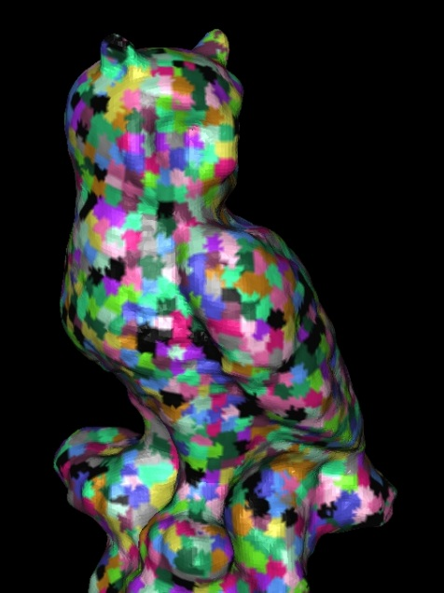
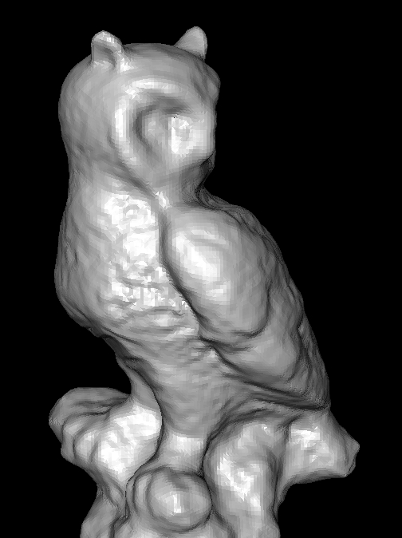
Mixed Representations:Local patches
Mixed approaches :
  patches on voxels for a finer surface representation
  mesh on pre-computed voxel correlation (potential fields)
  [Esteban and Schmitt CVIU 2005]
  (depth on base mesh)
Patches :
  arbitrary : [Zheng, Paris et al. IJCV2006]
  quadratic : surfels [Carceroni and Kutulakos IJCV 2002]

Slide 11
Optimization
Disparity map
Depth w.r.plane
Level sets
Mesh
Voxels
Graph-cuts
Belief propagation
Dynamic programming…
Discrete
methods
Non-linear optimization
Variational calculus
Continuous
methods
Voxel carving (exhaustive search
For same color)

Slide 12
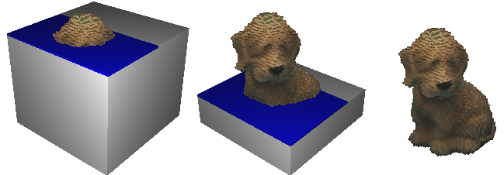
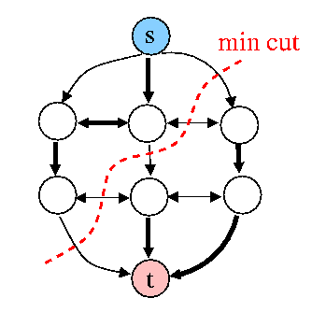
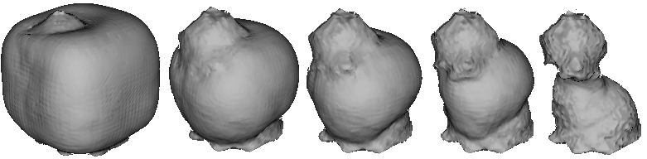

Summary
Discrete
Voxel carving
Graph cut techniques
Continuous
Variational and level set techniques
Mesh-based reconstruction

Slide 13
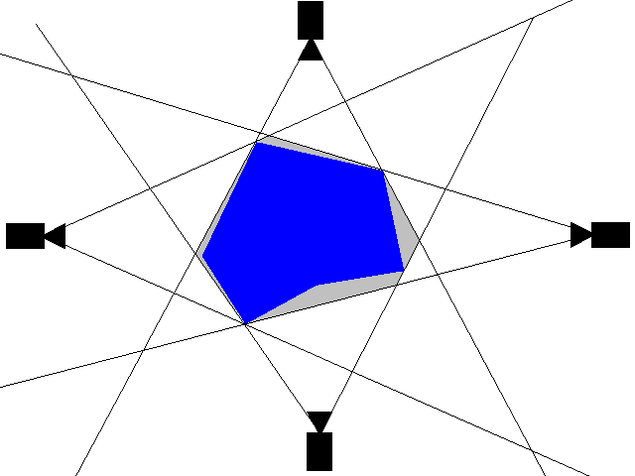
Shape from Silhouette
Binary images
Back project each silhouette → 3D cone.
Carve all voxels outside the cone.
Result:
  Reconstruction contains the true scene, but not the same (no concavities)
  Not photo-consistent (only to binary images).
  In the limit reconstructs a visual hull
[Martin PAMI 91][Szeliski 93] + Our capgui in lab

Slide 14
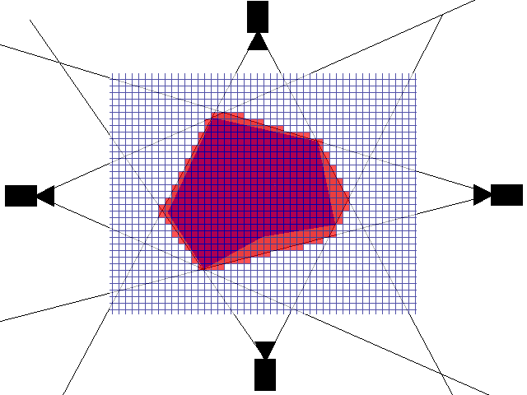
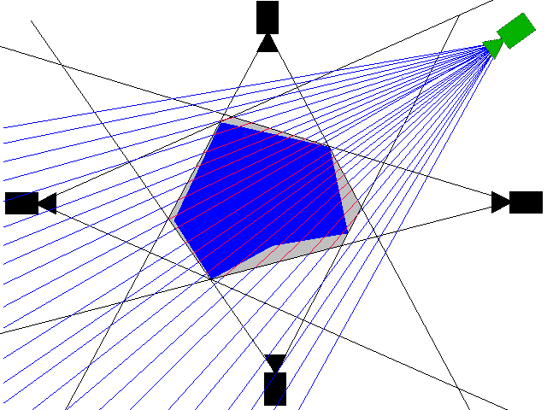

Smarter volumetric representations
Voxel-based Image ray based Axis-aligned
Inaccurate
+ Triangulate w. marching cubes
+ Accurate
Franco, Boyer
+ Moderatly accurate
+ Fast
+ Marching intersections
Tarini’01 + our Capgui

Slide 15
Volumetric reconstruction
Method : Carve voxels that are not consistent with images (according to a chosen photo-consistency score).
OR
Assign colors to voxels consistent with the input images.
(color + opacity)
Not unique solution
True scene
N³ voxels
C colors
all scenes
Order of traversal v. important
Photo-consist.
scenes

Slide 16
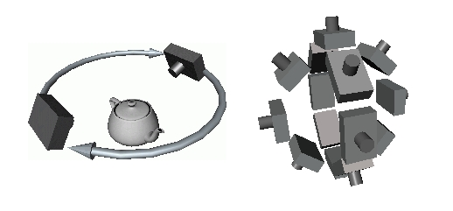
Voxel coloring
Each voxel
  Project in images and correlate
  Color if consistent
Visibility !
Depth ordering : Single visibility ordering for each view
(Restriction in camera placement)
Plane sweep [Collins CVPR 96]
[Seitz,Dyer CVPR97]
Traversal
order
No scene point contained within the convex hull of the cameras

Slide 17
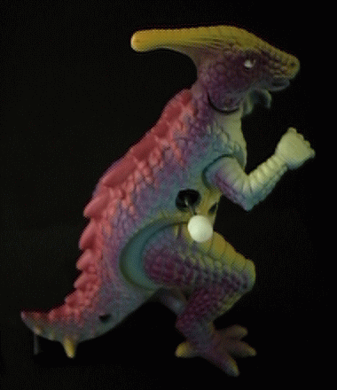
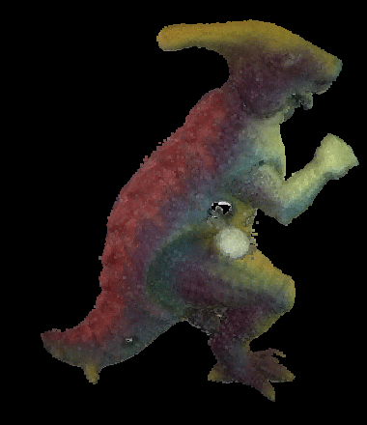
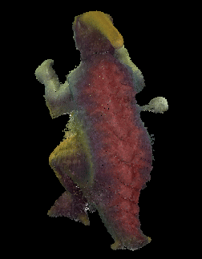
Voxel coloring : results
Input image
Results
[Seitz,Dyer CVPR97]

Slide 18
Space carving
In general a view independent order might not exist
Space carving [Kutulakos, Seitz ICCV 99, IJCV 2002]
initialize a volume containing the scene
Choose a voxel on the surface of the scene
Project in all visible images
Carve if not consistent
Repeat until convergence
Consistency:
The resulting shape is photo-consistent
(all inconsistent voxels are removed)
Convergence:
Carving converges to a non-empty shape
(a point on the true surface is never removed)
Photo-hull

Slide 19
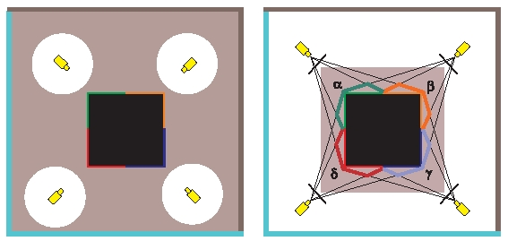
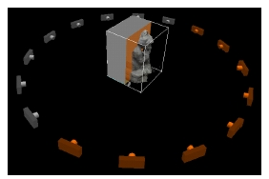
Space carving : photo hull
Initial volume and
true scene
Photo-hull
Photo-hull = union of all photo-consistent shapes
Basic algorithm : requires a difficult update procedure (visibility computation after carving a voxel)
Multi-pass plane sweep :
Sweep plane in each 6 directions
Consider active only cameras on one side of the plane

Slide 20
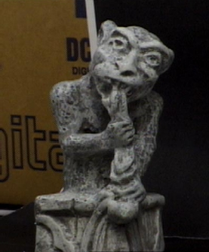
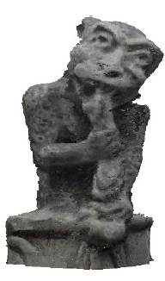
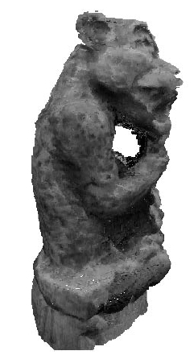

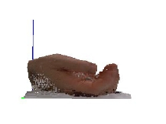
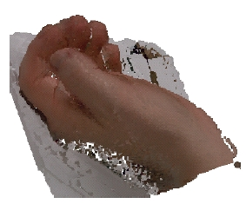
Space carving : results
[Kutulakos, Seitz ICCV 99, IJCV 2002]

Slide 21
Graph cuts for multi-view reconstruction
Discrete surface reconstruction
Graph cut
Graph cuts as hypersurfaces
  Example: [Paris, Sillion, Quan IJCV 05]
Types of energies minimized with graph cut
[Kolmogorov Zabih ECCV 2002]
Graph cuts for multi-labeling

Slide 22
Reconstruction as labeling
Photo-consistency
Smoothness
Discrete formulation:
Ex: disparity map voxels
pixels voxels
disparities occupancy
surface representation
labels
Find a set of labels that minimize
Notes:
NP hard
Can be solved using MRF energy minimization methods
  graph cuts (submodular E), dynamic programming, belief propagation,
  simulated annealing …

Slide 23
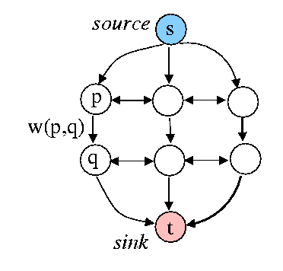
Graph cuts
Oriented graph
  nodes
  edges
V , source s , sink t
E , edge capacity w(p,q)
(non-negative)
Cut C={S,T} partition of nodes into two disjoint sets such that s∈S, t ∈T
Cost of the cut
Minimum cut cut that has minimum cost among all cuts (binary labeling)
Maximum flow maximum amount of liquid that can be sent from the source to the sink interpreting edges as pipes with capacity w.
Polynomial time algorithms
Augmenting paths [Ford & Fulkerson, 1962]
Push-relabel [Goldberg-Tarjan, 1986]

Slide 24
Energy minimization via graph cuts
Motivation:
Geometric interpretation
cut = hypersurface in N-D space embedding the corresponding graph
used to compute optimal hypersurface
Powerful energy minimization tool for a large class of binary and non-binary energies
global minimum; strong local minimum
Surface reconstruction:
Chose a surface representation
Define a graph (nodes, weights) such that the cost of a cut corresponds to the surface energy function.
How to find global labeling using graph cut ?
What kind of energy can be minimized with a graph cut ?

Slide 25
Graph Cuts as Hypersurfaces
cut
t
labels
“cut”
y
p
s
x
Graph fully embedded in the working geometric space
Feasible cut = separated hypersurface in the embedding continuous manifold

Slide 26
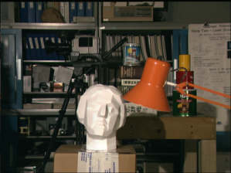
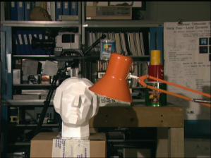
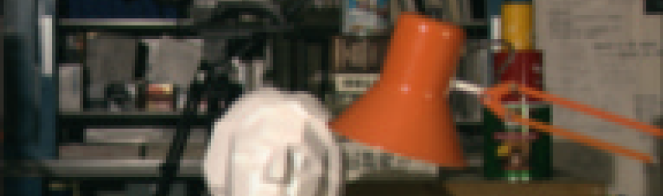
Comparison to “stereo”
Multi-scanline optimization
labels
“cut”
labels
L(p)
L(p)
y
p
x
x
p
s-t Graph Cuts
multi-scan-line optimization
single scan line optimization
eg Search, Dynamic Programming
26

Slide 27
Example of geometric graph
[Paris, Sillion, Quan: A surface reconstruction method using global graph cut optimization IJCV 05]
Disparity map: pixel label = disparity
source
D₁(d₁)
D₄(d₁)
d₁
λ’
λ’
λ’
D₁(d₂)
D₂(d₂)
D₃(d₂)
D₄(d₂)
d₂
D₄(d₃)
f₁=d4
f₂=d3
f₃=d3
f₄=d4
d₃
D₄(d₄)
d₄
λ’
λ’
λ’
∞
∞
∞
∞
sink
Graph
Surface

Slide 28
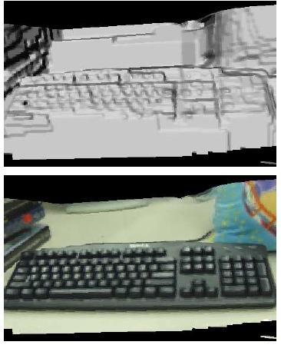
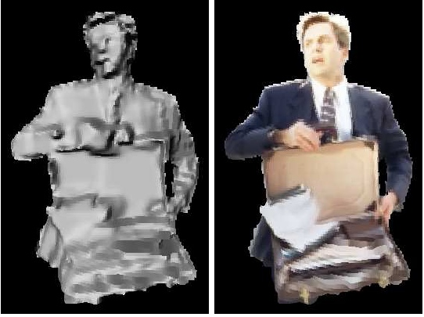
Results
Convex smoothing – global solution
[Paris, Sillion, Quan IJCV 05, ACCV 04]

Slide 29
Types of regularization energies
Convex
+ global convergence
oversmooth
linear
V(Δf)
Δf=fp-fq
Preserves discontinuities
NP hard
? convergence
V(Δf)
Δf=fp-fq
Potts
piecewise planar
binary graph
Potts
V(Δf)
Δf=fp-fq

Slide 30
Graph cuts : state of the art
[ Boykov CVPR 05 Tutorial]
Optimization of first-order properties of segmentation boundary (Riemannian length/area, flux of a vector field)
Can’t optimize curvature of the boundary (for now)
Class of energies that can be minimized exactly
  binary energies with regular (sub-modular) interactions
  multi-label (non-binary) energies with “convex” interactions
    excludes robust discontinuity-preserving interactions
Guaranteed quality approximation algorithms for multi-label energies with discontinuity-preserving interactions…
  Potts model of interactions
  Metric interactions
  Regular (sub-modular) interactions

Slide 31
GOTO slide 41

Slide 32
Exact multi-labeling
Linear and convex smoothing (interaction) energy
Geometric graphs.
t
Multi-scan-line stereo
  [Roy & Cox 1998, 1999]
  [Ishikawa & Geiger 1999] (occlusion handling)
“Linear” interaction energy
  [Ishikawa & Geiger 1998]
  [Boykov, Veksler, Zabih 1998]
Convex interaction energy
  [Ishikawa 2000, 2003]
s

Slide 33
Binary graphs
[Kolmogorov, Zabih : What energy functions can be minimized via graph cuts? ECCV 2002]
t
n-links
a cut
t-link
t-link
s
Complete characterization of energies that can be minimized with graph cut :
E(f) can be minimized by
s-t graph cuts
Large class of energies (Potts, metric …)
BUT multi-view reconstruction is a multi-labeling problem !

Slide 34
Approximate multi-labeling
t
Binary Potts energy
Extended to multi-labeling
NP hard (≥ 3 labels)
n-links
cut
t-link
t-link
s
[ Boykov et al: Fast approximate energy via graph cuts, PAMI 2001]
Expansion approximate solution
Ideea: break optimization into a set of binary s-t cut problems
Each iteration – consider one label a
Binary cut: some labels are relabeled with a; the others remain unchanged
a
current
label

Slide 35
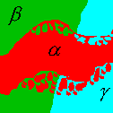
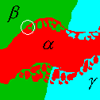
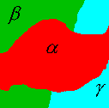
α - expansion
Examples of standard and large moves from a given iniotia; labeling.
The number of labels is |L| = 3.
initial labeling standard move swap a-expansion

Slide 36
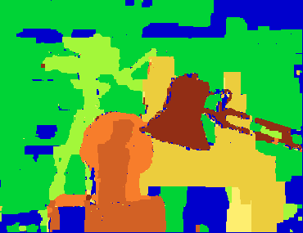
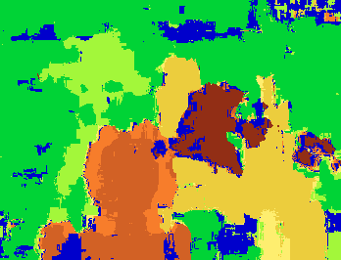
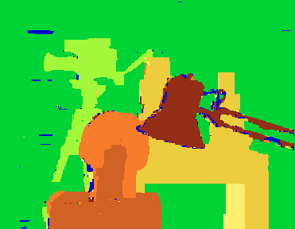
α expansion
Properties
Guaranteed approximation quality
  within a factor of 2 from the global minima (Potts model)
Applies to a wide class of energies with robust interactions
  Potts model
  “Metric” interactions
  “Submodular” (regular) interactions
normalized correlation,
start for annealing, 24.7% err
simulated annealing,
19 hours, 20.3% err
a-expansions (BVZ 89,01)
90 seconds, 5.8% err

Slide 37

Graph cut Example
[ Vogiatzis, Hermandez-Esteban, Torr, Cipolla PAMI 2007, CVPR 2005 ]
Surface representation: voxels; no need for bounding inner/outer surface
Regularization : weighted volume – balloon force
Minimization : graph cut
Occlusions : accounted using a voting photo-consistency score (occluded pixels are treated as outliers)
Photoconsistency
Foreground/background cost
σ(x)=-λ balloon force
silhouette cue – make σ(x) very large outside VH
S = surface
V(S) = foreground

Slide 38
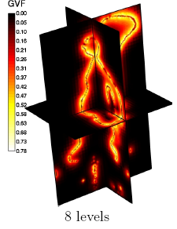




Photo-consistency metric
Account occlusions ρ(x,S) [continuous, level set formulations]
S determines visibility but S is the solution!
Problem : Not suitable for graph-cut
Solution : ρ(x) that accounts for occlusions using NCC
Optic ray
Correlation scores
Vote
x
d
c_{i}

Slide 39
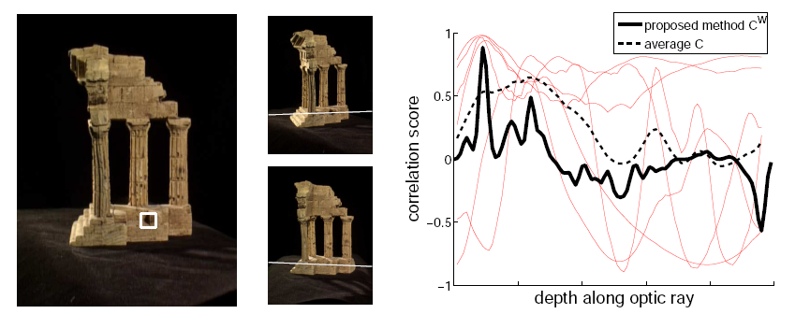

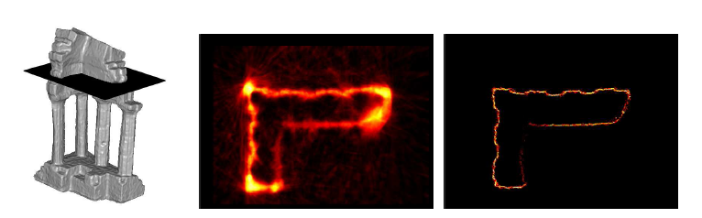
Account occlusions

Slide 40
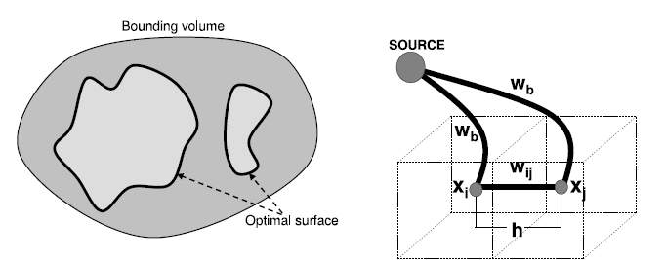


Graph structure
Data (photo-consistency)
Ballooning
6 neighboring system

Slide 41
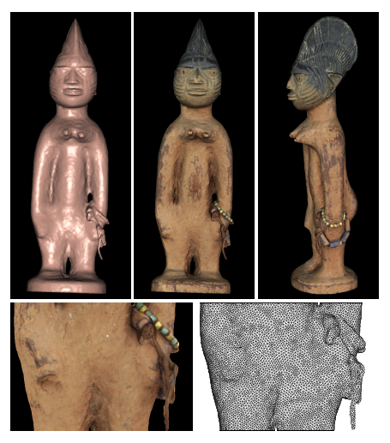
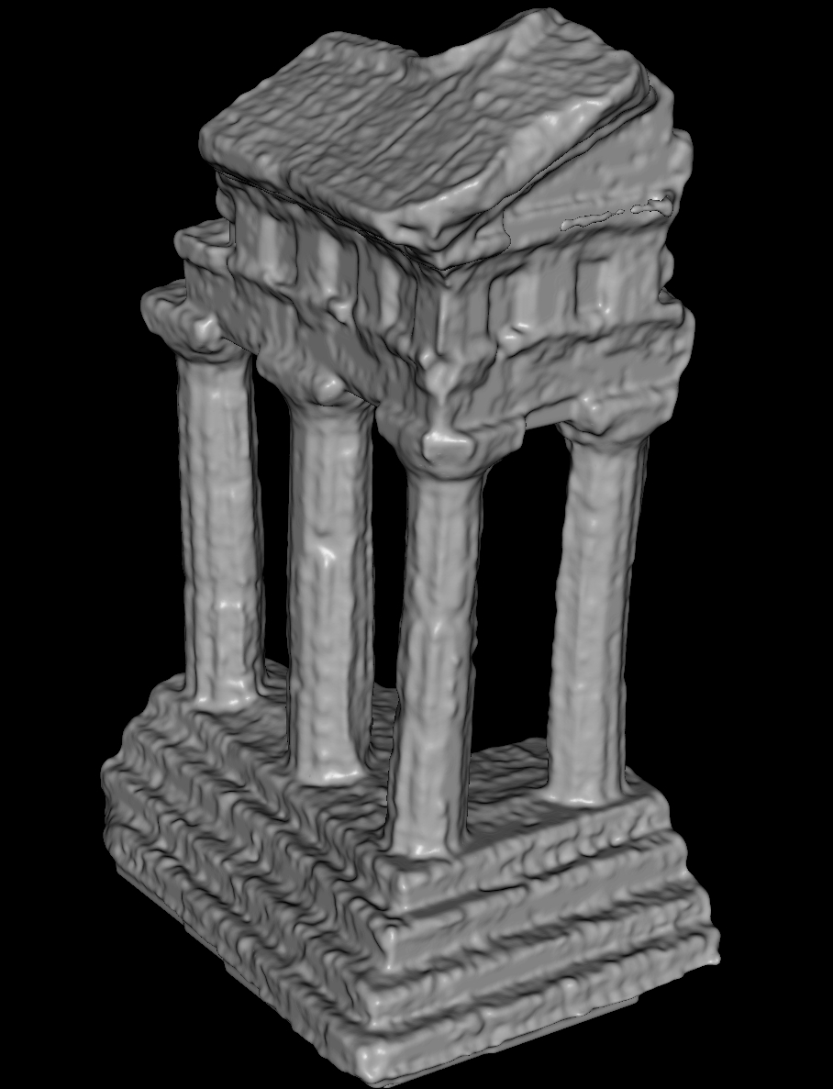
Results
Vogiatzis2 0.50mm
Furukawa2 0.54mm

Slide 42
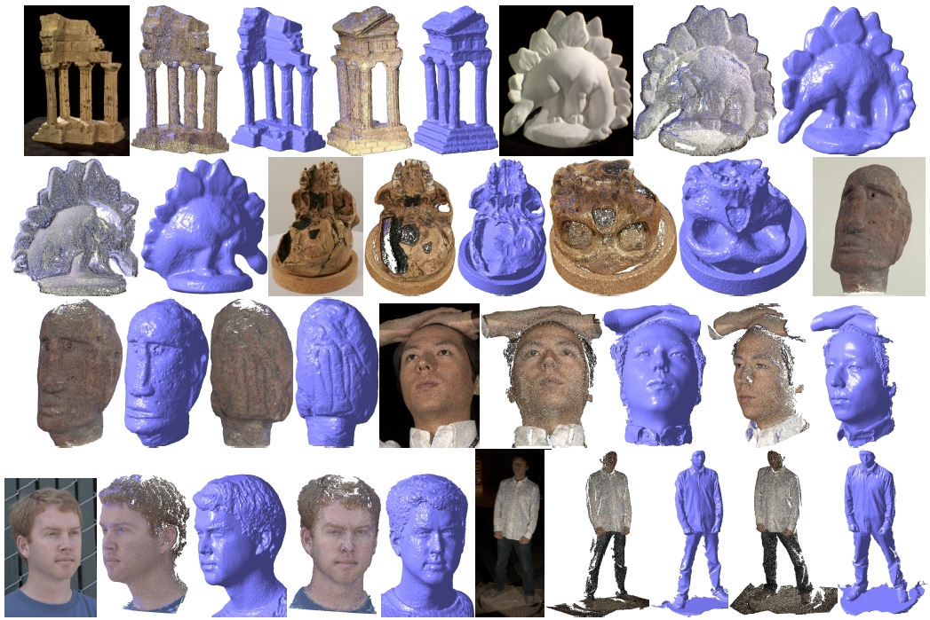
Competitor – Yasu Furukawa ☺
Video

Slide 43
Multi-view stereo
Disparity map
Depth w.r.plane
Level sets
Mesh
Voxels
Graph-cuts
Belief propagation
Dynamic programming…
Discrete
methods
Non-linear optimization
Variational calculus
Continuous
methods
Voxel carving (coloring)

Slide 44
Continuous multi-view methods
Regular surface and surface evolution
Level set methods
Example of mesh-based reconstruction

Slide 45

Surface evolution
Continuous formulation
recover shape (surface) by minimizing cost functional integrated over the surface.
Cost functional : photo-consistency + regularization (smoothness)
Numerical methods: gradient descent, conjugate gradient, level sets …
Natural extension of curve evolution (2D) [Caselles ICCV95] to 3D
[Robert,Deriche ECCV 96][Faugeras Kerivan 98]

Slide 46
Regular surface = smooth
Definition: Regular surface (manifold)
is a regular surface if for each point there exist a neighborhood V and a map of an open set such that (X = parametrization):
X differentiable
X homeomorphism ( continuous)
the differentiable is one to one

Slide 47

Regular surface - properties
Regular surface S
tangent vector
normal
area
curvature

Slide 48
Surface evolution
Cost functional
Energy of the surface
Evolution flow (Euler-Lagrange equations)
OBS:
problem is intrinsic (independent on parameterization)
automatic regularization H
motion in the normal direction
whole surface is evolving in time (reference frame attached to the object)
1. Discretization
2. Choice of cost functional

Slide 49
Photo-consistency functional
On Image On surface
π⁻¹(u,S)
I
X
Image point u π(X)
Surface point X(u)=π⁻¹(u,S) X
u
π(X)
Image i:
S-surface,
f(X)-color (radiance) of X

Slide 50
Where to integrate image/surface ?
On Image On surface
1.Depends on image derivative
2.Automatic regularization
3.Doesn’t account for image discretization
Constant f
Impossible to reconstruct

Slide 51


Surface evolution example
[Faugeras Kerivan 98]

Slide 52




Modeling correct visibility
C
Usual term
Horizon term
C’
Heaviside func.
Dirac func.
[Gargallo et al ICCV 07]

Slide 53
Surface discretization
Explicit representation
Depth / disparity map
3D point
Image plane
(Euler-Lagrange eq.)
[Robert and Deriche: Dense depth recovery from stereo images, ECAI1992]
[Strecha et al: Dense matching of multiple wide-baseline views ICCV 2003]
Depth with respect to plane
Move points along displacement direction
3D plane
[Birkbeck et al 2006]
Mesh
[Fua and Leclerc 1993]
[Birkbeck et al ECCV 2006]

Slide 54
Level set representation
Implicit representation
[Birkbeck]
Surface = Zero level set of a higher dimensional function
[Osher and Sethian 88]
[Faugeras Keriven 98] (stereo)
[Soatto Yezzi Jin ICCV 03] (specular refl.)
normal
curvature
Evolution cost function
If
then
Efficient numerical schemes
[Sethian 96][Osher 02]

Slide 55
Cost functional
Photo-consistency : image cues (SFS,PS,stereo,silhouette)
Where to integrate? : surface + makes the problem intrinsec
+ automatic regularization (multiplicative)
- over-smoothing
- not account for image discretization
image + can add a regularizer
Regularization : linear
quadratic + improves convergence
- penalizes large variation
- over-smoothing
non-quadratic, anisotropic
[Robert, Deriche 96] [Alvarez, Deriche 00] [Strecha 02]
(ex. Nagel-Enkelmann diff. oper.)
+ preserves discontinuities

Slide 56
Goto p 66

Slide 57
Surface/depth regularization
Depth map regularization f
energy
Euler Lagrange eq.
1. Homogenous
Diffusion (heat eq)
2. Image-based regularization –
align depth discontinuities with the image discontinuities
3. Depth map regularization
Not smooth across surface discontinuities
g – decreasing function g(s²)->0 when s big (high gradients) – inhibit diffusion
D – tensor
D

Slide 58


Example regularization
Image-based regularization
correlation
i-b regul.
homog
depth-based regularization
Depth based

Slide 59

Example regularization
d-b regul
i-b regul.

Slide 60





Learn more about variational methods
Level Set Methods
S. Osher and R. Fedkiw,
Springer 2003
Jan Erik Solem
PhD thesis,
Malmo Univ.
Mathematical Problems in Image Processing
Aubert et al
Springer 2002
Hailin Jin
PhD thesis,
Washington Univ.
The Handbook of Mathematical Models in Computer Vision
N. Pragios editor
Springer 2005

Slide 61

Graph-cuts and hypersurfaces
[Roy,Cox ICCV 98, IJCV 1999]
Geometric graph for stereo
Convex smoothing – global convergence
[Ishikawa, Geiger ECCV 1998]
distance
map
B
distance
map
B
A
A
Euclidian metric (ct)
Riemannian metric (varying tensor)
Connection between cuts and hypersurfaces in continuous spaces
[ Boykov, Kolmogorov: Computing geodesics and minimal surfaces via graph cuts, ICCV 2003]
Show how to build a grid graph and sets the weights such that the cost of cuts is arbitrarily close to the area of corresponding surface for any anisotropic Riemannian metric.
Graph cut to find globally minimum surfaces (like level sets) under arbitrary Riemannian metric.

Slide 62
Minimal surfaces and graph cut
[Boykov, Kolmogorov ICCV03,05]
distance
map
B
distance
map
B
A
A
Euclidian metric (ct)
Riemannian metric (varying tensor)
multi view stereo formulation
Can the minimal surface energy be minimized with graph cut ?

Slide 63
Cost of a cut
C
Cost of a cut can be interpreted as a geometric “length” (in 2D) or “area” (in 3D) of the corresponding contour/surface.
Cut metric is determined by the graph topology and by edge weights.

Slide 64
Riemanian metric
C
Euclidean length of C
Cauchy-Crofton formula
the number of times
line L intersects C

Slide 65
Cut Metric on grids
can approximate Euclidean Metric
Graph nodes are imbedded
in R2 in a grid-like fashion
C
4-neighborhoods
(Manhattan metric)
Edges of any regular neighborhood system generate families of lines
{ , , , }
8-neighborhoods
Euclidean
length
graph cut cost
for edge weights:
the number of edges of family k intersecting C

Slide 66

Example [Boykov]

Slide 67
Summary: representations
Image centered
Depth/disparity map
Object centered
Implicit (level sets) Mesh Voxels
time
3D point
Image plane
+ | Natural extension of SFS, PS, stereo Strong min with graph cuts | Handles topological changes Implied normals Visibility | Graphics based Implied normals Visibility | Handles large structures Arbitrary topology
- | Limited resolution Partial obj. reconstr Viewpoint dependent | Too smooth Slow Closed surfaces | Topological changes | Ignores regularization (sensitive to noise) Limited resolution Occlusion handling

Slide 68
Discrete vs. continuous
Level Sets | Graph Cuts
variational optimization method for fairly general continuous energies | combinatorial optimization for a restricted class of energies [e.g. KZ’02]
finds a local minimum near given initial solution | finds a global minimum for a given set of boundary conditions
numerical stability has to be carefully addressed [Osher&Sethian’88] continuous formulation -> “finite differences” | numerical stability is not an issue discrete formulation ->min-cut algorithms
anisotropic metrics are harder to deal with (e.g. slower) | anisotropic Riemannian metrics are as easy as isotropic ones
Gradient descent method VS. Global minimization tool
(restricted class of energies)
[Boykov CVPRTut 2005]

Slide 69

A complete system
Neil Birkbeck
Motivation
method that works for objects with general reflectance
  textured and uniform regions shading + texture
        light variation (multiview PS)
  specular materials general BRDF – parametric
System
Camera calibration: pattern
Light calibration: specular white sphere
Light variation: rotating table, fixed cam.

Slide 70
Cost functional
Cost functional
Per-point cost function
Visibility+sampling
reflectance
camera proj.
image
light
1. Lambertial reflectance
light dir.
light color
ambient color
BRDFalbedo
2. Non-Lambertian reflectance
BRDF = Phong
In practice : filter specular highlights
fit full reflectance only at the end

Slide 71

Surface discretization
Surface = triangles,
move vertices
Cost function
Normals interpolated
Albedo implied by the shape (closed form solution)
(knowing light dir+color)
Visibility/shadows Z buffering

Slide 72
Surface discretization
Regularizer mean curvature
Gradient finite differences
Initial shape = visual hull
Mesh handles topological changes
Multi-resolution (image pyramid)

Slide 73

Results : refinement

Slide 74

Results : shape + reflectance

Slide 75
Improvements
Better light model – no need for calibration
Model background ? no need to extract silhouette (foreground) – Mumford-Shah functional
Discontinuities – anisotropic regularization; discontinuous mesh
Incorporate noise ?

Slide 76

Capture system
Shape from silhouette
Dynamic texture

