Slide 1
3D Geometric Computer Vision
Martin Jagersand
Univ. Alberta
Edmonton,
Alberta, Canada

Slide 2
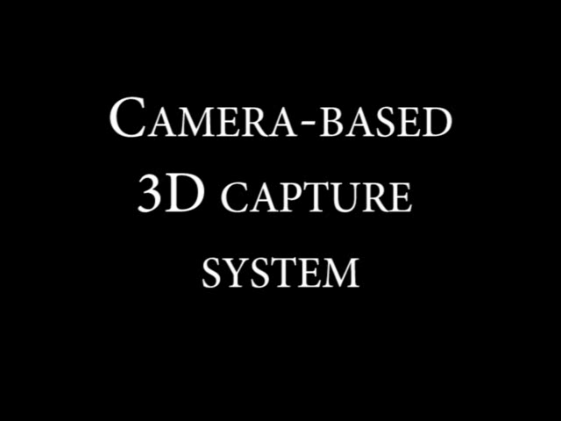
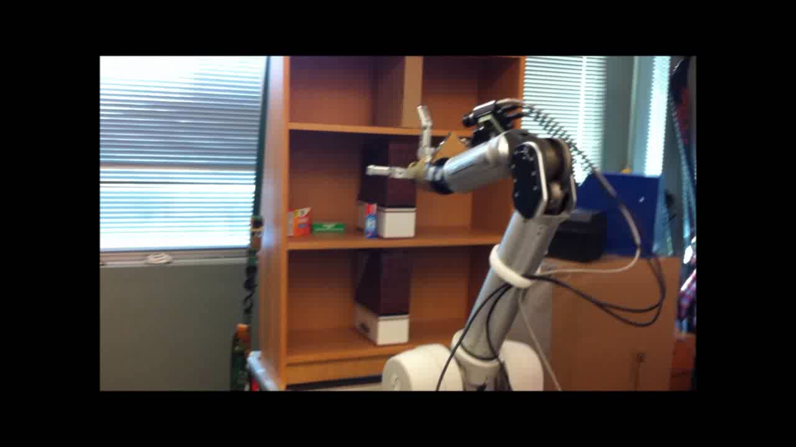
Multi-view geometry
Build 3D models from images
Carry out manipulation tasks
http://webdocs.cs.ualberta.ca/~vis/ibmr/
Training for Amazon manipulation challenge
And many other usages…

Slide 3
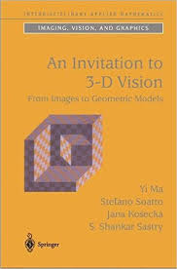

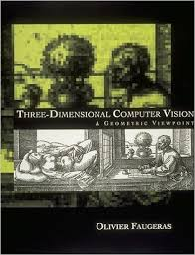
Multi-view Geometry
Relates
3D world points
Camera calibr.
2D image points
The reconstruction of 3D models of objects from a collection of 2D images

Slide 4
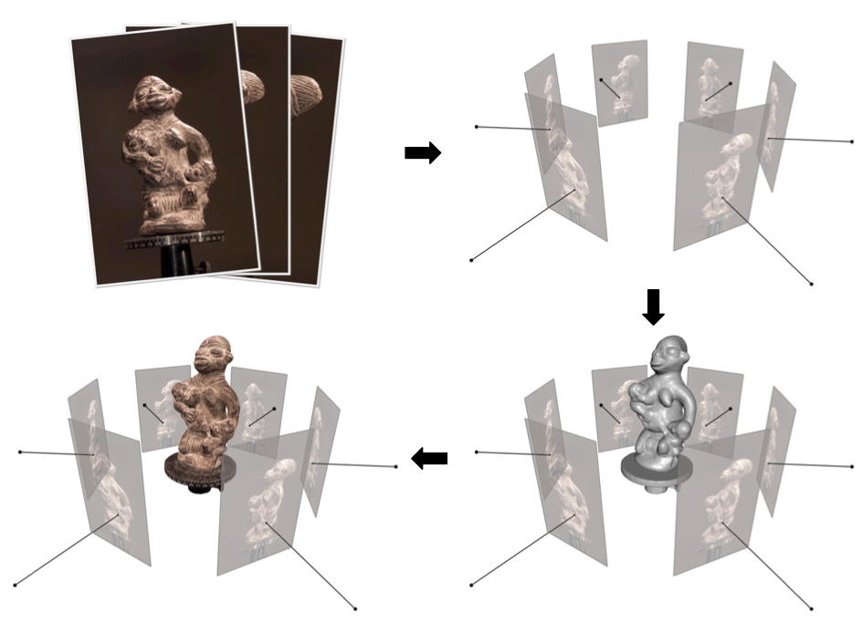
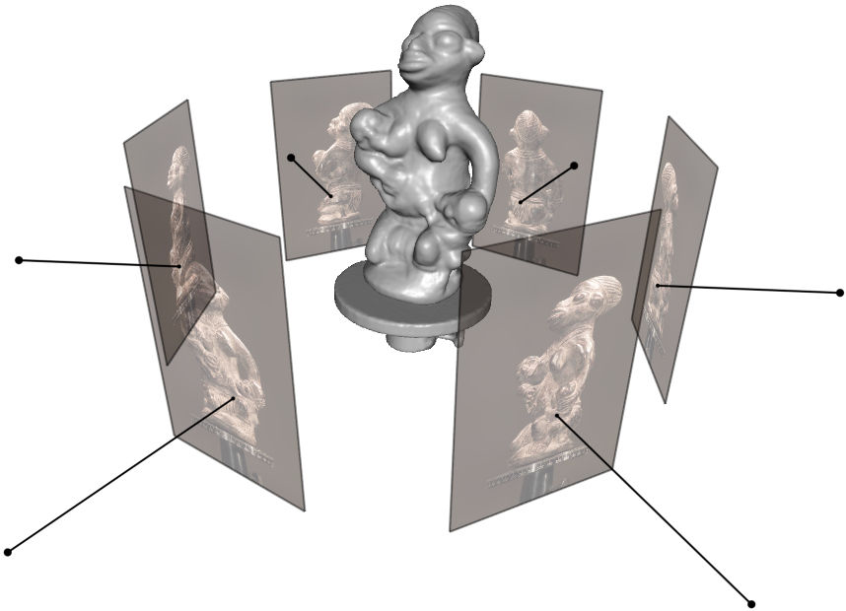
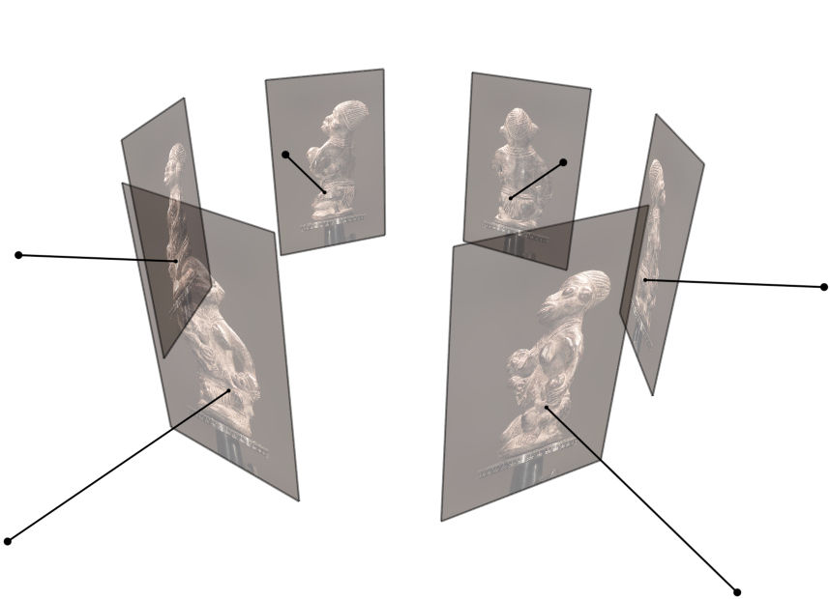
Multi-view Geometry
Typical processing pipeline (C. Hernandez MVS tutorial)

Slide 5
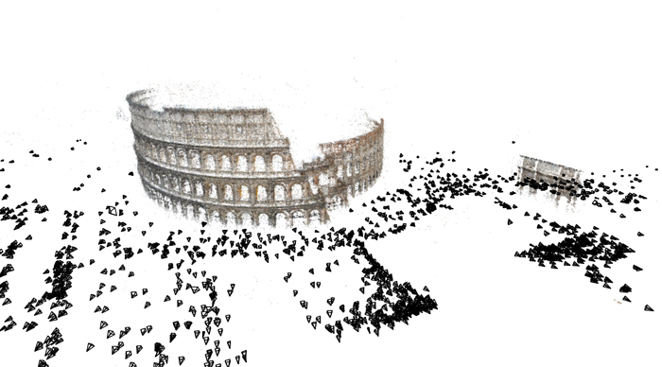
Multi-view Geometry

Slide 6
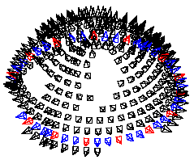
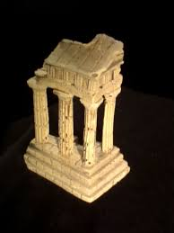
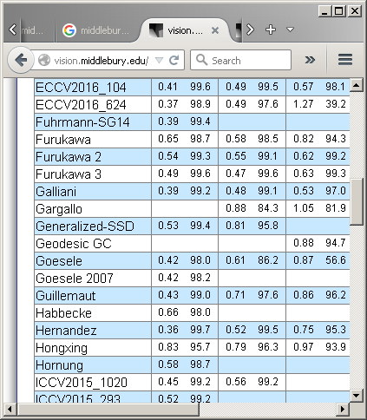
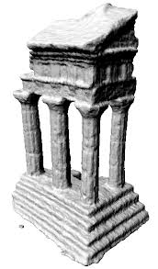
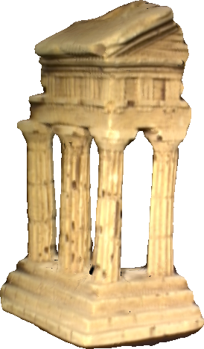
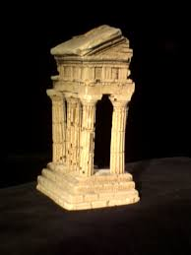
Middlebury multi-view benchmark
:
:
A Comparison and Evaluation of Multi-View Stereo Reconstruction Algorithms, Seitz, Curless, Diebel, Szeliski
CVPR 2006, vol. 1, pages 519-526.
Cited by 1479
Calibration accuracy on these datasets appears to be on the order of a pixel (a pixel spans about 1/4mm on the object).

Slide 7
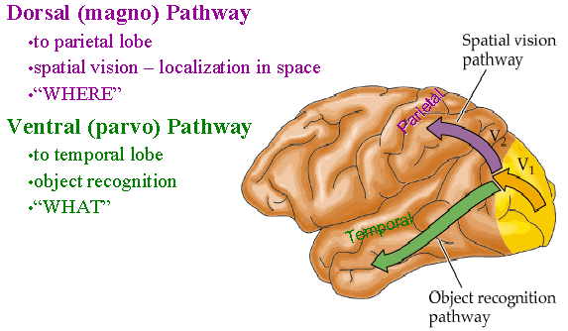
Dorsal and Ventral Pathways
Where/What or Action/Perception?
Humans don’t internalize detailed 3D maps!
Use external world as map. (Hayhoe, Pelz, Rensink, Goodale etc)

Slide 8
Course content
Video processing: Image motion and tracking
2D projective geometry
3D projective geometry
Cameras, their math model and calibration
Two-camera “stereo” 3D reconstruction
Multi-view geometry and general 3D reconstruct.
Light, surface reflectance and math modeling
Computer vision systems

Slide 9
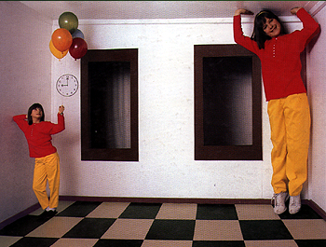
Challenges:
Geometric size ambiguity

Slide 10
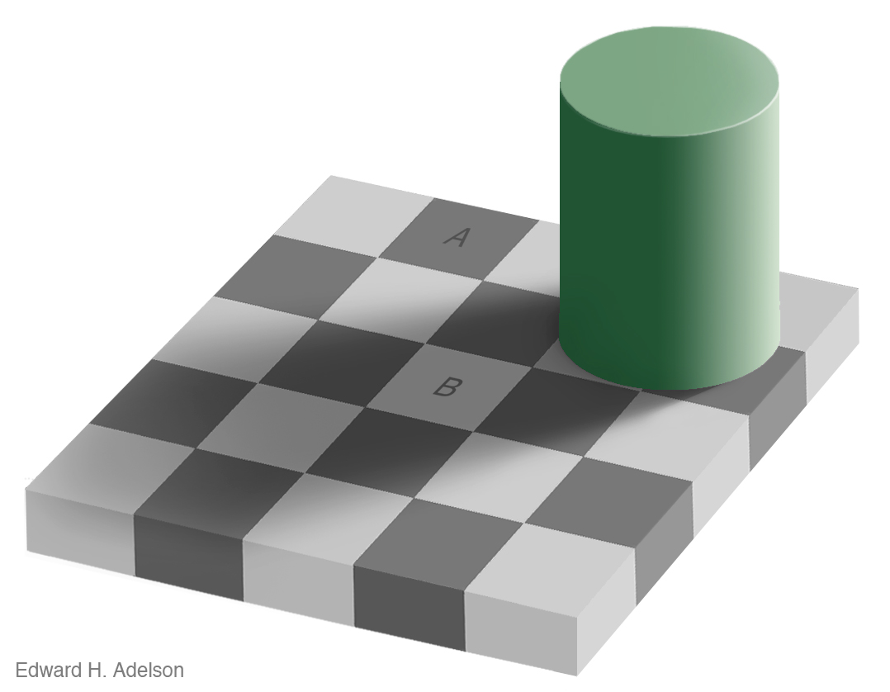
Challenges
Light / photometric ambiguity

Slide 11
Challenges
Light / photometric ambiguity

Slide 12
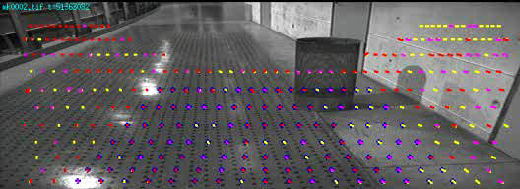
Fundamental types of video processing “Visual motion detecton”
Relating two adjacent frames: (small differences):

Slide 13
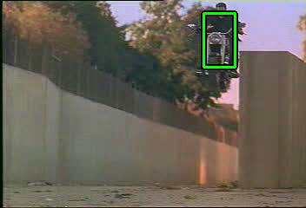
Fundamental types of video processing
“Visual Tracking” / Stabilization
Globally relating all frames: (large differences):
…

Slide 14
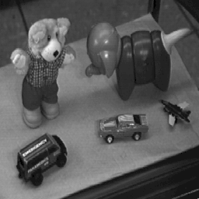
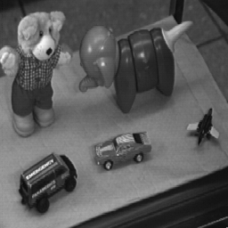
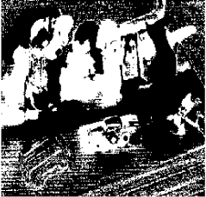
Intensity images / video non-trivial to get information
abs( Image 1 - Image 2) = ?
Note: Almost all pixels change!
Constancy: The physical scene is the same
How do we make use of this?

Slide 15

MTF – Modular Tracking Framework
Open source
C++ implementation
ROS interface
Matlab/Pyhton
Cross platform

Slide 16
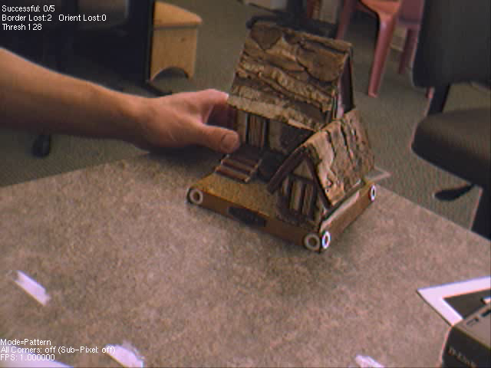
Application:
Augmenter Reality

Slide 17
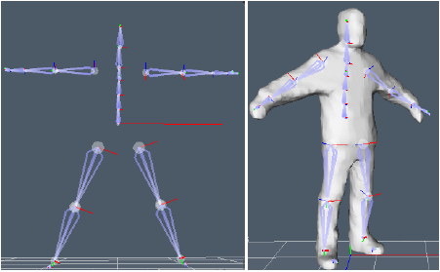
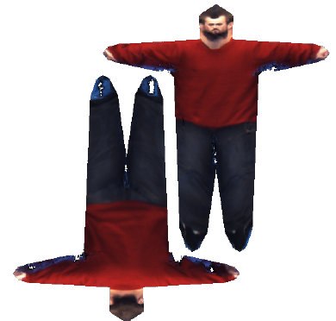
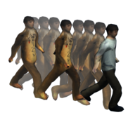
Beyond 3D
Non-rigid and articulated motion
Humans ubiquitous in graphics applications
A practical, realistic model requires
  Skeleton
  Geometry (manually modeled, laser scanned)
    Physical simulation for clothes, muscle
  Texture/appearance (from images)
  Animation (mocap, simulation, artist)

Slide 18
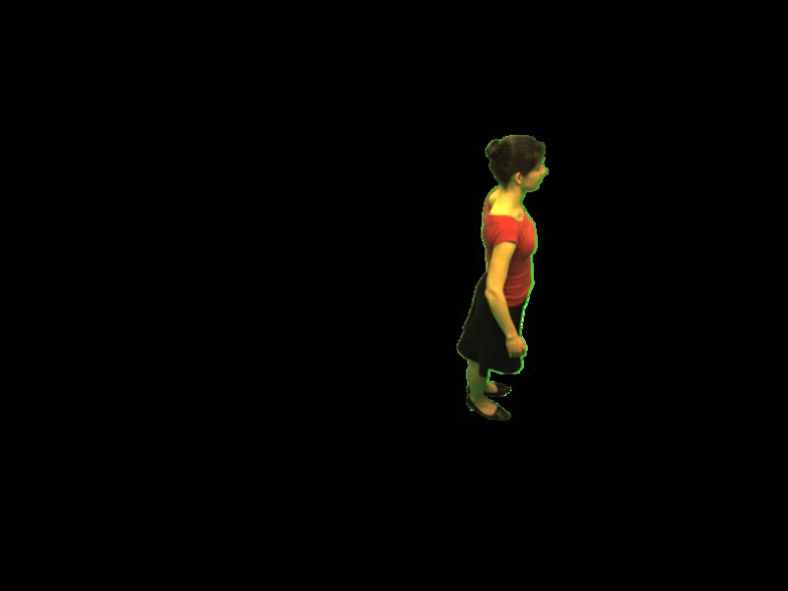
Beyond 3D:
Non-rigid and articulated motion
PhD work of Neil Birkbeck, Best thesis prize winner

Slide 19
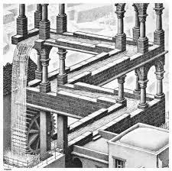
Uses of partial information from
2D-3D camera geometry
Measurements in single images
Visual constraints: verify alignments, detect impossible configurations (Escher paintings)
Visual servoing
Video tracking
Rendering
… many more
Why? Compact, accurate
Few relative alignments vs. complete global geometry

Slide 20
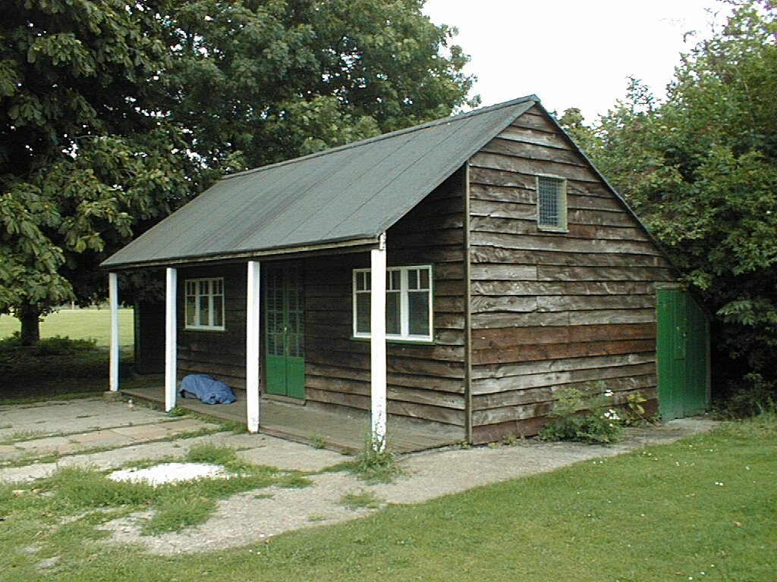
Geometric Cues
Vertical vanishing
point
(at infinity)
Vanishing
line
Vanishing
point
Vanishing
point

Slide 21
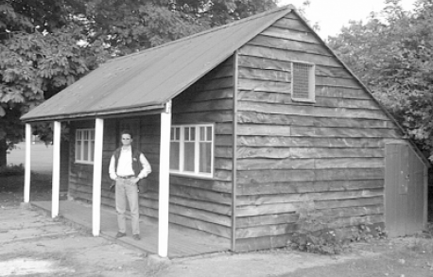
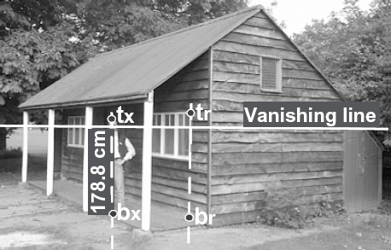
Estimating Height
The distance || t_{r} – b_{r} || is known
Used to estimate the height of the man in the scene
A. Criminisi, I Reid, A Zisserman
International Journal of Computer Vision 40 (2), 123-148, 2000

Slide 22
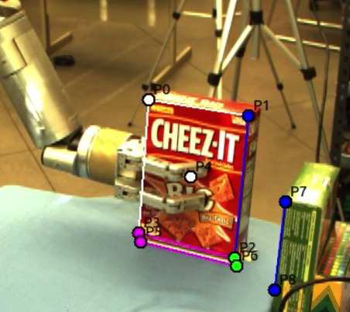
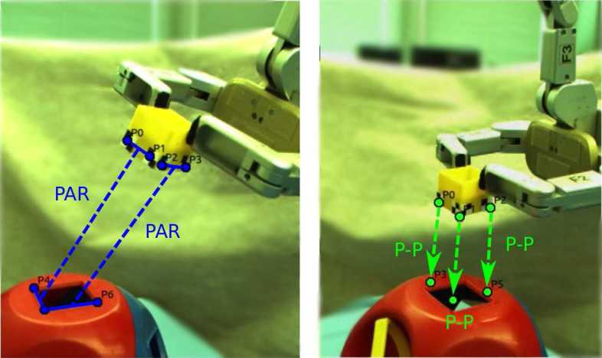
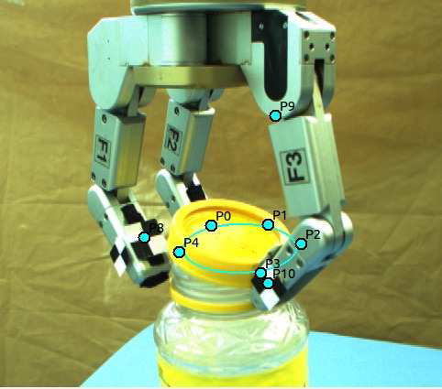
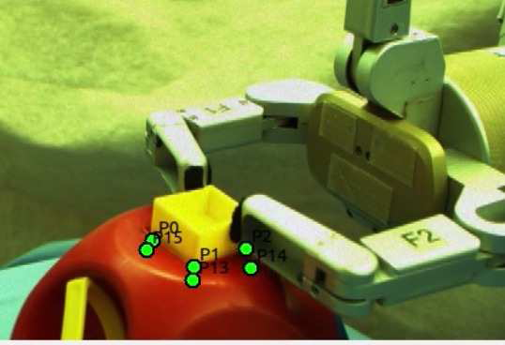

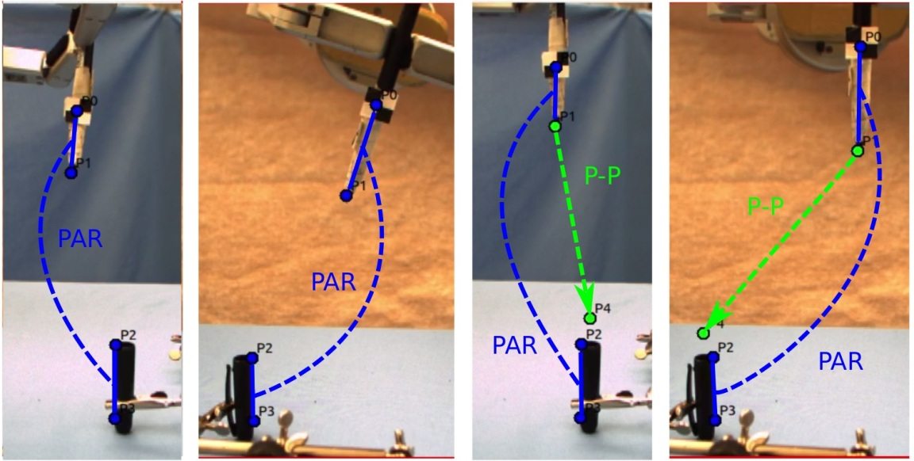
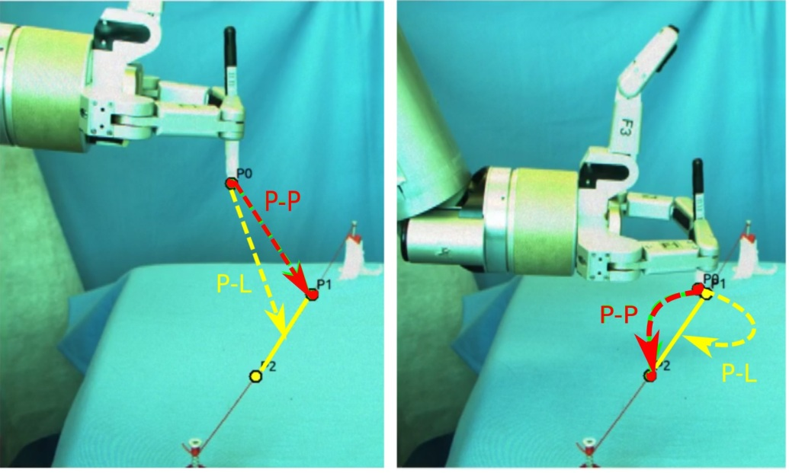

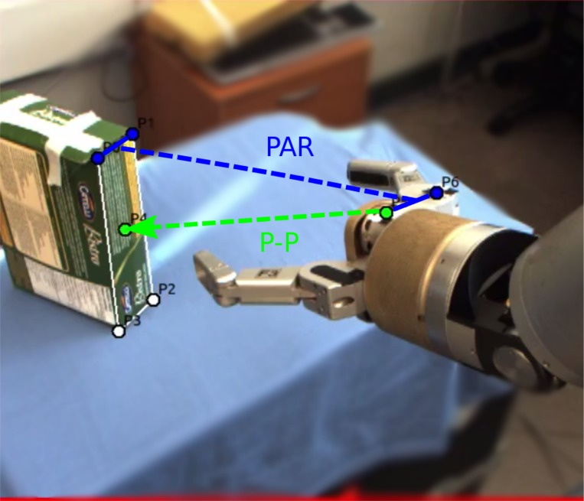
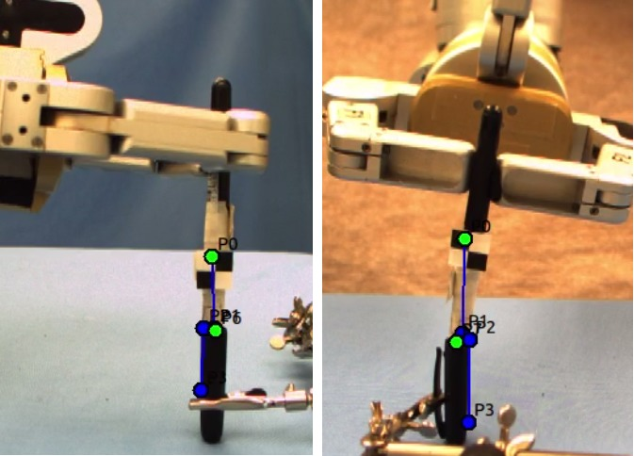
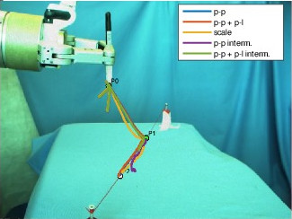

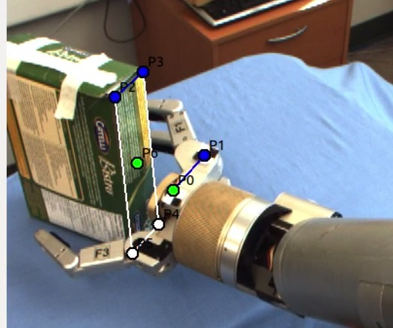
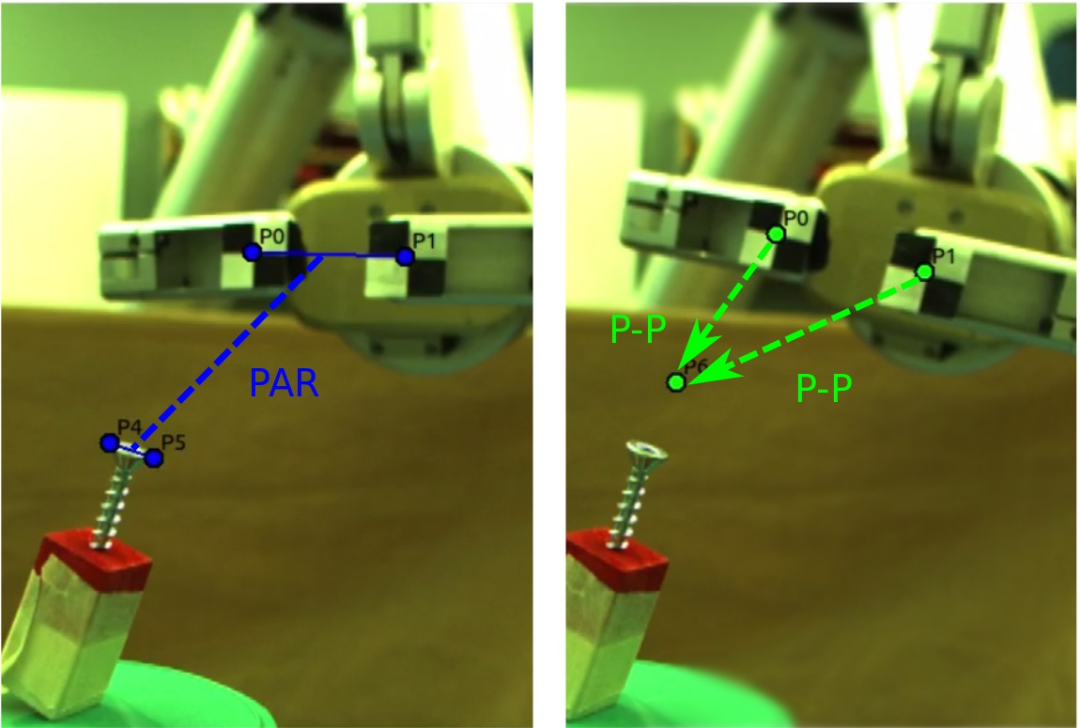
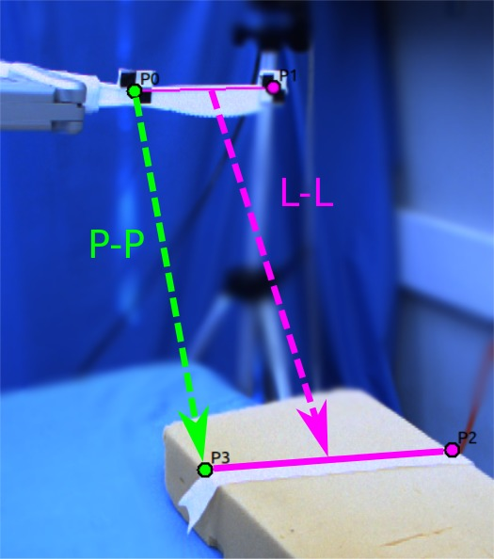
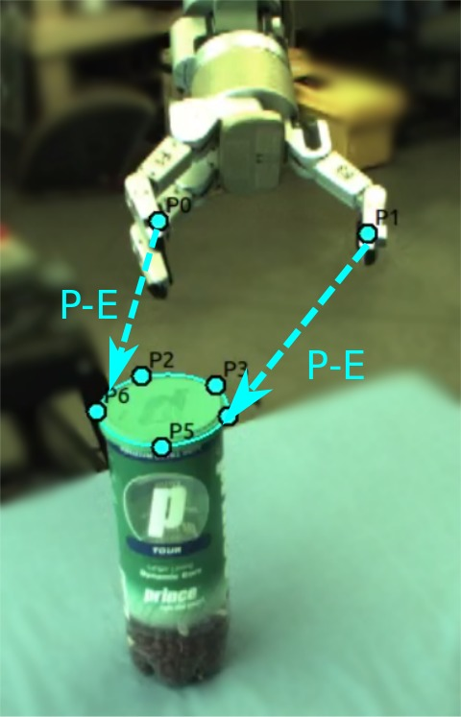
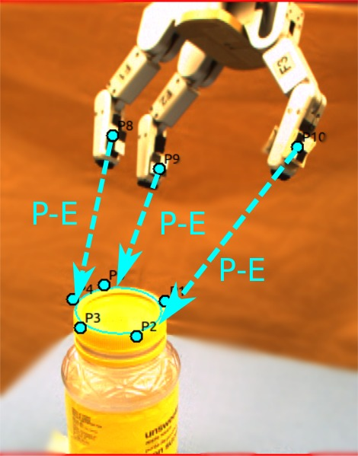
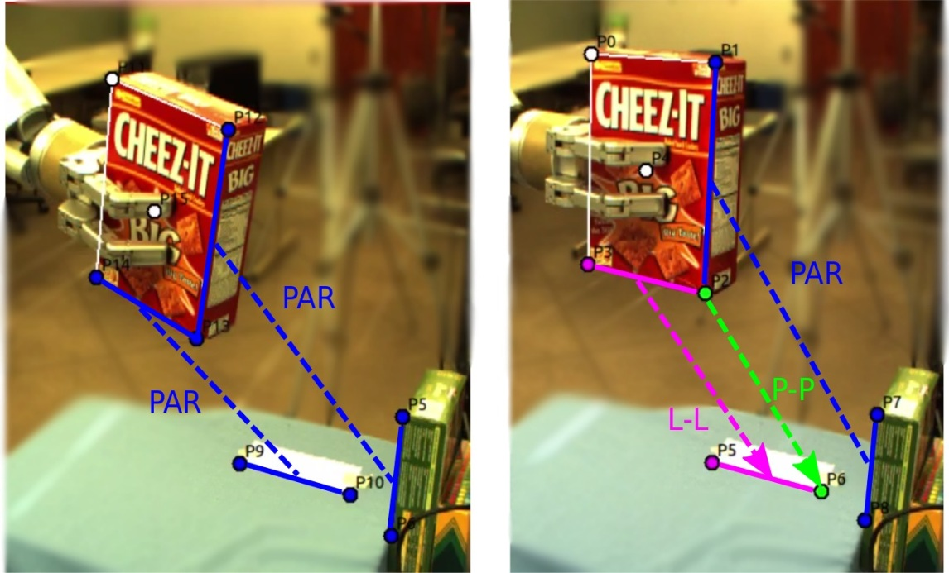

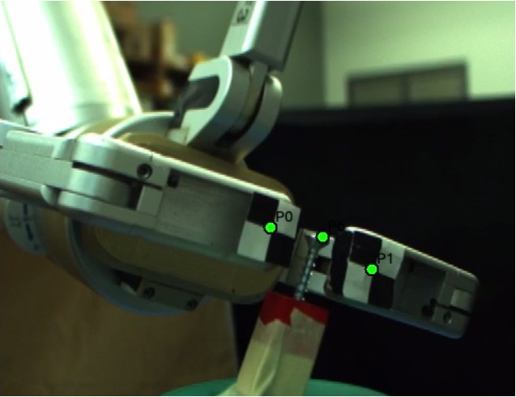
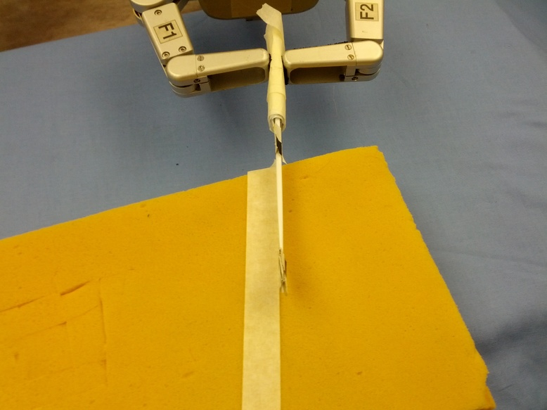

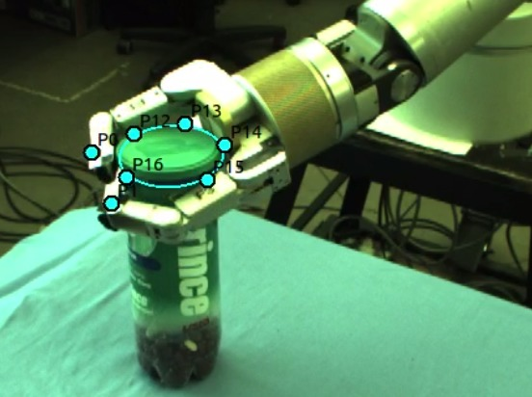
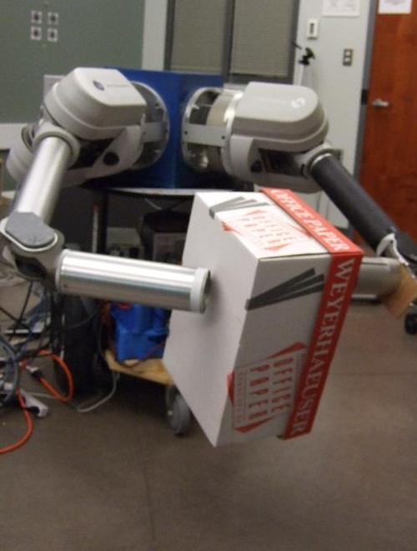
Geometry for hand-eye coordination
Image-Based Visual Servoing (IBVS)
Insert Cube Insert Marker in Cap Line Following Grasp Box
Grasp Screw Cut Along Line Grasp Cylinder Grasp Ellipse Place Box
Notes:
Pic of robot

Slide 23




Intro to Image-based Visual Servoing
IBVS
Initial Image
User
Desired Image

Slide 24
Vision-Based Control (Visual Servoing)
: Current Image Features
: Desired Image Features

Slide 25

Vision-Based Control (Visual Servoing)
: Current Image Features
: Desired Image Features

Slide 26

Vision-Based Control (Visual Servoing)
: Current Image Features
: Desired Image Features

Slide 27

Vision-Based Control (Visual Servoing)
: Current Image Features
: Desired Image Features

Slide 28
Vision-Based Control (Visual Servoing)
: Current Image Features
: Desired Image Features

Slide 29

u,v Image-Space Error
v
u
: Current Image Features
: Desired Image Features
One point
Pixel coord
Many points

Slide 30

Conventional Robotics: Motion command in Eucl. base coord
EE
We focus on the geometric transforms “visual-motor kinematics”

Slide 31


Problem: Lots of coordinate frames to calibrate
Camera
  Center of projection
  Different models
Robot and scene
  Base frame
  End-effector frame
  Object

Slide 32

Use only camera coord.
Uncalibrated Visual Servoing
Jagersand’94,96,00 Hosoda, Asada’94, 97
Only assume
y = f(x)
smooth
Solve for motion:
Move robot joints:
Read actual visual move
Update Jacobian:
repeat
Downloadable templated library: http://ugweb.cs.ualberta.ca/~vis/ros-uvs/

Slide 33





Can use 1,2,..n cameras
Fixed or on robot
Image 1
Image 2

Slide 34

Two fixed cameras
Image 1
Image 2

Slide 35

Two fixed cameras
Image 1
Image 2

Slide 36

Two fixed cameras
Image 1
Image 2

Slide 37

Two fixed cameras
Image 1
Image 2
Was same alignment task solved as in previous example?

Slide 38




How to specify a visual task?

Slide 39






Task and Image
Specifications
Task function T(x) = 0 Image encoding E(y) =0
When T(x) = 0 iff E(y) =0 ?
task space error
task space satisfied
image space error
image space satisfied

Slide 40


Visual specifications
Point to Point task “error”:
Why 16 elements?

Slide 41
Visual specifications 2
Point to Line
Line:
Note: y’s in homogeneous coord.
How to design visual specifications in a principled way?

Slide 42

Review of projective geometry
The 2D projective plane
Projective point
Homogeneous coordinates equivalence relation
X
X
Y
≡
s
Y
Z
Z
s ≠ 0
x
1
X
=
Inhomogeneous equivalent
y
Z
Y
2D projective space models perspective imaging
Each 3D ray is a point in P² : homogeneous coords.
Notes:
Nice properties I won’t elaborate on: Hom coord write cam proj as linear matrix mult.

Slide 43
The 2D projective plane
l∞
X∞
Projective point
Homogeneous coordinates
X
X
Y
≡
s
Y
k
k
s ≠ 0
x
1
X
=
Inhomogeneous equivalent
y
k
Y
2D projective space models perspective imaging
Each 3D ray is a point in P² : homogeneous coords.
Ideal points
P² is R² plus a “line at infinity”
X
X∞
=
Y
0
l∞

Slide 44

Projective Lines
X
A
Projective line ~ a plane through the origin
Y
=
X
l
=
B
l^{T}X = X^{T}l = AX + BY + CZ = 0
Z
C
X
X
0
l
X∞
=
Y
l∞
=
0
0
1
“line at infinity”
HZ
Ideal line ~ the plane parallel to the image
For any 2d projective property, a dual property holds when the role of points and lines are interchanged.
Duality:
l
=
X₁
X₂
X
=
l₁
l₂
The line joining two points
The point joining two lines

Slide 45

Conics
Conic:
  Euclidean geometry: hyperbola, ellipse, parabola & degenerate
  Projective geometry: equivalent under projective transform
  Defined by 5 points
Tangent line
Dual conic C*
inhomogeneous
homogeneous

Slide 46
Projective transformations
Homographies, collineations, projectivities
3x3 nonsingular H
maps P² to P²
8 degrees of freedom
determined by 4 corresponding points
Transforming Lines?
subspaces preserved
substitution
dual transformation

Slide 47



Homographies a generalization of affine and Euclidean transforms
Group | Transformation | Invariants | Distortion
Projective 8 DOF |  | Cross ratio Intersection Tangency
Affine 6 DOF |  | Parallelism Relative dist in 1d Line at infinity
Metric 4 DOF |  | Relative distances Angles Dual conic
Euclidean 3 DOF |  | Lengths Areas
2 dof
l
∞
l
∞
2 dof
C*
C*
∞
∞

Slide 48
Goto slide 59

Slide 49
How to define a visual task?

Slide 50




Visually defined alignment: basic
point-to-point: e_{pp}(y) = y₂ - y₁
or (homogenous coord) e_{pp}(y) = y₂ x y₁
point-to-line: e_{pl}(y) = y₁ . (y₂ x y₃)

Slide 51






Some more visual alignments
parallel lines: e_{par}(l) = (l₁ x l₂) x (l₃ x l₄)
line-to-line: e_{ll}(y) = y₁ . (y₃ x y₄) + y₂ . (y₃ x y₄)
point-to-ellipse: e_{pe}(y) = y^{T}₁ C_{ellipse} y₁

Slide 52



Now: Language for visual alignments
What else do we need?
Need: 1. Some way of entering alignments in images 2. video tracking to perform servoing!
Feature
trackers
Registration
trackers:
Download:
http://webdocs.cs.ualberta.ca/~vis/mtf/

Slide 53

ViTa: Visual Task spec. for Manip.
Mona Gridseth, Martin Jagersand ICRA’16

Slide 54

ViTa: Visual Task spec. for Manip.
Mona Gridseth, Martin Jagersand ICRA’16

Slide 55

Composing basic visual alignments
1. Parallel
Conceptual task
Image of task
y - y
2
5
y - y
4
7
E (y ) =
wrench
y • (y × y )
6
1
2
y • (y × y )
8
3
4
Which encoding E(y) is better? Can both reach E(y) = 0 ?
Do we need 1 or 2 cameras? Why?

Slide 56

Composing basic visual alignments
1. Parallel constrains

Slide 57


Composing basic visual alignments
2. Serial seqencing
Many tasks divide naturally into
Transportation / reaching
  Coarse primitive for large movements
  Low DOF control (e.g. of object centroid)
  Robust to disturbances
Fine Manipulation
  For high precision control of both position and orientation
  6DOF control based on several object features

Slide 58

Serial Composition
Solving whole real tasks
Linked task primitive
Acceptable initial (visual) conditions
Visual or Motor constraints to be maintained
Final desired condition
Task =

Slide 59

Previous alignments just examples.
Can use any invariants for the level of calibration available
Group | Transformation | Invariants | Distortion
Projective 8 DOF |  | Cross ratio Intersection Tangency
Affine 6 DOF |  | Parallelism Relative dist in 1d Line at infinity
Metric 4 DOF |  | Relative distances Angles Dual conic
Euclidean 3 DOF |  | Lengths Areas
2 dof
l
∞
l
∞
2 dof
C*
C*
∞
∞

Slide 60
Use only camera coord.
Uncalibrated Visual Servoing
Jagersand’94,96,00 Hosoda, Asada’94, 97
Solve for motion:
Move robot joints:
Read actual visual move
Update Jacobian:
repeat
Can we always guarantee when a task is achieved/achievable?
Downloadable templated library: http://ugweb.cs.ualberta.ca/~vis/ros-uvs/

Slide 61
Visual Ambiguity
Issues:
What alignments can be performed?
  Camera models, geometry, visual encodings
How to do vision guided movement?
  H-E transform estimation, feedback, feedforward motion control
How to plan, decompose and perform whole tasks?

Slide 62


Visual ambiguity
Will the scissors cut the paper in the middle?

Slide 63

ambiguity
Will the scissors cut the paper in the middle? NO!

Slide 64


Task Ambiguity
Is the probe contacting the wire?

Slide 65

Task Ambiguity
Is the probe contacting the wire? NO!

Slide 66
Solve the cut in the middle task?
Compute paper midpoint. How?

Slide 67
Solve the cut in the middle task?
Compute paper midpoint.
(Are we done yet?)
x_{m}= (l₁ x l₂)
l₁
l₂

Slide 68
Solve the cut in the middle task?
Compute vanishing point X∞,
Intersect X∞ w. midpt X_{m}
X∞
= (l₃ x l₄)
l₄
l_{m}= (X∞ x X_{m})
l₃
Alternative formulations?

Slide 69
Visual Servoing
Summary
Steps in Image-Based Visual Servoing
Specify image alignments
Video tracking of regions and features
Minimize visual error by moving robot
Difficulties:
  Tracking: finding trackable regions. Tracker robustness and accuracy
  Creating correct and complete specifications can be tedious.

Slide 70

What information do we use to move?
Mobile robot navigation: From appearance to metric SLAM
Recognizable Locations
Topological Maps
Courtesy K. Arras
Metric Topological Maps
Fully Metric Maps
How about other applications?

Slide 71
Underappreciated topic?
A Comparison and Evaluation of Multi-View Stereo Reconstruction Algorithms,
Seitz, Curless, Diebel, Szeliski
CVPR 2006, vol. 1, pages 519-526.
1479 citations
Single View Metrology
559 citations
A. Criminisi, I Reid, A Zisserman
International Journal of Computer Vision 40 (2), 123-148, 2000
What tasks can be performed with an uncalibrated stereo vision system? JP Hespanha, Z Dodds, GD Hager, AS Morse
International Journal of Computer Vision 35 (1), 65-85, 1999
34 citations
Untapped opportunity?

Slide 72

Beyond projective camera vision and screen GUI: Pointing

Slide 73
Beyond projective camera vision and screen GUI
Without physical GUI: Gestures and pointing
Combine modalities: Camera vision, RGBD, force …
Use sensory feedback and calibration level most appropriate for task
  Precise visual alignments can be combined with approximate Euclidean, (e.g. hold glass up)
  Force feedback can maintain contact with surface, and visual feedback define the motion on the surface.

Slide 74
Questions?
More information:
Downloadable renderer+models
  www.cs.ualberta.ca/~vis/ibmr
Capturing software + IEEE VR tutorial text
  www.cs.ualberta.ca/~vis/VR2003tut
Main references for this talk:
Jagersand et al “Three Tier Model” 3DPVT 2008 ….
Jagersand “Image-based Animation…” CVPR 1997
More papers: www.cs.ualberta.ca/~jag

Slide 75


Questions?
Making Pizza with my robot
3rd Prize ICRA’15 Video competition
Change a Lightbulb
ICRA’97 Video

