Slide 1
Real-Time Template Tracking
Stefan Holzer
Computer Aided Medical Procedures (CAMP),
Technische Universität München, Germany

Slide 2
Real-Time Template Tracking Motivation
Object detection is comparably slow detect them once and then track them
Robotic applications often require a lot of steps the less time we spend on object detection/tracking
the more time we can spend on other things or
the faster the whole task finishes
Notes:
To give a short motivation, Why do we need fast tracking in robotics?
First, compared to tracking object detection is usually slow, although we just have seen that there are already methods which are able to detect objects in real-time.
However, they ovten either need a big chunk of the available processing power or slow down if a large set of objects has to be detected.
Especially Robotic applications often require a lot of steps to be solved, like localization and mapping, path planning and so on. So the less time we spend on object detection or tracking, the more time we can spend on other things or even better the faster the whole task can be finished.

Slide 3
Real-Time Template Tracking Overview
Real-Time Template Tracking
Feature-based Tracking
Intensity-based Tracking
Analytic Approaches
Learning-based Approaches
…
LK, IC, ESM, …
JD, ALPs, …
Notes:
In the following we will concentrate on intensity-based tracking, where we first will talk about analytic appraoches, where the optimization is done using analytic computation of the Jacobians,
and then take a closer look at a learning-based approach, where the optimization is done using pre-learned predictors.

Slide 4
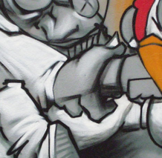
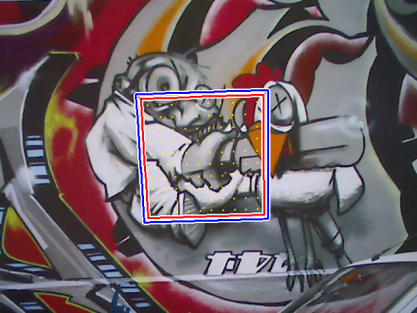
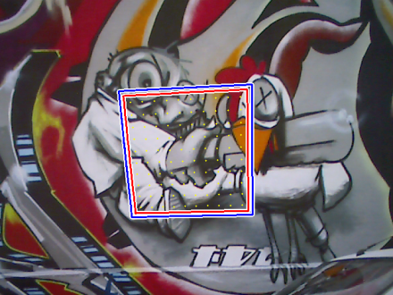
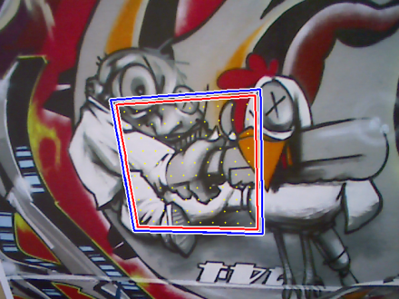
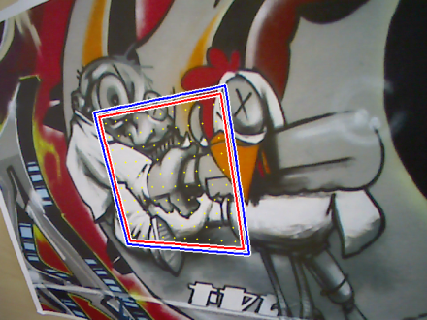
Intensity-based Template Tracking Goal
Find parameters of a warping function such that:
for all template points
Notes:
Considering only the current image of an image sequence,
the goal of intensity-based tracking can be formulated as finding the parameters of a transformation, for example a homography,
such that all the pixels of the template I_T are warped to their corresponding positions in the current frame I (with the same intensity value).

Slide 5
Intensity-based Template Tracking Goal
Find parameters of a warping function such that:
for all template points
Reformulate the goal using a prediction as approximation of :
Find the parameters‘ increment such that
by minimizing
This is a non-linear minimization problem.
Notes:
Since we have a prediction of the warp parameters from the previous frame of the image sequence,
we can use this as an approximation and reformulate the goal to find a parameter increment such that the combination of both gives the desired result.
This is done by minimizing the length of the intensity error vector between the template and the warped current frame.
This is a non-linear optimization problem, even if the warp is linear, since the pixel values are in general unrelated to their positions.

Slide 6
Intensity-based Template Tracking Lukas-Kanade
Uses the Gauss-Newton method for minimization:
Applies a first-order Taylor series approximation
Minimizes iteratively
B. D. Lucas and T. Kanade. An iterative image registration technique with an application to stereo vision, 1981.
Notes:
For this minimization the Lucas-Kanade algorithm uses the Gauss-Newton method,
which applies a first-order Taylor series approximation to the error vector
and minimizes this iteratively.

Slide 7
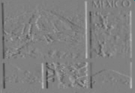
Lukas-Kanade Approximation by linearization
First-order Taylor series approximation:
where the Jacobian matrix is:
gradient images
Jacobian of the current image
Jacobian of the warp
Notes:
Assuming that the parameter increment is small we can use a first-order Taylor series to get a linear approximation of the error vector, where the Jacobian contains the partial derivatives of y in delta-x.
By using the chain rule, the ith line of the Jacobian can be computed using the Jacobian of the current image evaluated at the warped point p_i and the Jacobian of the warp.
The Jacobian of the image can hereby be computed by warping the gradient images of the current image.

Slide 8
Lukas-Kanade Iterative minimization
The following steps will be iteratively applied:
Minimize a sum of squared differences
where the parameter increment has a closed form solution (Gauss-Newton)
Update the parameter approximation
This is repeated until convergence is reached.
Notes:
This approximation is minimized as sum-of-squared-differences cost function, which is solved using the inverse of the Gauss-Newton approximation of the Hessian.
The obtained parameter increment is then used to update the approximation and the whole procedure is repeated until convergence is reached, for example of the norm of the delta or of the error vector is below a certain threshold.

Slide 9
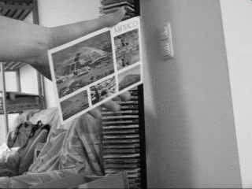
Lukas-Kanade Illustration
At each iteration:
Warp
Compute
Update
template image
current frame
Notes:
To shortly illustrate the tracking procedure,
we first warp the current frame using the parameter approximation,
then compute the Jacobian and the error vector in order to get the update vector.
Using this we update our approximation of the warp and repeat this until we get a satisfying result.

Slide 10
Lukas-Kanade Improvements
Inverse Compositional (IC): reduce time per iteration
Efficient Second-Order Minimization (ESM): improve convergence
Approach of Jurie & Dhome (JD): reduce time per iteration and improve convergence
Adaptive Linear Predictors (ALPs): learn and adapt template online
Notes:
In the following we take a look at some improvements of this algorithm,
where the first one, the inverse compositional algorithm, addresses the computation of the Jacobian, which can be fixed by reformulating the image alignment process.
Then we will take a very brief look at the Efficient Second-Order Minimization, which applies a second-order approximation to improve convergence.
After that we focus on learning based approaches where we first focus on the approach of Jurie and Dhome and then talk about an extension which allows to efficiently adapt templates online.

Slide 11
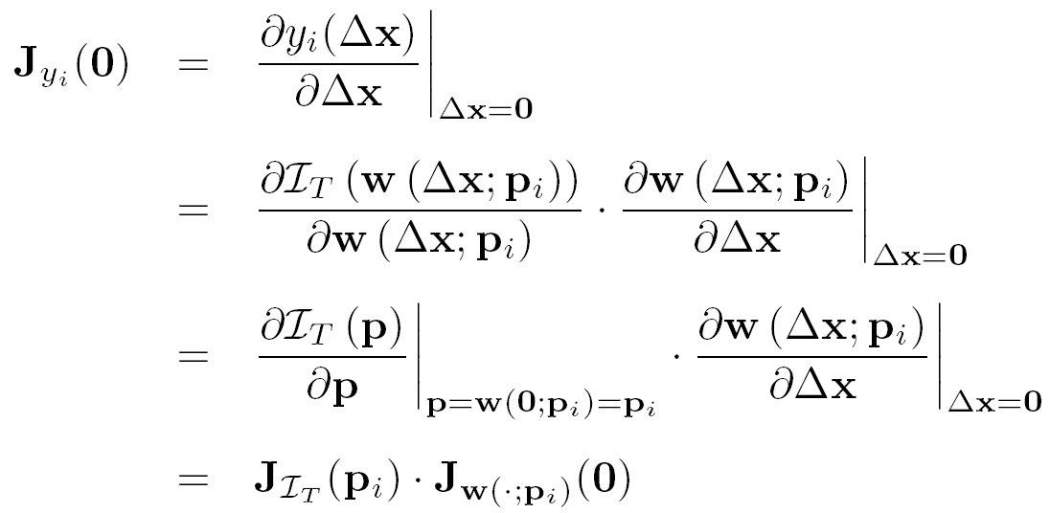
Inverse Compositional Overview
Differences to the Lukas-Kanade algorithm
Reformulation of the goal:
Jacobian of the template image
Jacobian of the warp
Notes:
As just mentioned the inverse compositional algorithm reformulates the image alignment process such that we now search for a delta-x which warps the template and not the current frame.
This way the roles of the template and the current image are switched and therefore the i-th line of the Jacobian can be computed using the Jacobian of the template image and the Jacobian of the warp.

Slide 12
Inverse Compositional Overview
Differences to the Lukas-Kanade algorithm
Reformulation of the goal and can be precomputed only needs to be computed at each iteration
Parameter update changes
S. Baker and I. Matthews. Equivalence and efficiency of image alignment algorithms, 2001.
Notes:
Since none of the Jacobians depends on the parameter approximation, they can be set constant for all iterations. Only the error vector hast to be re-computed in each iteration.
Using this reformulation, the parameter update using a summation is no longer valud but has to be done using a composition, where the update is inverted. This is why the approach is called „Inverse Compositional“.

Slide 13
Efficient Second-Order Minimization Short Overview
Uses second-order Taylor approximation of the cost function Less iterations needed to converge Larger area of convergence Avoiding local minima close to the global
Jacobian needs to be computed at each iteration
S. Benhimane and E. Malis. Real-time image-based tracking of planes using efficient second-order minimization, 2004.
Notes:
Only a very short overview for the ESM algorithm.
In contrast to the previous two methods the ESM algorithm uses a second-order approximation, which leads to a
lower number of necessary iterations,
a larger area of convergence and
a better avoidance of local minima close to the global minimum.
Besides these advantages the necessary Jacobians need to be computed at each iteration, which makes each iteration computationally more expensive.

Slide 14
Jurie & Dhome Overview
Motivation:
Computing the Jacobian in every iteration is expensive
Good convergence properties are desired
Approach of JD: pre-learn relation between image differences and parameter update:
relation can be seen as linear predictor
is fixed for all iterations
learning enables to jump over local minima
F. Jurie and M. Dhome. Hyperplane approximation for template matching. 2002
Notes:
Now, to get a tracking which is as fast as possible, computing a Jacobian at every iteration is too expensive,
but since we also want to have convergence properties which are as good as possible, Jurie and Dhome came up with a learning based approach.
Here, the key idea is to pre-learn the relation between the error vector and the parameter update, which is here specified by the matrix A.
This relation can be seen as linear predictor which is fixed for all iterations.
The learning phase makes it also possible to jump over local minima and get a large convergence basin.

Slide 15
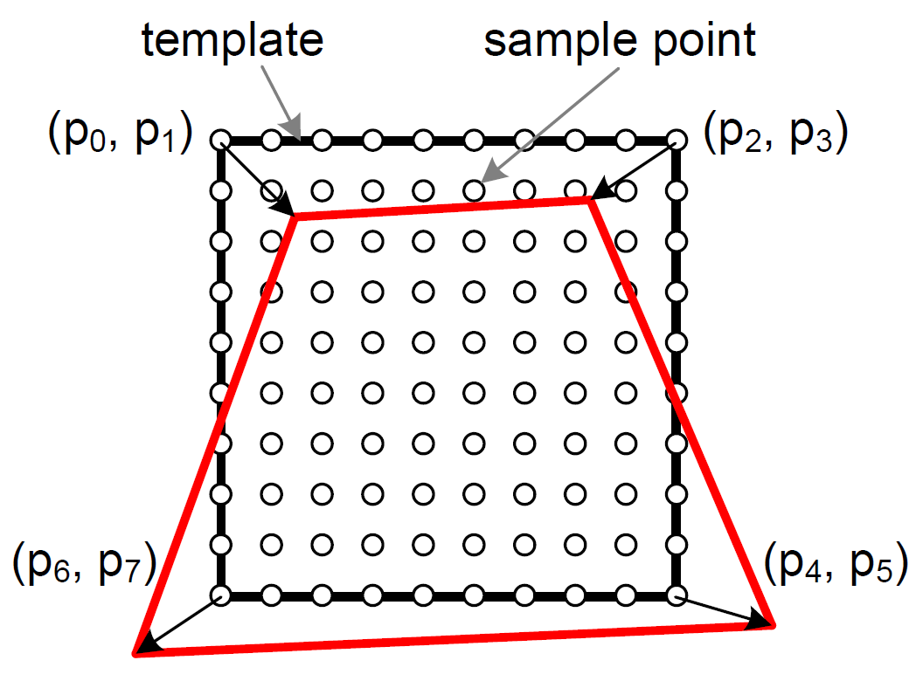
Jurie & Dhome Template and Parameter Description
Template consists of sample points
Distributed over the template region
Used to sample the image data
Deformation is described using the 4 corner points of the template
Image values are normalized (zero mean, unit standard deviation)
Error vector specifies the differences between the normalized image values
Notes:
We represent the template we want to track by n_p sample points which are equally distributed over the template region and used to sample the image data.
As deformation model we use a homography which is parameterized by the 4 corner points of the template.
To make the tracking more robust against illumination changes the image values are normalized to zero mean and unit standard deviation.
This is done for the template as well as during tracking and therefore the error vector specifies the differences between the normalized image values.

Slide 16
Jurie & Dhome Learning phase
Apply set of random transformations to initial template
Compute corresponding image differences
Stack together the training data
(
)
=
(
)
=
Notes:
So, for the learning we first apply a set of n_t random transformations tot he initial template and compute the corresponding error vectors. These error vectors and the corresponding transformation parameters are then stacked into two matrices X and Y, where X is a 8 times n_t matrix and Y a n_p times n_t matrix.

Slide 17
Jurie & Dhome Learning phase
Apply set of random transformations to initial template
Compute corresponding image differences
Stack together the training data
The linear predictor should relate these matrices by:
So, the linear predictor can be learned as
Notes:
The linear predictor we want to learn should now relate these two matrices as X is equal to A times Y. So, A can be learned by multiplying the X with the pseudo-inverse of Y.

Slide 18
Jurie & Dhome Tracking phase
Warp sample points according to current parameters
Use warped sample points to extract image values and to compute error vector
Compute update using
Update current parameters
Improve tracking accuracy:
Apply multiple iterations
Use multiple predictors trained for different amouts of motions
Notes:
For the tracking we simply warp the sample points according to the current parameters
and use them to compute the corresponding error vector.
Using the error vector we compute the parameter update
and update the current parameters using it.
To improve the tracking accuracy we apply this procedure multiple times and also learn multiple predictors for different amounts of motions, where we start with a predictor learned for large motions and then switch to predictors for smaller motions.

Slide 19
Jurie & Dhome Limitations
Learning large templates is expensive not possible online
Shape of template cannot be adapted template has to be relearned after each modification
Tracking accuracy is inferior to LK, IC, … use JD as initialization for one of those
Notes:
However, also the approach of Jurie and Dhome has some limitations.
First, learning large templates is quite expensive since it includes the inversion of a large matrix which size corresponds to the number of sample points. So, this is not possible to be done online.
Because of that we also cannot adapt the shape of a template since for this the template has to be relearned after each modification.
Additionally the accuracy of the tracking is in general worse than of the mentioned analytic approaches, so if you want to get a similar accuracy you should apply one of these algorithms after refinement using the Jurie/Dhome approach.

Slide 20
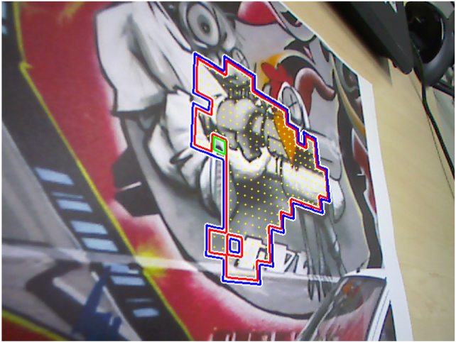
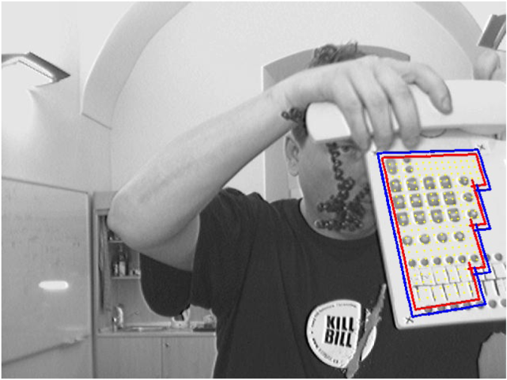
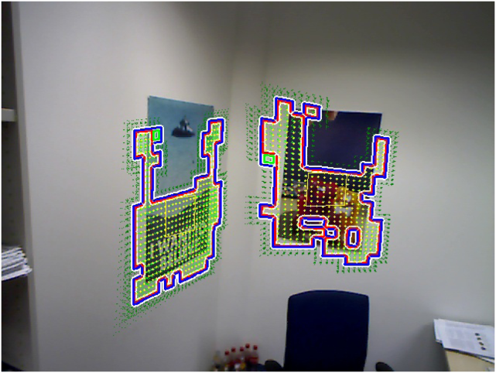
Adaptive Linear Predictors Motivation
Distribute learning of large templates over several frames while tracking
Adapt the template shape with regard to
suitable texture in the scene and
the current field of view
S. Holzer, S. Ilic and N. Navab. Adaptive Linear Predictors for Real-Time Tracking, 2010.
Notes:
To overcome the first two restrictions we introduced Adaptive Linear Predictors, which allow to distribute the learning of large templates over several frames while tracking
and to adapt the template shape online to the scene and to the current field of view as is exemplary shown in these videos.

Slide 21
Adaptive Linear Predictors Motivation
Notes:
The first video shows some simple tracking where the template is grown and adapted if it goes out of sight.

Slide 22
Adaptive Linear Predictors Motivation
Notes:
The second video shows a more tight scenario where a template with only very basic texture is tracked

Slide 23
Adaptive Linear Predictors Motivation
Notes:
the third video shows the tracking of two separate templates which are adapted to the available texture regions.

Slide 24
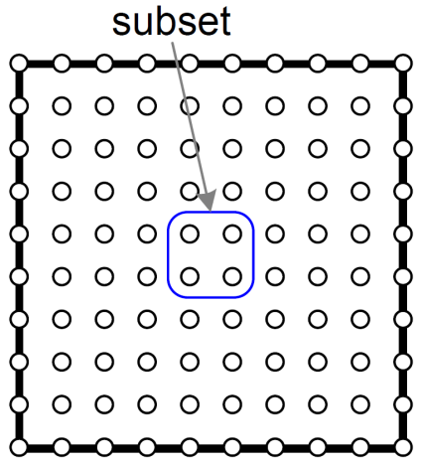
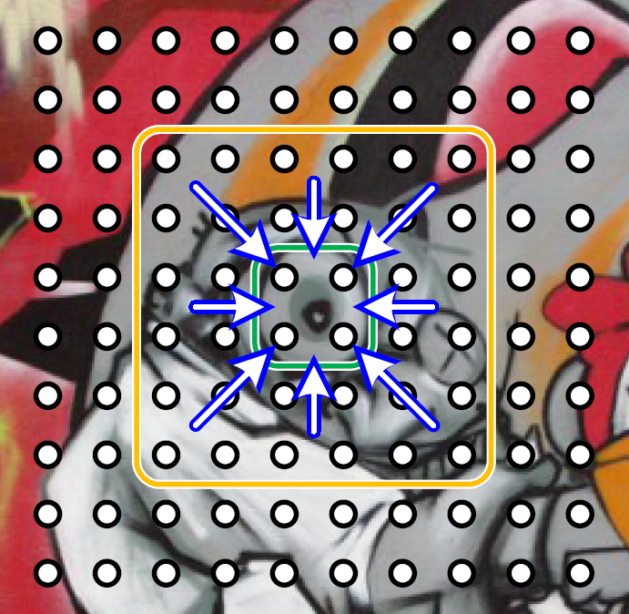
Adaptive Linear Predictors Subsets
Sample points are grouped into subsets of 4 points only subsets are added or removed
Normalization is applied locally, not globally each subset is normalized using its neighboring subsets necessary since global mean and standard deviation changes when template shape changes
Notes:
For the adaption of the template we group the sample points into sets of 4 points and only such subsets are added or removed from the template to adapt its shape.
Basically we can also choose a different size for the subsets, but as we will see later adding and removing parts will require the inversion of a matrix which size corresponds to the subset size. So, choosing a bigger subset-size increases the time necessary to update the template shape.
Additionally, since we normalize the image data before we use it to compute the error vector we now have to apply a local normalization for each of the subsets since the global mean and standard deviation changes when the template shape is changes.
Therefore, the data of each subset is normalized using the mean and standard deviation of its local neighborhood.

Slide 25
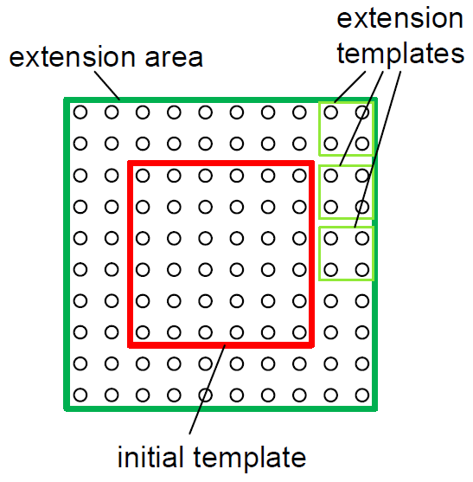
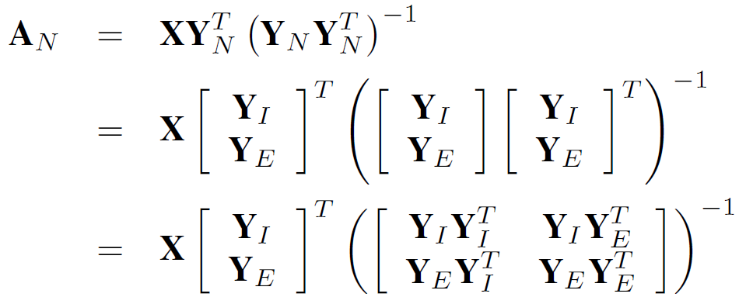
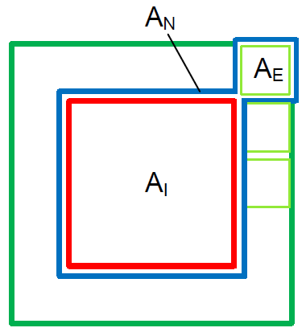
Adaptive Linear Predictors Template Extension
Goal: Extend initial template by an extension template
Standard approach for single templates:
Standard approach for combined template:
Notes:
So, now coming to the adaption of the template shape we
first start with an initial template and want to extend it by a small extension template.
For this, we start with taking a look at how we would compute the single templates and the combined templates using the standard approach with the pseudo-inverse.
Use the same random transformations for the extension template as for the initial template.
The expensive part here is the inversion, so lets take a closer look on that.

Slide 26
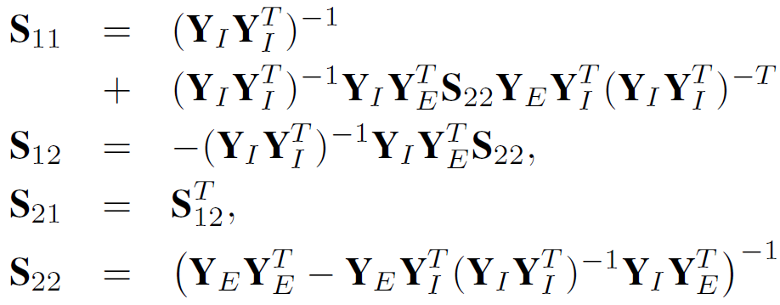
Adaptive Linear Predictors Template Extension
Goal: Extend initial template by an extension template
The inverse matrix can be represented as:
Using the formulas of Henderson and Searle leads to:
Only inversion of one small matrix necessary since is known from the initial template
Notes:
So, if we consider the blocks of the inverse matrix as S_11 to S_22 we can use the formulas of Henderson and Searle to compute the single S matrices, where the inverse of the matrix Y_I times Y_I^T is already known from the initial template
and the inversion necessary to compute S_22 can be done quite fast since the size of the matrix corresponds to the subset size, which is 4 in our case.
Therefore, we only have to apply the inversion of a 4 times 4 matrix and matrix multiplications and summations, which is much faster than computing the inverse of the full matrix.

Slide 27
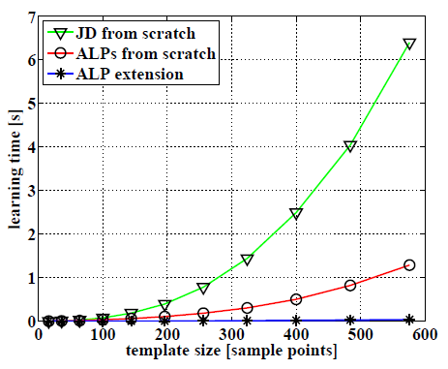
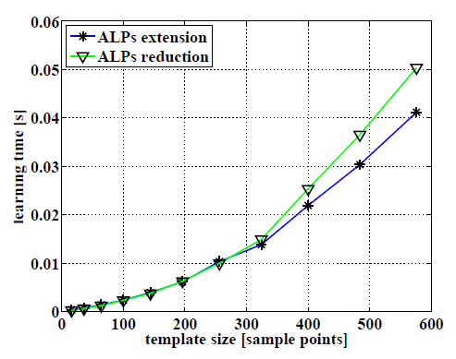
Adaptive Linear Predictors Learning Time

Slide 28
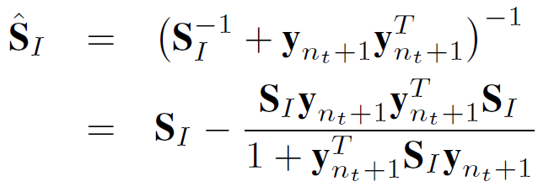
Adaptive Linear Predictors Adding new samples
Number of random transformations must be greater or at least equal to the number of sample points
Presented approach is limited by the number of transformations used for initial learning
Restriction can be overcome by adding new training data on-the-fly This can be accomplished in real-time using the Sherman-Morrison formula:
Notes:
But, since the number of random transformations used to create the training data must be larger than or at least equal to the number of sample points the presented approach would be restricted by the initially chosen number of random transformations.
However, this problem can be solved using the Sherman-Morrison formula, which allows to update the inverse of a matrix as show here, which is equal to adding a new column to the X and Y matrices in the original learning scheme.
And again, this includes only matrix multiplications and summations, which makes it quite fast.

Slide 29
Thank you for your attention!
Questions?

